Slide 1
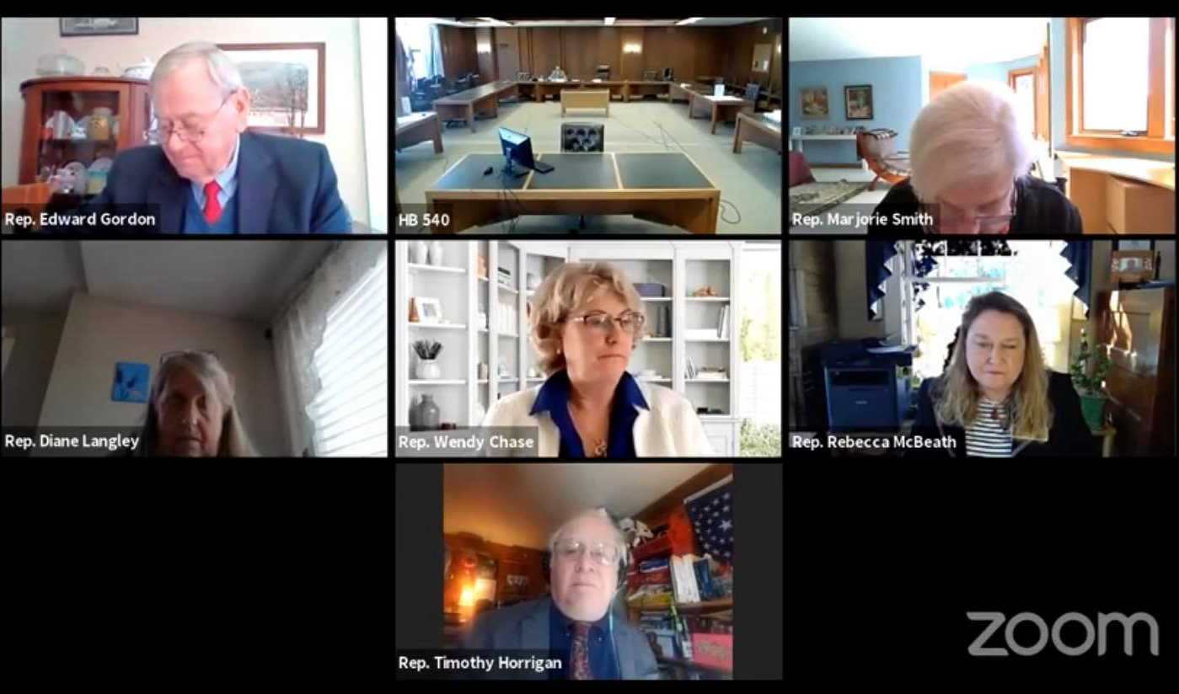
Supported Decision Making as an Alternative to Guardianship Policy Monitoring and Advocacy during the New Hampshire 2021 Legislative Session
Jessica Goff, 2022 MSW Candidate at University of New Hampshire, Manchester
NH-ME LEND, Institute on Disability, University of New Hampshire
What is Supported Decision Making?
New Hampshire HB (House Bill) 540 is “Relative to supported decision-making as an alternative to guardianship”
Currently, NH utilizes guardianship more than the average state. HB540 creates a comprehensive and legally recognized alternative. It provides a template, lays out the responsibility of the student’s IEP team, and delineates who can be a supporter.
Testifying for HB540
Guardianship
Loss of legal status through Substituted Decision Making
Impedes ability for self-determination
Supported Decision Making
Maintain legal decision-making capacity with the aid of trusted supporters
Often overbroad and linked to negative impact on mental health and internalized belief in inability
Allows for sharpening of skills and increased community integration
Living Document ensures flexibility and choice
Supported by self-advocates and organizations
Loss of ability to make choices around healthcare, housing, finances, education, etc.
On February 26th, 2021, I sent in my written testimony and testified in front of the House Judiciary Committee via the online platform, Zoom.
On March 10th, 2021. the Judiciary Committee voted OTP (Ought to Pass) on HB540 21-0 with amendment #2021-0565h, which clarified educational duties and the statement of findings. Committee members voted for HB540 to go onto the consent calendar for the next full House session.
HB540 was passed with amendment by the full NH House of Representatives on April 7th, 2021. It was introduced on the Senate on the same day and referred to the Judiciary Committee. The relevant hearing was on April 14th.
HB540 will go to the full Senate for a vote by June 3rd. If this occurs with changes, there will be a committee of conference. If passed by both chambers, it will go to the Governor’s desk to be signed
My NH-ME LEND Leadership Placement was a 70- hour policy placement with the NH Council on Developmental Disabilities.
The purpose of federally funded State Councils is to "engage in advocacy, capacity building, and systemic change activities that are consistent with the purpose of the DD Act… that enable individuals with developmental disabilities to exercise self-determination, be independent, be productive and be integrated and included in all facets of community life.“
There are 21 members appointed to the NH Council on Developmental Disabilities, at least 60% are self advocates or family members.
Learning Activities
I assisted Isadora Rodriguez-Legendre and Ronnieann Rakoski, the Executive Director and Policy Director of the Council, respectively, with legislative monitoring and advocacy in preparation for and during the 2021 Legislative Session by:
Attending monthly Policy Committee Meetings/ assisting in developing the priority list of bills to follow and monitor
Evaluating and Tracking the status of House and Senate Bills related to quality of life for individuals with ID/DD
Attending Committee Hearings and Executive Sessions to stay abreast of developments and community concerns; updating Trackbill platform
Researching related disability policy issues
Drafting written testimony and testifying at committee hearing for chosen priority bill (HB540)
Creation of supplemental plain language brochure about SDM in NH for self-advocates
Does HB540 meet this need?
HB540 was thoughtfully drafted by a workgroup of the Disability Rights Center in the state (DRC-NH) and other stakeholders, including individuals with disabilities and family members.
This piece of legislation entered the policy stream through sponsorship by Representative Wendy Chase who noted:
“I am the prime sponsor for this bill and was the guardian of my physically disabled daughter for the last 7 years of her life. SDM would have been the right choice for supporting her in areas of her life rather than becoming her guardian and driving wedges in our relationship at different times.”
Resources
American Association of Intellectual and Developmental Disabilities & The ARC. (2016).
Autonomy, decision making, and guardianship. https://www.aaidd.org/news-policy/policy/position-statements/autonomy-decision-making-supports-and-guardianship
Autistic Self Advocacy Network. (2016, February 1). The right to make choices: New resource
on supported decision-making. https://autisticadvocacy.org/2016/02/the-right-to-make-choices-new-resource-on-supported-decision-making/
HB540, NH Leg. Session. (2021).
http://www.gencourt.state.nh.us/bill_status/billText.aspx?sy=2021&id=730&txtFormat=pdf&v=current
Maloney, B. A., McCarty, J., Bomster, J., Skibbie, M. (2021, February 16). Panel discussion.
Supported Decision Making and other Alternatives to Guardianship. https://iod.unh.edu/SupportedDecisionMaking%20
New Hampshire Judicial Branch. (2021, February 8). Questions and answers about New
Hampshire guardianship. https://www.courts.state.nh.us/probate/guardianshipfaq.pd
NH Council on Developmental Disabilities. (2021, February 8). About us. https://www.nhddc.org/about.php.
Bill Monitoring
Selection from Priority Bills with Ronnie and Isadora
Research and Testimony on HB540
Notes:
To affirm my understanding and gain feedback on my written testimony, I met with Stephanie Patrick, the executive director of DRC-NH.
Michael Skibbie, the Policy Director of DRC-NH, was present at the hearing for the bill and was able to answer technical questions and attest to the community’s need for such a legal option.
Two Co-sponsors of the bill, a parent, an attorney, and an education professional testified in support of HB540 and one attorney spoke in concern of language used in the statement of findings.

