Slide 1
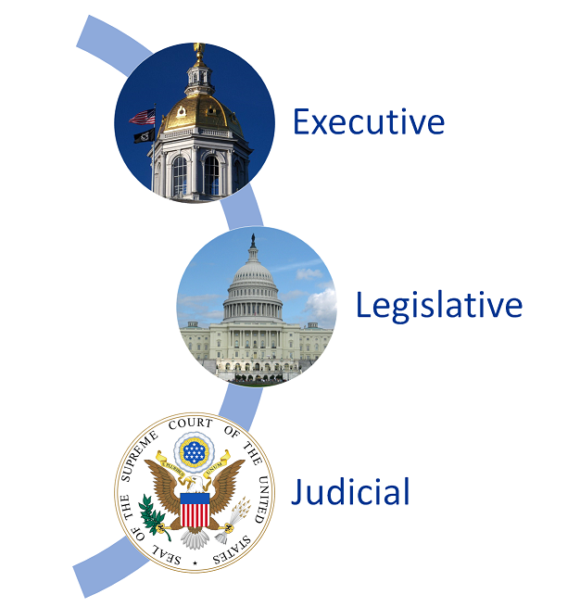

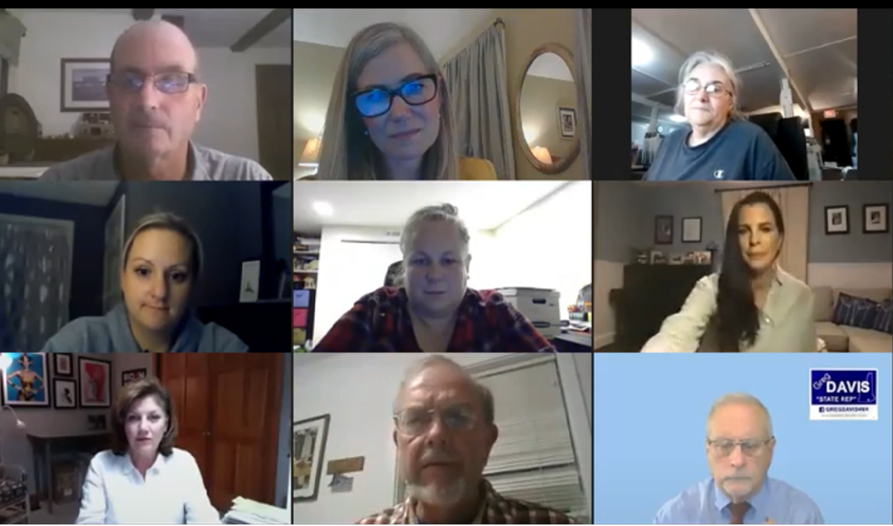

The Role of Policy and Advocacy For All
Katie Buckley, MSW Candidate 2021
Key Concepts
Staying Informed
Public Outreach
Relationship Building
Issue Framing
Appeal to Self Interest
Community Crossroads strives to provide people in need of long term supports, either through age or disability, with the information, guidance, support and advocacy they need to remain in their chosen homes and live full, independent lives.
Stay informed with media reports, asking questions and attending forums
Provide issue education and community organizing through public outreach
Build alliances
Work on how you talk about issues
Continue to work together and take action to ensure a better future for individuals with disabilities
Policy and advocacy work at Community Crossroads is under the direction of Jennifer Bertrand, Director of Community Partnerships who provided an eye-opening experience into policy and how policy intertwines with practice.
Legislative and Policy Activities
Relationship building with policy makers is essential.
Completed Policy Partners Training Program
Reviewed the concept of Federalism and the
structure/function of American Government & Politics
Gained knowledge about how to impact the public
policy cycle and the NH state budget process
Developed an understanding of how to advance
public policies and achieve disability justice equity
Conducted 1-to-1 meetings with NH legislators
Attended candidate events
Monitored and reviewed NH legislative bills
Observed NH legislative hearings
Submitted written testimony to the NH House
Finance Committee
Virtual Candidate Event where bipartisan members learned about the lived experiences, contributions, and challenges faced by these politically engaged group of NH citizens.
Background
The reality that community-based, person-centered systems of support is constantly being challenged and its future security is not guaranteed. Individuals, families & professionals touched by disability may not always be aware of the long history of activism in New Hampshire
“This is quite a game, politics. There are no permanent enemies, and no permanent friends, only permanent interests”
- William Clay

