Slide 1
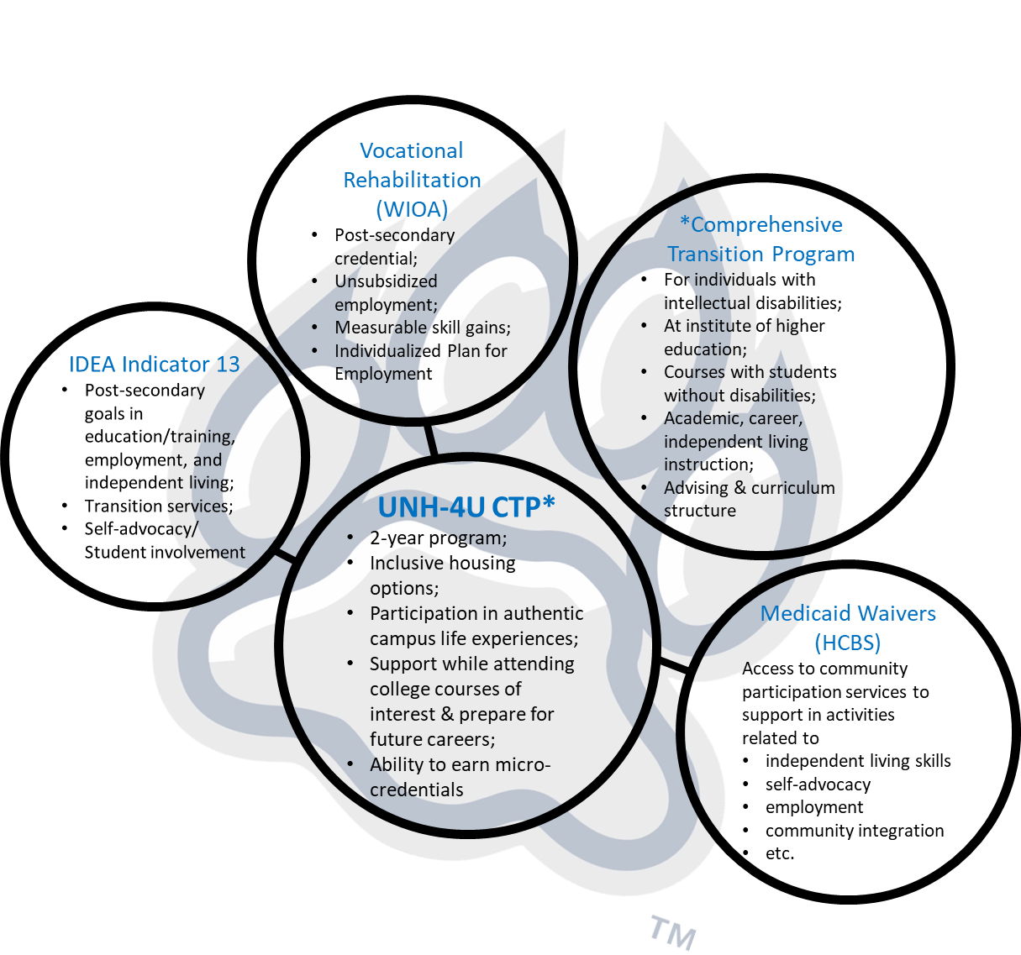
UNH-4U Comprehensive Transition Program & Bridges Training Series
Ashley Woodbury, B.S., Communication Sciences and Disorders
NH-ME LEND, Institute on Disability, University of New Hampshire
Background
Leadership Activities
The Higher Education Opportunity Act (HEOA, 2008) provided access to financial aid to students with intellectual disabilities attending college programs that meet the requirements of a “Comprehensive Transition Program” (CTP) and provided grants to create or expand model Transition and Postsecondary Programs for Students with Intellectual Disabilities (TPSID).
In 2020, the Institute on Disability (IOD) at the University of New Hampshire received a $2.5 million TPSID grant to improve access to post-secondary education for young adults with intellectual disabilities. The goal of UNH-4U has been to provide a 2-year Comprehensive Transition Program for 5-10 students in its first year.
Facilitated small groups in Bridges courses to provide support to students in activities surrounding assistive technology and person-centered planning
Piloted and evaluated an extension opportunity that involved Bridges students guest presenting in a Recreation Management class at UNH on the topic of Inclusive Recreation
Piloted and evaluated an extension opportunity that involved Bridges students attending a Recreation Management & Policy class at UNH to watch and engage in presentations on the topic of Livable Communities
Disseminated information on how UNH-4U adjusted to the COVID-19 pandemic through the spring 2021 issue of the Disability Rights Center of NH Disability RAPP newsletter
Created demonstration videos for students on how to use different Canvas functions and other academic tools
Designed an example presentation video and slides to support students in preparing for their final projects
Researched and compiled information on jobs related to student interests
Connected with campus organizations to recruit peer mentors for the 2-year CTP
Bridges
In light of the COVID-19 pandemic, this past year, UNH-4U shifted to offer a 10-week UNH-4U Bridges to College and Career Webinar Training Series remotely via Zoom in fall 2020 and spring 2021 in lieu of the full program. The UNH-4U Bridges series is available to young adults with intellectual disabilities who were previously eligible for special education under the Individuals with Disabilities Education Act (IDEA).
Bridges
• Faculty connections
• Pipeline of students
• Student supports
• Accessibility needs
• Advising & peer mentoring structure
• Feedback
2-year CTP
Next Steps
Continue to develop UNH infrastructure for academic coaching and peer mentoring from same-age peers to support academic success and authentic campus life experience
Solidify connections with UNH academic faculty members and campus organizations to support inclusion of UNH-4U students
Develop/improve advising and curriculum structure in preparation for first cohort of the comprehensive transition 2-year program
Create system to monitor measurable skill gains to support attainment of micro-credentials
Carryout admissions process while building safety measures, identifying inclusive campus housing, and working out course selection details
References
Individuals with Disabilities Education Act of 2004, Indicator 13
Workforce Innovation and Opportunity Act, Section 116
Code of Federal Regulations, Title 34, Part 668, Subpart O, Definitions
NH Code of Administrative Rules, Part He-M 517 & He-M 518
https://iod.unh.edu/projects/unh-4u
Higher Education Opportunity Act, 2008

