Slide 1
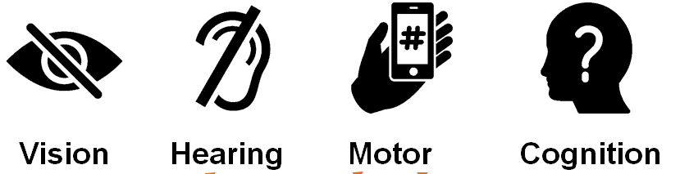
Editing the Inaccessible: Creating Equitable Programming for Trainers of New Hampshire’s Multi-Tiered System of Support
Erin Wardrop, BSW | Social Work
NH-ME LEND, Institute on Disability, University of New Hampshire
MTSS-B
Description of Project Activities
Conclusions and Next Steps
Multi-Tiered System of Support for Behavioral Health and Wellness (MTSS-B) is a data driven, tiered framework to address students’ behavioral needs
Three focus areas:
Primary prevention: School-wide supports to address the needs of all students
Secondary Prevention: Targeted, function-based intervention aimed to reduce challenging issues within academic and social behaviors
Tertiary prevention: Intensive, individualized supports for students with significant emotional or behavioral challenges
Engage in MTSS-B Sessions
Create FAQ document for future use Observe MTSS-B framework in motion to inform auditing process
Conduct Accessibility Audits
Editing alternative text Improving color contrast Revising reading order to make accessible to screen readers
Collaborate with others
Discuss complicated accessibility questions Review work in team meetings to ensure best possible outcomes
Continue accessibility audits with other materials
Utilize screen reader to access documents and Powerpoints
Extend strategies into future professional work
Incorporate lessons of accessibility into teaching resources/programs
Lessons Learned
“Accessibility cannot be an afterthought,”
(Youngblood, Tirumala, and Galvez, 2017, p. 342).
Accessibility is not a beginner task.
Not widely understood Needs additional research, resources, and time To become an expert, you must learn from and alongside experts
When we aren’t being thoughtful about accessibility, we leave out some of the population.
Not ensuring accessible resources for all forces people to disclose their experience in an uncomfortable manner We need universally accessible materials!
Accessibility
Creating Accessibility | Legal and Ethical Responsibilities
General: Resources, physical spaces, print materials, and other aspects of our environment Digital materials: Alternative text, color contrast, reading order | Americans with Disabilities Act (ADA) Microsoft products, particularly, are inherently inaccessible and must be reviewed and processed for accessibility
Accessibility Example
Weak Contrast and Small, Unique Fonts are Difficult to Read
INACCESSIBLE
Strong Contrast and Larger, Universal Fonts Make Things Easier to View
ACCESSIBLE
References
Lazar, J., Olelere, A., and Wentz, B. (2012). Investigating the accessibility and usability of job application websites for blind users. Journal of Usability Studies, 7(2), 68-87.
Youngblood, N. E., Tirumala, L. N., and Galvez, R. A. (2017). Accessible media: The need to prepare students for creating accessible content. Journalism & Mass Communication Educator, 73(3), 334-345.
“It is not enough to simply assume such usability based on automated accessibility evaluations,”
(Lazar, Olalere, and Wentz, 2012, p. 84).

