Slide 1
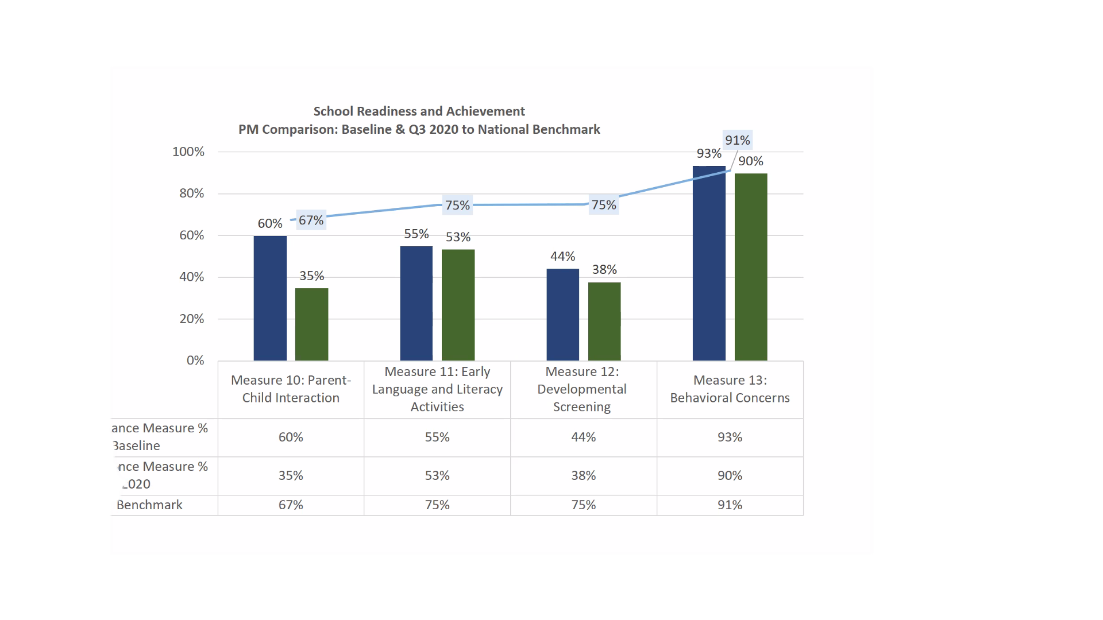
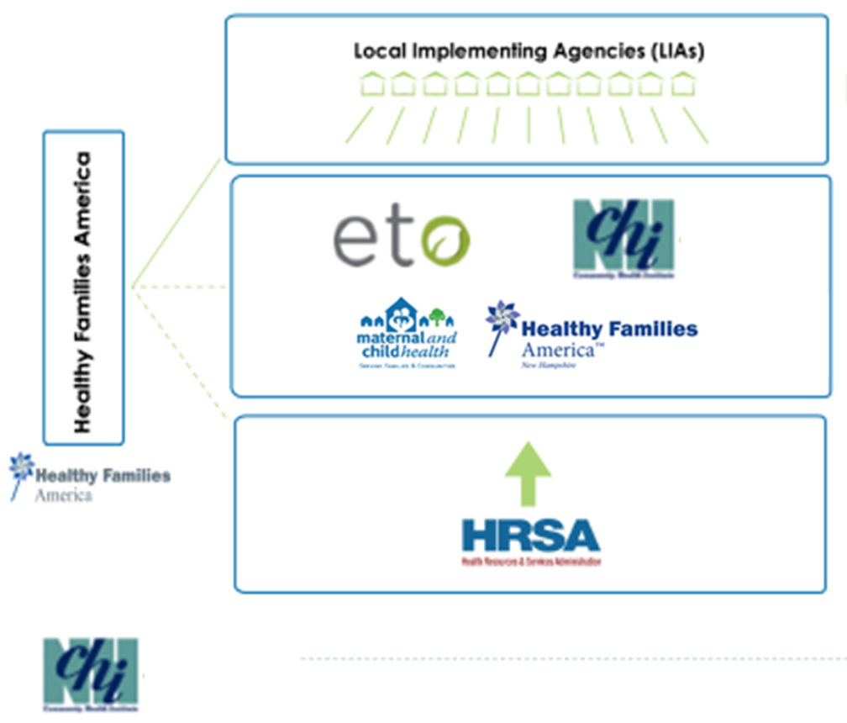
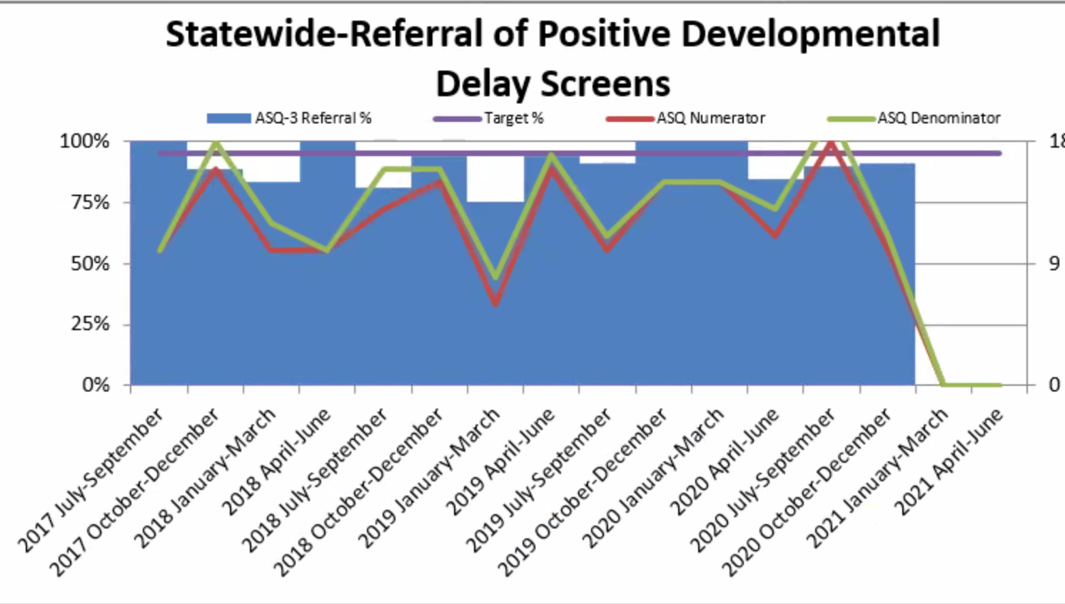
Finding the Balance: Data for Best Practice and Benchmarks
Gayle Perreault, M.B.A., M.Ed., BCBA
Background
HRSA Performance Benchmarks
Products
Maternal and Child Health, Home Visiting Program administers the Maternal Infant Early Childhood Home Visiting (MIECHV) federal grant. The program oversees agencies embedded within communities throughout NH, to implement an evidence-based home visiting model, Healthy Families America, to prenatal families and those with children under the age of three.
The MIECHV program intends to gather a richer understanding of data input practices and develop tools, and training that will be utilized by the MIECHV contracted agencies
Created an alternative tool for home visitors (HV) to manage data
Periodicity Table – tells them what and when it needs to happen
Highlights the critical data for Developmental Screens
One area where the benchmark and best practice standards caused data outcomes to look inconsistent
Completed data analysis on Developmental Screening Summary Report
identified discrepancies and areas for additional research
Process
Started with looking at the requirements for Developmental Screening
HRSA Performance Benchmarks looked low, but
HFA Best Practice Standards looked excellent
Interviewed staff at local implementing agency
Attended Continuous Quality Improvement Meetings
Attended State-wide Supervisors Meetings
Brainstormed with project leaders
HFA Best Practice Standards
References
Challenge
HRSA (Health Resources and Services Administration) requires that programs achieve and document performance according to 19 national performance measures.
Healthy Families America requires fidelity to approximately 155 best practice measures in 12+ categories
Agencies need to balance data needs with doing the work of implementing the evidence-based practices.
Healthy Families America, HFA Best Practice Standards, Effective January 1, 2018 – December 31, 2021.
Lipkin, P.H., Macias, M.M., and Council on Children with Disabilities, Section on Developmental and Behavioral Pediatrics (2020). Promoting Optimal Development: Identifying Infants and Young Children with Developmental Disorders through Developmental Surveillance and Screening. Pediatrics, 145. DOI: 10.1542/peds.2019-3499
The Maternal, Infant, and Early Childhood Home Visiting Program Form 2 Performance Indicators and Systems Outcomes Data Collection & Reporting Manual and Grantee Plan; August 2019

