Slide 1


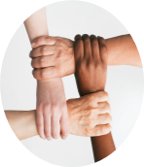

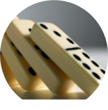

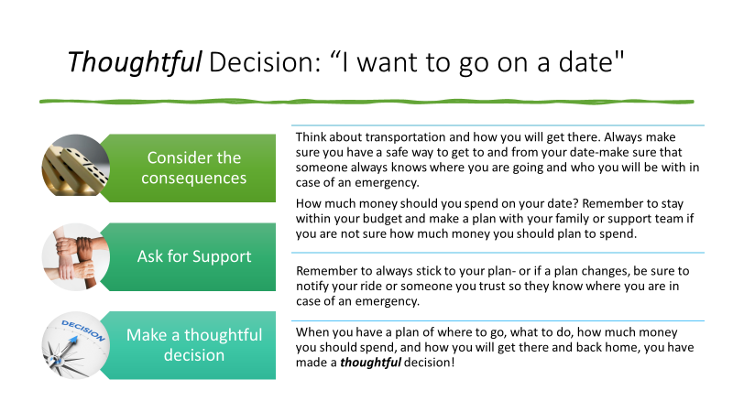

Supported Decision Making and Healthy Living Decisions
Jaci Peterson-B.S. Social and Behavioral Sciences, Early Childhood Education.
5-Point Decision Making: How to make a Thoughtful Decision:
Identify your goal
Ask for support
How Can We Support Young Adults in making well-informed decisions in Nutrition and Sexuality?
The Maine Parent Federation (MPF), is a private non-profit organization established in 1984 and located in Farmingdale, Maine.
Mission: The Maine Parent Federation, Inc. is a statewide organization that provides information, advocacy, education, and training to benefit families of children and adults with disabilities and special health care needs.
How do they support families, children, and youth? Through various grant-funded and federally-funded projects, MPF provides advocacy, peer-to-peer, parent-to-parent support staff, education and training, referrals to additional services and/or linkages to other resources for families and professionals.
How did I support MPF as a LEND Trainee? Using the current framework of Supported Decision Making training for families and youth, collect and review research, resources, materials, and curriculum examples to support the implementation of healthy eating and sexual development into the current training for families and youth.
Remember knowledge is POWER
Ensure that IEP goals meet the needs of a well rounded transition plan
  Curriculum about nutrition & cooking healthy food
  Teaching healthy physical boundaries
  Social/emotional goals around respectful relationships
  Developmentally appropriate sex education curriculum
  In home and community based treatment plans (ITP) can also support real life-applicable goals and situations
  Support the youth in finding their voice, Self-Determination, Confidence, and Self-Advocacy are life long skills
Weigh your options
Make a thoughtful decision
Consider the consequences
What is Supported Decision Making (SDM)?
Supporting Resources:
Additional Resources available on MPF website
www.accessiblechef.com
UCONN PPT Healthy Bodies Curriculum/study
https://uconnucedd.org/wpcontent/uploads/sites/1340/2016/09/turner.pdf
Healthy Eating, Nutrition, and Illness (Girls Health. Gov)
https://www.girlshealth.gov/body/index.html
Unpacking barriers to healthy lifestyles from the perspective of youth with disabilities and their parents
https://www.tandfonline.com/doi/abs/10.1080/10852352.2018.1386270
SDM is not a legal document or contract; it is a series of relationships, practices, arrangements and agreements designed to assist an individual with a disability to make and communicate with others, decisions about their life.
Everyone has the right to make choices.
People can get assistance without giving up their right to make choices.
People often need help in understanding, making, and communicating their choices.
Relationships and Sexuality can be tricky to navigate at any life stage.
As a parent, caregiver, and supporter, we want our youth to:
Understand the importance of continually developing self-confidence and resilience.
Understand that strong self-awareness and self-respect are the foundation for all healthy relationships.
Identify and know the characteristics of healthy and unhealthy relationships.
ALL people are sexual beings.
Sexuality is inclusive; We ALL have sexual identities and orientations.
Gender Identity is inclusive; We ALL have gender identities and gender expressions.
Watch SPAN 4 Part Webinar on Disability & Sexuality:
REAL Transition Partners | SPAN Parent Advocacy Network (spanadvocacy.org)
MAIER: Sexuality Education Resource free to download
Autism Resources (umaine.edu)
May Institute Article - supporting parents of young adults
https://www.mayinstitute.org/news/acl/asd-and-dd-adult-focused/helping-a-young-adult-with-special-needs-develop-dating-skills/
Easter Seals Website
https://www.easterseals.com/explore-resources/living-with-disability/love-dating-relationships-disability.html
When to ask for support?
I can do this alone
I can do this with support
I need someone to do this for me

