Slide 1
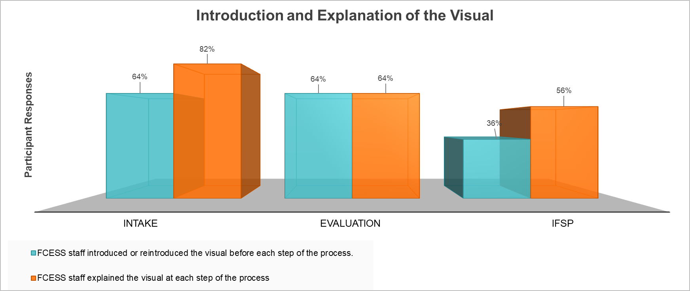
Finding Your Way Through Early Supports and Services
Shawnna Bowman – Family Discipline and Ellen Rislove, OTR/L – Clinical Discipline
Introduction
The goal of this project is to engage participants through conversation regarding their experience using the tool to obtain supports for their child through Early Supports and Services.
We conducted 11 interviews via Zoom or telephone with questions designed to gather data on how helpful the “How to Find Your Way” visual was for parents and caregivers.
Families were given adequate time to answer questions as well as explanations if needed to increase their understanding. The questions progressed through stages of intake, evaluation and planning. We utilized a “partnership model of listening” applying to our diverse disciplines to provide different perspectives of the participant’s responses.
NH Family Centered Supports and Services (FCESS) is a non-profit specialized service to evaluate a child, birth through 2 years, who have a diagnose, established condition with high probability of resulting in delay, are experiencing developmental delays or at risk for substantial developmental delays. Anyone who is concerned about the child’s development may make a referral to FCESS. The services are supported by the Bureau for Family Centered Services (BFCS) and are provided within a child’s natural environment (home or wherever they spend the most time) to increase the child’s and family participation.
FCESS worked closely with NH Family Voices to ensure parent/caregiver engagement was supported through the process of services, including: Intake, evaluation and planning. NH Family Voices provides free and confidential services to families and professionals who care for children with lifelong disabilities. This program ensures family centered care to enhance the knowledge and confidence for families and professionals when deciding the child’s ongoing care needs.
Positives
Comprehensive questions decreased time required for interviews
There was a majority of positive responses to the visual
Zoom platform improved communication with participants
Negatives
Limited participation from families with multiple attempts via email or telephone. The response rate to our evaluation invitations was 25% involvement.
Participation may have been impacted by COVID-19
Referrals to Early supports and services were at an all time low this year
Question lead to a misunderstanding of whether we were evaluating the visual or the FCESS staff
Use of the visual seemed inconsistent
Evolution of the Project
(2019) In effort to improve families understanding of the FCESS process of Intake, Evaluation and Individual Family Support Plan (IFSP), the following visual was developed. This visual is the result of findings after observations between FCESS staff and families engagement were conducted. (2020) To determine the usefulness of the visual and families understanding of their role as part of the team, a questionnaire was developed utilizing the data from the 2019 observations.
(2021) Using the questions developed in 2020, interviews were conducted with families who recently became engaged with FCESS agencies across the state. Each response will determine necessary changes to the level of family engagement and/or the visual tool.
What’s Next?
Draft a summary report of the data collected, obstacles and improvised methods to overcome those obstacles
Offer research on neighboring state’s effort to improve parent engagement and advocacy
Make recommendations for better data collection
The Visual
Family-Centered Early Supports and Services: Bureau of Developmental Services: NH Department of Health and Human Services. (n.d.). Retrieved April 01, 2021, from https://www.dhhs.nh.gov/dcbcs/bds/earlysupport/index.htm
New Hampshire Family Voices. (n.d.). Retrieved April 01, 2021, from https://nhfv.org/
* Numbers above reflect the percentages of participant responses. We had a total of 11 participants.

