Slide 1

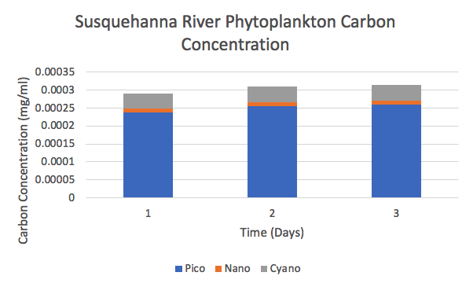
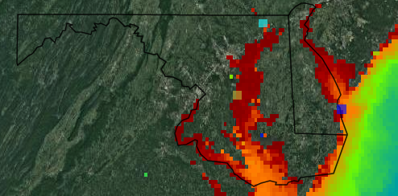
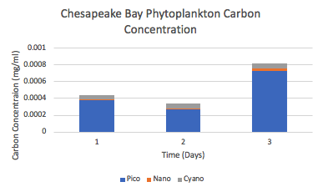
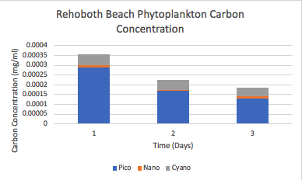
Mid-Atlantic Phytoplankton Abundance Relative to Water Quality
Assisted by New Logic Marine Science
Cooper Mattheu
Department of Earth Science, University of New Hampshire
Introduction
Results
Discussion
The goal of this paper was to further understand the consequences that ocean acidification and poor water quality management is having on phytoplankton abundances in the Mid-Atlantic region over time. Phytoplankton samples were taken from three different bodies of water in the Mid-Atlantic to account for freshwater, brackish water and saltwater environments. Sampling was accomplished by taking 50 mL samples of surface water from each location every day for a week, then measuring the samples’ abundance utilizing the Guava EasyCyte HT flow cytometer made by Luminex. By understanding the abundances of phytoplankton in specific water environments within the Mid-Atlantic it is possible to separate these values into categories dependent on size, pico-, nanoeukaryotes and cyanobacteria. The significance of knowing the relative size of the plankton being measured allows for the conversion to relative carbon concentration in each of the samples. Obtaining the relative amount of carbon in the Mid-Atlantic dependent on the salinity-based environment will provide a different look at the importance of ensuring good water quality to support phytoplankton abundance.
Figure 1: This figure shows the calculated carbon concentrations converted from phytoplankton abundance based on size. The Susquehanna represented the freshwater environment being sampled in the Mid-Atlantic and showed the highest nanoeukaryote carbon concentration out of the three sampling sites at a mean of 1.14E-5 mg/mL of C.
Figure 4: The map above shows chlorophyll-a abundance measurements taken from the Global Change Observation Mission (GCOM). The teal square marks the Susquehanna River sampling site, the yellow square marks the Chesapeake Bay sampling site, and the purple squares marks the Atlantic Ocean sampling site.
Methods
Phytoplankton collection:
Phytoplankton was sampled by taking 50 mL vials of surface water from various locations dependent on the water type present in each sampling site. Locations were determined based on the salinity content of each body of water. The initial set of samples were taken from surface waters at the Susquehanna River as freshwater samples, the next set of samples was taken from the Chesapeake Bay for a brackish water environment, and the last set of samples was taken from the Atlantic Ocean out of Rehoboth Beach, Delaware to represent the saltwater environment. Samples were taken once a day for three days at each location, but the vials needed to be preserved following sampling. Adding a glutaraldehyde solution of 1% final concentration allowed for long term preservation and were kept on ice in a cooler immediately following sampling and transported to a refrigerator for longer term storage.
Water quality testing:
Water quality was tested by utilizing NH₄, NO₃⁻, and NO₂⁻ measuring kits to determine specific values of the nutrient concentration along with pH, salinity, and temperature. These measurements were taken once a day for three days along with the phytoplankton samples. Water quality measurements taken were done by support scientists through New Logic Marine Science for the original purpose of administering the results to local governments to assist in furthering environmental research efforts.
Phytoplankton abundance and biomass estimates:
Phytoplankton abundance was determined by utilizing the Guava EasyCyte HT flow cytometer made by Luminex and were separated by specific phytoplankton sizes, this allowed for the separation of phytoplankton into distinct groups, pico-, nanoeukaryotes and cyanobacteria. By separating the phytoplankton measurements into abundances based on their relative sizes it became possible to determine the estimated range of carbon for each grouping of phytoplankton. Abundances of each phytoplankton group measured via flow cytometry were converted to carbon biomass (μgCL⁻¹) by utilizing literature conversion factors. Assuming 255 fg C cell-1 for cyanobacteria classified as Synechococcus spp. (Buitenhuis et al. 2012), 1500 fg C cell⁻¹ for picoeukaryotes (Zubkov et al. 1998), and 2763 fg C cell-1 for nano eukaryotes, presuming an average cell diameter of 6 μm (Tarran et al. 2001; Pan et al. 2007).
The samples taken and measured from the three different environments was done as a survey of Mid-Atlantic phytoplankton abundance to further examine the relationship between local water quality and phytoplankton abundance. The highest carbon concentrations and phytoplankton abundance measurements came from the Chesapeake Bay which correlated with the highest NH₄⁻ measurements. Phytoplankton abundance shows strong correlation to NH₄⁻ concentrations as seen in figure 2 and table 2, as NH₄⁻ concentration remains relatively high, the abundance of phytoplankton present in surface waters increases as well (Domingues et. al. 2011). The Chesapeake Bay having the highest phytoplankton abundance came as a surprise considering the body of water’s history with pesticide runoff from local farmlands in Maryland (Tippie et. al 1984). The surface water samples taken and analyzed further prove that the Chesapeake Bay is recovering from record high levels of pollutants and acidification. The main contributor to past pollution of the Chesapeake Bay was pesticides and omnicides that would deposit runoff into rivers that would empty freshwater into the Bay, the Susquehanna River is the Chesapeake Bay’s largest contributor of freshwater . The samples taken from the Susquehanna River further prove that pollution control is improving throughout the Mid-Atlantic region showing an increase in phytoplankton abundance since the later 1900’s (Wager et. al. 1969). The Atlantic Ocean phytoplankton abundance measurements were taken in order to further understand the effects Mid-Atlantic pollution and runoff can have on the local environments. The Atlantic Ocean phytoplankton abundance is increasing along with its improving water quality since the mid 1900’s when pollution and runoff in the Mid-Atlantic was at its worst (Goldsmith et. al. 2019). The improvement of pollution management in the Mid-Atlantic has been made apparent through the sampling of surface waters for phytoplankton abundance and water quality, surveys similar to this one should be continued on a larger scale for areas that have suffered from pollution and are locally dependent on distinct bodies of water.
Figure 2: This figure shows the phytoplankton carbon concentration calculations from the phytoplankton abundance samples taken in the Chesapeake Bay from Mayo Beach in Anne Arundel County, Maryland. The Chesapeake Bay represented the phytoplankton carbon concentration of brackish water in the Mid-Atlantic and showed a max value of 7.31E-4 mg/mL of carbon from picoeukaryotes.
.
References
Figure 3: This figure shows the calculated carbon concentrations converted from phytoplankton abundance based on size in the Atlantic Ocean sampled off the coast of Rehoboth Beach, Delaware. The Atlantic Ocean is the only saltwater environment in the Mid-Atlantic and served as the sampling site for such environment. The Atlantic Ocean samples show the highest cyanobacteria carbon concentration out of all three sites with a mean of 5.15E-05 mg/mL of carbon.
Domingues, R. B., Barbosa, A. B., Sommer, U., & Galvão, H. M. (2011). Ammonium, nitrate and phytoplankton interactions in a freshwater tidal estuarine zone: potential effects of cultural eutrophication. Aquatic Sciences, 73(3), 331–343. Goldsmith, K. (2019). Scientific considerations for acidification monitoring in the U.S. Mid-Atlantic Region. Estuarine, Coastal and Shelf Science, 225.
Tippie, V. (1984). AN ENVIRONMENTAL CHARACTERIZATION OF CHESAPEAKE BAY AND A FRAMEWORK FOR ACTION. Science Direct, 467–487.
Wager, D. B., & Schumacher, G. J. (1970). PHYTOPLANKTON OF THE SUSQUEHANNA RIVER NEAR BINGHAMTON, NEW YORK: SEASONAL VARIATIONS; EFFECT OF SEWAGE EFFLUENTS 1, 2. Journal of Phycology, 6(2), 110–117.

Slide 2

This poster template provided courtesy of
UNH ESRC Poster Printing Services
Trust us to make your poster look GREAT!
Website: http://posters.unh.edu
Poster Guide: http://goo.gl/1E7TJY
DELETE THIS SLIDE BEFORE PRINTING

