Slide 1
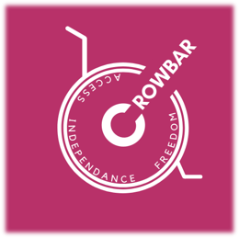
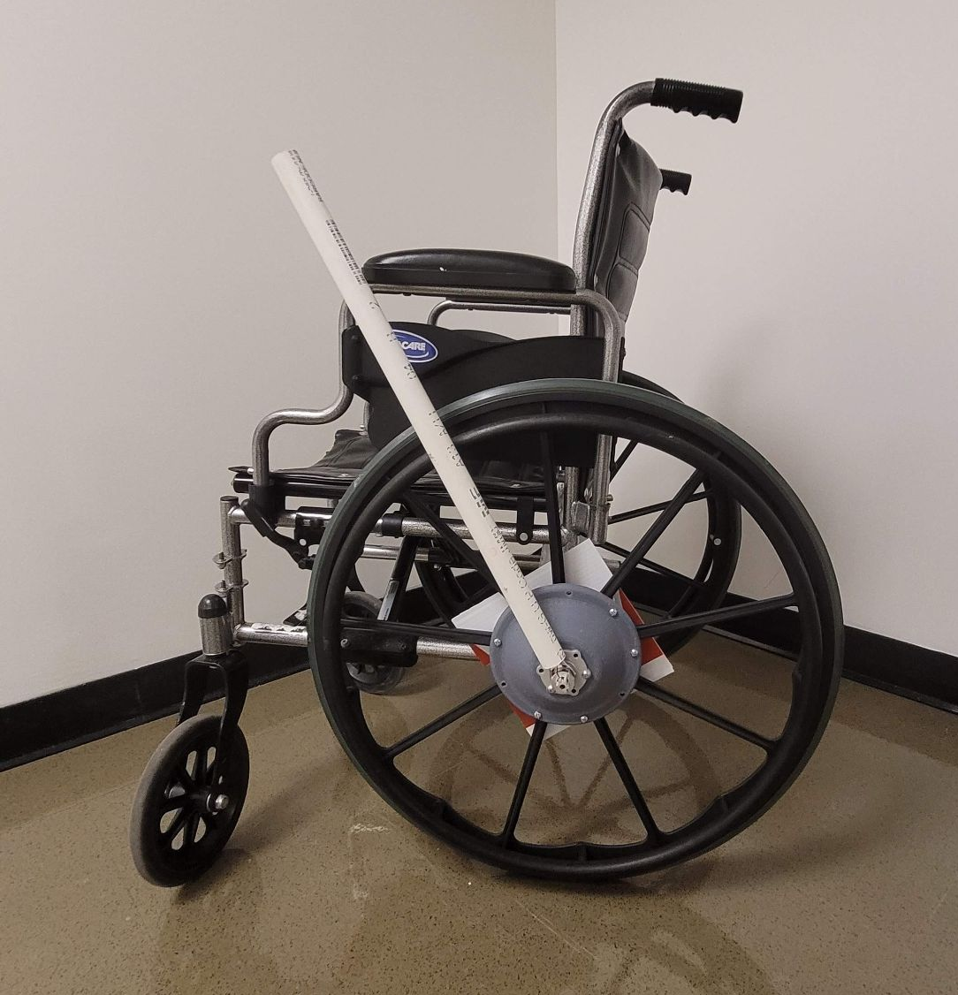
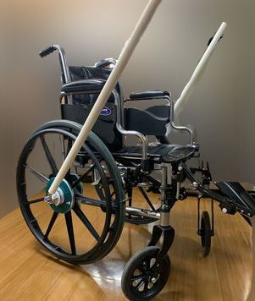
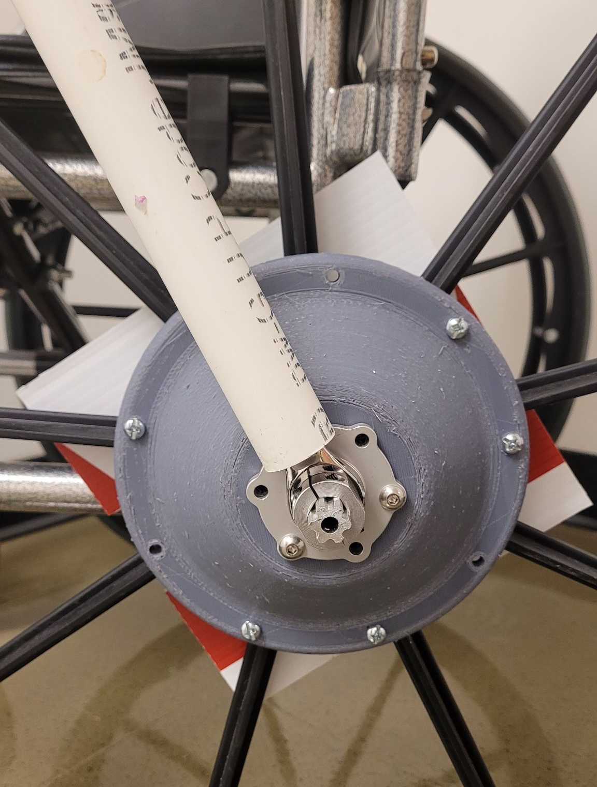
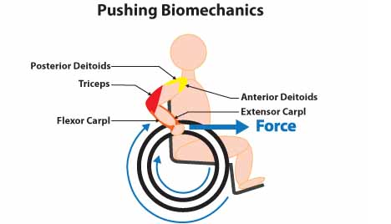
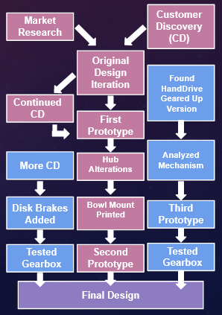
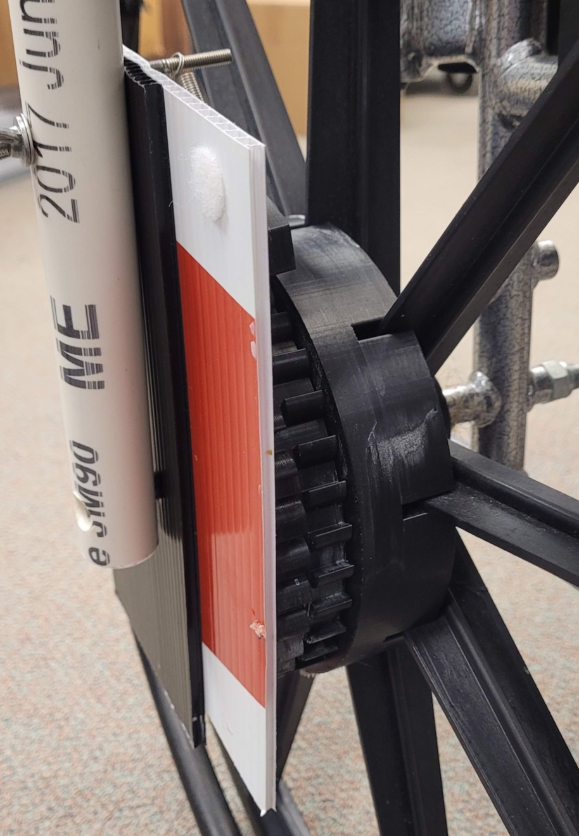
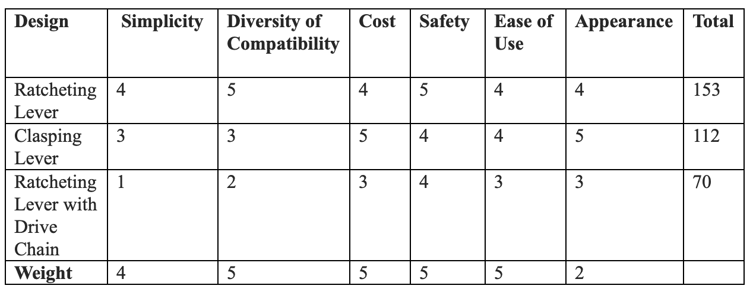
CROWBAR
Introduction
Design Iterations
Wheelchair levers are an alternative mode of wheelchair propulsion. They can be built into the chair or externally mounted, and give users a
mechanical advantage
when going up hills
or over rough terrain.
This advantage has
also been shown to
reduce the risk of
overuse injury to the
wrists and shoulders.
We succeeded in making a basic prototype by the end of fall semester which is pictured here mounted to a typical rental chair.
Modular Wheelchair Levers
By Devony Whiting and Ariana Schmidt
Current Design
Our current design incorporates a disk brake for easy braking, a 3:1 overdrive planetary gear box, and all-wheel mounting brackets. The ratchet mechanism contains a switch which allows the user to change between moving
forward or in reverse.
7
This design was our proof of concept. We then fabricated a sturdier mount.
Background
1
2
5
1. Bowl Mount
2. Disk brake and Gear
3. Planetary Gearbox
4. Bidirectional Ratchet
5. Switch
6. Base
7. Lever
3
Handrim propulsion is inefficient
Risk of injury increased due to overuse of joints - Most common in wrists and shoulders
Levered wheelchairs have been in development, shown to be superior for decades
Although several versions are available, they are sometimes inaccessible due to cost and insurance coverage
Explored several different styles: Hub Crank, Ratchet Lever, Chain Lever
The bowl mount was effective, but the gear ratio was far too low. We began searching for ways to overdrive the ratchet.
4
6
Project Goals
Design Process
Change hub design – allows user to mount to any wheelchair type
Add brake system - allows user to slow to a stop
Change material used - 3D prints allow for cheaper options - customer discovery showed us users preferred a price range of $100-$500
Decision Matrix
Kate Reed and Nathaniel Tong created an open source, 3D printable ratcheting mechanism, which we are using for our purposes.
After more customer discovery interviews, we added disc brakes. Our final iteration will include a 3:1 overdrive, and a bowl-shaped mount .
Acknowledgements
Therese Willkomm
Kate Reed and Nathaniel Tong
Van der Woude et all
​

