Slide 1
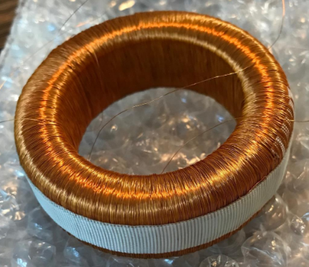
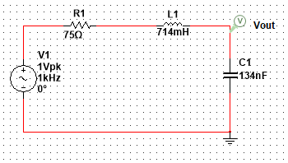
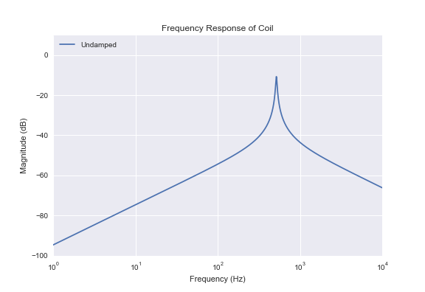
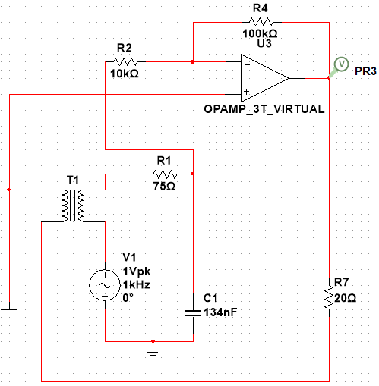
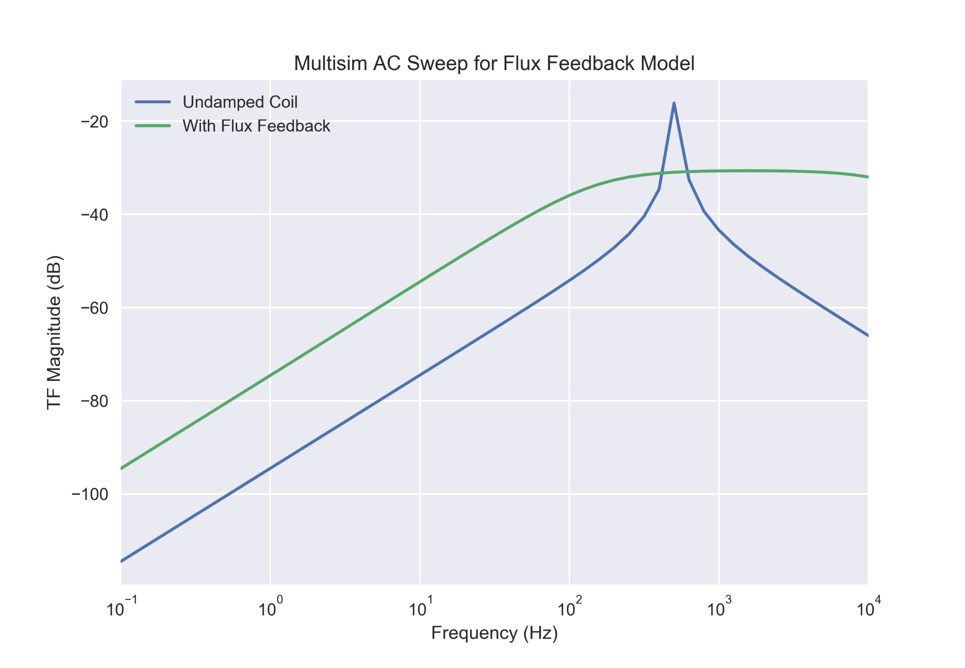
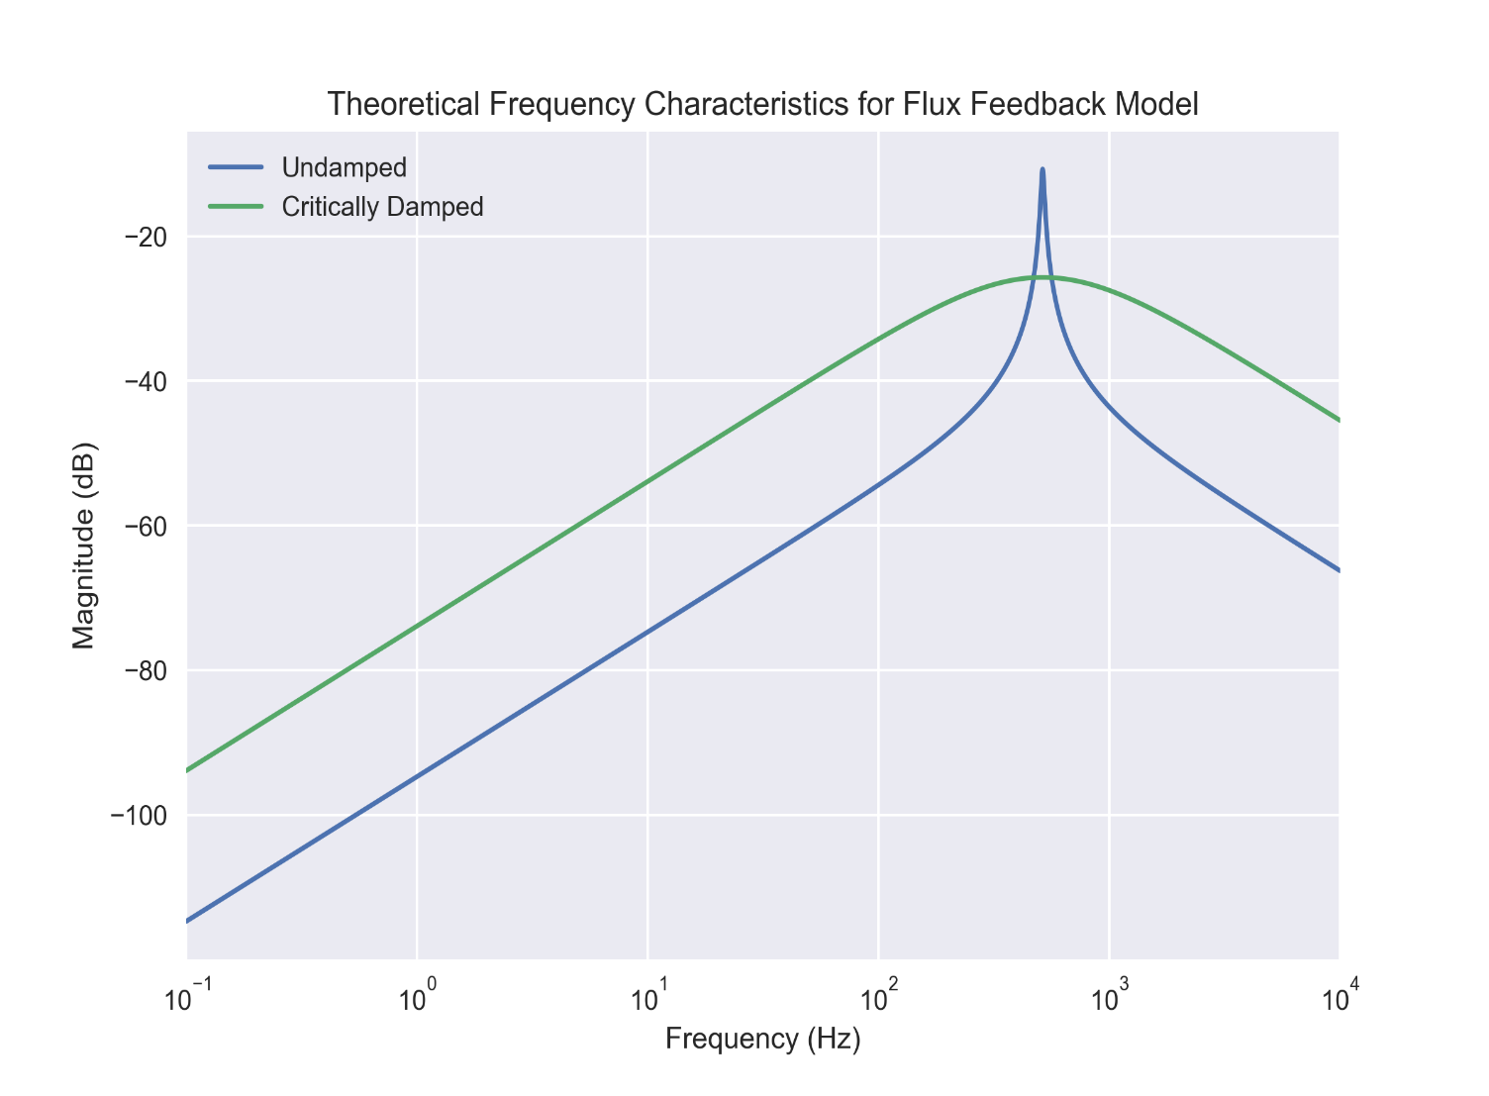
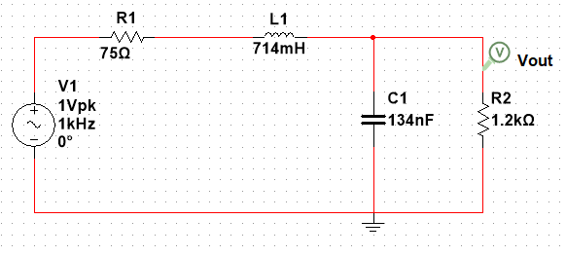
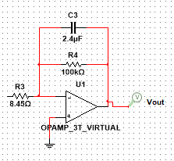
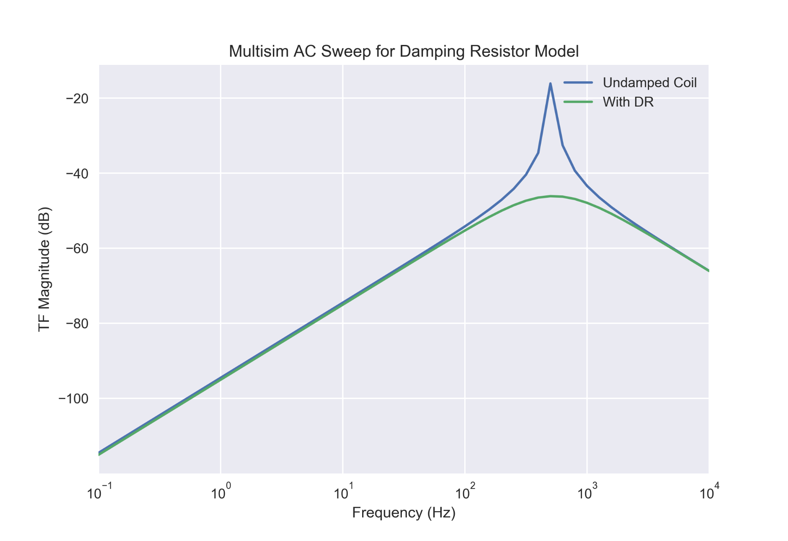
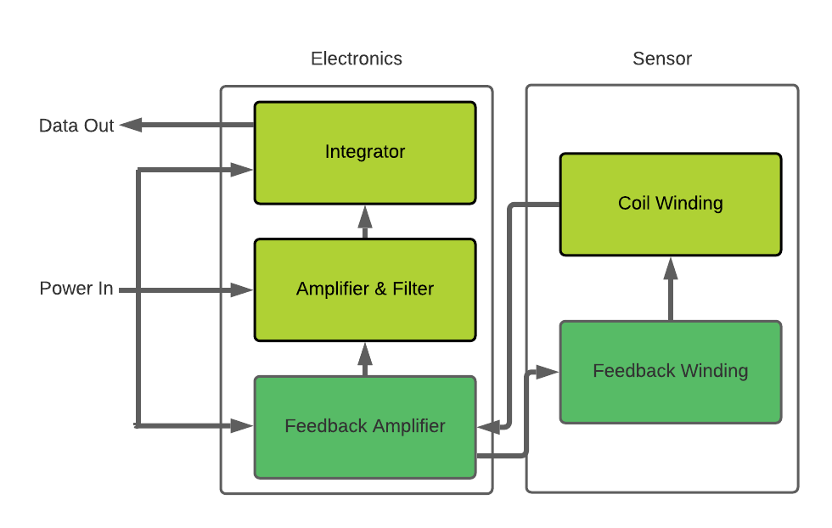
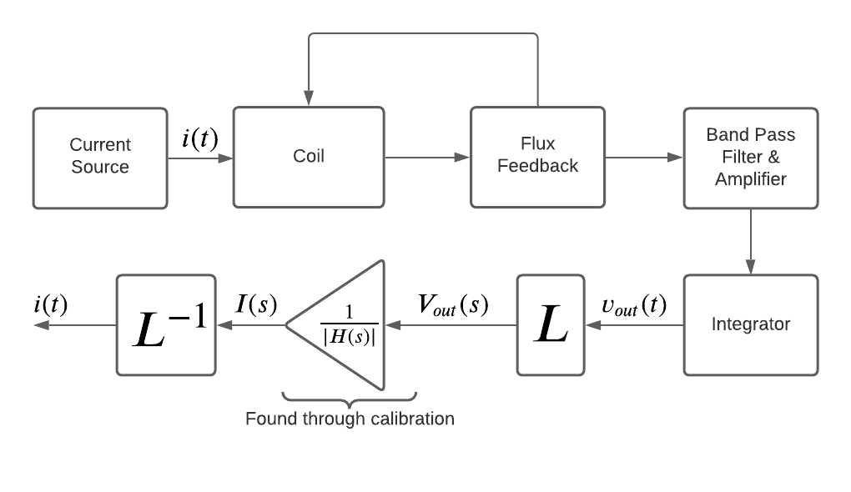
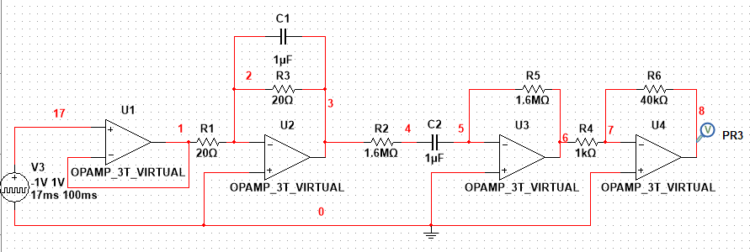
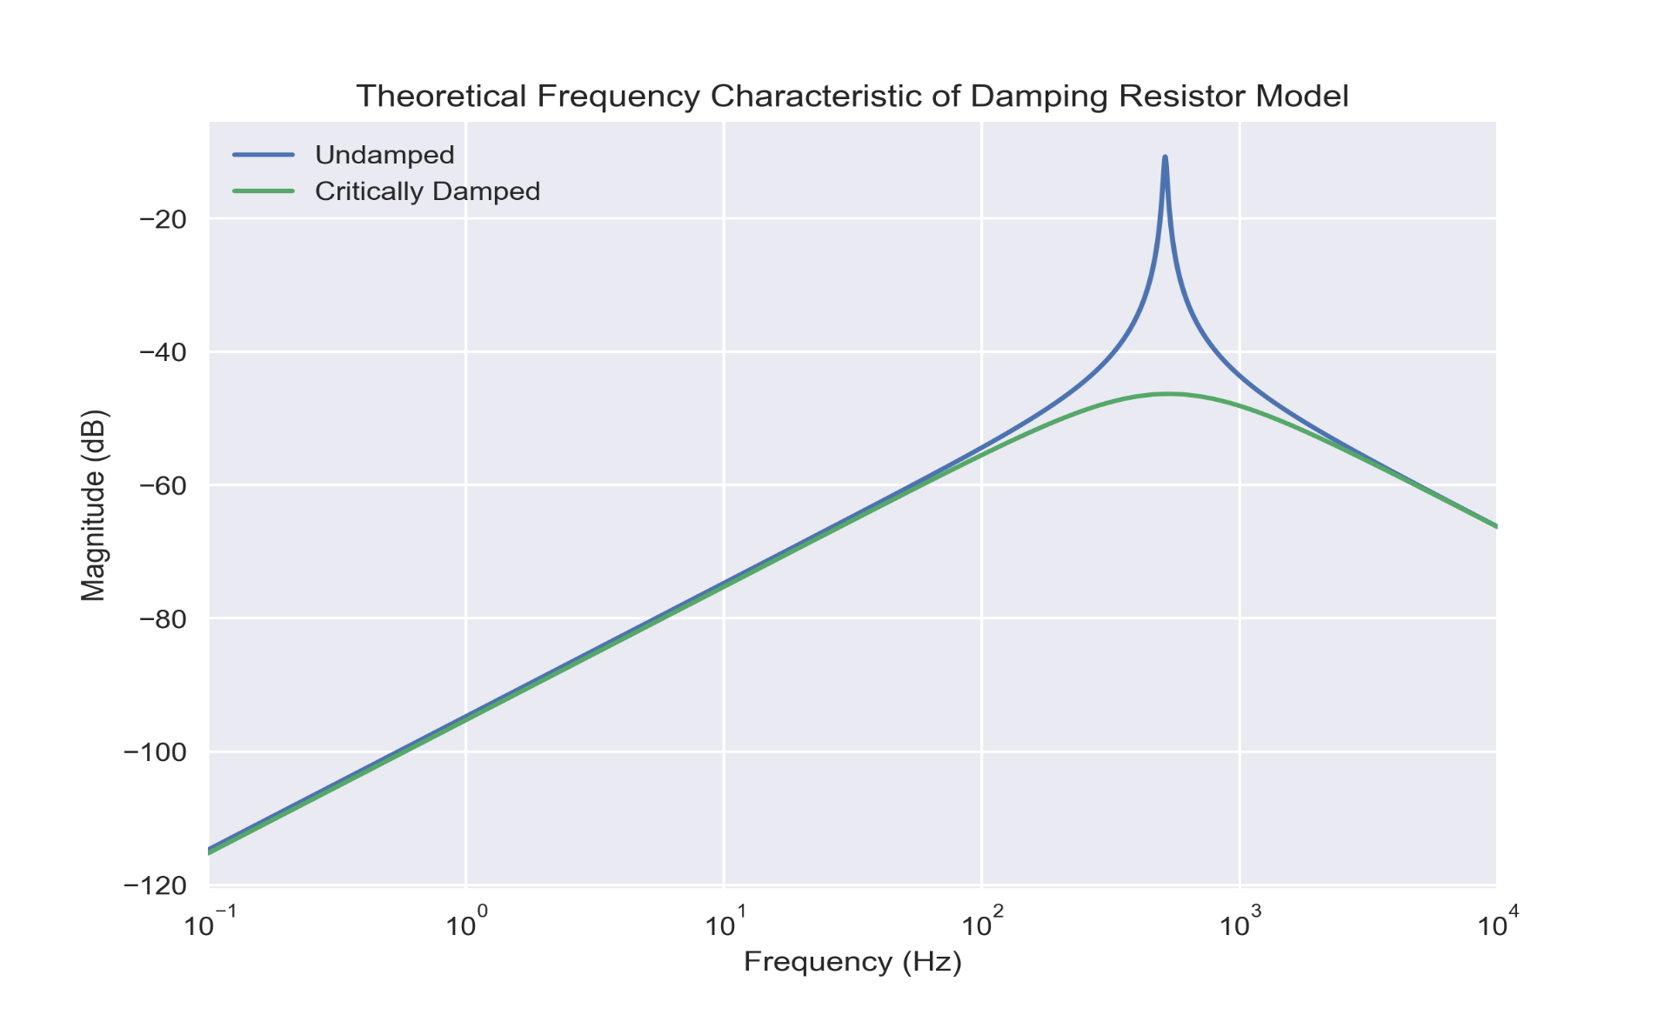
Damping and Maximizing Output Signal of Rogowski Coil with Flux Feedback System Shawn Cawley Advisor: Dr. Matthew Argall Department of Space Science, University of New Hampshire, Durham, NH 03824
Introduction and Objective
The Rogowski Coil is a current sensor that will be launched in 2022 as part of the ACES-II sounding rocket experiment to better understand Magnetosphere-Ionosphere coupling. As the toroidal instrument travels through space, any plasma current moving through the center will induce a voltage difference across the coil. There exists a natural frequency of the system that lies within the frequency range of interest. In order to read in consistent measurements, the system should be damped using external components
Prototype
RLC Model
Frequency Analysis
Ferrite Core with 7500 turns of copper wire
The Rogowski Coil has resistive, inductive, and capacitive properties so it can be modeled as an RLC circuit with a voltage source that is proportional to plasma current.
There is natural frequency of the system at around 500 Hz, which will negatively affect the output measurement process.
Additional Modules
Methods of Damping
Integration of Output
Flux Feedback Model
Damping Resistor Model
Ampere’s Law and Faraday’s Law are used to develop a relationship between the output voltage of the Rogowski Coil and the time derivative of the original plasma current. In order to preserve the original current signal, the output voltage must be integrated. Electronic integration was chosen.
Schematic
Frequency Analysis
Schematic
Frequency Analysis
Full System
Band Pass Filter (Joe Lazarro)
For this experiment, the AC current frequencies of interest are 0.1 Hz – 8 kHz. In order to reduce noise in data while amplifying the output signal, a bandpass filter was designed and will be included in the final circuit.
Buffer
LPF (f_{H} = 8 kHz)
HPF (f_{L} = 0.1 Hz)
Gain Stage

