Slide 1
The Living Bridge Project 2020-2021
Instrumentation Alongside Tidal Turbine
Tom Spiro and Maclane Keohane
Advisors: Martin Wosnik, Patrick O’Byrne
Funding Provided by NH Sea Grant

Slide 2
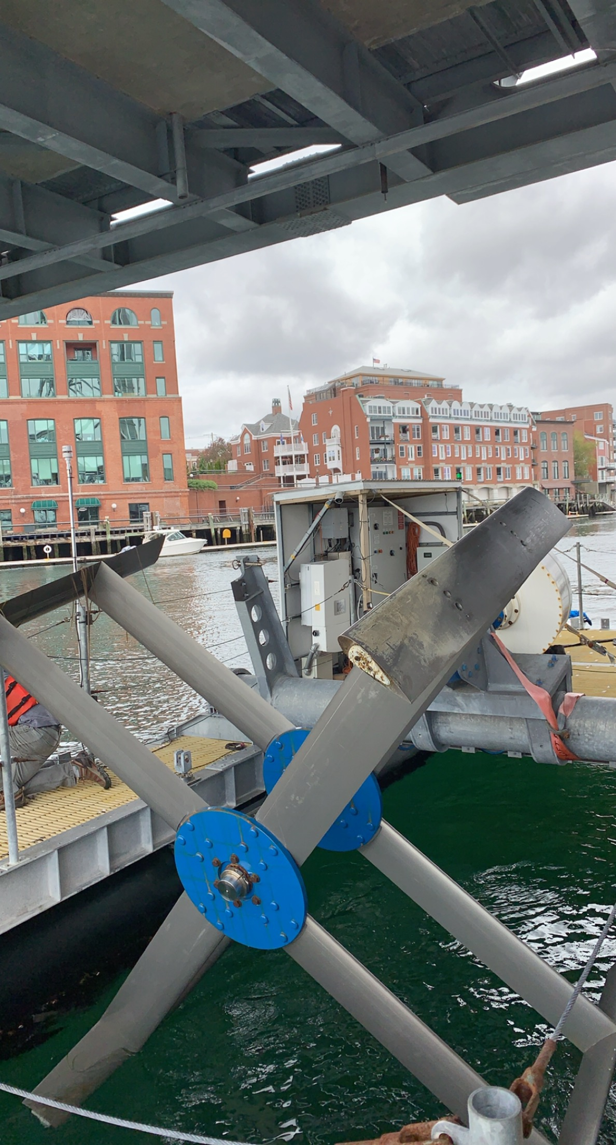
Memorial Bridge and Tidal Platform
Portsmouth, NH

Slide 3
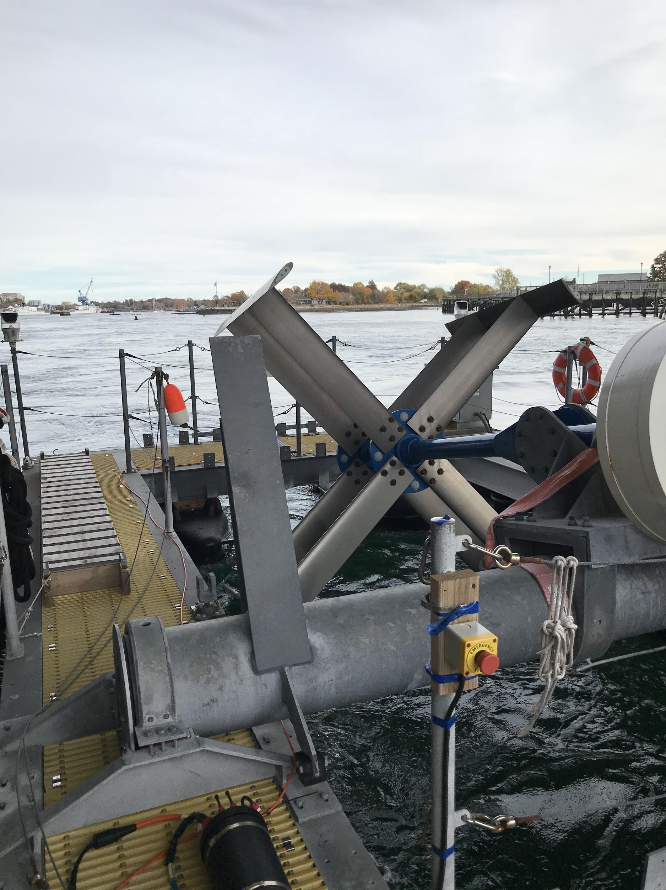
Goals of Project
Create deployment and measurement plan of CTD instrument
Calibrate sensors, including optical sensors
Prepare mounts, replace parts as needed
Deploy instruments
Perform long term measurements

Slide 4
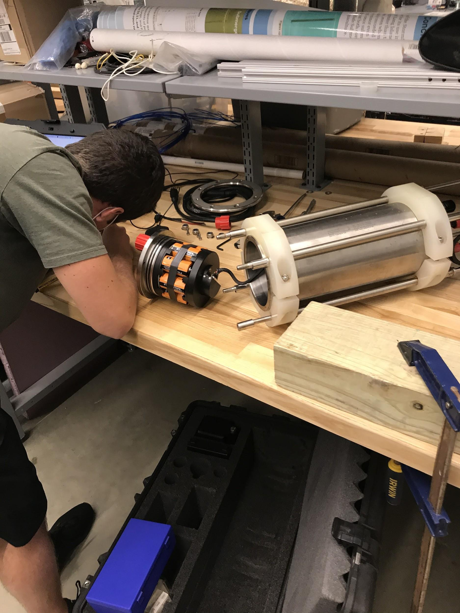
Midas CTD+ Disassembly
A detailed list of the physical components that make up the Midas CTD+ was essential along with an internal status check
Gaining knowledge of the assembly/disassembly procedure was a key step in familiarizing ourselves with the device
Internal Status check of the battery housing, O rings and internal electronics was needed prior to calibration and deployment

Slide 5
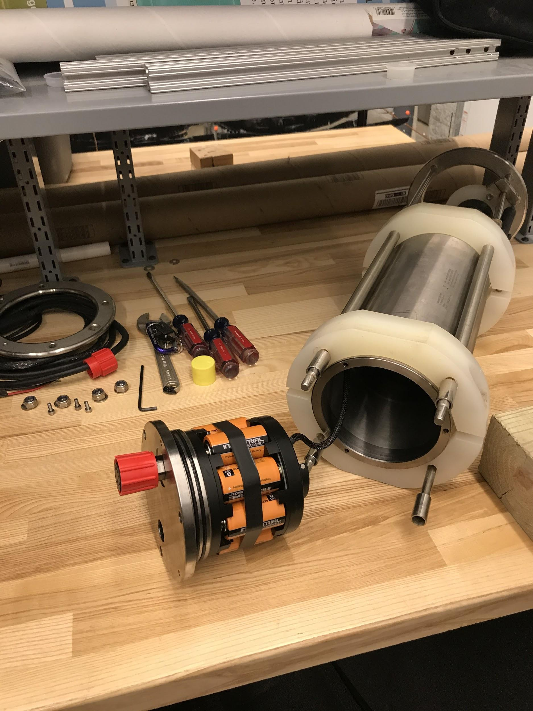
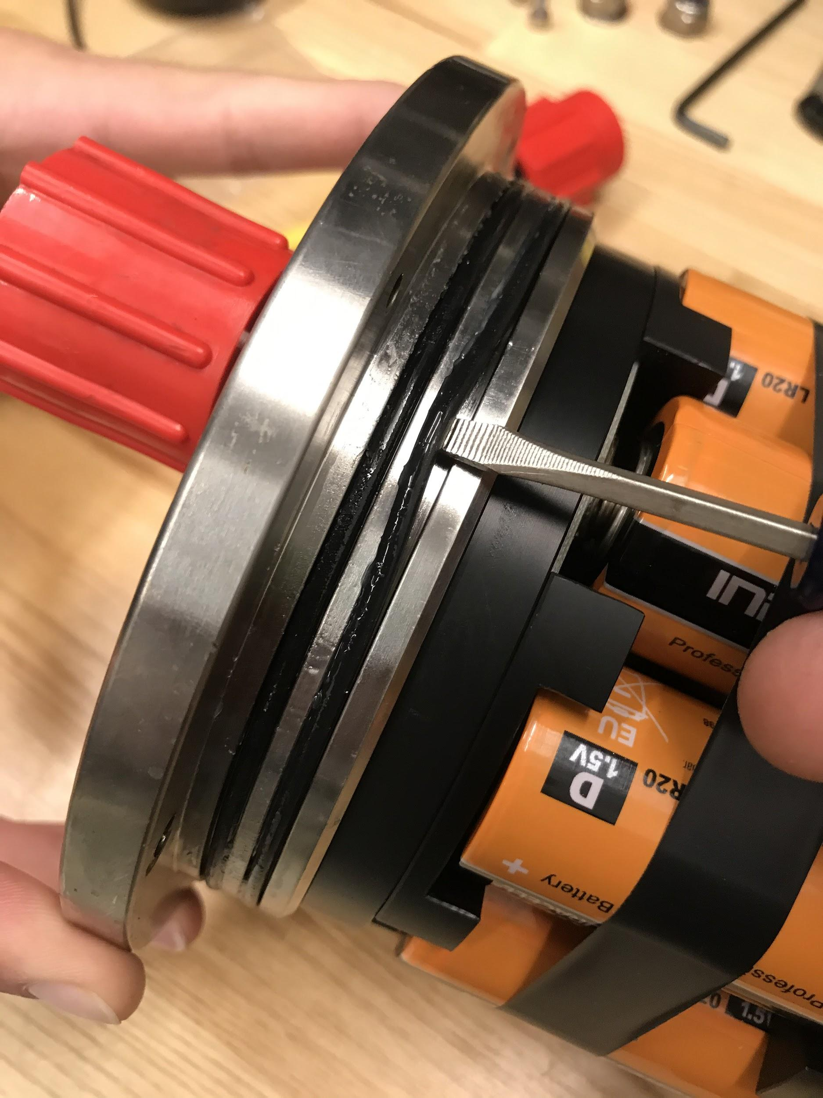
Midas CTD Casing
The titanium housing of the CTD has a removable end cap with two O-rings. The battery set up is connect to the end cap along with the communication/dummy plug port. The cap is held in place by alan head screws and is kept sealed by hydrostatic water pressure when submerged.

Slide 6
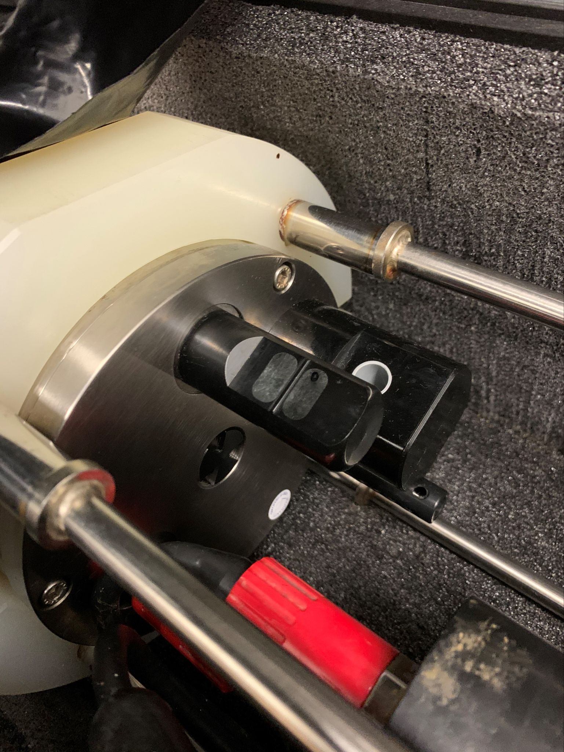
Sensors Configuration
Conductivity Sensor
Turbidity Optical Sensor
Temperature Sensor
Pressure Strain Gauge Sensor
Chlorophyll-A Optical Sensor

Slide 7
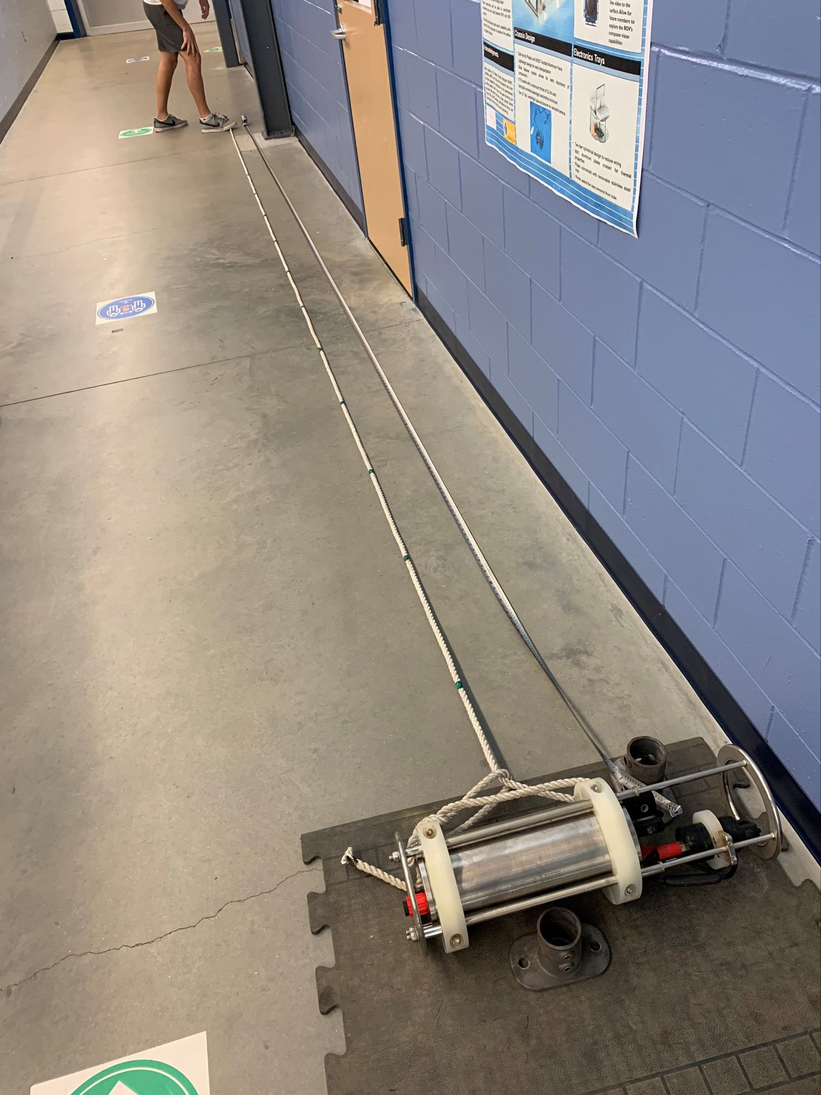
Pressure Sensor Experiment
On the face of the CTD opposite of the end-cap is the sensor configuration. The Pressure sensor is a small strain gauge plate in the middle of this configuration. The Sensor was checked against a simple hydrostatic experiment:
A rope marked every meter from sensor
Lowered into Chase Engineering Tank
Time and Depth Recorded
Measured Against Sensor and Hydrostatic Equation
Pressure=Density*Gravity*Depth + Atmospheric Pressure

Slide 8
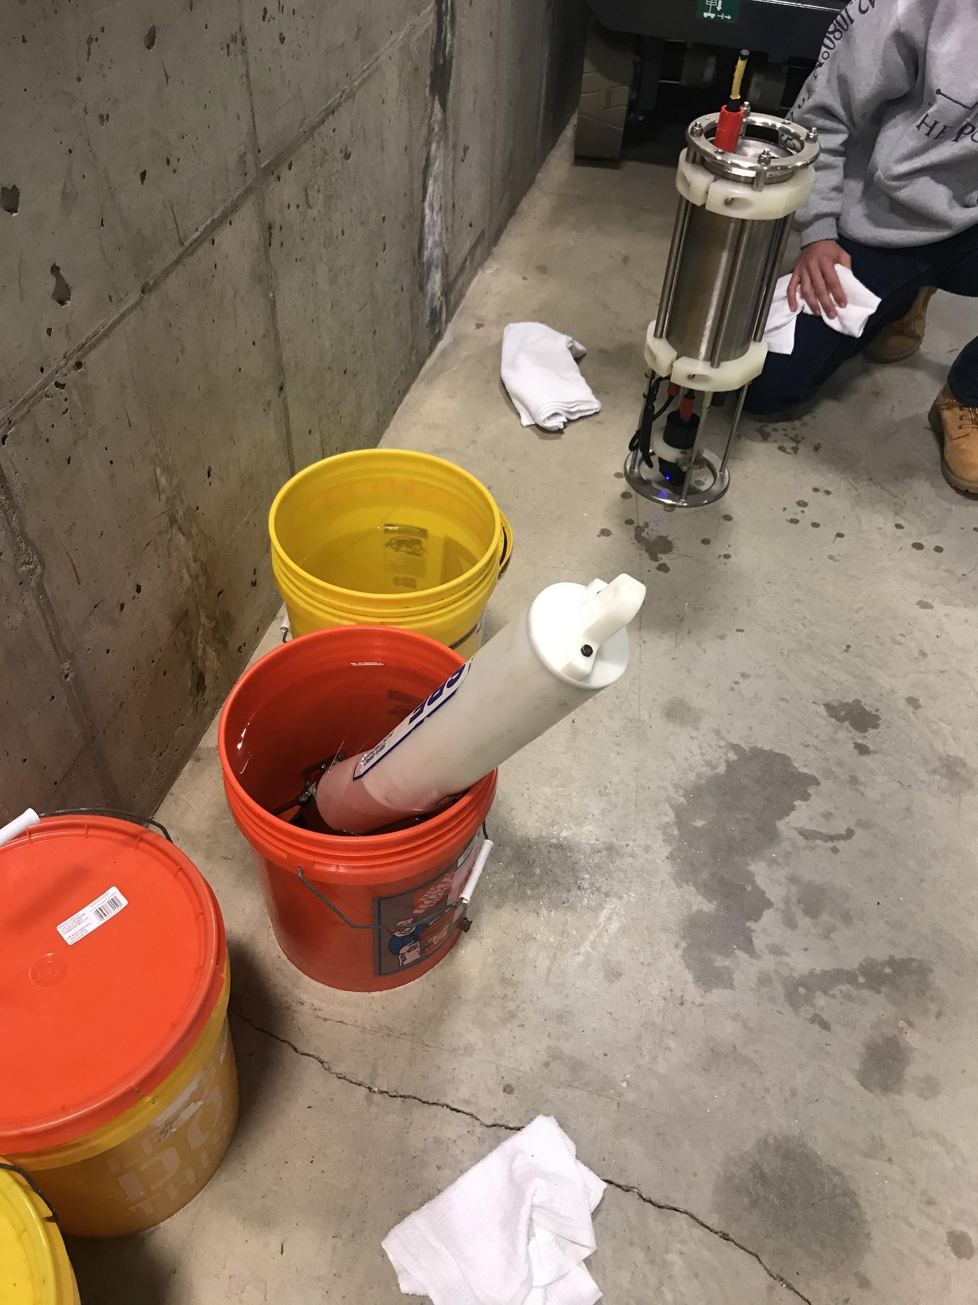
Salinity Calibration
The Midas CTD+ was placed alongside a newly calibrated Seabird CTD in various solutions containing instaocean.
Each solution contained different known levels of salinity in which both devices were tested in methodical time increments
Time stamps were recorded for each device in every solution and then compared to obtain a clean salinity/conductivity reading for the Midas

Slide 9
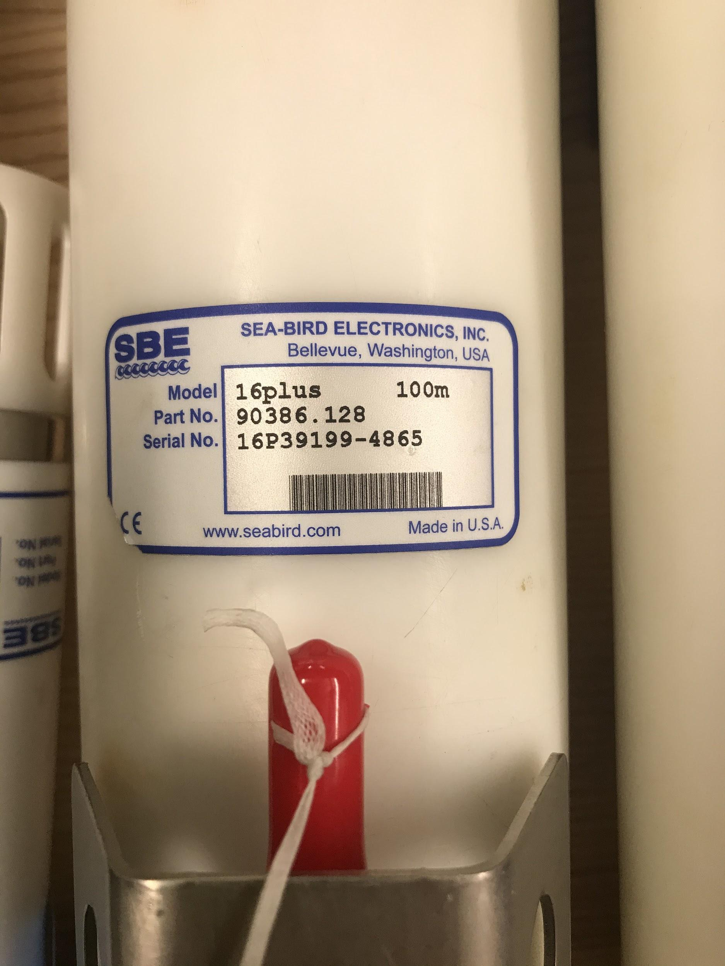
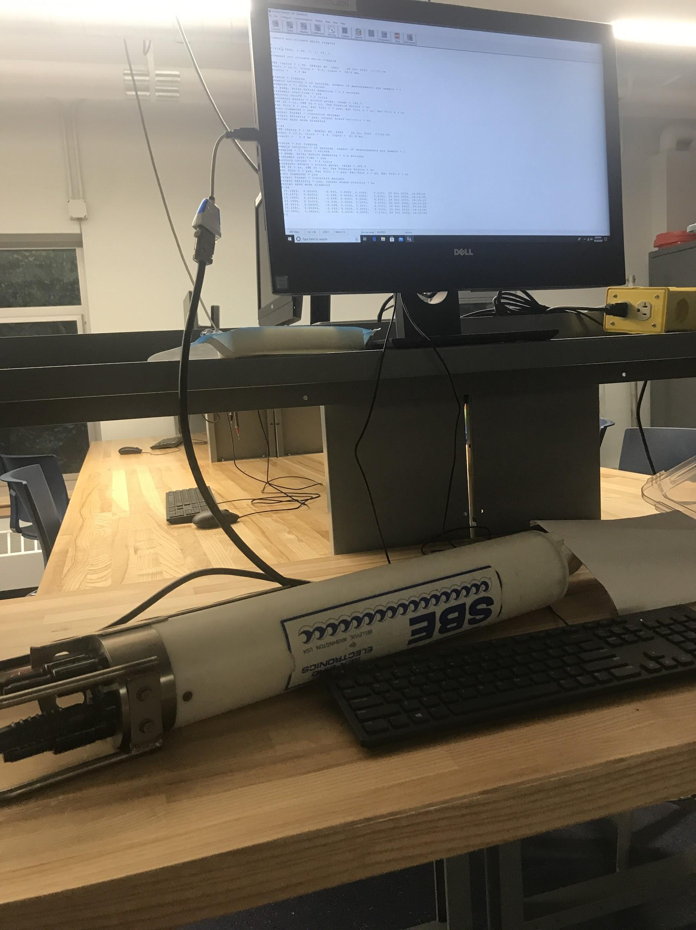
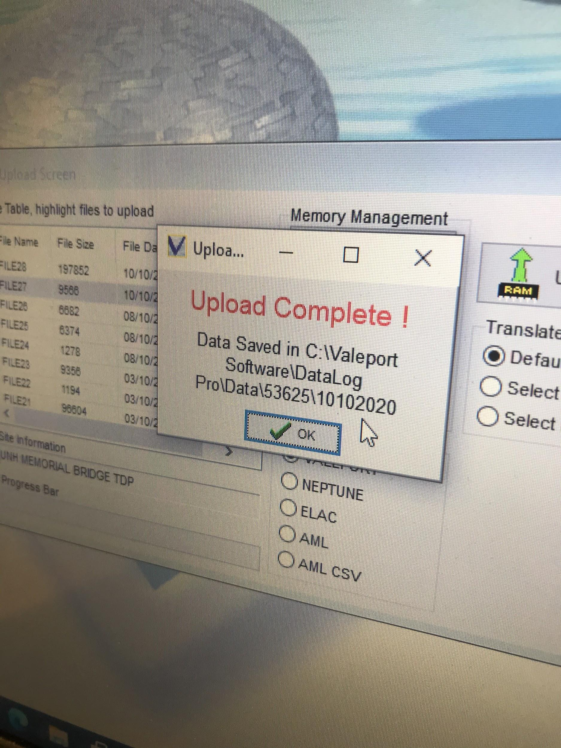
The 16 Plus Seabird seen above had returned from calibration October 2020

Slide 10
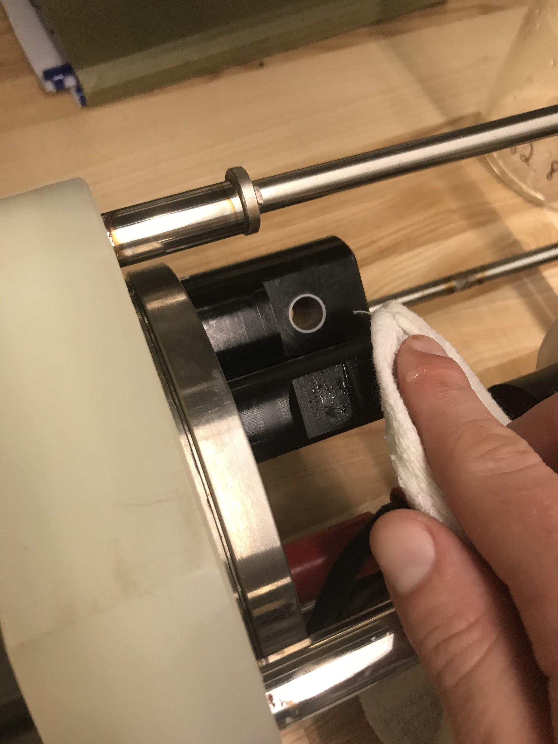
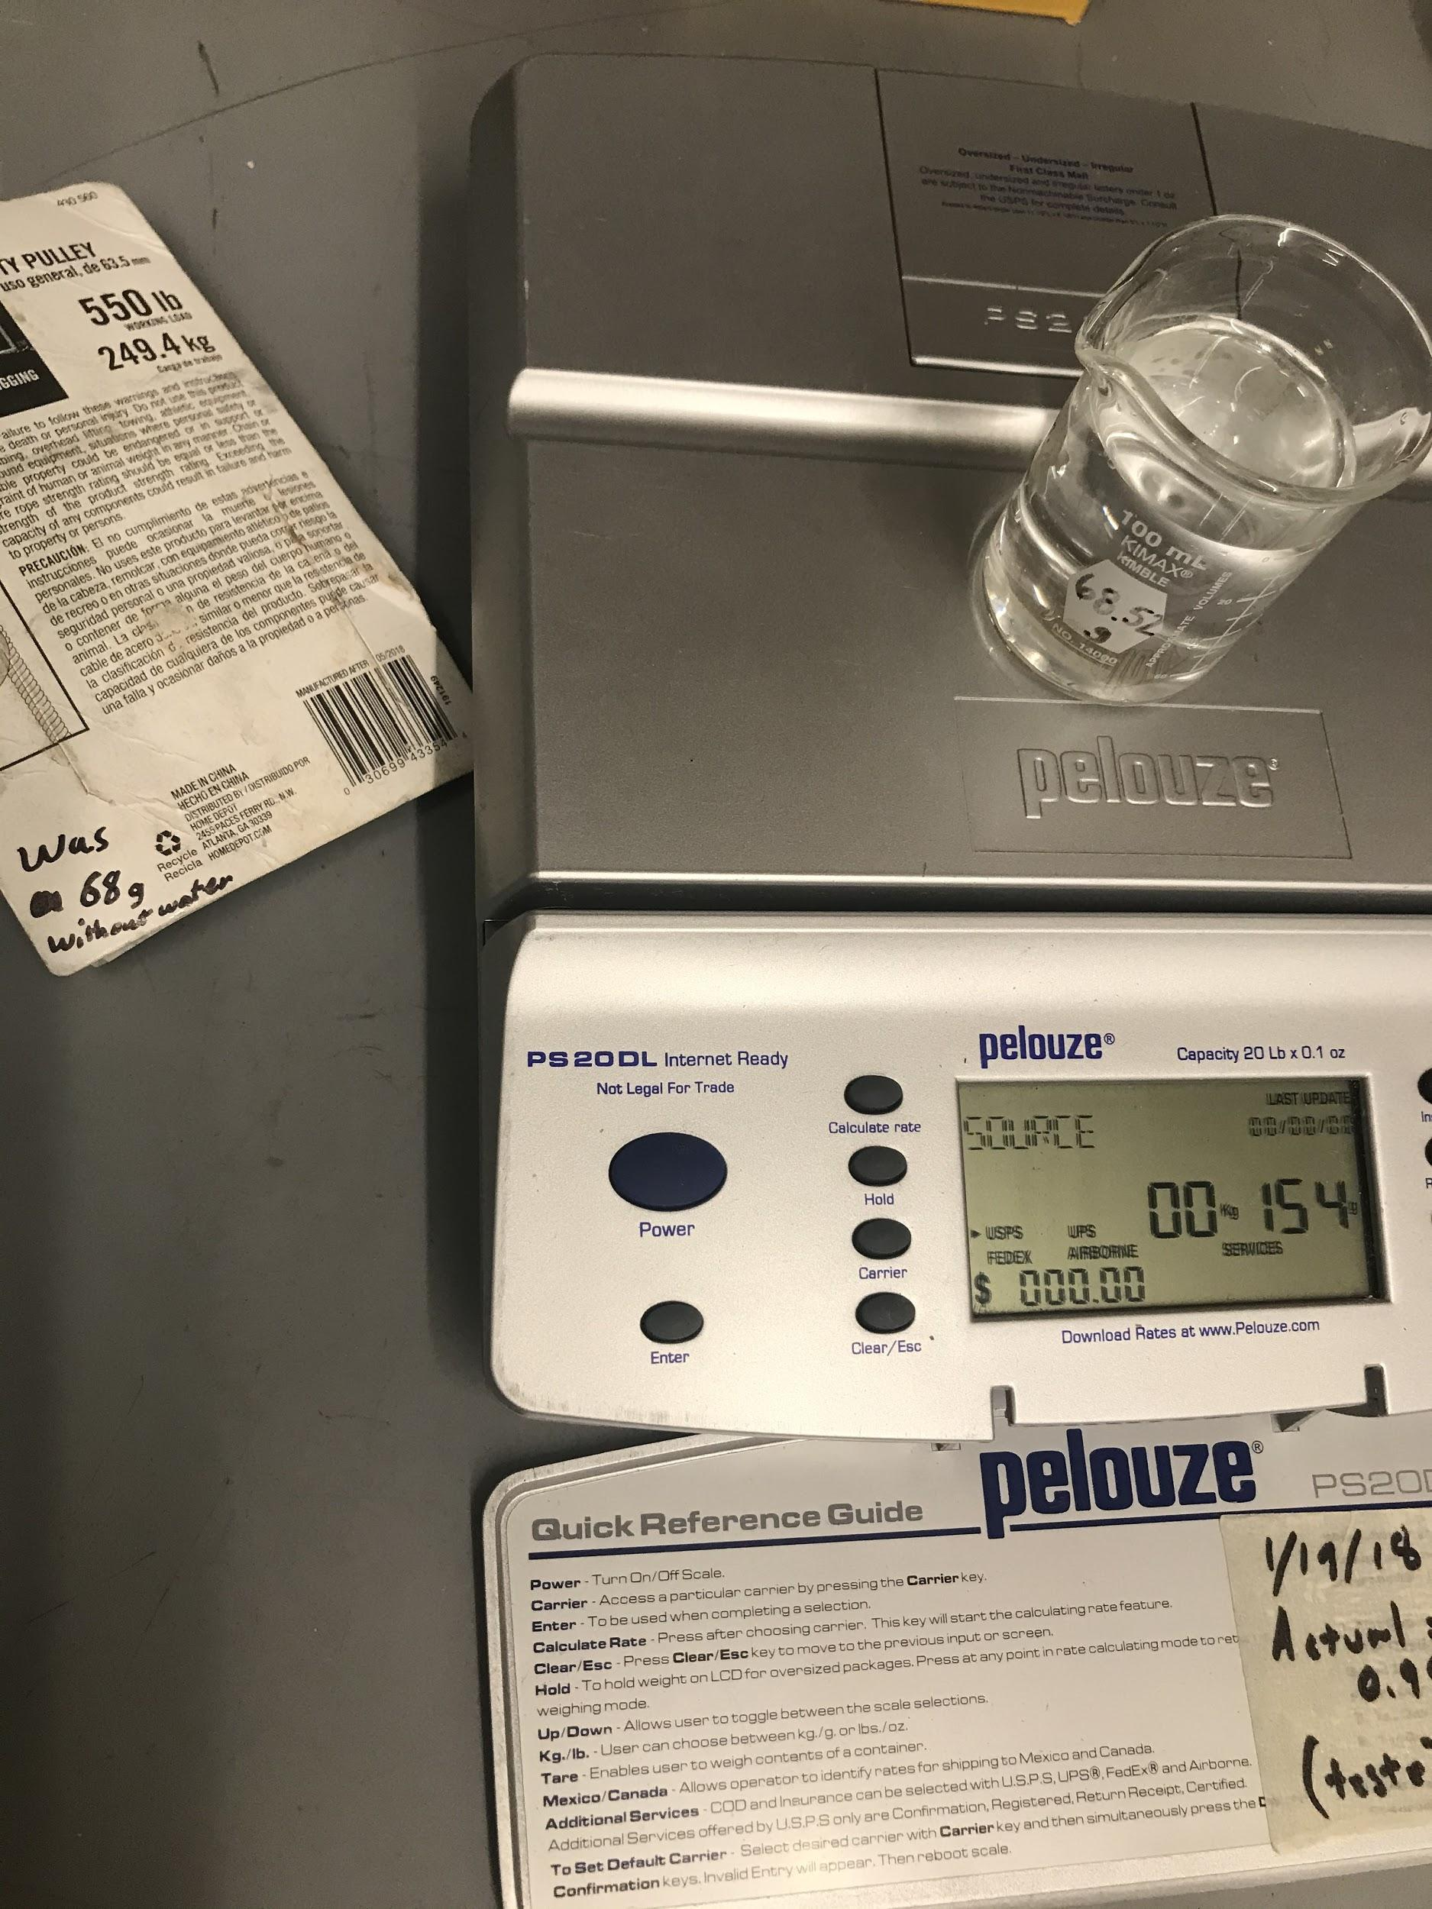
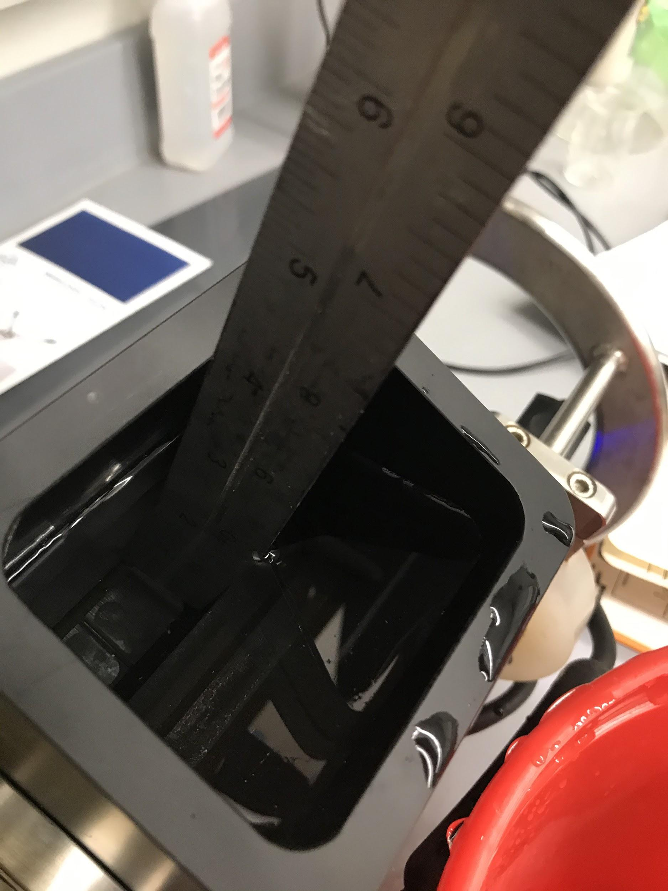
Turbidity Calibration
Turbidity, usually needing further definition, is the measurement of refracted light off suspended solids and sediment in the water
Water was sampled from the site of the tidal turbine and analyzed to determine proper gain of the sensor
The water samples were analyzed for sediment concentration

Slide 11
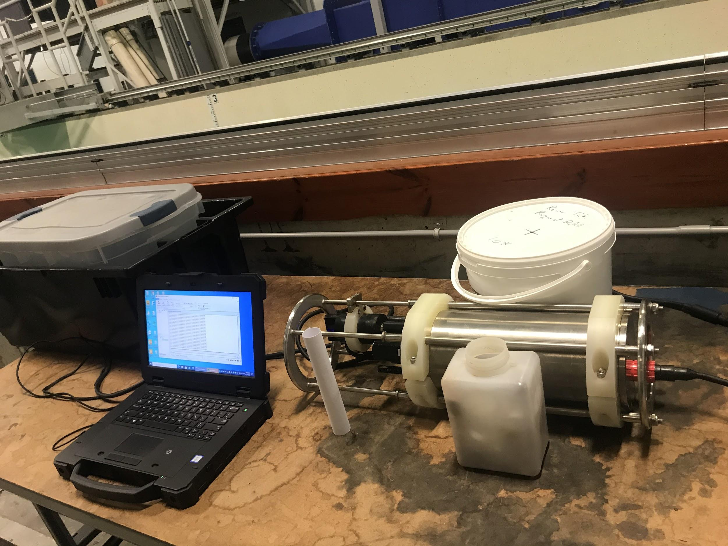
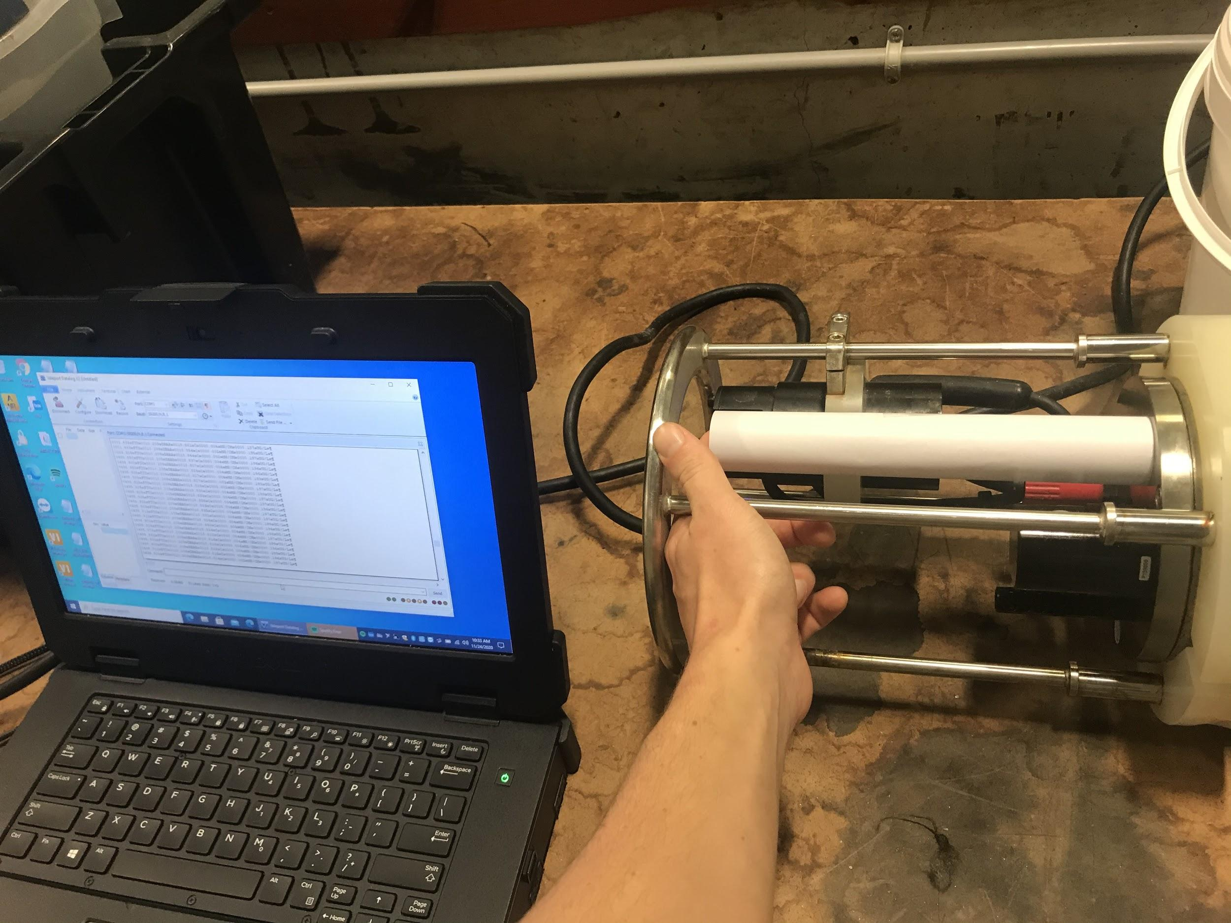
Turbidity Experiment
A sheet of white paper, with a diameter of approx. 30mm was rolled up around the optical sensor
The Midas CTD+ was configured to run continuously in Datalog Pro with turbidity gain set to 5
Use the Data Display in ‘Scroll’ to monitor the live output, displaying Formazin Turbidity Units (FTU)
A value around 495-500 FTU is expected
(Lighting of the procedure requires fluorescent or natural lighting!)

Slide 12
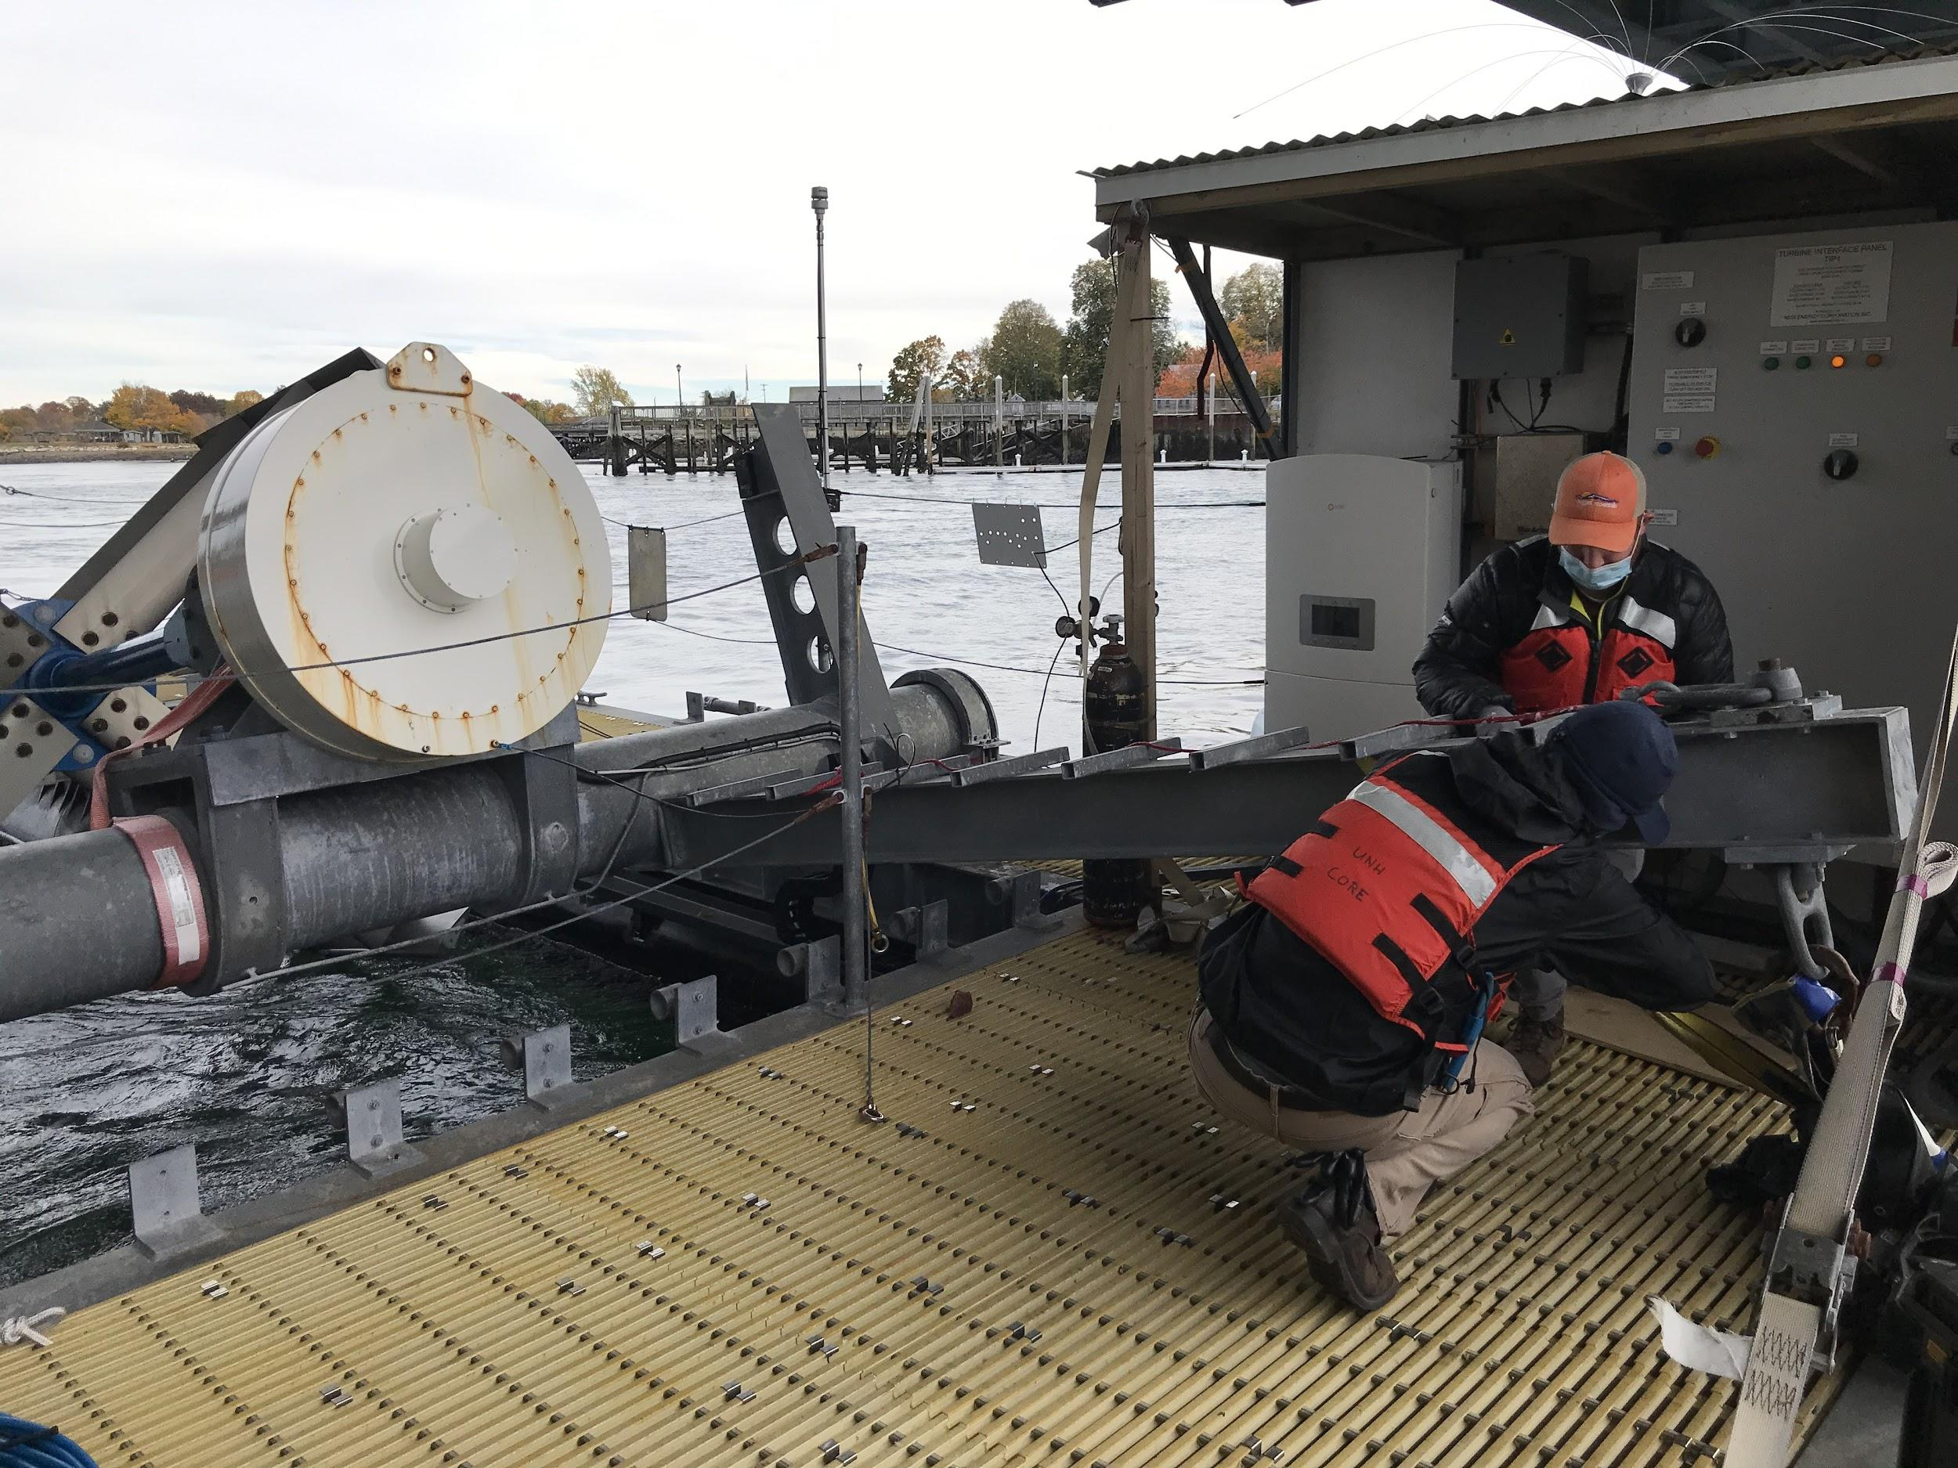
Trips to Platform
Multiple trips were taken via the Galen J from Judd Gregg Research Center to the tidal platform under the Memorial Bridge
Proper planning and care was taken into every trip
The Tidal Turbine was deployed multiple times throughout 2020-2021
Proper procedure of analyzing the platform, removing safety pins, safety straps, and careful winch operation was followed

Slide 13
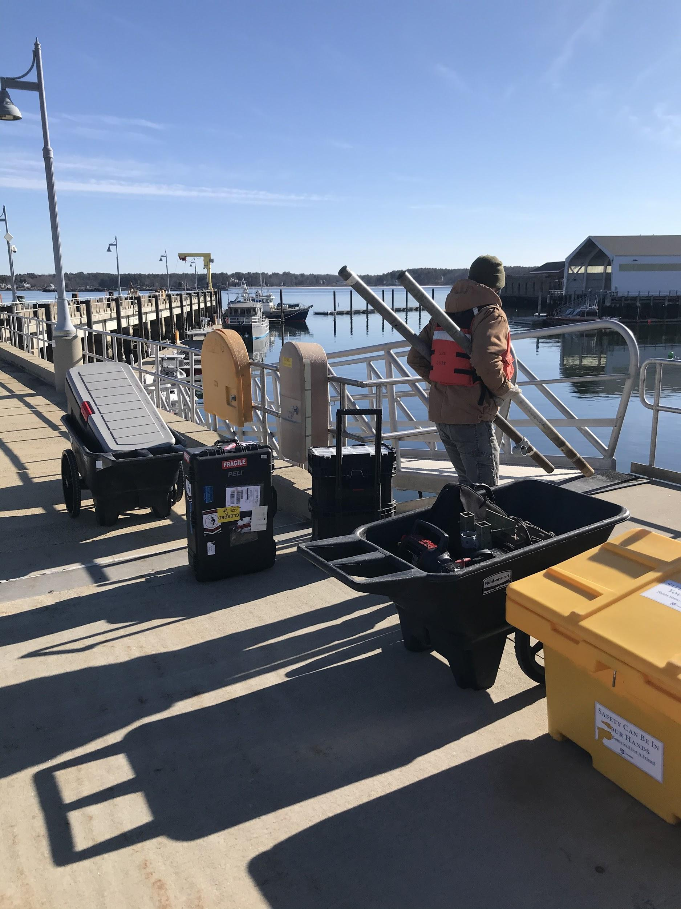
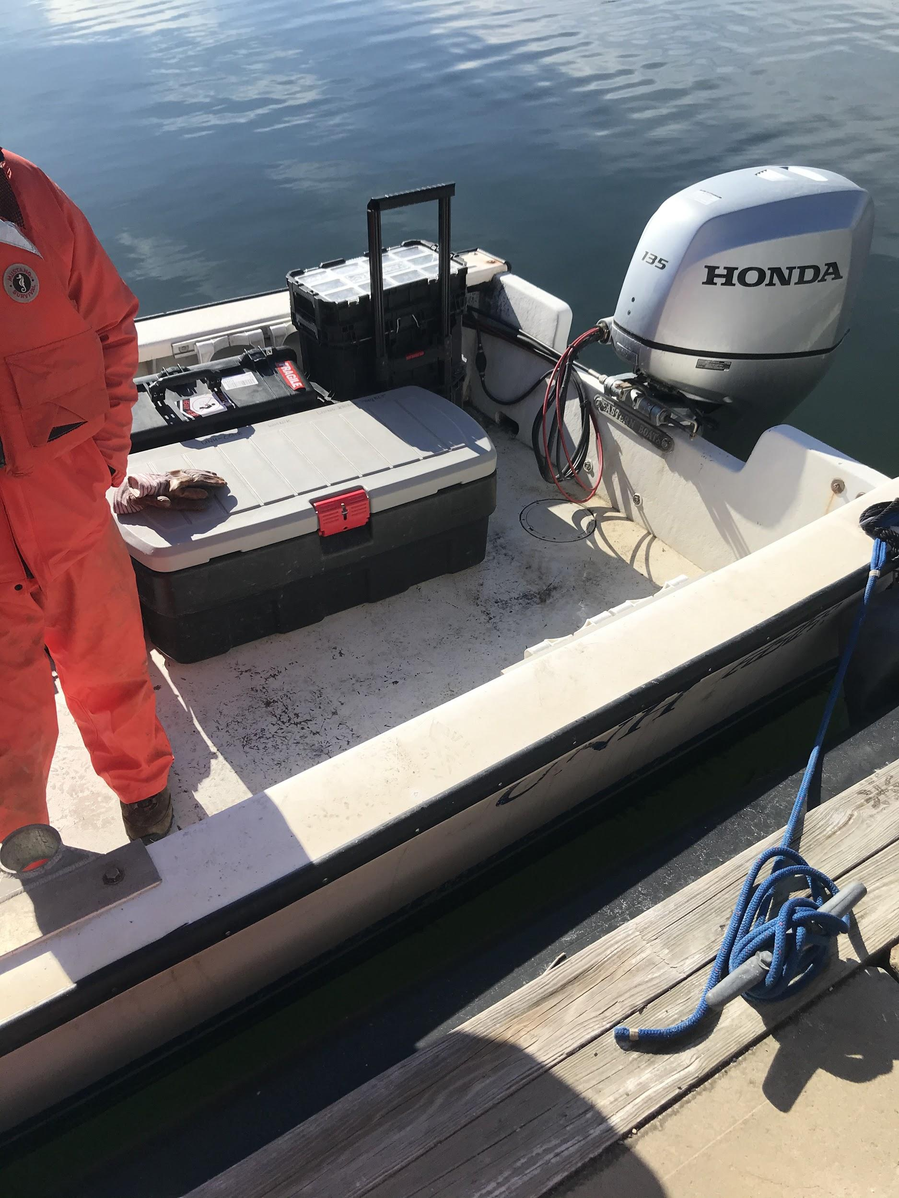
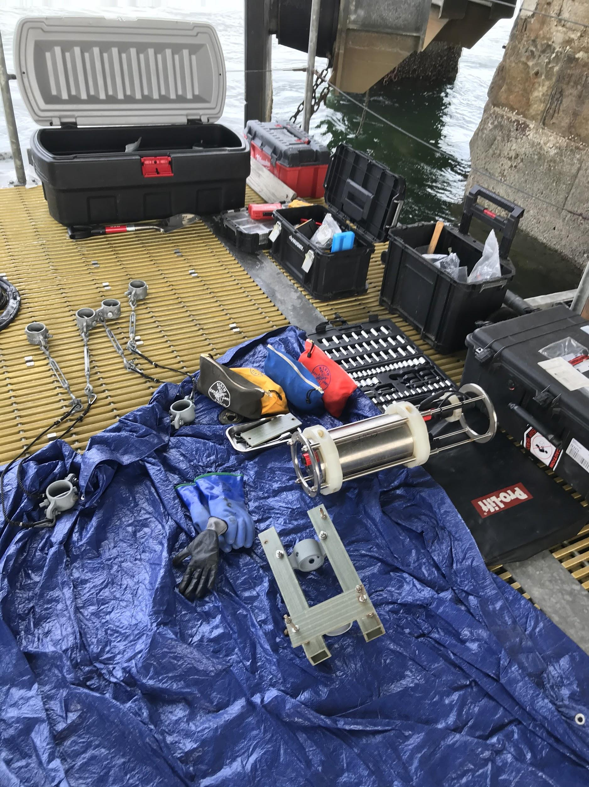
An example tool selection and supplies loadout that is taken to the tidal platform site

Slide 14
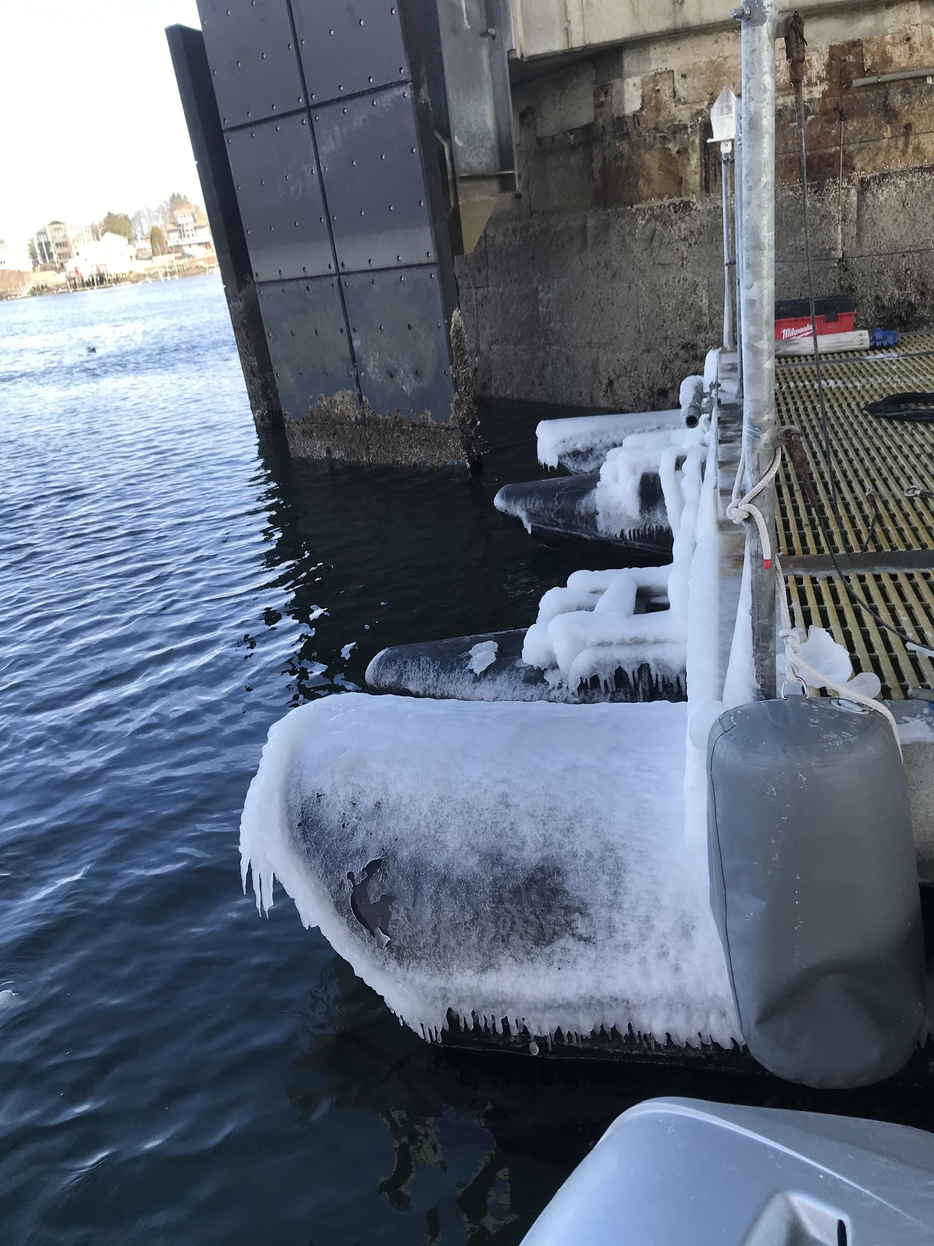
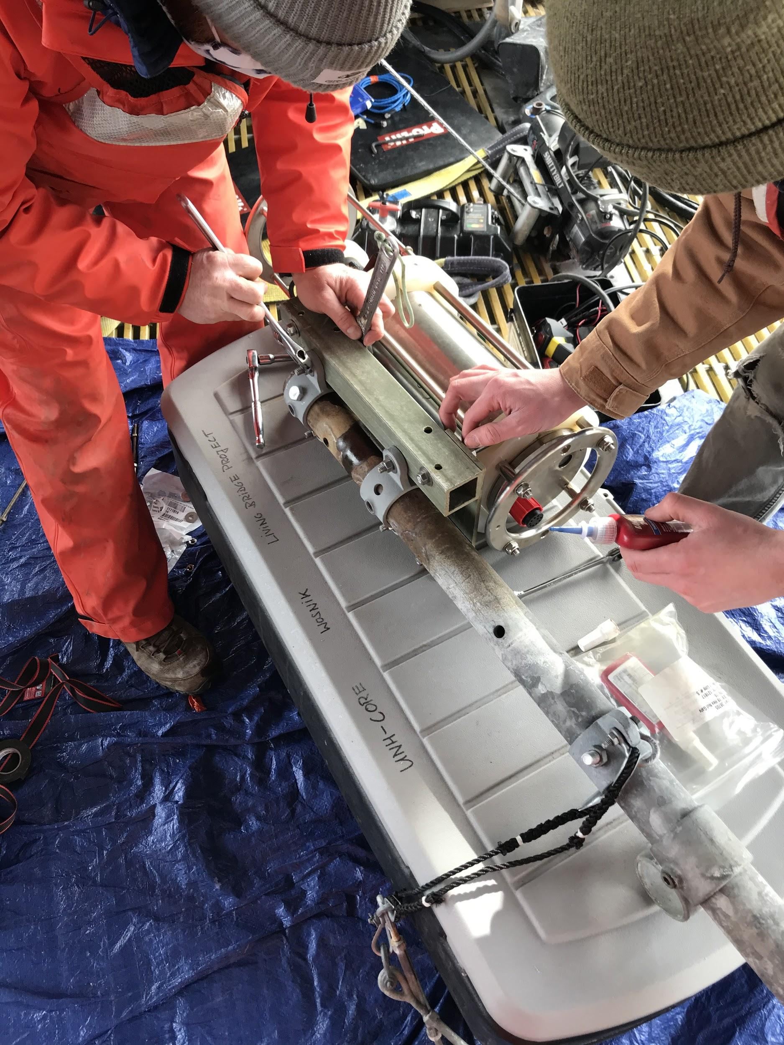
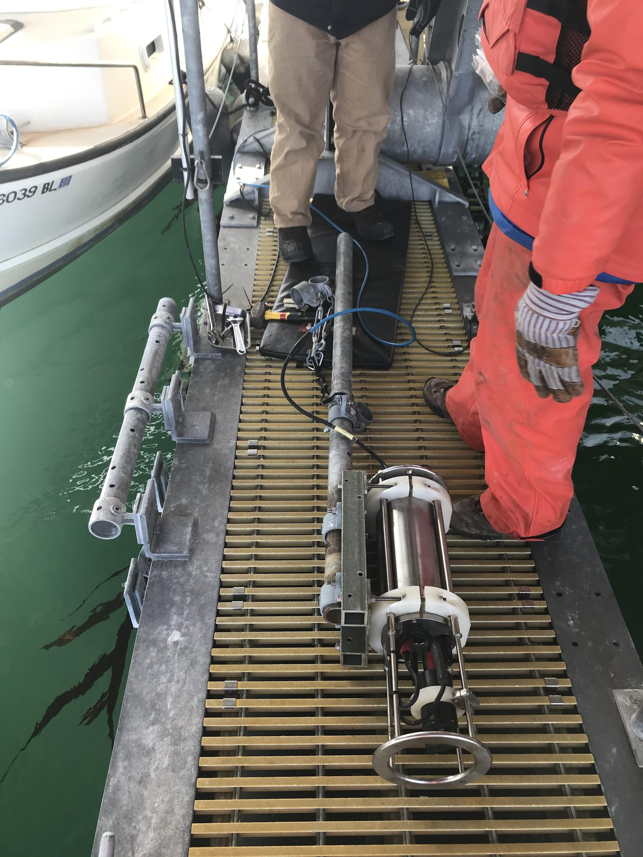
Operations on the Tidal Turbine include deploying the Turbine, cleaning the platform, water sampling, scrubbing off marine life and ice off the pontoons, and working on instruments

Slide 15
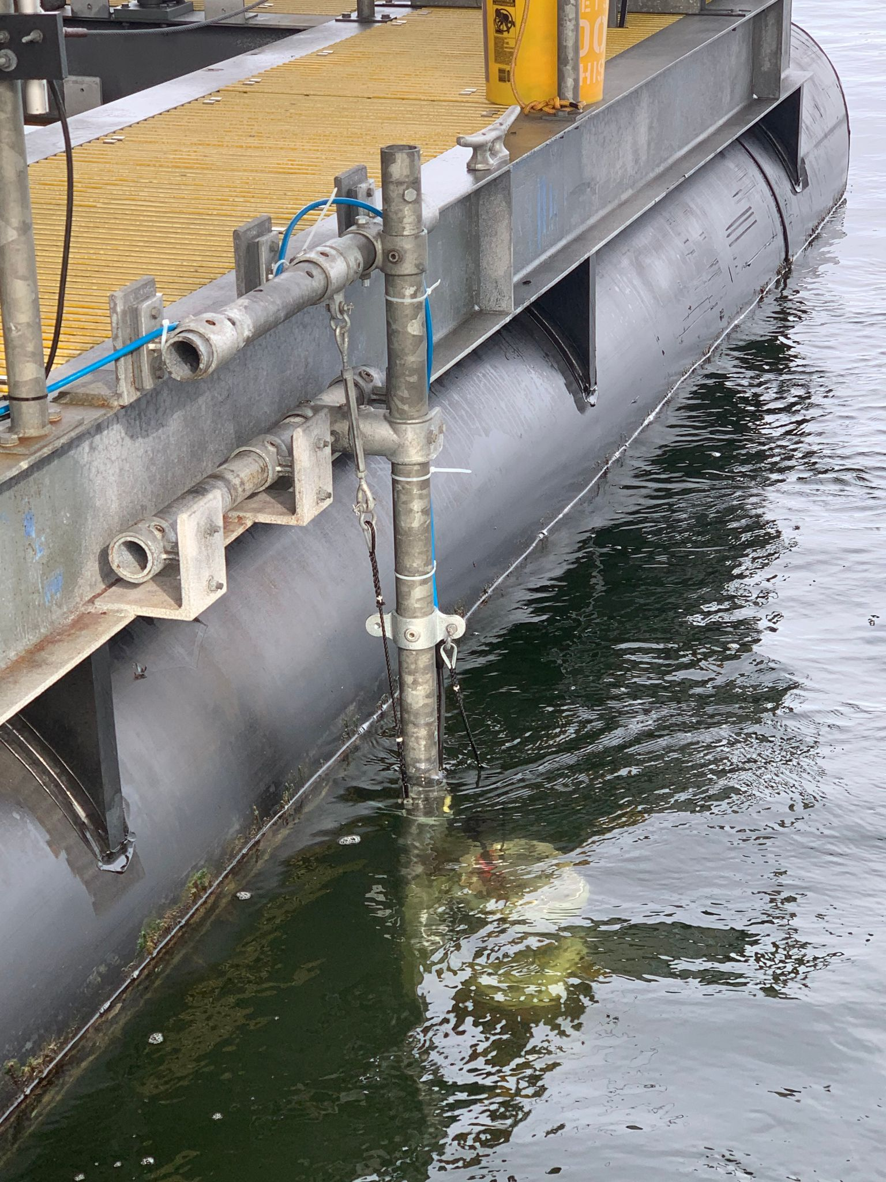
Midas CTD+ Deployed
The Midas was deployed at the Tidal Turbine Platform 3/16/2021 and is connected to the SCADA Data System. Measurements from 3/19/2021 have been recorded on the data system. The data system saves measurement values every 5 mins even though the MIDAS has a set sampling rate of 1 Hz (with capability of measuring at 8 Hz). The 1 Hz data is recorded on the internal flash memory (16 Megabytes).
The Midas CTD + rest about 1 meter deep in water on the mount designed by the 2016 Tech 797 crew.

Slide 16
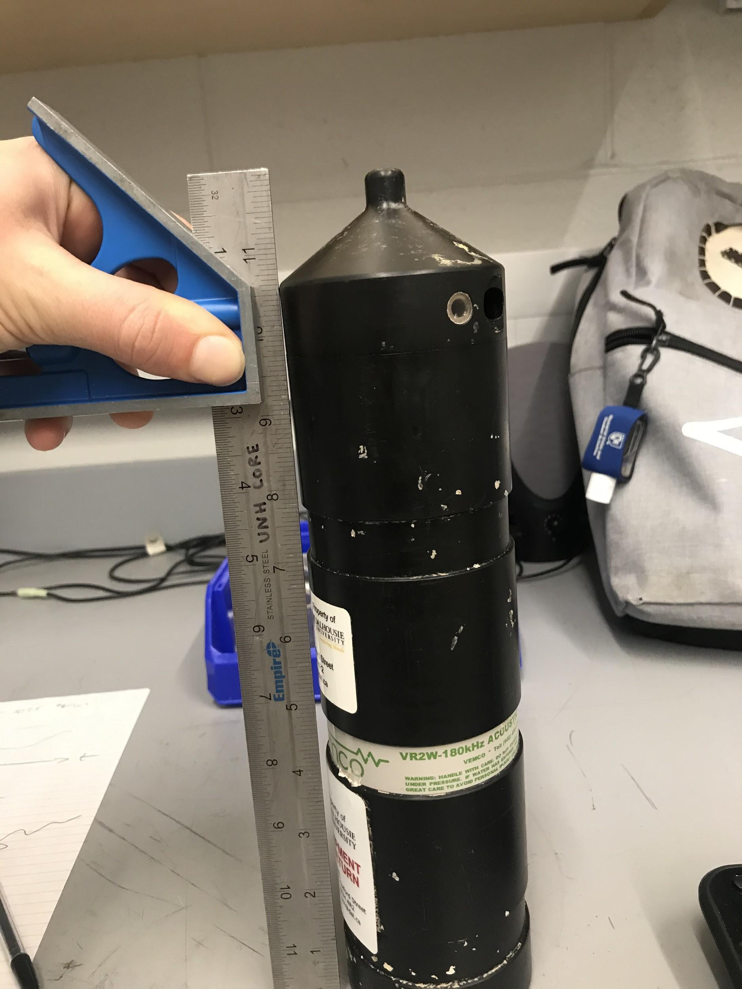
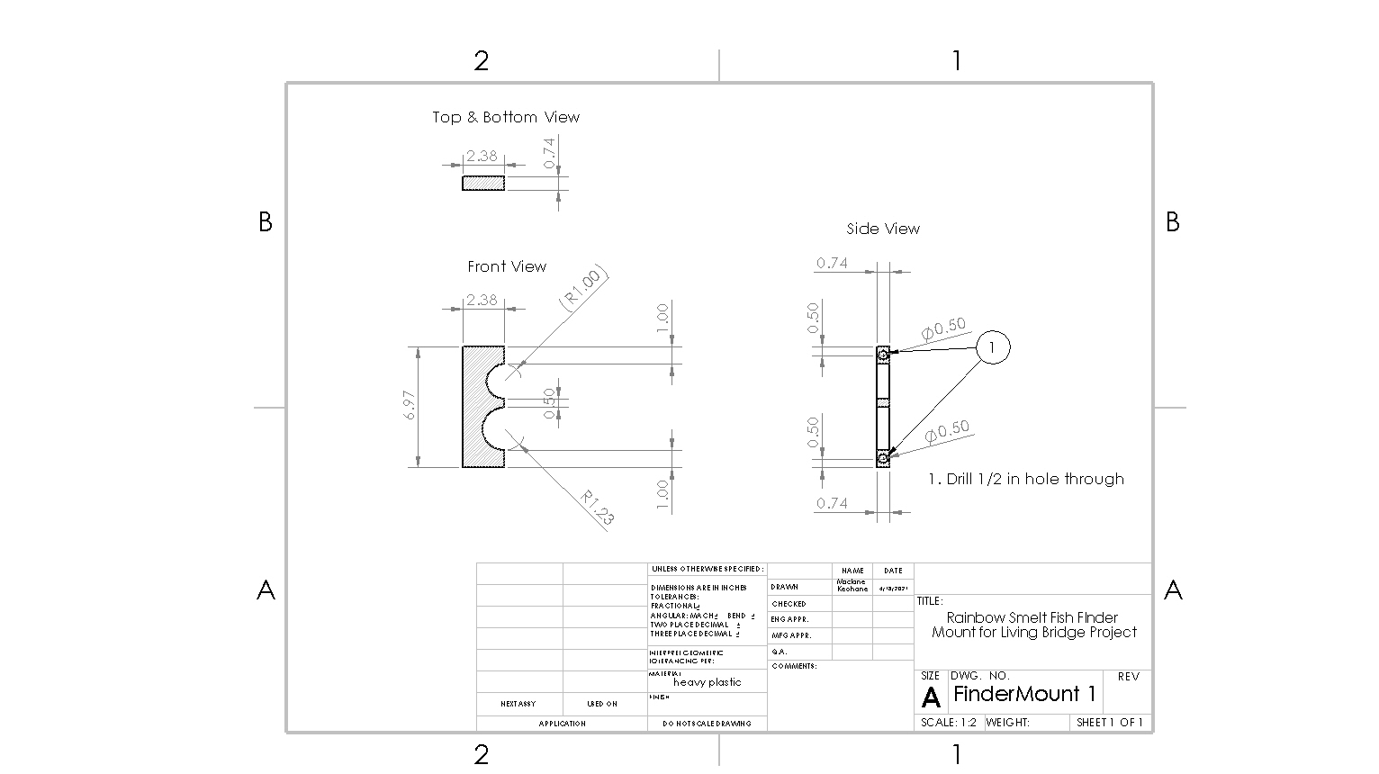
Extra Instrumentation: Rainbow Smelt Fish Finder
In cooperation with Professor Nathan Furey in the Department of Biological Sciences, the Living Bridge undergraduates designed a mount for an acoustic fish finder. This fish finder is used to identify tagged Rainbow Smelt, a declining fish species in NH. The fish finder will help provide info to understand Smelt migration of estuaries.

Slide 17
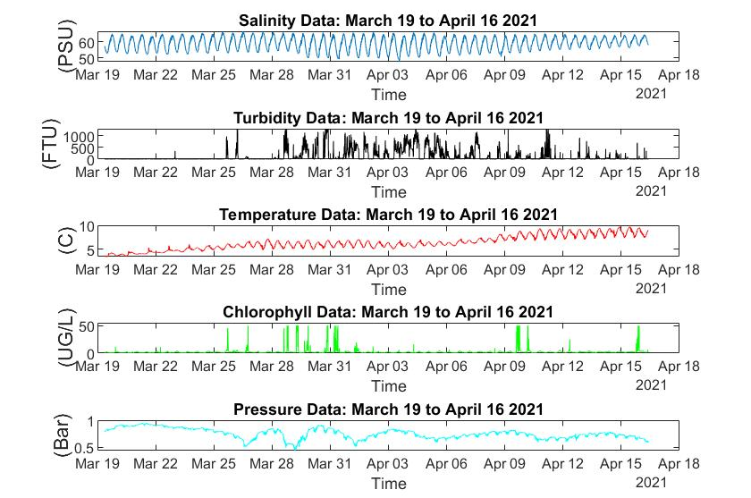
Post Processing of the CTD data is still ongoing and will continue as long as it is connected to the SCADA data system. This figure is an example of a data set of the CTD from 3/19 to 4/16 in a Matlab Figure Plot.

Slide 18
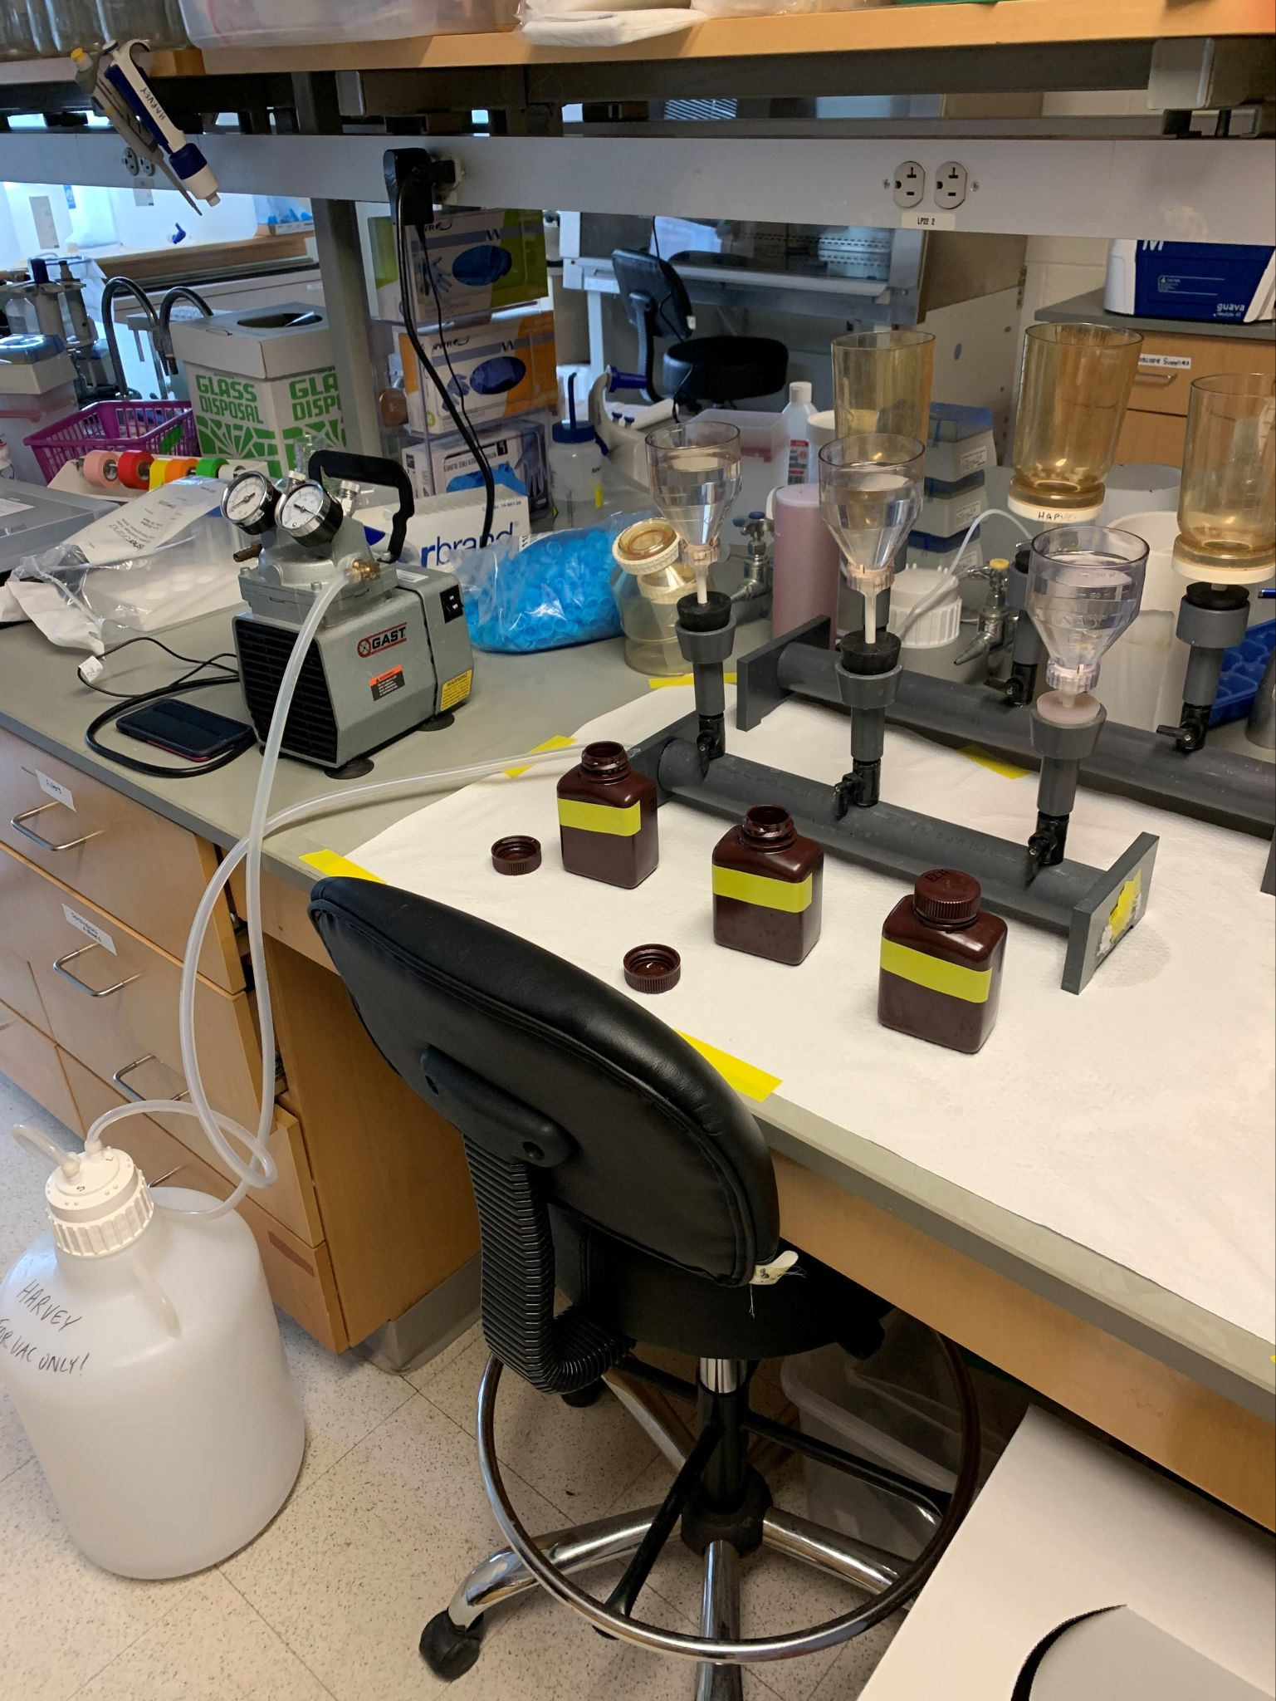
Harvey Lab Cooperation
Teamed up with Dr. Elizabeth Harvey to help calibrate our Seapoint Fluorometer
3 water samples from the platform site at the Memorial Bridge in Portsmouth, NH were collected and brought back to the Harvey Laboratory to be accurately processed for Chlorophyll a levels

Slide 19
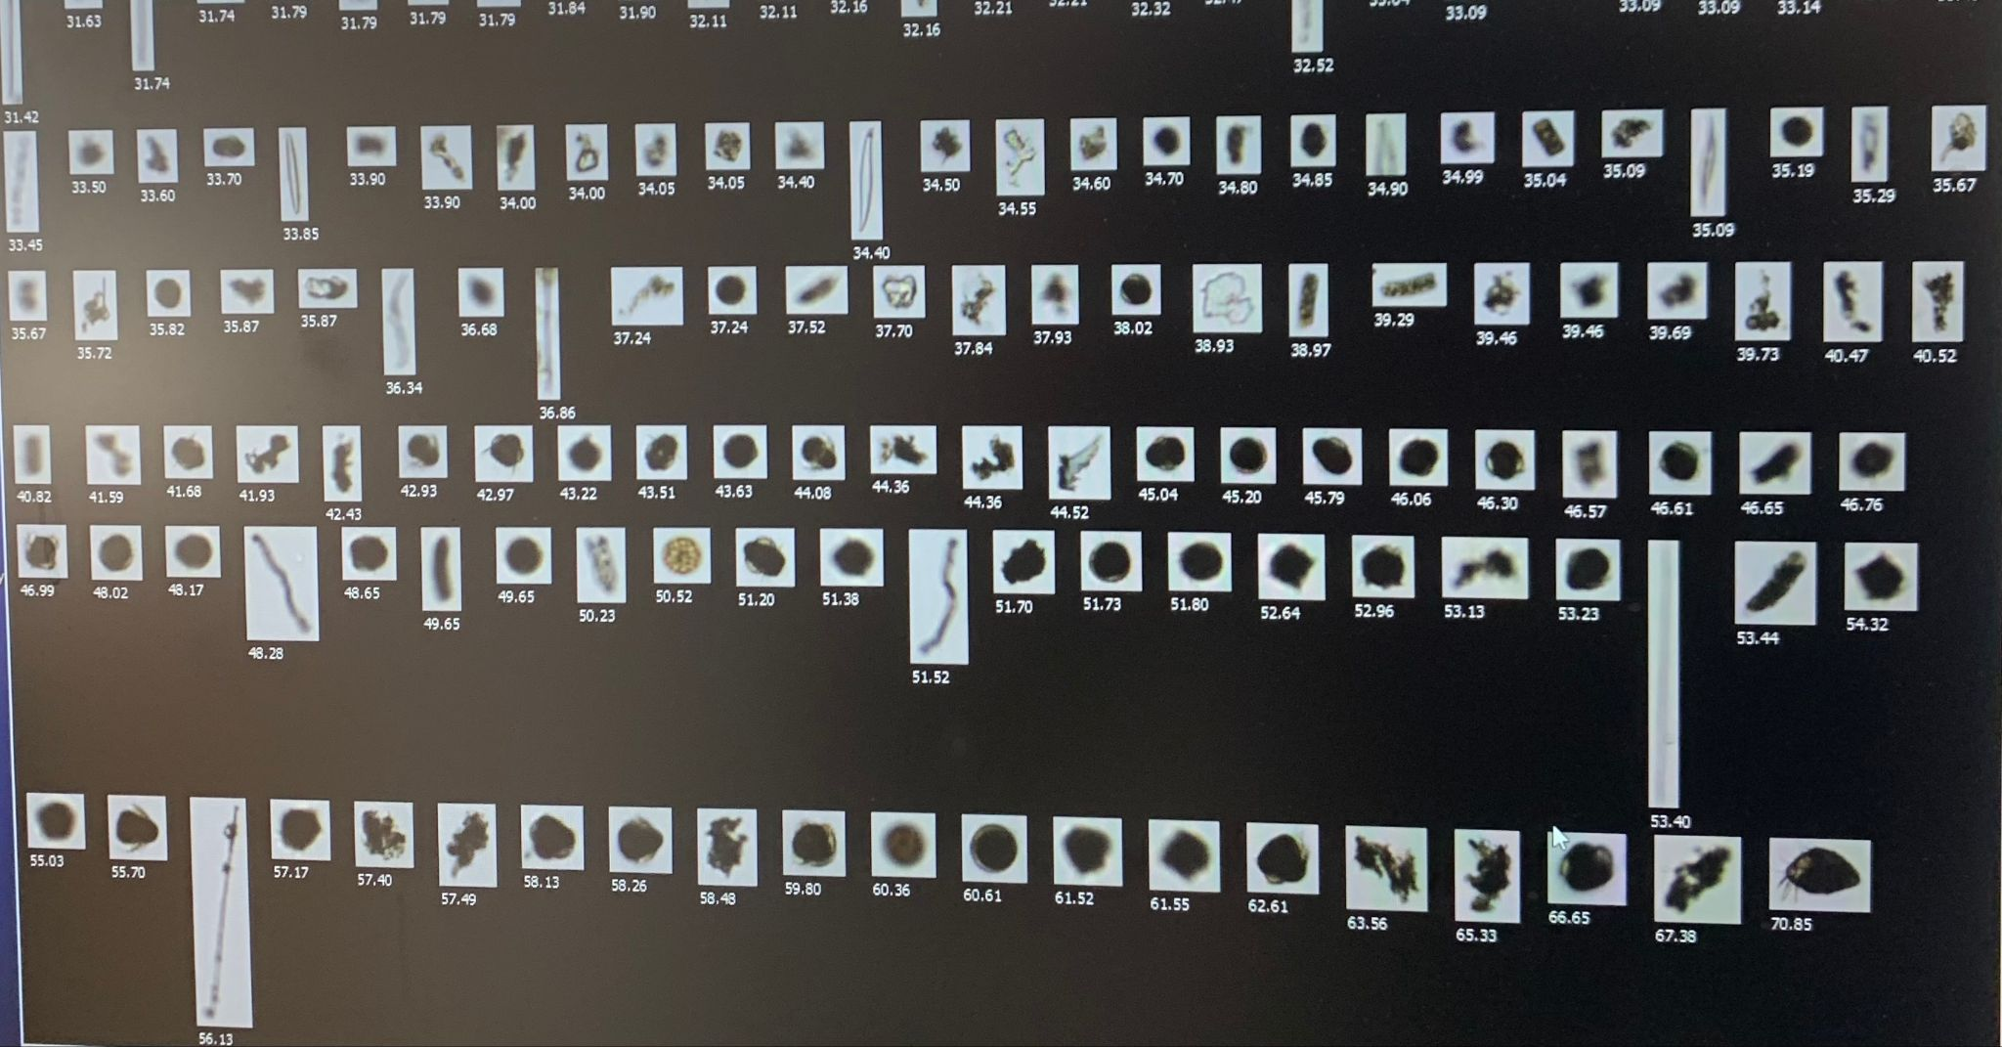

Slide 20
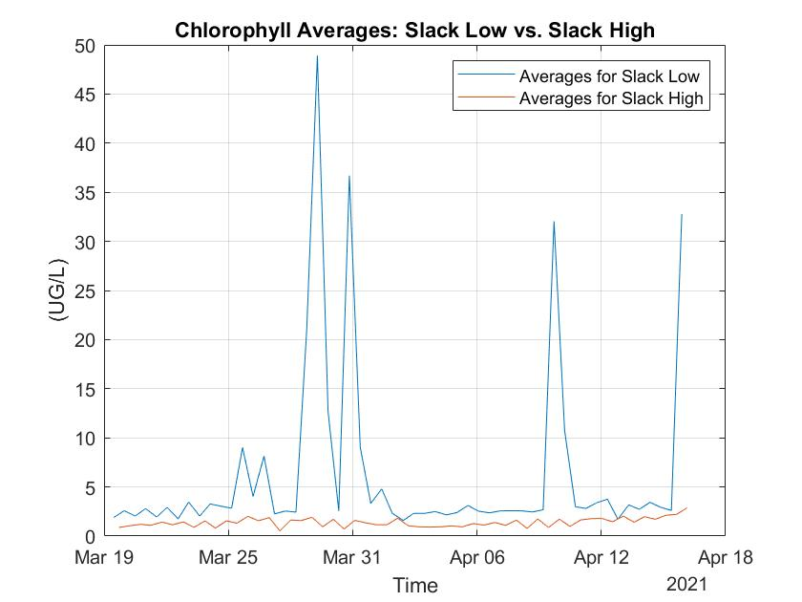
Hypothesis of Data Analysis
Of all our measurements, chlorophyll is of most interest to the scientific community. Great Bay experiences less harmful algae blooms than that of the Atlantic; However, this does not mean there are not high amounts of algae in Great Bay.
A hypothesis was generated that non harmful algae blooms occur in Great Bay. The figure of Chlorophyll Averages at slack tides illustrates that phytoplankton exit Great Bay via Ebb tide in larger numbers compared to phytoplankton entering the Great Bay.

Slide 21
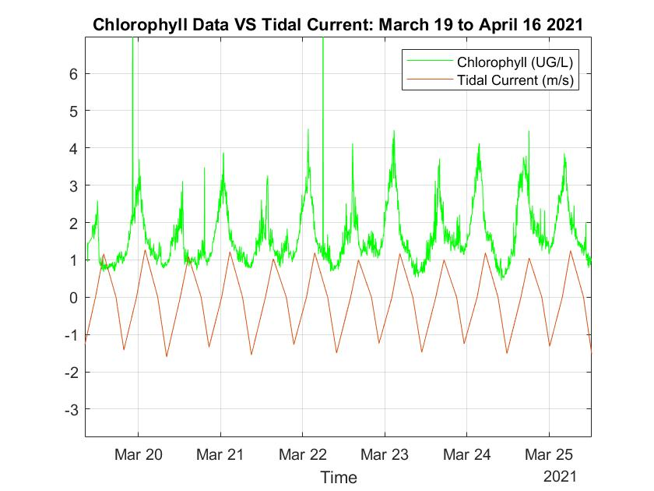
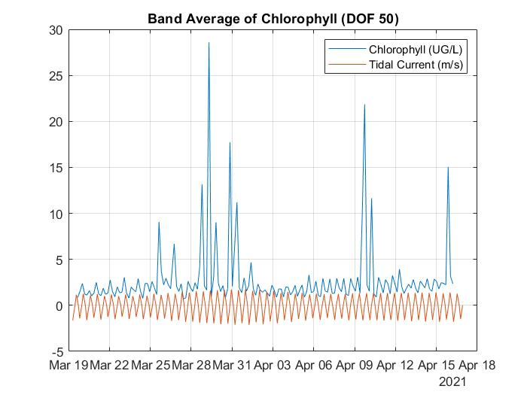
Data Analysis Results
The negative slope below zero in tidal current data represents outgoing ebb tide while the positive slope above zero represents incoming flood tide
Data from the chlorophyll sensor in the Midas along with concurrent tidal data provided by NOAA, show that there is patterns in the high spikes of chlorophyll occurring when low slack tide takes place

Slide 22
Interpreting Data Results
Comparing data provided from Dr. Elizabeth Harvey collected at the Jackson Estuarine Laboratory from the Midas CTD+ we can draw conclusions on our hypothesis. These comparative findings reiterate the fact our hypothesis about Chlorophyll concentrations being higher in the more stagnant Great Bay than that of the highly circulated Piscataqua River System seems likely.
Data source | Midas CTD+ | Dr. Harvey
Location | Memorial Bridge Portsmouth, NH | Jackson Estuarine Laboratory
Average Chlorophyll-a level (ug/L) | 2.748 | 21.11

Slide 23
Theories
Phytoplankton are autotrophic plants or bacteria that utilize nutrients such a phosphorous, nitrogen, and sulfur. It is commonly known that blooms can occur due to high levels of these nutrients in the water. Therefore, measurements of chlorophyll at the Memorial Bridge in Portsmouth, New Hampshire might indicate correlation between nutrient pollution in the Great Bay and Upper Piscataqua.

Slide 24
Environmental Monitoring of the Piscataqua River
Environmental monitoring of water ways like the Piscataqua river have a grave importance to the local ecosystem and society. Parameters being monitored like Turbidity and Chlorophyll-A can provide significant knowledge to the health of the local estuaries that flow into the main waterways. In our case the Great Bay Estuary is a very influential source to the the Piscataqua river and plays a large role in how its environmental parameters change.
Acknowledgements
•Dr. Elizabeth Harvey and the Harvey Laboratory
•Professor Thomas Lippmann
•Professor Martin Wosnik
•Graduate Student Patrick O’Byrne

Slide 25
References
Valeport, Ed., Midas CTD Profiler Hardware Manual. Valeport Limited, St. Peters Quay, UK, 2006.
NOAA, “Tide Predictions - NOAA Tides & Currents,” Tides & Currents. [Online]. Available: https://tidesandcurrents.noaa.gov/noaatidepredictions.html?id=8419870.

