Slide 1
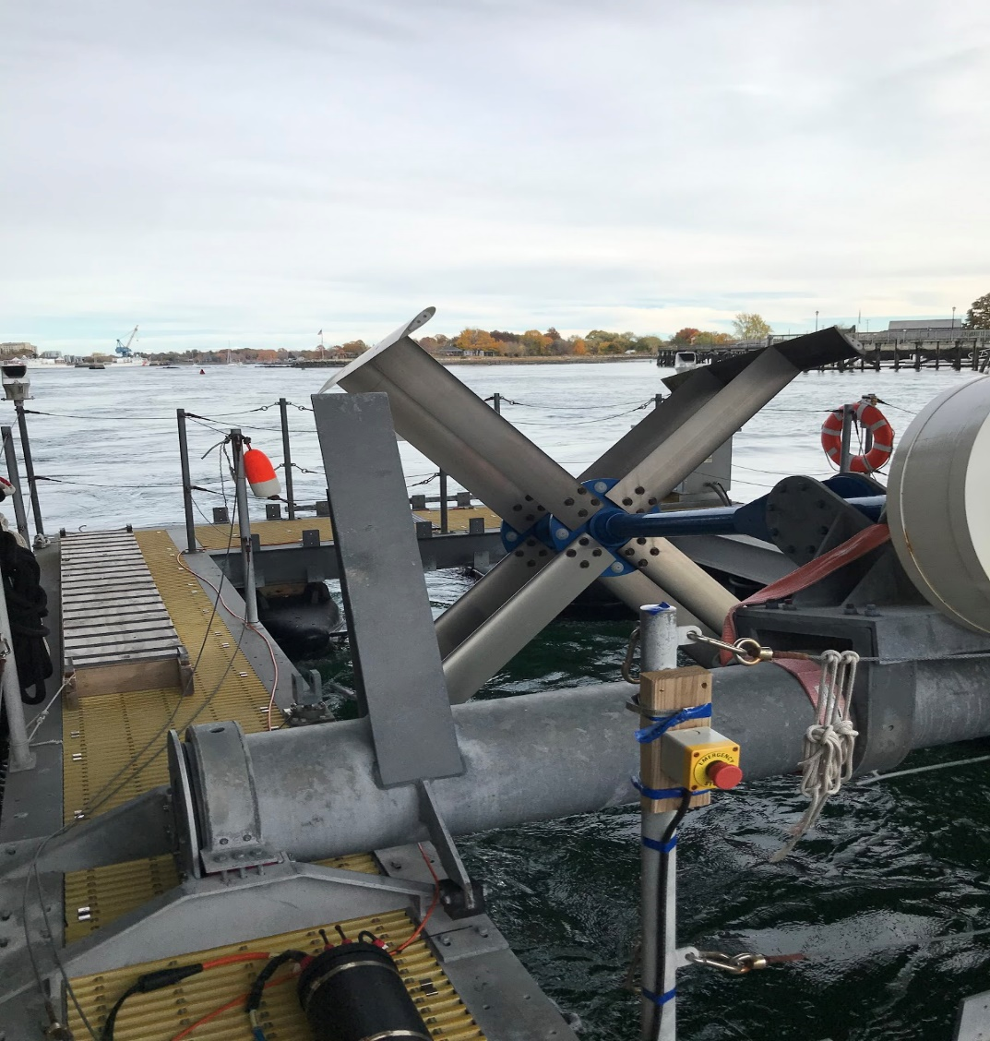
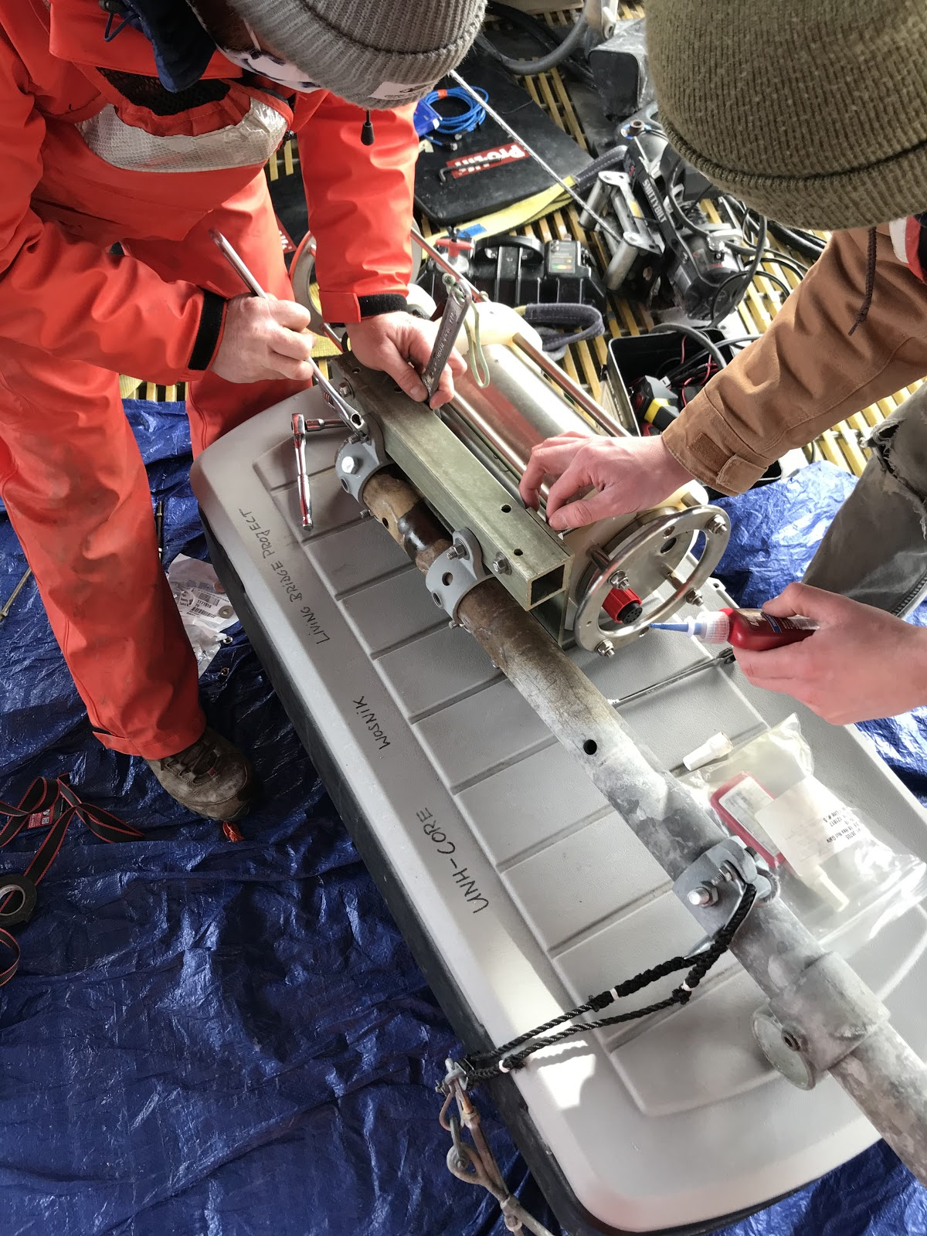
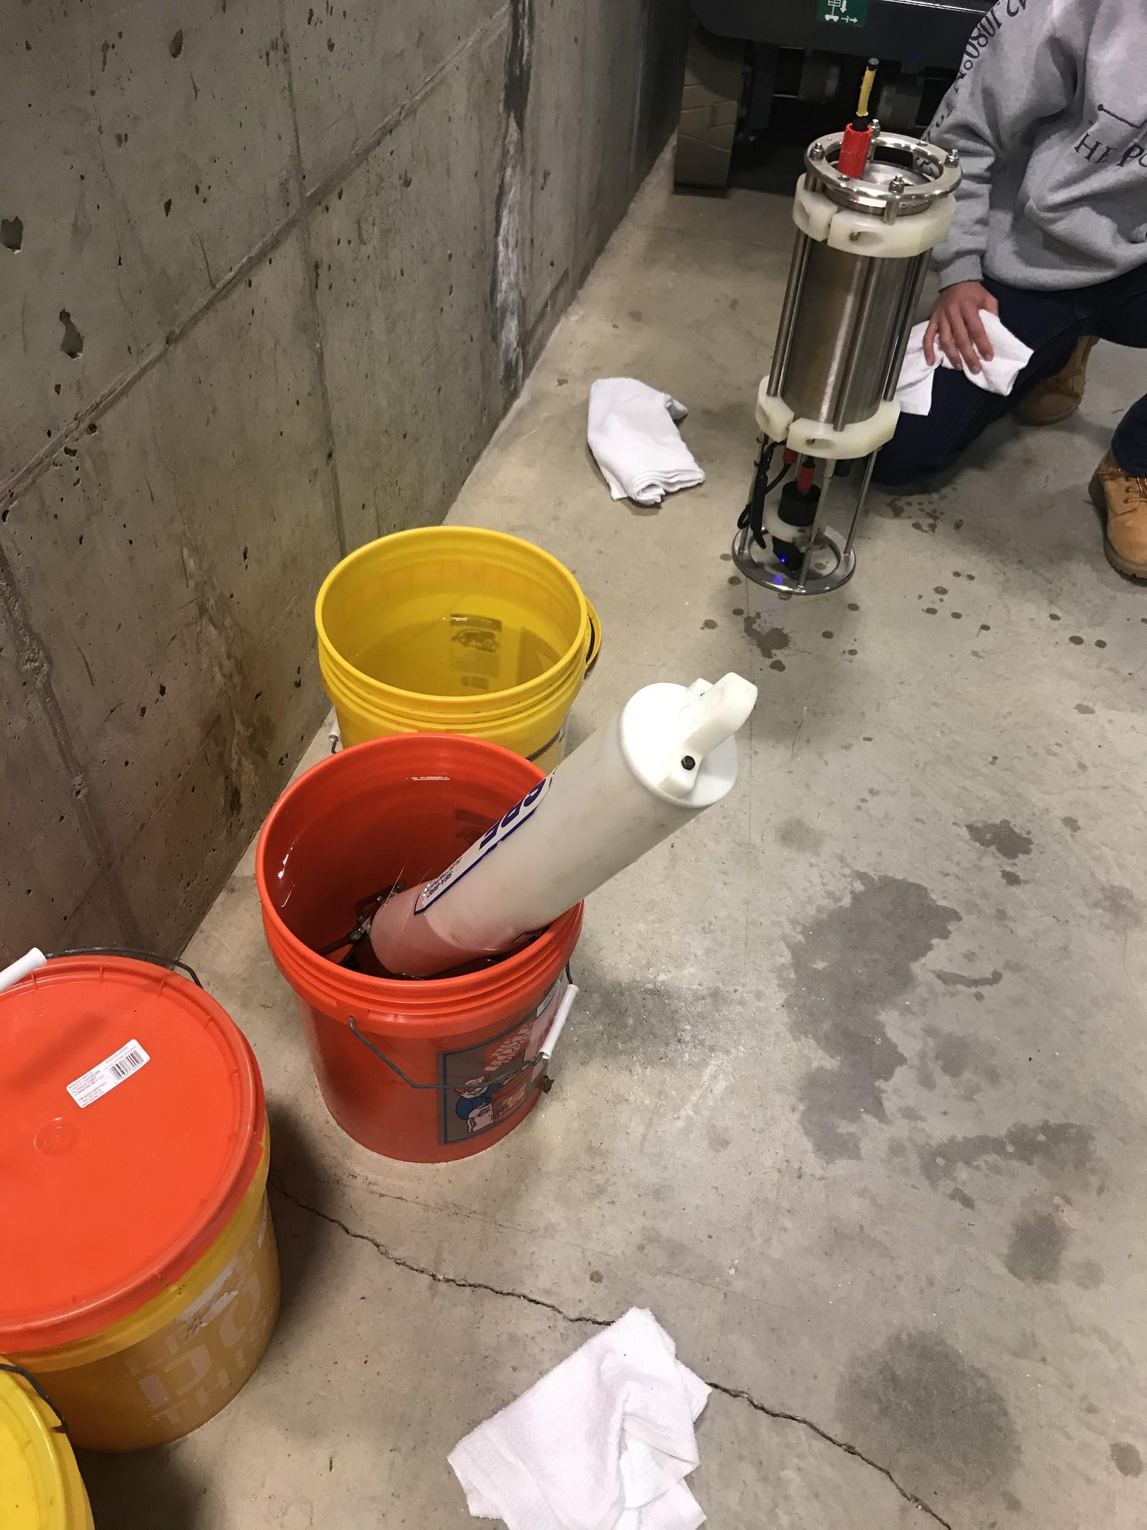
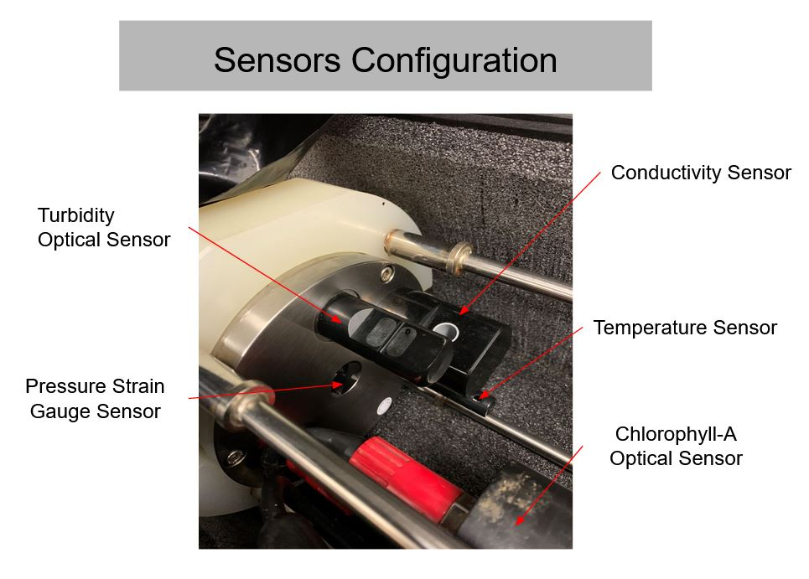
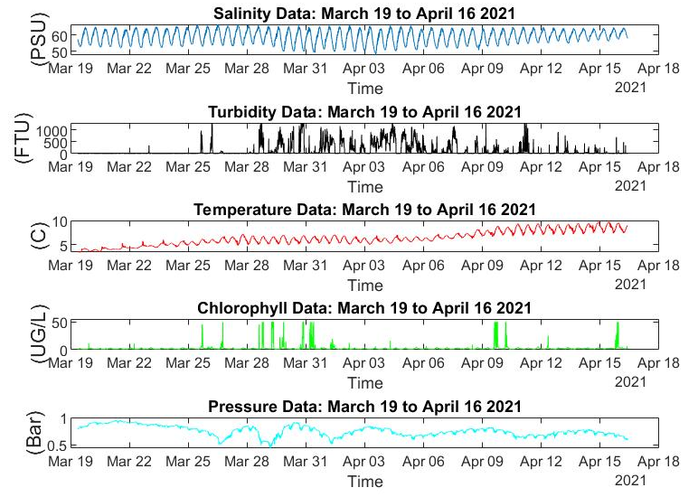
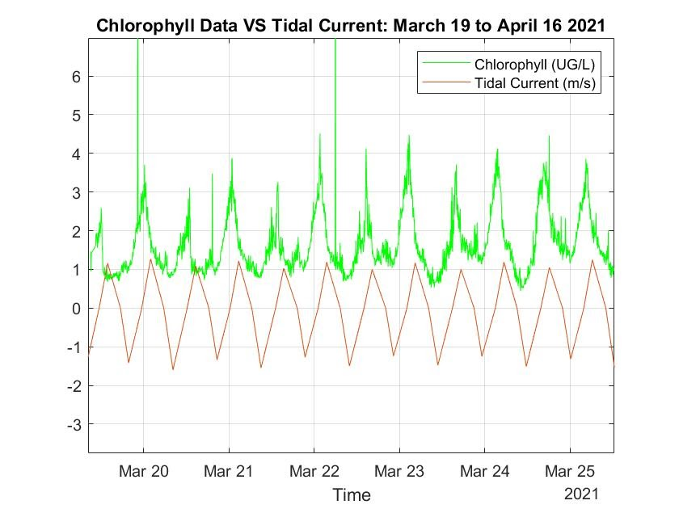
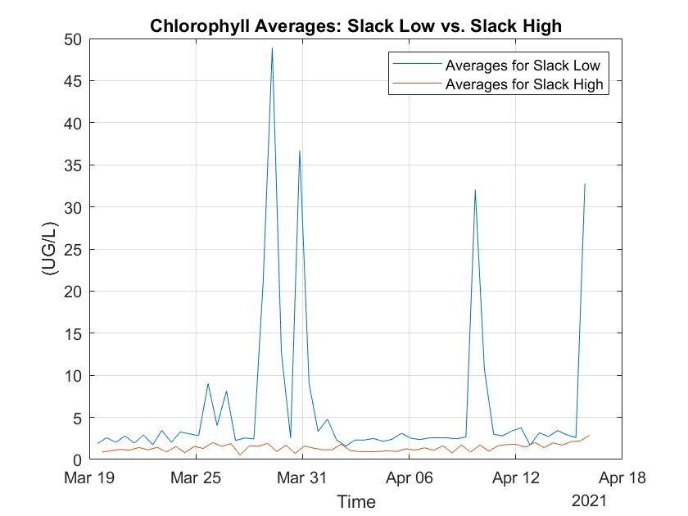
Living Bridge Project 2020-2021 Tom Spiro, MacLane Keohane Ocean Engineering, University of New Hampshire, Durham, NH 03824 Advisors: Martin Wosnik, Patrick O’Byrne
Introduction
Tidal Turbine Platform Memorial Bridge Portsmouth, NH
Results
The living bridge Team obtained long term environmental data set measured by a Midas CTD+ at the Memorial Bridge Tidal Turbine platform in Portsmouth, NH. Recorded data is now accessible from the mobile Scada Data system from the deployed Midas CTD+, and environmental parameters like Turbidity, Chlorophyll, Temperature, Salinity, and Pressure can help monitor the local waterways condition.
We now have a successful livestream of data in 5-minute intervals that allow for interpretation of the constant changing environmental parameters in the Piscataqua River.
It is clear the tidal current oscillation is relevant in the data trends of Salinity, Temperature, and Chlorophyll
Methodology
Calibration, Configuration of Midas CTD+
Conclusions
Create deployment and measurement plan of CTD+ instrument
Calibrate sensors, including optical sensors
Prepare mounts and replace parts as needed
Prepare all instrumentation for long term deployment
Perform long term environmental measurements
Analyze continuous data flow from SCADA data system
Comparing data provided from Dr. Elizabeth Harvey collected at the Jackson Estuarine Laboratory from the Midas CTD+ we can draw conclusions on our hypothesis. These comparative findings reiterate the fact our hypothesis about Chlorophyll concentrations being higher in the more stagnant Great Bay than that of the highly circulated Piscataqua River System seems likely.
Data
Graphs
Data source | Midas CTD+ | Dr. Harvey
Location | Memorial Bridge Portsmouth, NH | Jackson Estuarine Laboratory
Average Chlorophyll-a level (ug/L) | 2.748 | 21.11
Acknowledgements
Dr. Elizabeth Harvey and the Harvey Laboratory
Professor Thomas Lippmann
Professor Martin Wosnik
Graduate Student Patrick O’Byrne
Funding Provided by NH Sea Grant

