Slide 1
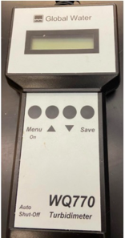
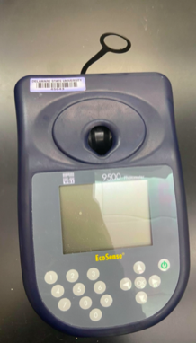
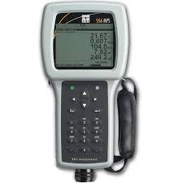
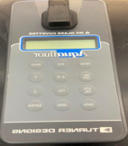
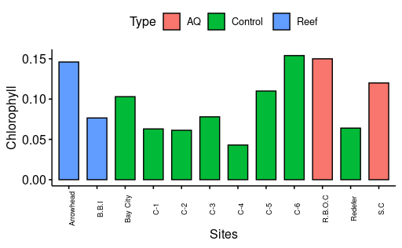
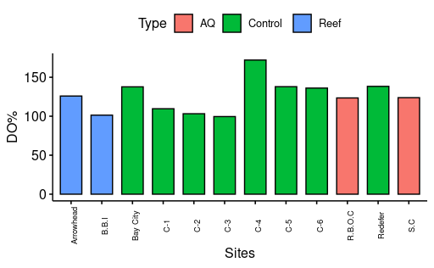
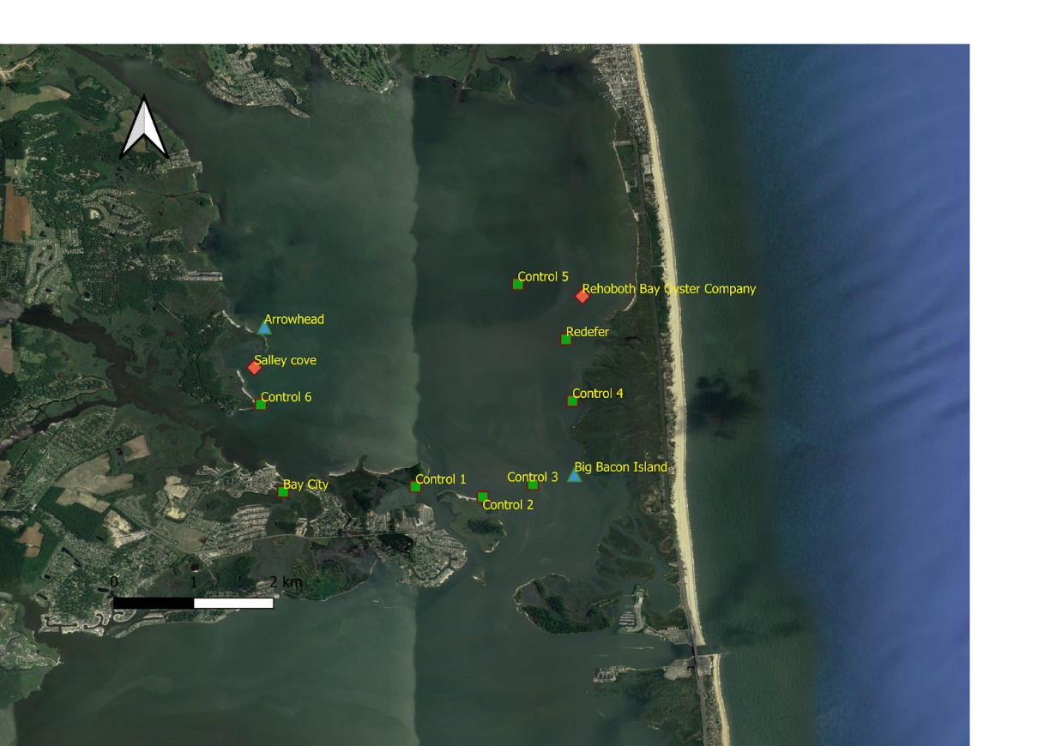
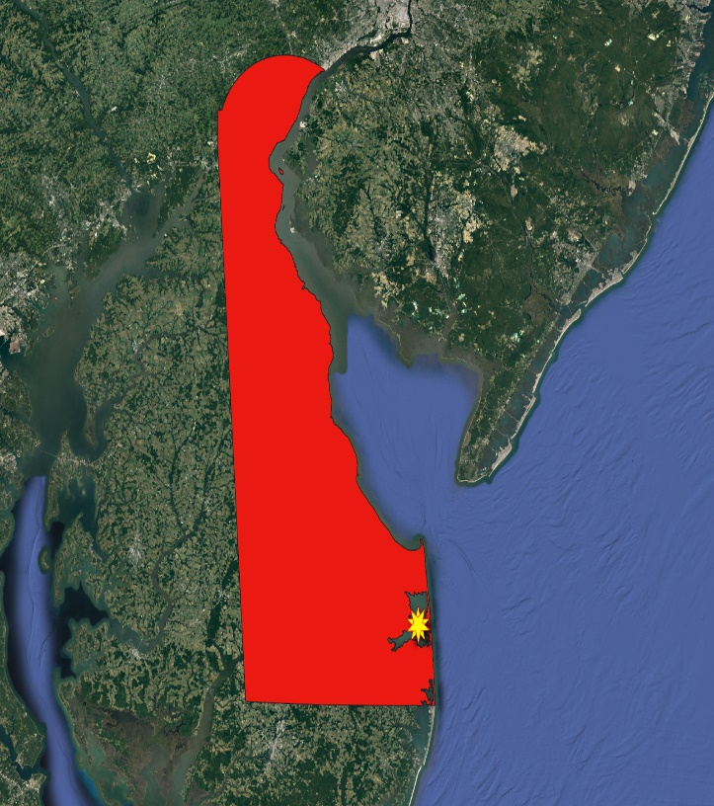
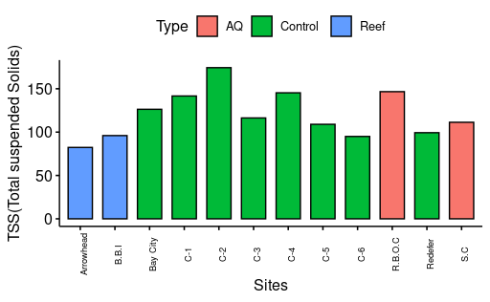
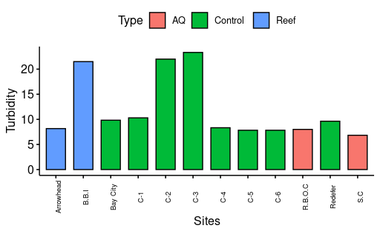
Rehoboth Bay, DE Water Quality Variation in Relation to Potential Eastern Oyster (Crassostrea virginica) Viability Elisha Bunch * Gulnihal Ozbay PhD Department of Agriculture and Natural Resources ,Delaware State University
Introduction
Methodology
Results
The Delaware Inland Bays consist of three interconnected water bodies such as Rehoboth Bay, Indian River Bay and Little Assawoman Bay
Rehoboth Bay is a typical shallow estuary that
plays a significant ecological and recreational role
Contributes to DE eco-tourism and coastal economy
However, the Bay is now highly polluted and is recorded to have the highest concentration of total nitrogen, phosphorus .
Degradation of water quality in Rehoboth Bay has been attributed to:
Expansive coastal development
Stormwater runoff
Wastewater sewage
Agricultural runoff
Methodology: Water quality ln the field
Chlorophyll was highest C-6
TSS was highest at C-1
DO was highest at C-4
Turbidity was highest at C-3
(Peaks were gathered from Data Averages)
C-3, C-4, and RBOC were found to be most suitable
Although, there was a lot of variations across the different habitat types this was only a one day sampling, therefore we expect the values to change with continuous sampling.
Methodology: Water quality laboratory
Parameters measured:
DO (Dissolved Oxygen)
TDS (Total Dissolved Solids)
pH
Salinity
Conductivity
Nutrient analysis:
Orthophosphate mg/L
Nitrite mg/L
Nitrate mg/L
Ammonia mg/L
Non- Nutrient Analysis:
Alkalinity mg/L
Calcium hardness mg/L
TSS(Total suspended solids) mg/
Objectives and Hypotheses
Results
Objective
To monitor Turbidity, Chlorophyll , DO, and TSS at various sites around Rehoboth Bay.
To evaluate and compare locations for future oyster activity success
Hypotheses
There will be a difference in water quality parameters across Aquaculture sites, Oyster Reefs and control sites in the Rehoboth Bay
Discussion
My findings show that there are location that can be perceived as optimal for oyster placement in relation to the others, although in the grand scheme of the bay and possible water qualities these parameters readings do not greatly differ and may all be suitable for oyster growth.n It is also to be noted that not all parameters are equal and some may be more influential to Oysters in different stages of there development as well as being more or less helpful overall thourghout the lifespan of the yster compared to others
Study site
Chart #2 Caption Here
Acknowledgements
NSF and Delaware EPSCoR program for funding NSF-1801420
CLOSES GAP Team 2020
Dr. Gulnihal Ozbay
, Jaquiline Maina, Mhanna Gadde, Memory Nakazwe and Aaron Bland of the Aquatic Sciences Lab at DSU
QGIS instructor Emma Burkkett
R instructor Clarice Perryman
References
My observed sites around the bay included eight control sites, two Oyster Reef sites, and two Aquaculture locations.
Center for Inland Bays, 2017. Special Inland Bays Oyster Gardening Program Message. https://www.inlandbays.org/projects-and-issues/all/oyster-gardening/
DREC, State of Delaware Division of Fish & Wildlife,2020. 2019 Delaware Inland Bays Shellfish Aquaculture Report Planting, harvest, and survey of participants.
http://www.dnrec.delaware.gov/fw/Fisheries/Documents/2019-Inland-Bays-shellfish-aquaculture-summary.pdf

