Slide 1
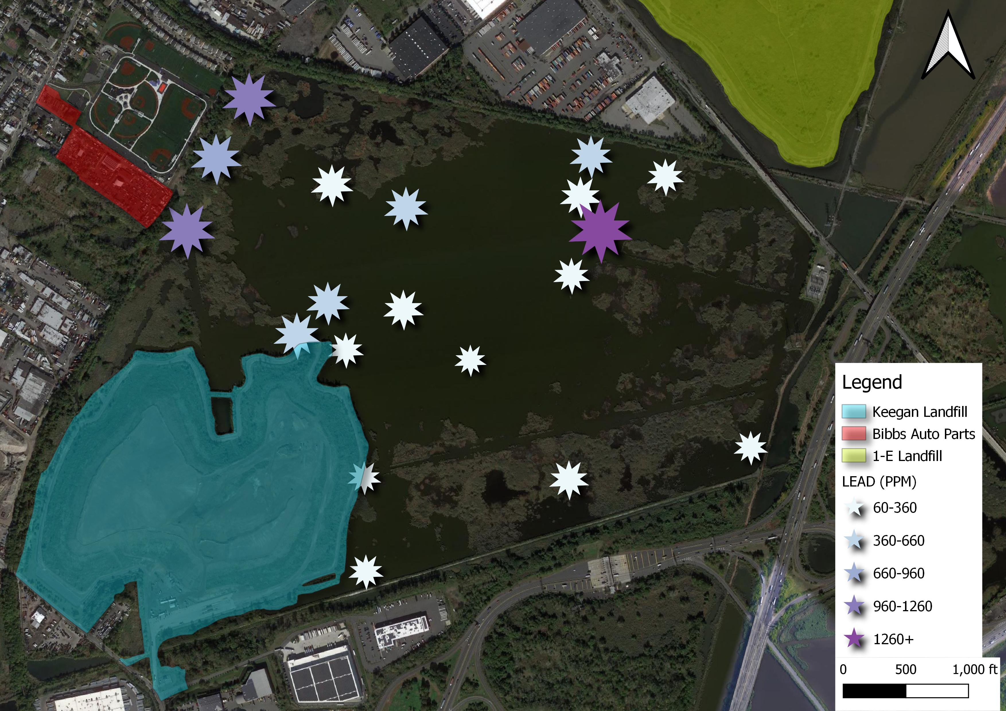
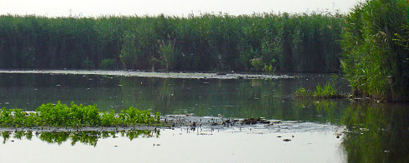
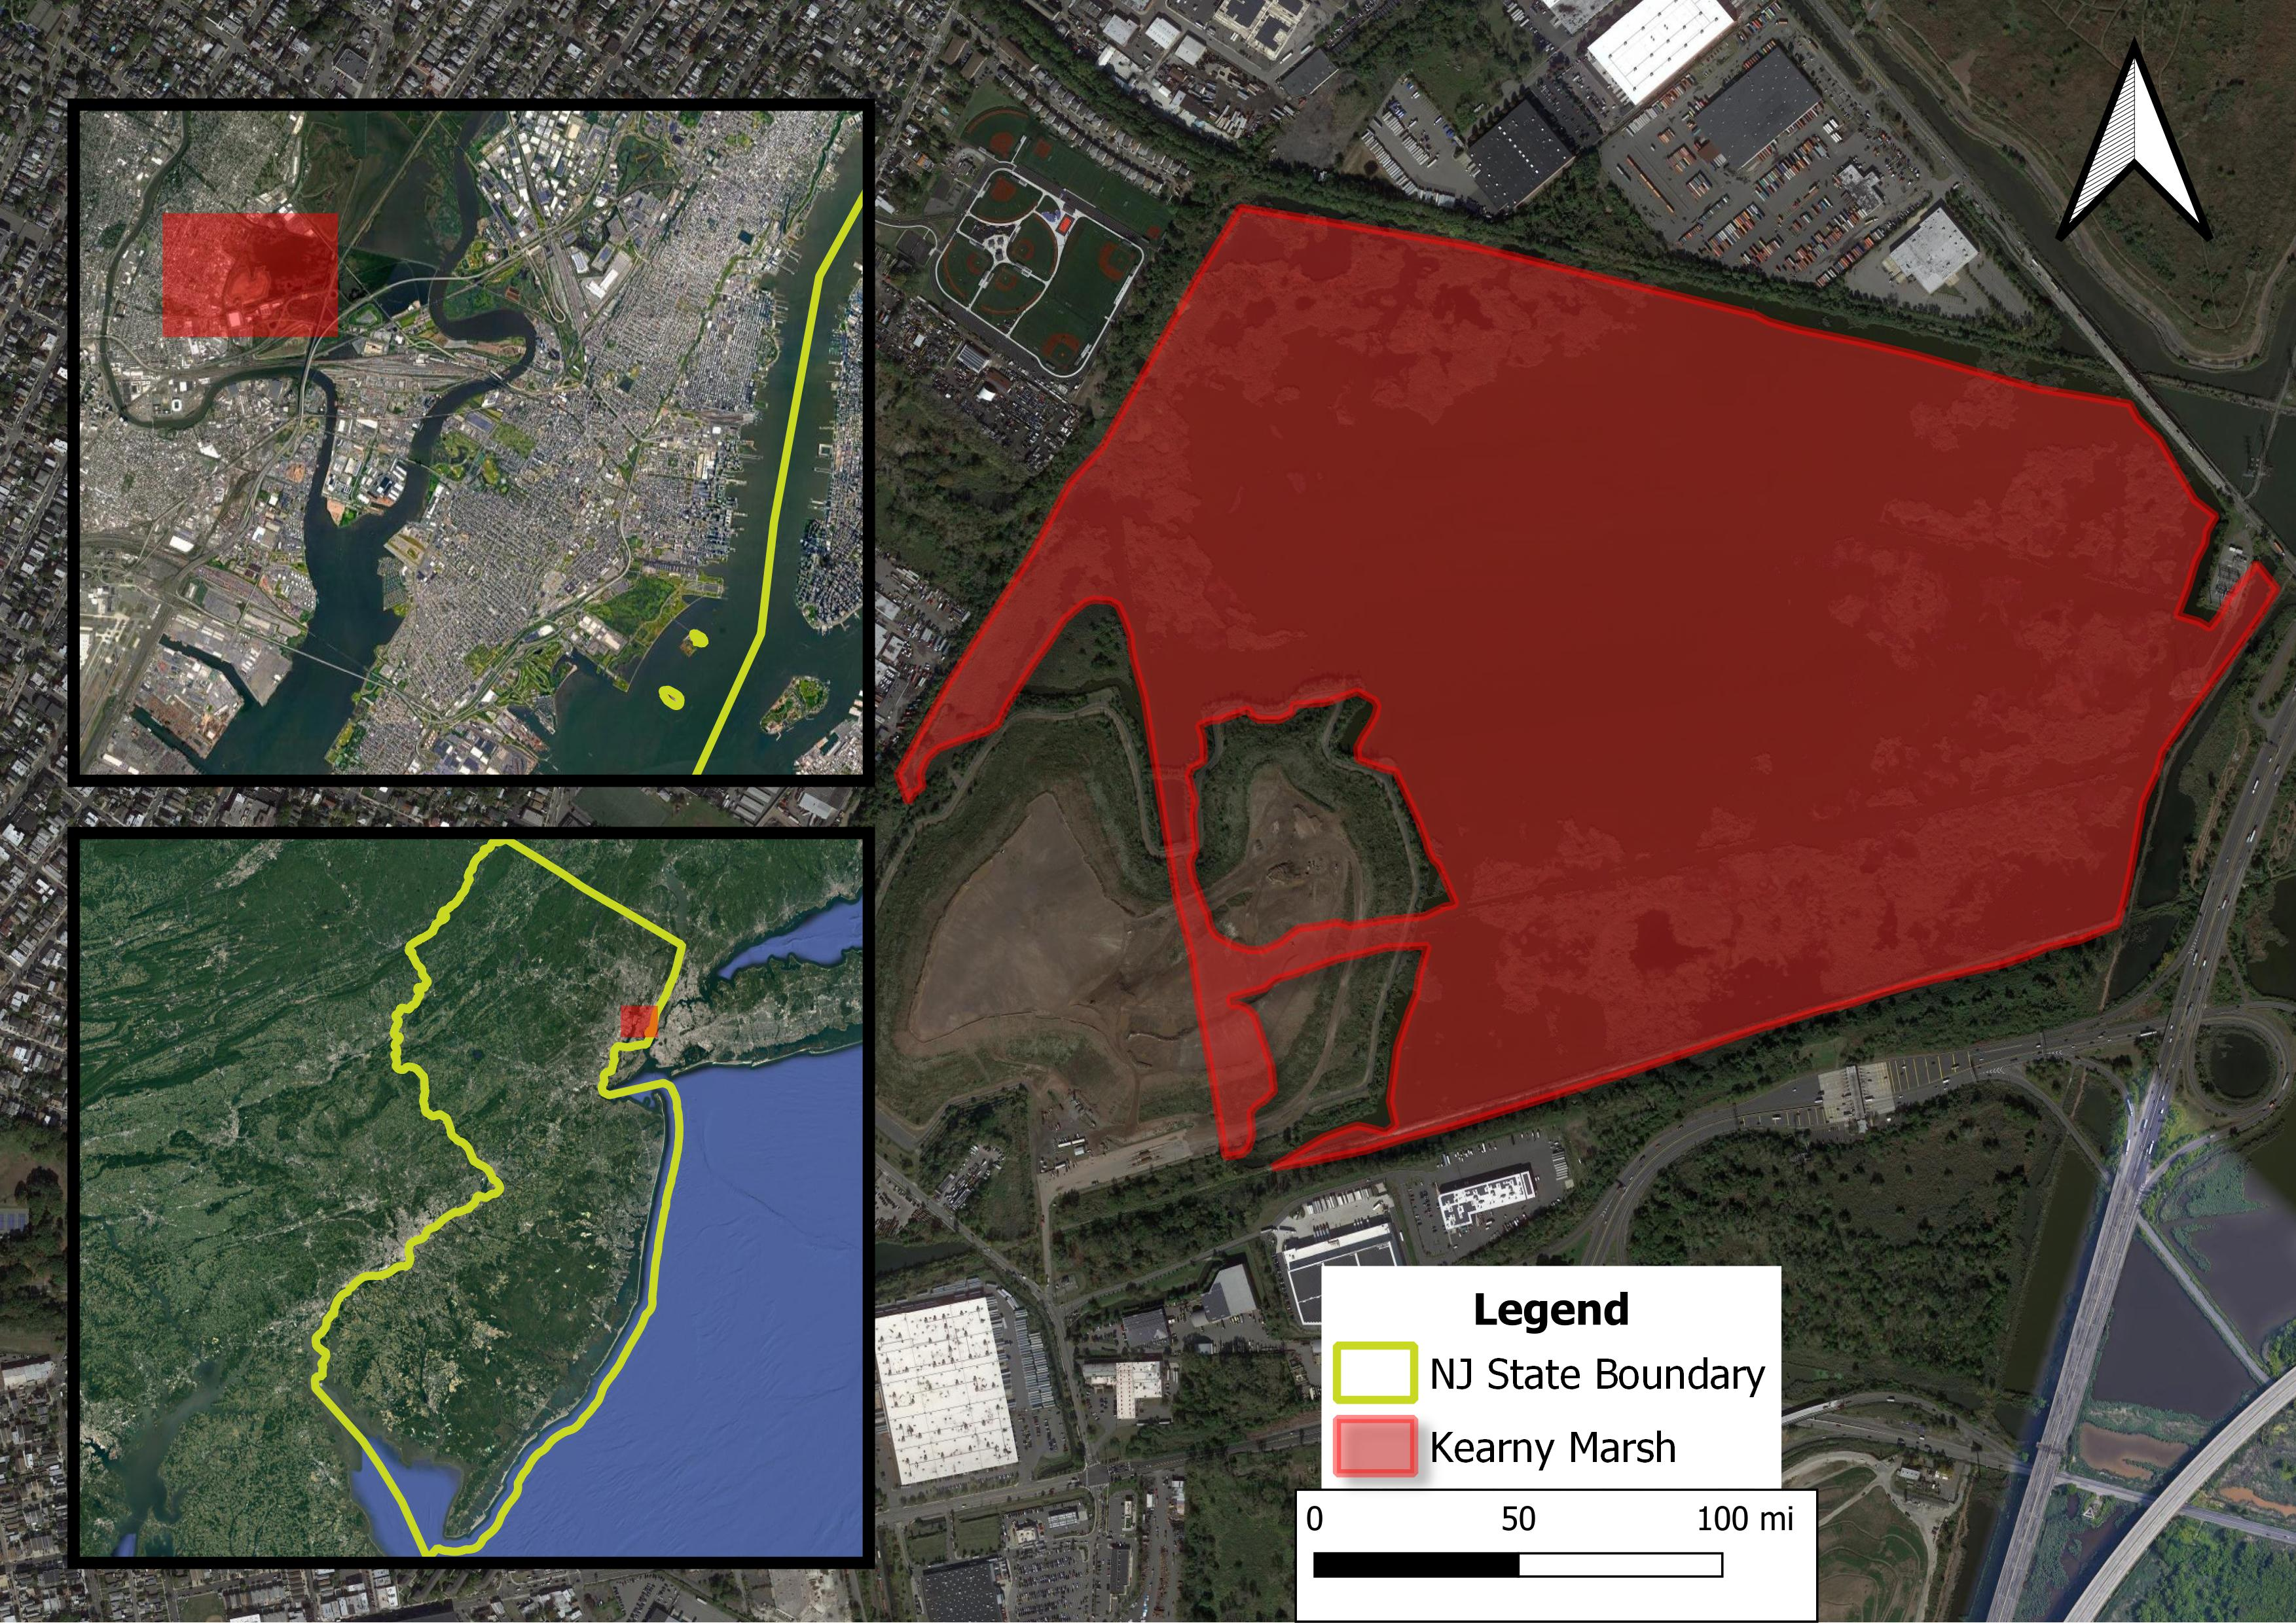
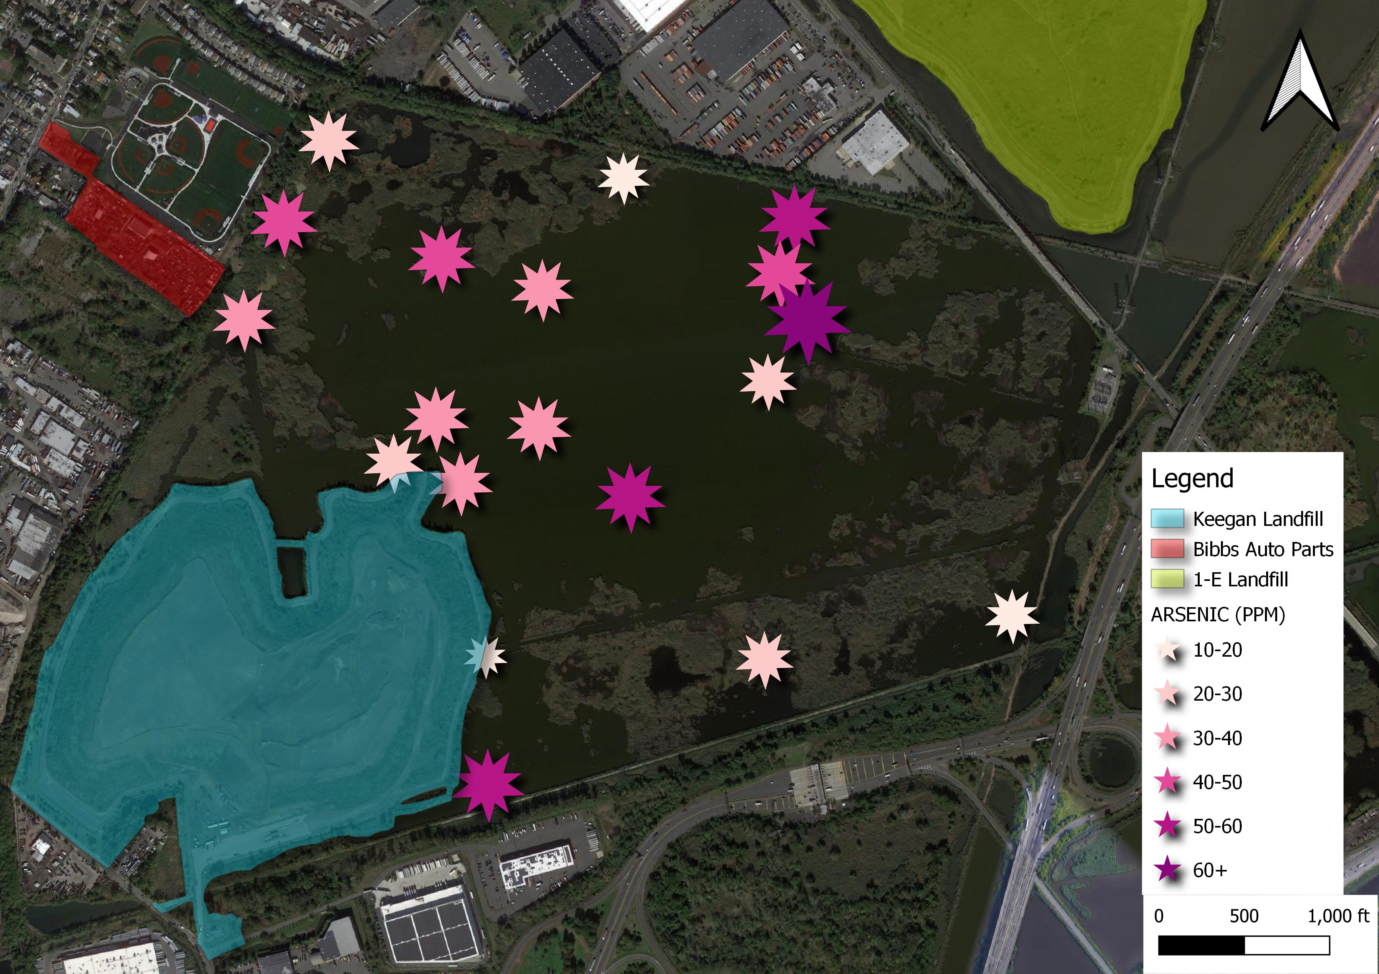
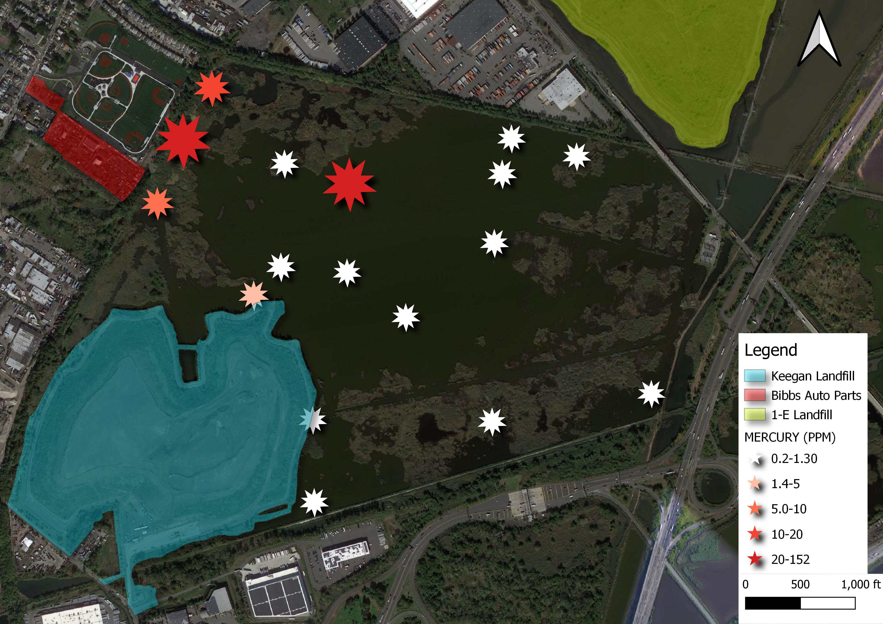
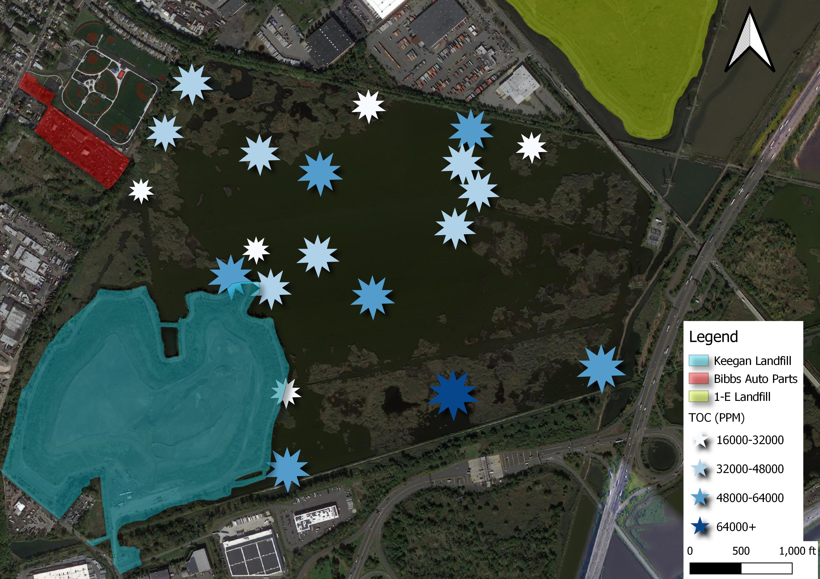
Identifying Sources of Heavy Metal Contaminants in Kearny Marsh, NJ Shruti Patel ¹, Vincent Favorite ¹, Lee Slater ¹, Florencia Fahnestock ² Department of Earth and Environmental Sciences, Rutgers University-Newark ¹ Department of Earth Sciences, University of New Hampshire ²
Introduction
Results
Discussion and Conclusion
We investigated the spatial distribution of contaminants in Kearny Marsh, a freshwater marsh in eastern New Jersey.
Three sites identified as possible pollution sources: 1-E Landfill, Keegan Landfill, and Bibbs Auto Parts.
Lead
Figure. 2 All lead concentrations are above MCL. Highest concentrations near Bibbs Auto Parts and 1-E Landfill.
Arsenic
Figure. 3 All arsenic concentrations are above MCL. Highest concentrations near Bibbs Auto Parts, 1-E landfill, and south-east of Keegan Landfill.
Figure. 6 Image of Kearny Marsh environment. Marsh grasses are roughly 6 ft tall.
No correlation found between mercury concentration and TOC, which means mercury concentrations are not influenced by TOC.
Contamination does appear to be coming from Keegan landfill, but it is not a significant source.
Bibbs Auto Parts appears to be the major contamination source followed by 1-E Landfill.
Comparison with new contamination level data would show if contamination sources changed.
Mercury
Figure. 1 Highlighted shape and location of Kearny Marsh in New Jersey.
Figure. 4 All mercury concentrations are above MCL. Highest concentrations near Bibbs Auto Parts.
Background (Langan 1999)
Acknowledgements
Sample Collection: April-May 1999.
A grab sampler transferred surficial water samples.
A hand corer collected surficial sediment at 0.5 ft.
Core samples using the Vibracore method were taken at depths of 12, 24, and 36 inches.
Equipment was cleaned between collections.
Sample analysis included TOC, Lead, Arsenic, and Mercury.
Total Organic Carbon (TOC)
Figure. 5 Highest concentrations near NJ Turnpike and southeast of Keegan Landfill. Lowest concentrations near Bibbs Auto Parts.
CLOSES-GAP 2020 program funded by National Science Foundation (NSF-1801420). Thank you to all CLOSES-GAP team: Ruth Varner, Julice Bryce, Thomas Lippman, Maurice Crawford, Rose Ozbay, and Steve Hale. Also thank you to Emma Burkett and Clarice Perryman for their guidance.
Methods
Table. 1 Maximum Contamination Limits (PPM) for Mercury, Lead, and Arsenic, respectively.
References
Concentration and sample location were processed in QGIS to emphasize spatial relationships between contaminants and possible source location.
Contamination concentrations were compared to NJ government allowable standards.
Contaminant | MCL (PPM)
Mercury | 0.0014
Lead | 0.038
Arsenic | 0.34
Langan Engineering and Environmental Services, Inc., 1999, Sediment and Water Sampling Report: Kearny Marsh, Kearny, New Jersey.
New Jersey Statutory Authority, Surface Water Quality Standards. Section 7:9B. New Jersey Administrative Code, 2016.
Notes:
MCL- Maximum contamination limit

Slide 2
.
Figure. 1 Highlighted shape and location of Kearny Marsh in New Jersey.

Slide 3
.
Figure. 2 Lead

Slide 4
.
Figure. 3 Arsenic

Slide 5
.
Figure. 4 Mercury

Slide 6
.
Figure. 5 Total Organic Carbon

