Slide 1
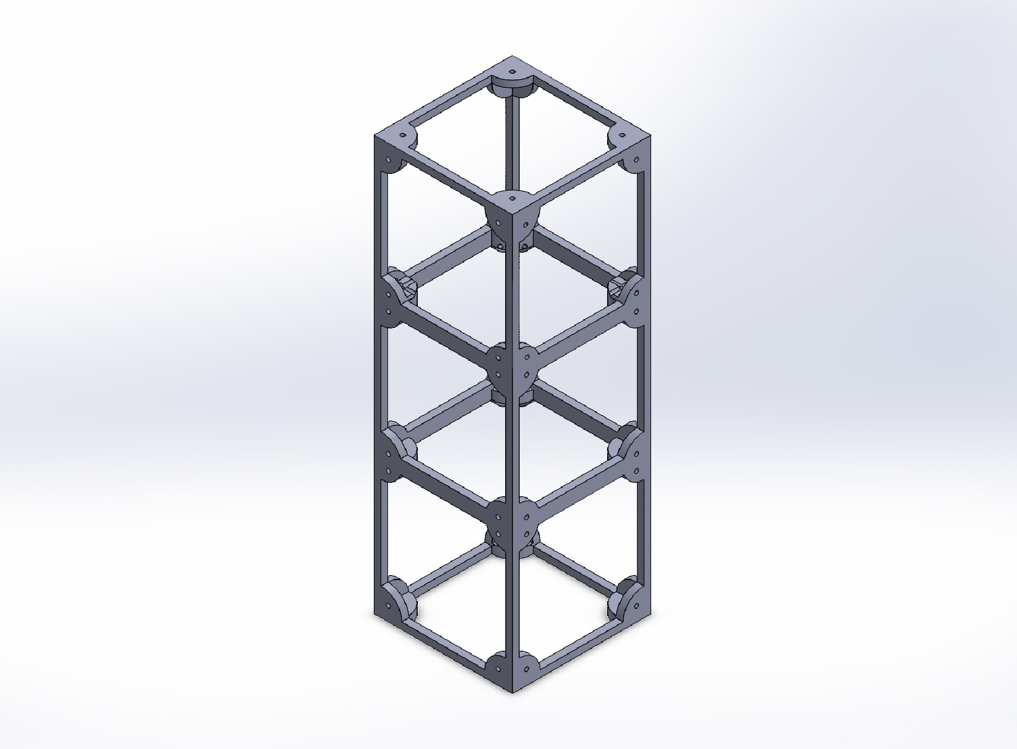
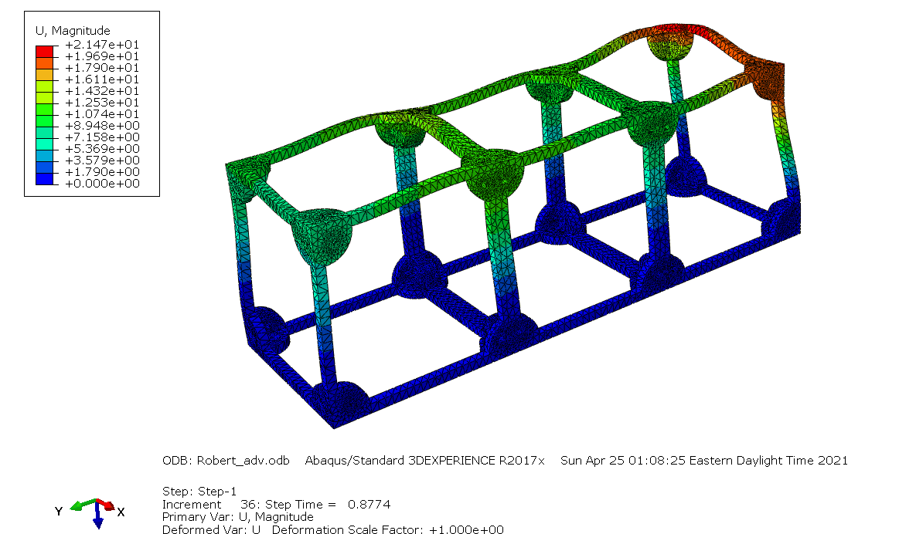
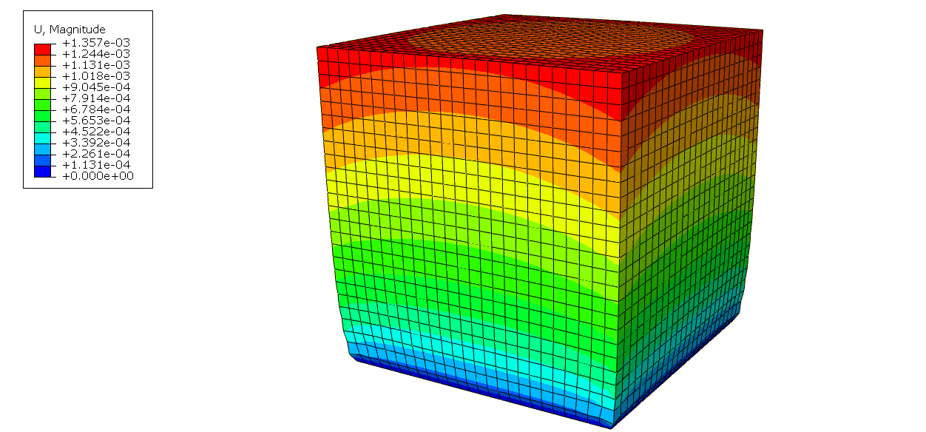
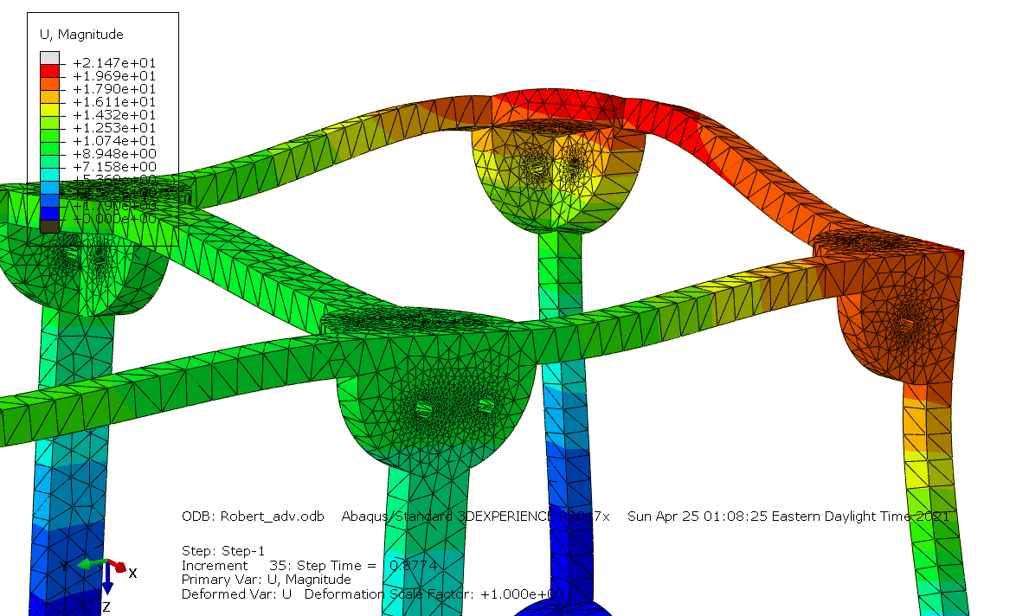
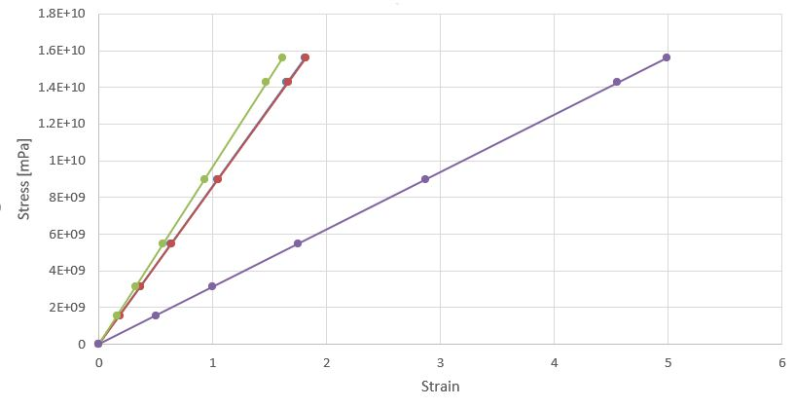
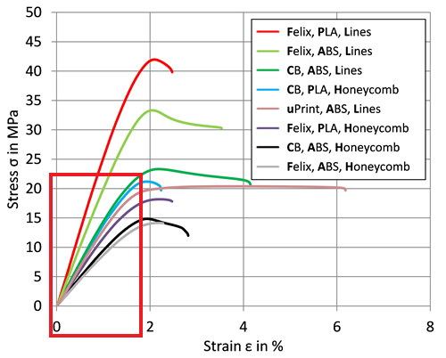
Application and Feasibility of 3D-Printed Materials in CUBESAT Construction Robert Wells, Advisor: Amy Keesee Ph.D Morse Space Science Center, University of New Hampshire, Durham, NH 03824
Place your Project Logo Here
Introduction
Cube Satellite Chassis Design and Vacuum Chamber
Abaqus Testing Considerations
Plastics are an important material that are commonly utilized in in spacecraft designs if suitable airtight construction is used. This study aims to determine the feasibility and application of plastics in low-pressure environments such as Low Earth Orbit (LEO) in small cube satellites, where airtight builds may not be possible. The plastics studied include ABS, HDPE, PTFE, and Polystyrene, all of which can be manufactured into chassis through FDM – 3D printing or injection molding methods. Abaqus simulation software was used to build a low-pressure environment, that would mimic the effects the pressure in low-earth orbit would have on a plastic chassis without subjecting a physical model to stress tests in a vacuum chamber. Utilizing plastics in cube satellites in a larger capacity would be extremely beneficial in order to reduce weight, mass, electrical interference, and provide faster prototyping as well a new method of producing parts through 3D printing.
Cube Satellite Chassis Design for 3D-Printing
Cube Satellite Total Deformation Analysis
Outgassing – the most prominent issue - occurs with plastic materials that form “bubbles” of trapped gas
Simulated a 3D cube satellite chassis model, rated and designed to fit NASA CubeSat specifications
Abaqus simulated a fine mesh model comprised of approx. 180,000 elements
Multiple simulations were run for each plastic, ABS was the most suitable
Compared to Rapid Technology’s stress curve analysis
High deformation occurred – plastic rigidity needs to be increased
Methodology and Experiment
Deformation Magnitude Charts and Abaqus Simulation Results
Results
Research plastic material properties such as Young’s modulus, Poisson’s Ratio, density
Vacuum chamber testing dangers include specimen rupture and damage
Utilize Abaqus simulation program to build and test the model
Examine the stress-strain curves of the plastics and their magnitudes of deformation
Final stress test of SOLIDWORKS model of a CubeSat Chassis
Future work - prediction and research of factors that would positively impact the outgassing
The most ideal plastics for the satellite chassis would be ABS and HDPE, both of which offer the most rigid surfaces, and least amount of strain deformation. Comparing the Abaqus generated stress-strain curves and the curves referenced from Rapid Technology abstract, we can conclude that the Abaqus simulation was successful in approximating a LEO environment. These plastics also have relatively high heat tolerances, which would be ideal for baking and subjecting the plastics to curing methods, to reduce the outgassing rate of the plastics for future testing.
Figure depicting the deformation magnitudes of the ABS test cube used to model the vacuum chambers simulation; Red areas are maximum deformation
Magnitude of the deformation of the Cube Satellite, showing the deformation occurring most around the tapped sections and corners.
Future Work
Stress-Strain Curve Comparisons
Plastic survivability can be achieved by reducing factors that contribute to specimen rupture
Outgassing issue could be solved through baking/ curing methods
Recent studies have determined that baking ABS plastics at approx. 95 $C^{o}$ increase pressure tolerance on magnitudes of 2 orders [1]
Plastic Benefits
Abaqus Plastics Analysis (Youngs Modulus)
Rapid Technology ABS-PLA Analysis
Plastics are lightweight, and simple manufacturability
ABS plastic density is approximately 7-8 times lighter than steel, 3 times lighter than Aluminum
Plastics offer excellent electrical insulation, especially at lower power levels
Ideal for sensitive apparatus such as spectrometers and magnetometers
Manufactured through simple, cost effective means
Complex shapes - printed into any shape, as a singular unit
References
Supported by Research Advisor, Professor Amy Keesee.
Continuation of work by UNH alumni Reed Dannar, and Cam Lamarre.
“Stress Strain Curve” https://www.rtejournal.de/ausgabe11/3872. Rapid Technology
“Basic Concepts and Processes for First-Time Cubesat Developers” https://www.nasa.gov/sites/default/files/atoms/files/nasa_csli_cubesat_101_508.pdf. NASA
[1] “Vacuum Compatibility of ABS plastics” https://hal.archives-ouvertes.fr/hal-01599113/document. Hal Archives
Stress-strain curve magnitudes for the plastic types of ABS, HDPE, Polystyrene, and PTFE (left to right), displaying the Youngs Modulus Abaqus generated for each.
Stress-strain curves (full) for the FDM ABS plastic in light green, displaying the same curvature as the Abaqus graph (Highlighted in red square).

