Slide 1
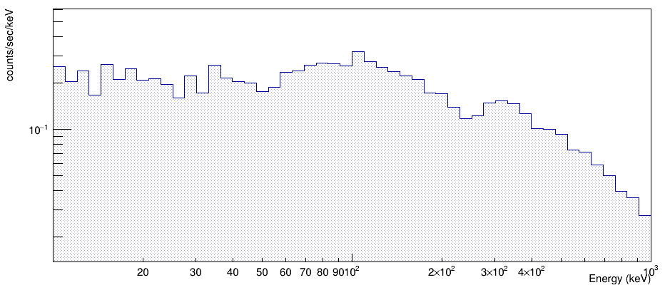
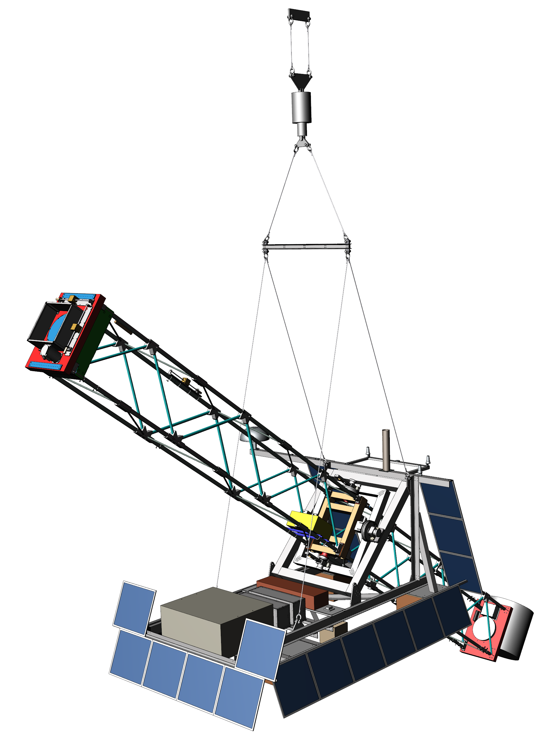
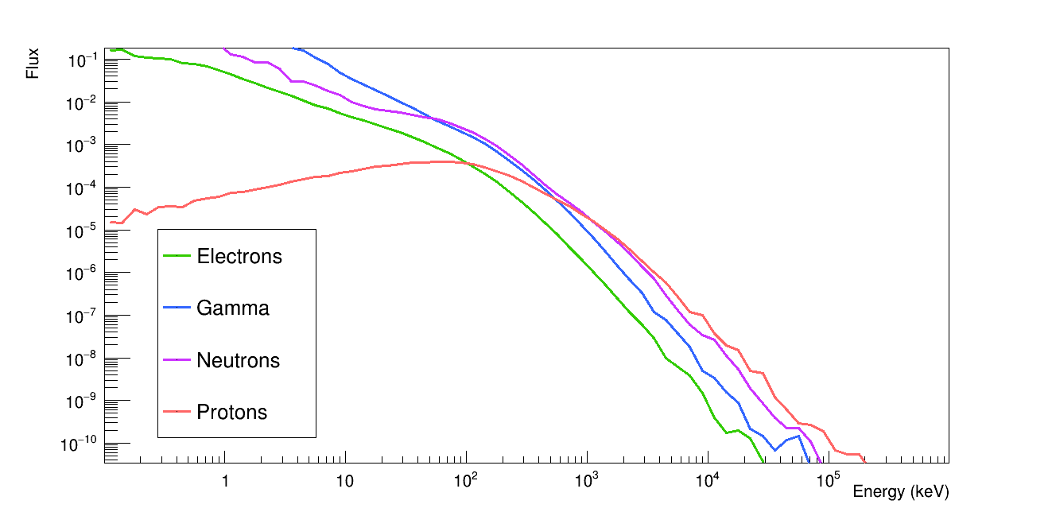
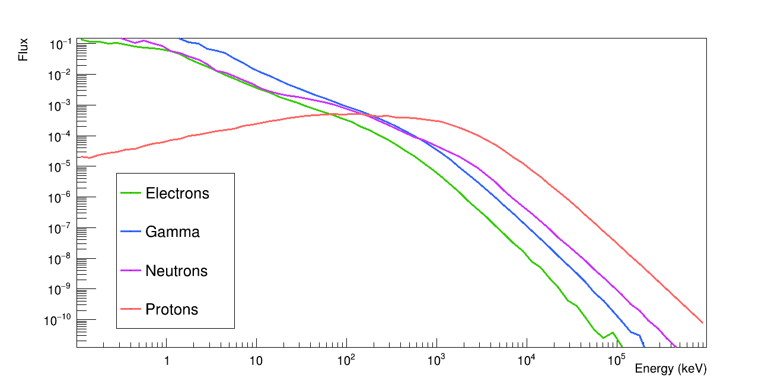
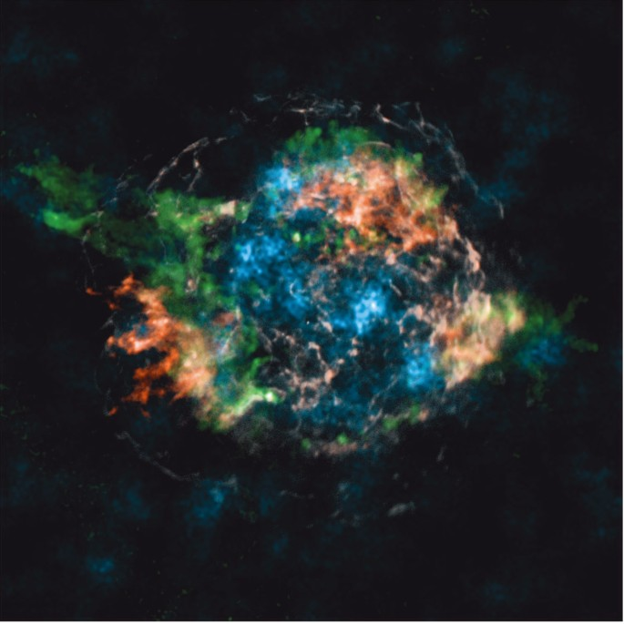
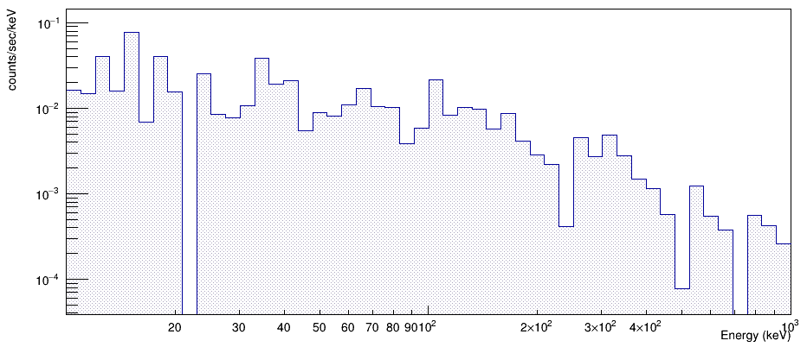
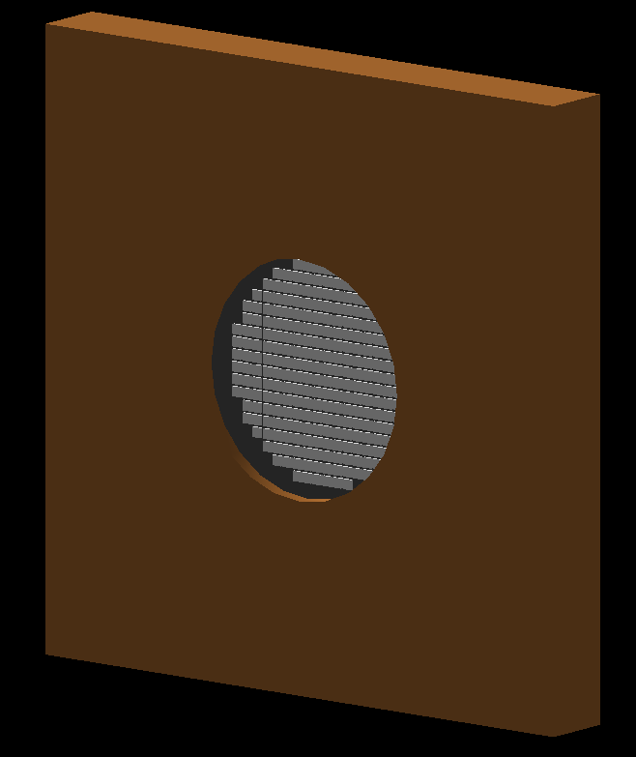
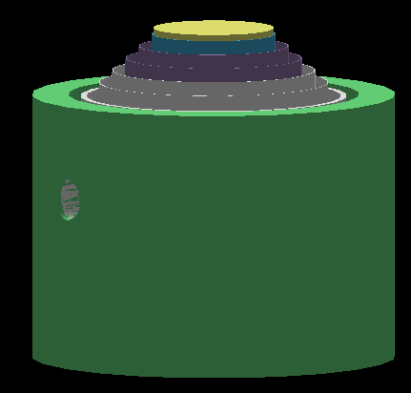
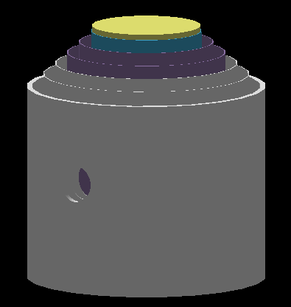
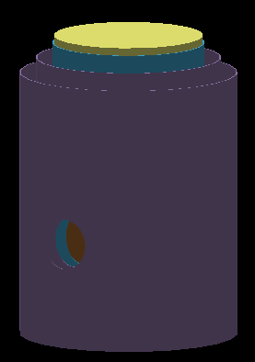
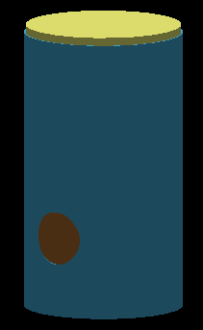
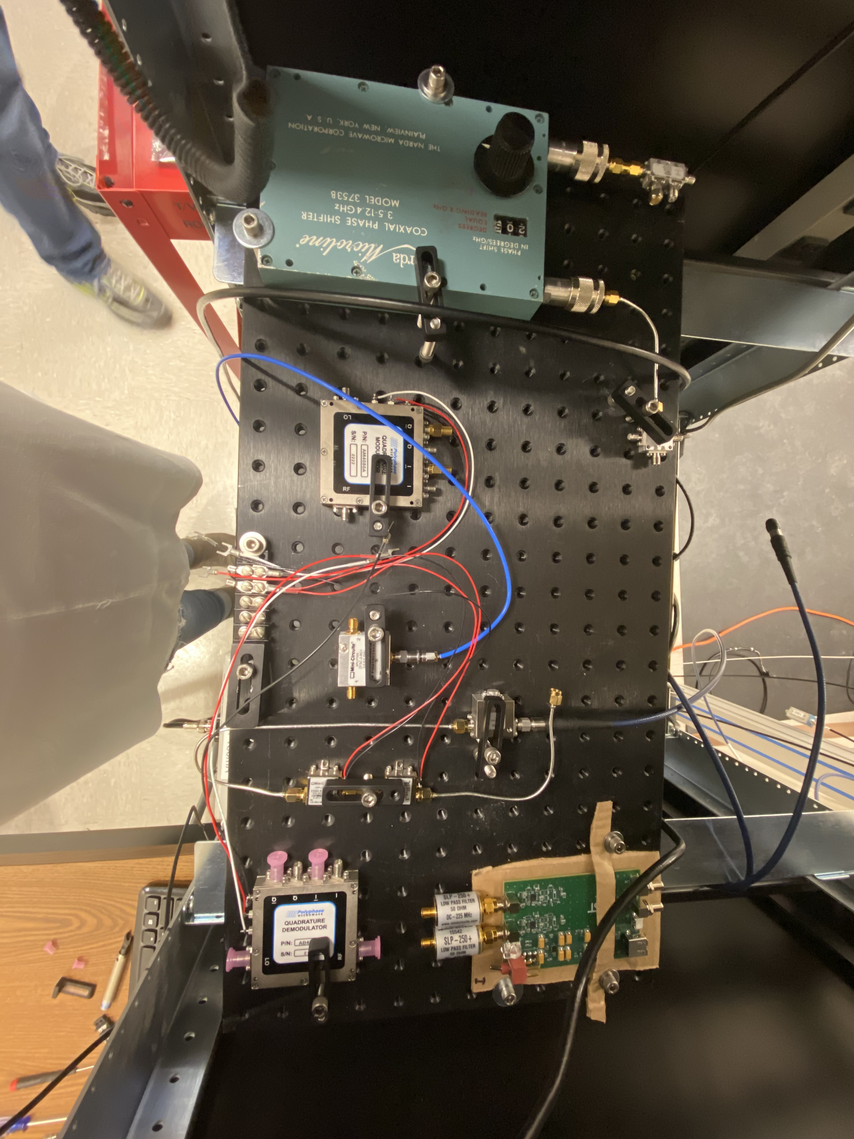
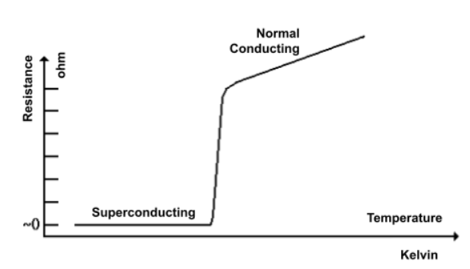
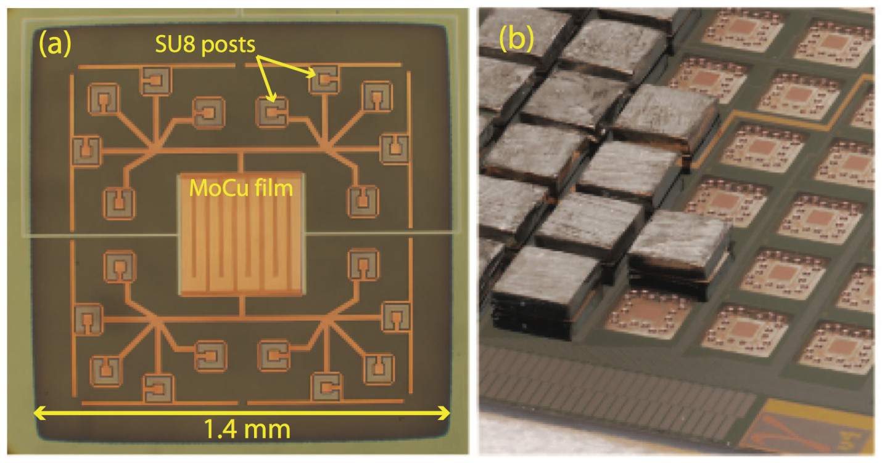
Transition Edge Sensor Microcalorimeters for ASCENT
A Superconducting Energetic X-ray Telescope
Amanda Wester, Dr. Fabian Kislat (Faculty Advisor)
Department of Physics and Astronomy
Introduction
Background Radiation
Simulation and Results
ASCENT is a proposed telescope (figure 1) project that aims to better understand the structure of supernova remnants. This will be accomplished by observing the emissions from the radioactive decay of titanium-44 (⁴⁴Ti) in the remnant Cassiopeia A (Cas A), seen in figure 2. Cas A is a prime remnant to observe because it is young enough to where its ⁴⁴Ti has not completely decayed into the stable isotope calcium-44. ASCENT seeks to achieve an energy resolution of 8-16 fold better than previous measurements of Cas A so that more precise and accurate models of the remnant can be analyzed. This improvement in resolution will be obtained by the use of transition-edge sensor (TES) microcalorimeters.
During flight, the telescope and detectors will be exposed to background cosmic radiation from above and secondary radiation from below due to cosmic radiation interacting in the atmosphere. Below in figures 5a and 5b are the background spectra that ASCENT will likely experience while it observes Cas A. It’s important to know what kind of radiation the telescope and detectors will be exposed to so the unwanted signals can be removed from the data. We need to do more than just subtract the undesired spectra from the data, so the detectors will be surrounded by a thick layer of bismuth germanate (BGO). This BGO shield will help to absorb the high energy particles so that they don’t make it to the detectors. The BGO shield also acts as a particle detector itself and even if a high energy particle were to make it through the shield, we can remove it from the data so long as it deposits at least 100 keV into the BGO. This data was obtained from the Models for Atmospheric Ionizing Radiation Effects (MAIRE) project.
Figure 1: A 3D model of ASCENT’s telescope
Figure 5: (a) is the “up” spectrum of particles that ASCENT is likely to be exposed to during its observation period. This spectrum represents the particles that come from above the telescope from space and (b) is the “down” spectrum of particles that ASCENT is likely to be exposed to during its observation period. This spectrum is the particles that come from below the telescope from the atmosphere.
Figure 2: A filtered image of Cassiopeia A where each color denotes different element populations in the remnant.
Figure 8a: This figure depicts the results of the simulation. This is a combined spectrum of protons, electrons, neutrons, and high energy photons. These are the particles that triggered a response in any of the TES detectors without taking into consideration the vetoing of the BGO shield. This histogram includes particles that the BGO will indicate to us to remove from the data because many of these particles deposited more than 100 keV into the BGO shield.
Geant4 Model and Simulation
TES Detectors
Geant4 is a particle simulation program developed by CERN that can be used to model a physical structure and how particles interact with that structure. Using this program, I created a model of the detector array along with its housing (figures 6a and 6b) and the cryostat (figure 7) that we are using for lab testing and calibration. This model will help in determining if changes will need to be made to the detector geometry in the telescope to account for more or less shielding.
(a)
(b)
A TES is a microcalorimeter that takes advantage of the temperature-dependent nature of a metal’s electrical resistance in order to measure small changes in temperature that cause large changes in resistance. At a low temperature specific to each metal, the metal will begin to superconduct where its resistance is almost zero. Before this point, there is a steep transition zone where the resistance climbs rapidly until it begins to conduct normally (figure 3). The entire detector structure consists of the TES calorimeter, a metal absorber, and a thermal link through which to dissipate heat (figure 4). For ASCENT, we will be utilizing tin (Sn) as our absorber because of its desirable properties including a high probability to absorb photons as opposed to scattering, a large nucleus with Z=50, and a low heat capacity. The low heat capacity is important in being able to measure a noticeable temperature change from a small amount of energy being deposited. For tin, the transition temperature is around 100 mK and the detector array will need to be kept in a cryostat to maintain a temperature that low.
Figure 8b: This figure depicts the same data shown in figure 8a though it has been filtered via the BGO shield. All of the particles that deposited more than 100 keV into the BGO have been removed from the data set. This removal caused the counts/sec/keV to decrease by an order of magnitude, revealing that the BGO is effectively enabling us to remove much of the unwanted background radiation.
Figure 7: This is a series of images depicting layers of the cryostat. First is the BGO shield encased in aluminum (green), three layers of aluminum (grey), two layers of A4K (purple), one layer of copper (blue), and a tungsten cap (yellow).
Figure 6: (a) shows the copper housing and the silicon disk (dark grey) behind the detector array (light grey) and (b) shows a closer view of the detector array.
References
Outlook and Future Plans
Figure 2: B.W. Grefenstette et al. Nature 506 (2014) 339.
We are currently going through all of the electronics systems in the lab to calibrate the cryostat and electronics in preparation for the detector testing. We’ve seen a few timeline setbacks due to the coronavirus and some technical issues with equipment, but we’re hoping to start back up in the coming weeks. We’ve done several preliminary baseline measurements on the existing setup but have not been able to work with a detector array yet.
In the future, we plan to test and calibrate the TES detectors in the cryostat using a radioactive source and a collimator designed by Savannah Labounty.
Models for Atmospheric Ionizing Radiation (MAIRE)
https://www.radmod.co.uk/maire
Figure 3: A plot illustrating the resistance of a metal as a function of temperature.
Figure 4: (a) TES detector structure with MoCu film, and (b) an array of detectors with visible absorbers connected.
Joel N. Ullom, Douglas A. Bennett, 2015, Review of superconducting transition-edgesensors for x-ray and gamma-rayspectroscopy
Acknowledgements
I would like to thank Dr. Fabian Kislat for the opportunity to be a part of this project and for his continued support and insight for my work. I am also grateful to the Space Grant Consortium and the Hamel Center for providing the funding to make my projects possible.
Figure 9: This is the room temperature electronics setup that we are currently using in the lab. Much of what is pictured will be used in the signal processing of the TES detectors and is connected to the cryostat electronics.
Notes:
References: (2) https://www.nature.com/articles/nature12997#Fig3
https://www.radmod.co.uk/maire

