Slide 1

Age of Fingerprints Established Through Ambient Ozonolysis of Unsaturated Triacylglycerols
Jessica Douillette, B.A.
Department of Chemistry

Slide 2

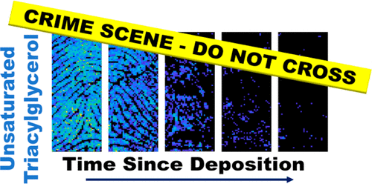
Introduction
Many compounds can be found within finger print residue
  Each can be extracted and analyzed for patterns
Once a patterns are determine, a cause of such reaction can be investigated
  Patterns include the change in amount of the compounds over time
Many variables must be considered: environment, collection, preservation, extraction solvents
The application of these finding could possibly be essential to solving a criminal case
  This may include providing evidence that an individual was or was not at the crime scene within a specified amount of time
Hinners, P., Thomas, M., & Lee, Y. J. (2020). Determining fingerprint age with mass spectrometry imaging via ozonolysis of triacylglycerols. Analytical chemistry, 92(4), 3125-3132.

Slide 3
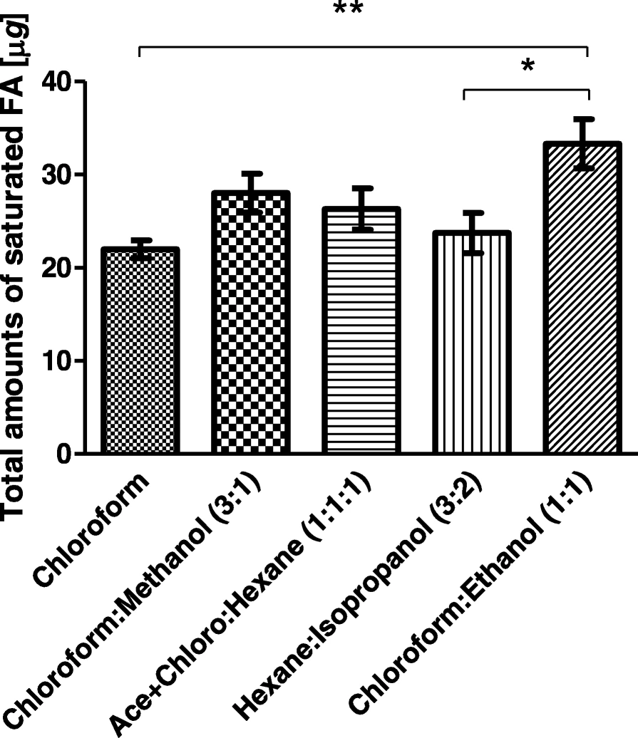
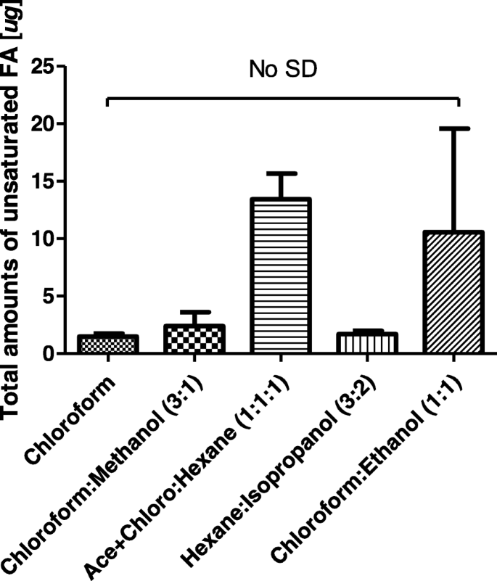
Background
Compounds:
  Sweat
    Proteins
    Amino acids- found in residue
    Urea
    Lipids- fats and oils that make up residue
    Water- evaporates quickly
    Inorganic ions such as Na+ and Cl-
How Finger Prints are Collected
  the fingerprints will have been lifted using a powder or super glue;
  specific solvents that should be used to extract the fatty acids from the other compounds in the residue
  Proper containment of collected prints can affect aging process
Figure 1. Kim, Y., Choi, W. S., Choi, E. J., Jeon, B., Kim, J., Park, G. H., ... & Choi, T. H. (2019). Evaluation of fatty acids in groomed fingerprint by gas chromatographic analysis using various extraction solvents and treatment methods. Journal of Analytical Science and Technology, 10(1), 1-13.
Notes:
The two asterisks and one asterisk indicate 0.001≤p < 0.01 and 0.01≤p < 0.05, respectively
“No SD” means there is no significant difference (n = 10, all donors)
all unsaturated fatty acids showed donor dependence

Slide 4
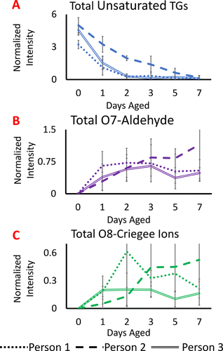
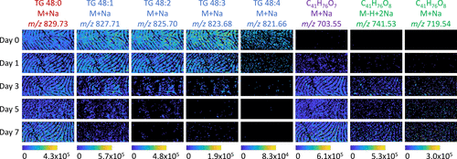
Measurement of Collected Data and Analysis
Figure 2 and 3. Hinners, P., Thomas, M., & Lee, Y. J. (2020). Determining fingerprint age with mass spectrometry imaging via ozonolysis of triacylglycerols. Analytical chemistry, 92(4), 3125-3132.
Notes:
Figure 1 on the left shows a mass spec image of triacylglycerols, the change is potentially due to the ozonolysis of the unsaturated triacylglycerols.
Specific to this study→ in ambient conditions, used electrospray ionization after extraction with chloroform
Image shows increase of ozonide on the right
Color code
Red→ saturated TG (6 oxygens)
Blue→ unsaturated TGs ( 6 oxygens)
Green→ 8 oxygen series
Purple→ 7 oxygen series

Slide 5
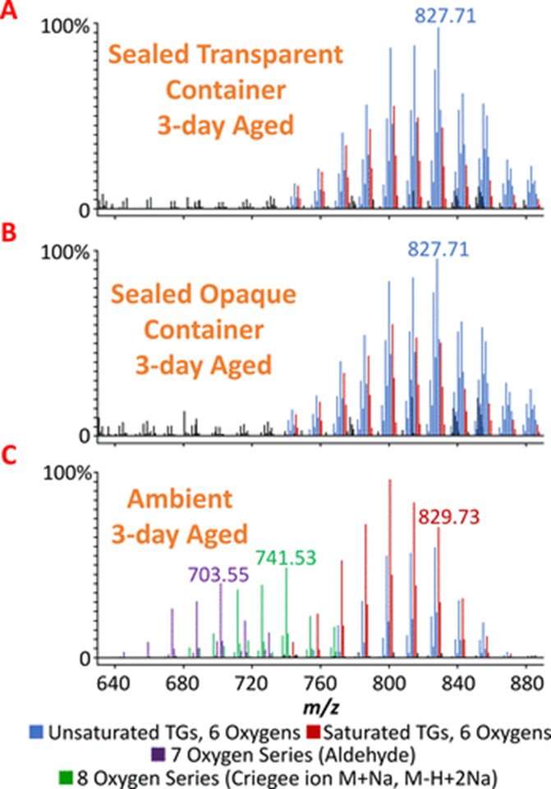
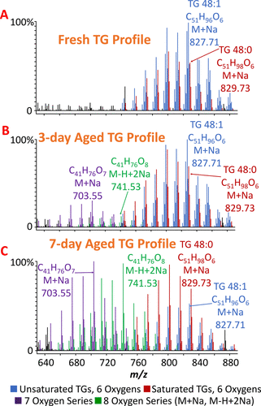
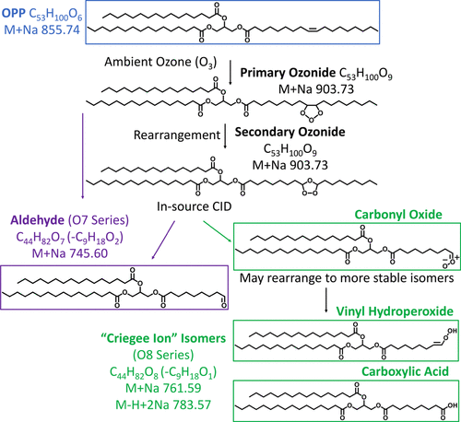
Graphs and Visual Data Collected
Figure 4, 5 and 6 Source: Hinners, P., Thomas, M., & Lee, Y. J. (2020). Determining fingerprint age with mass spectrometry imaging via ozonolysis of triacylglycerols. Analytical chemistry, 92(4), 3125-3132.

Slide 6
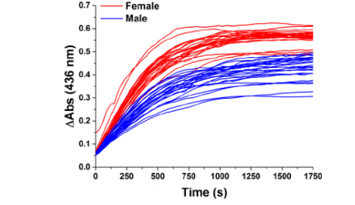
Results and Conclusion
Conclusion to Findings
Decrease in levels of unsaturated fatty acids corresponding with the increase of time the fingerprint has been left at the crime scene.
Additional research:
  Further test on collection and preservation of residue
  Determination of a profile of an individual based on a fingerprint when not found in the data base
    gender, lifestyle, age, ethnicity, and eating habit to be predicted.
Figure 7. Huynh, C., Brunelle, E., Halámková, L., Agudelo, J., & Halámek, J. (2015). Forensic identification of gender from fingerprints. Analytical chemistry, 87(22), 11531-11536.
Notes:
Gender can be determined through the concentration of amino acids and their absorbance intensities. Females show a higher difference in absorbance by amino acids than males

Slide 7
Resources
Hinners, P., Thomas, M., & Lee, Y. J. (2020). Determining fingerprint age with mass spectrometry imaging via ozonolysis of triacylglycerols. Analytical chemistry, 92(4), 3125-3132.
Chemistry for Liberal Studies - Forensic Academy / Dr. Stephanie R. Dillon. (n.d.). The chemical components of fingerprints.
Kim, Y., Choi, W. S., Choi, E. J., Jeon, B., Kim, J., Park, G. H., ... & Choi, T. H. (2019). Evaluation of fatty acids in groomed fingerprint by gas chromatographic analysis using various extraction solvents and treatment methods. Journal of Analytical Science and Technology, 10(1), 1-13.
Pleik, S., Spengler, B., Schäfer, T., Urbach, D., Luhn, S., & Kirsch, D. (2016). Fatty acid structure and degradation analysis in fingerprint residues. Journal of The American Society for Mass Spectrometry, 27(9), 1565-1574.
Huynh, C., Brunelle, E., Halámková, L., Agudelo, J., & Halámek, J. (2015). Forensic identification of gender from fingerprints. Analytical chemistry, 87(22), 11531-11536.

