Slide 1

ECE ET NavSwarm
Dylan Brown, Simon McIntosh
Interdisciplinary Team Members: Larry Nguyen, Tim Vigliotte, Ricky Cheng, Jon Ells, Jaiden Evarts, Colin Daly, Connor Fleury, Dylan Russell, Aidan Moore, Nick Miele, Zach Hulecki, J.P. Lapierre

Slide 2
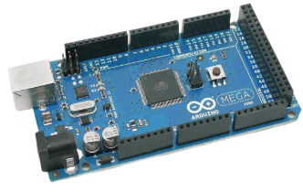
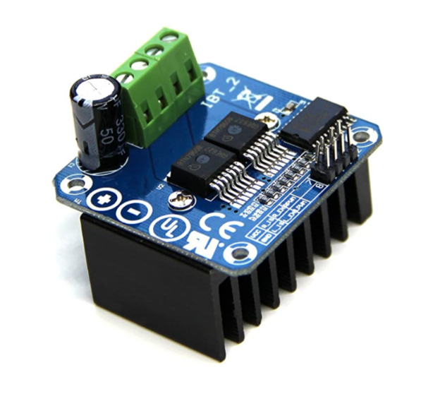
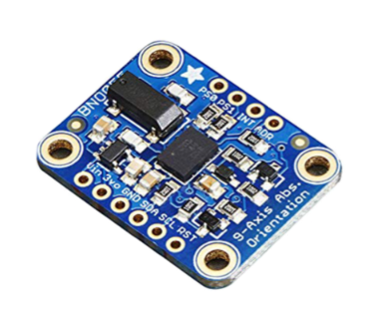
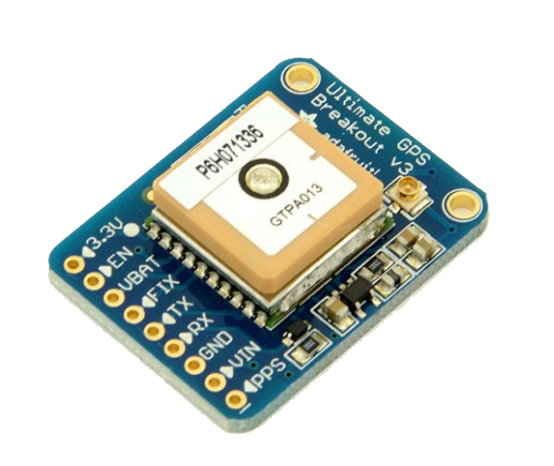
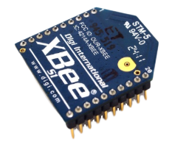
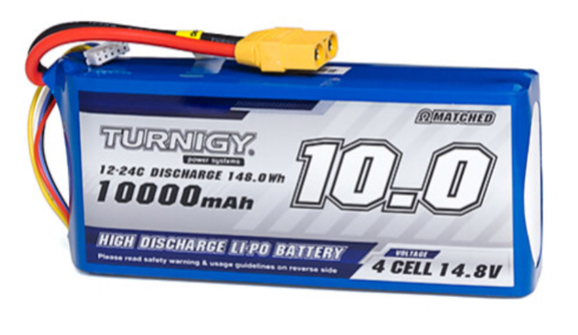
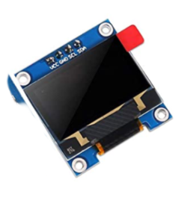
Mission Statement
Arduino Mega Controller 2560
Analog and digital input/output
Reads data for various tasks
Electronic Speed Controller (ESC)
Uses pulse width modulation from Arduino to power motors
One ESC powers two motors, one for each side of the bot
Inertial Measurement Unit (IMU)
Accelerometer, magnetometer, gyroscope
Determines roll, pitch and yaw with 9 degrees of freedom
Global Positioning System (GPS)
Locates up to 22 satellites
Tracks current and future locations of bots
XBee and Shield
2.2 GHz transmitter/receiver
Allows for swarm data communication
Battery
10,000 mAh capacity LiPo pack
Provides overall power to bot
OLED Screen
1” display for troubleshooting messages
Outputs status of bot in real time
The goal is to design and test fully autonomous robots in order to implement a particle swarm optimization (PSO) algorithm. This algorithm will then be tested on an open field where the swarm of bots needs to locate and travel to the desired location.
Requirements
2 hour run time
45 degree incline climbing
Robust and impact resistant
Waterproof

Slide 3

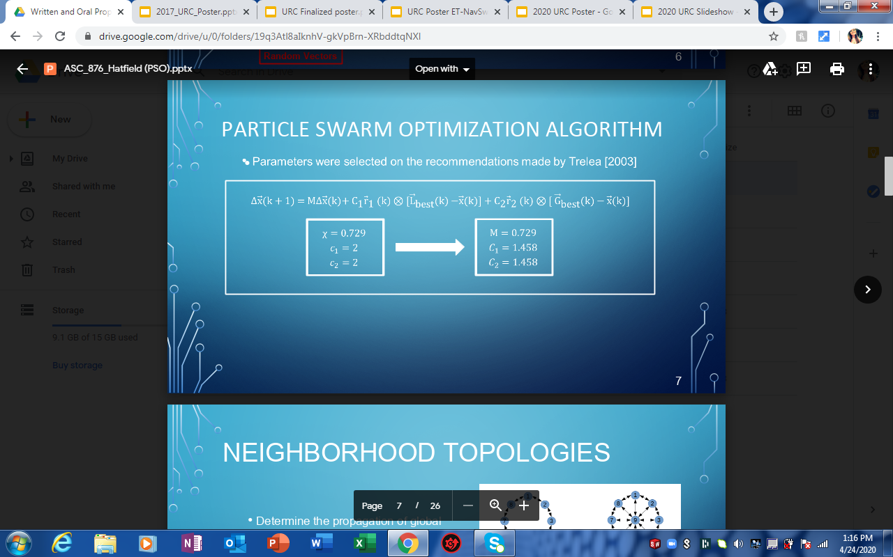
Particle Swarm Optimization (PSO)
Based on Swarm Intelligence by mimicking birds and fish
Mathematical principles for efficient movements and common goals
Searches for parameters that provide a maximum or minimum of a specific target
Swarm locates best/most efficient solution
Requires current velocity, local (personal) best location, and global best location from the search space

Slide 4
Software and Control
Arduino Mega and corresponding software used for all control and PSO calculations
Communication between rovers facilitated through XBee and corresponding software
PSO algorithm outputs direction vector, control system is used to physically map out vector
Control system is designed such that it compensates for low hardware resolution, for example the implementation of thresholds on all control systems output such as direction and velocity
Can incorporate obstacle avoidance in parallel with PSO control output using IR sensors

Slide 5
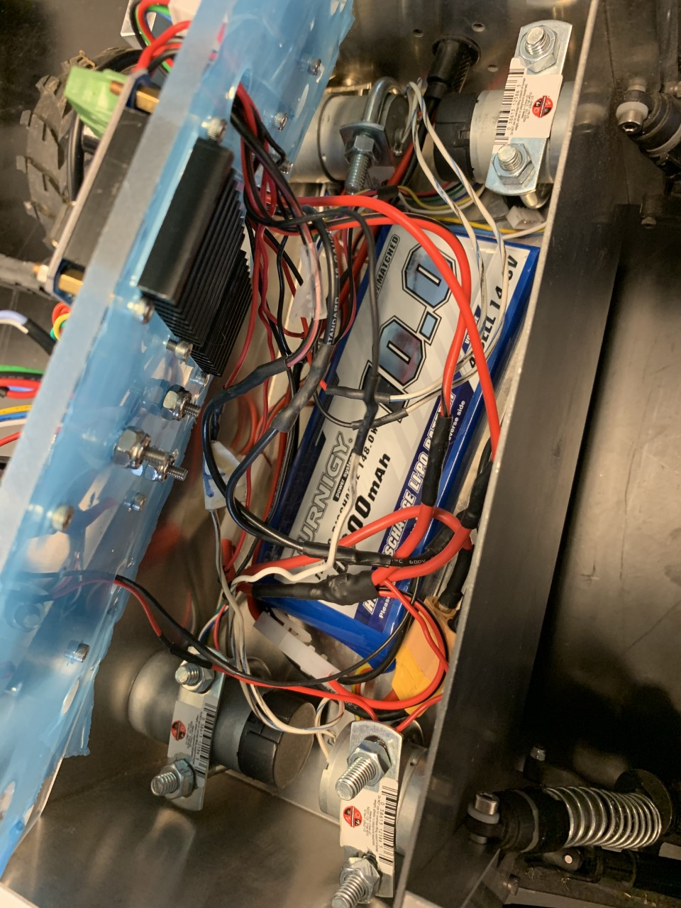
Roadblocks of Design
IMU Tower - “Unicorn Horn”
  Tower originally designed to prevent interference from magnetics inside the bot
  Completely removing the Tower has been sought after for years due to mechanical errors
Burnt Out Motors Under Stressful Testing
  Burnouts caused by over amperage due to external stress on the motors (resistance)
  Time consuming to replace parts
  Preventing future component failures is crucial
Components Damaged Overtime Due to Chaotic Interior
  Various components and wires “shoved” into the chassis
  Hard to tell what is actually not working with clutter
  Parts fall out easily
  Would be a huge Quality of Life improvement

Slide 6
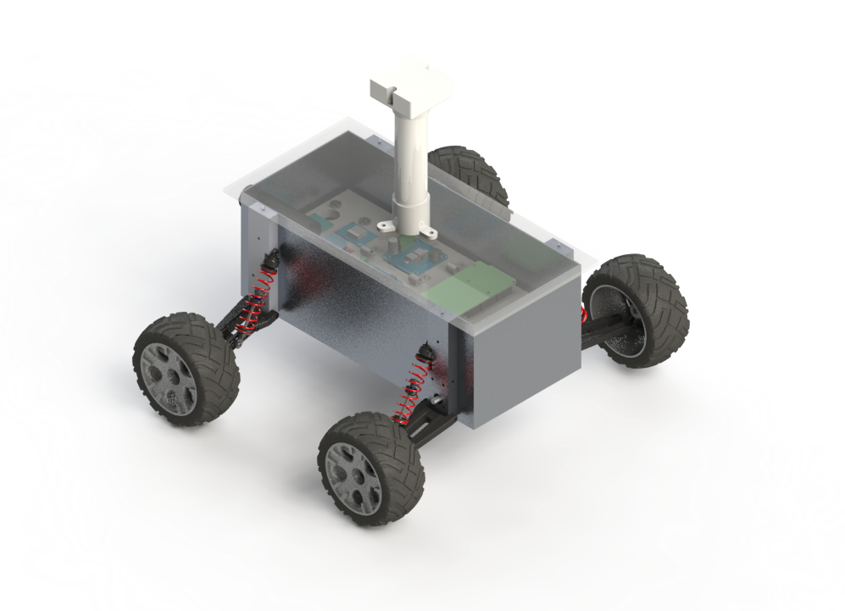
IMU Tower and Significant Locations
Current IMU Location
1 foot above the motors
On IMU tower
Proposed Location
6 inches above the motors
On the plastic shielding of robot chassis
Location of Magnetic Interference
Motors
Arduino Board
Notes:
When designing the bot to not have an IMU tower,
we found that the next ideal location for the IMU would be directly on top of the robot’s chassis,
This location would leave a 6 inch gap between the IMU and the magnetic interference generated by the motors.
This unfortunately results in half of the previous protection granted by the IMU tower’s 12 inch distance from the motor.
Maxwell’s equations indicate that this change of half the distance from the magnetic source should result in a 4 times increase in the magnetic field interference.
Therefore to remove the IMU tower we had to determine four main questions,
A comparison between the magnetic fields at each location,
if the same protection at the IMU towers’ height can be replicated at the proposed location through shielding materials
how the IMU’s ability to read true North is affected by interference at the proposed location.
And finally how these test work in the real life PSO testing

Slide 7
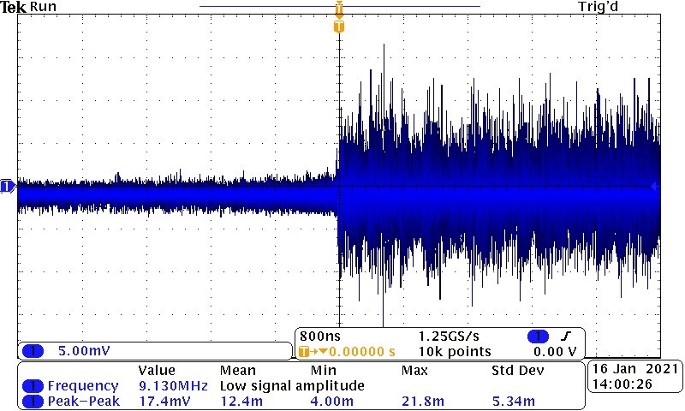
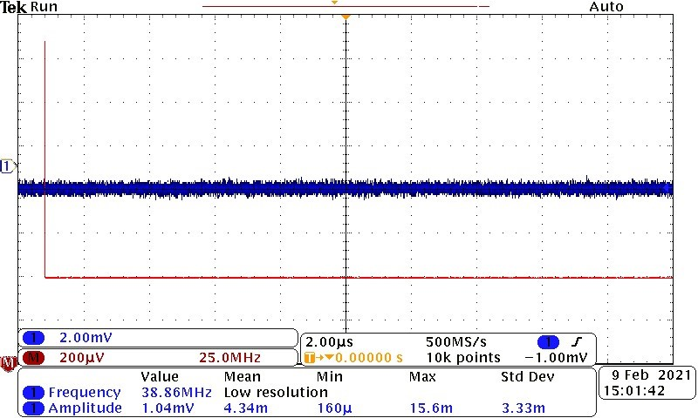
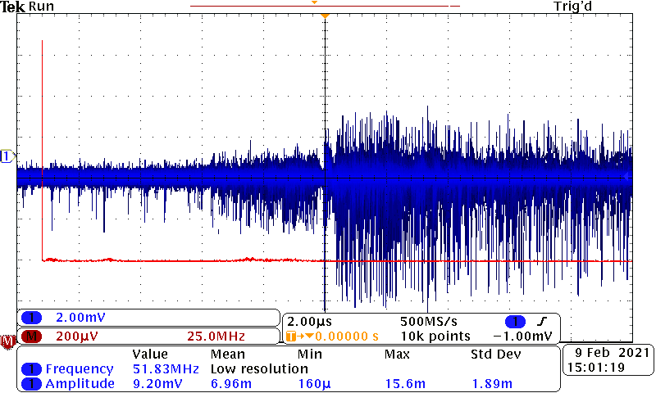
Magnetic Field Interference Measurement
At Source of Interference
1 inch Directly above the motor
  Using the 100 C Beehive H-Probe
At the IMU Tower Height
1 Foot Directly above the motors
  Using the 100 C Beehive H-Probe
At Proposed Location
6 inches above the motor
  Using the 100 C Beehive H-Probe

Slide 8
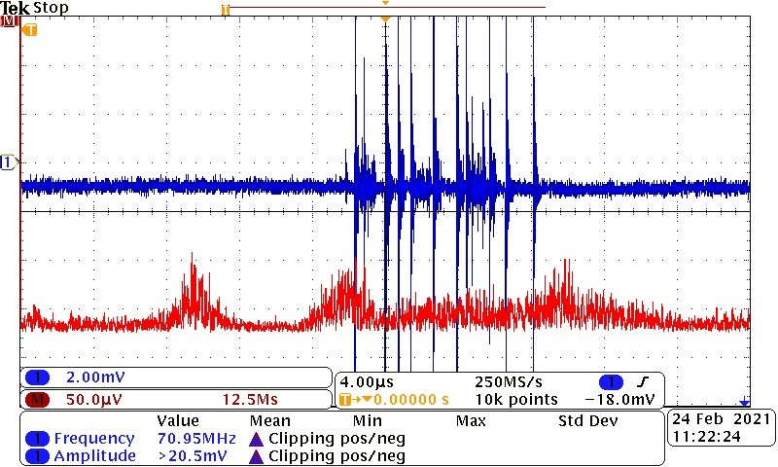
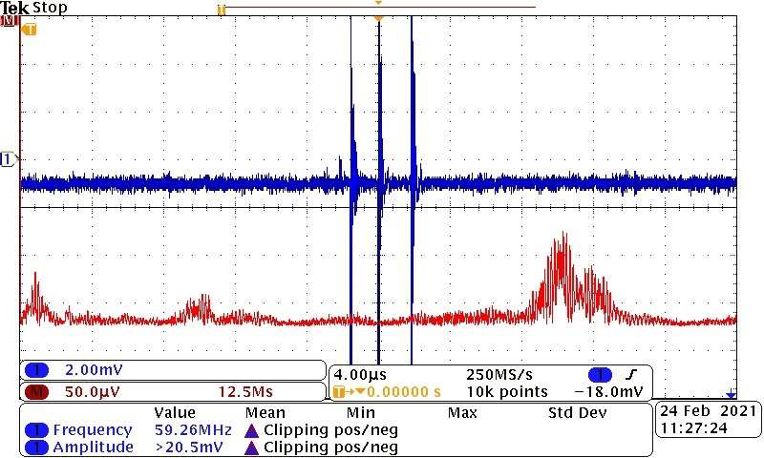
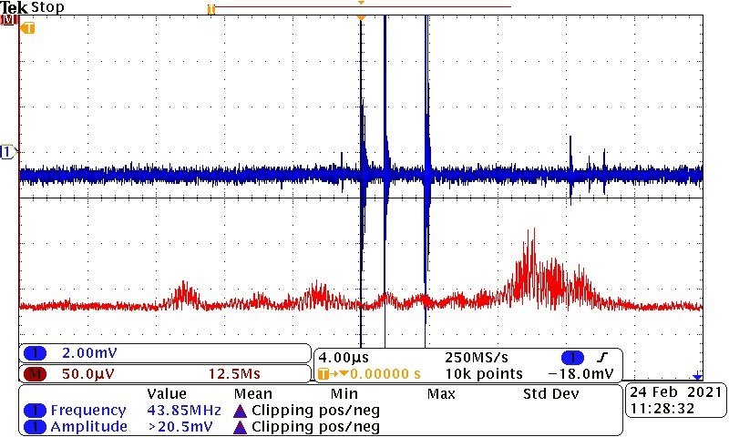
Fourier Analysis of Magnetic Interference
With and Without Shielding
Proposed Location above Source
Significant noise at 10-11.25MHz determine to be background noise unrelated to the motor
Sheet of Co-Netic Shielding AA 0.010’’
Reduces main noise components at 0-0.625MHz, 2.5-3.75MHz and 5-6.25MHz significantly as shielding improves
Reduce overall noise of the FFTnot including the band 10-11.25MHz
  Limitation comes from Probe noise at higher frequencies
Sheet of Co-Netic Shielding AA 0.025’’
Reduced all signals withing 0-0.625MHz to negligible noise
Reduce overall noise of the FFT not including the band 10-11.25MHz
  Limitation comes from Probe noise at higher frequencies

Slide 9
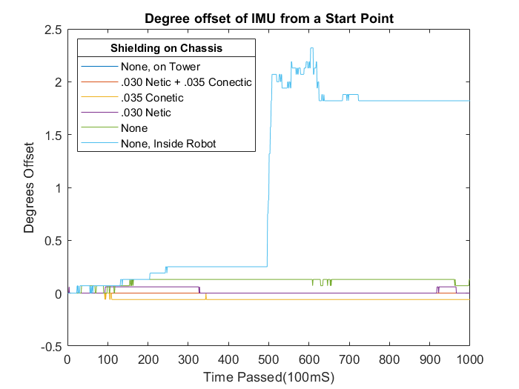
IMU Degree Change at Location
Tower and Co-Netic + Netic Shielding
  No Change Greater than 0.01°
Co-Netic Shielding and Netic Shielding
  Less than 0.1° Total Change
Top of Bot, No Shielding
  Less than 0.2° Total Change
  Limited Rapid Changes
Inside Bot, No Shielding
  Rapid Changes
  Greater than 2° Total Change

Slide 10
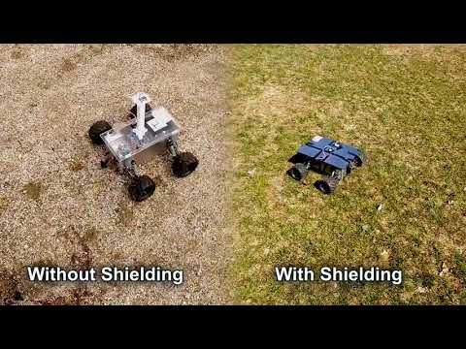
PSO Testing of Device
Device With Shielding
●Functions Identical to using an tower
Device Without Shielding
Functions nearly identical to shielding
  Rare issue in which IMU signal is interrupted and robot shift till it corrects itself
Comparison Between
Worse Case No Shielding
Normal Operation with Shielding
As seen on the right

Slide 11
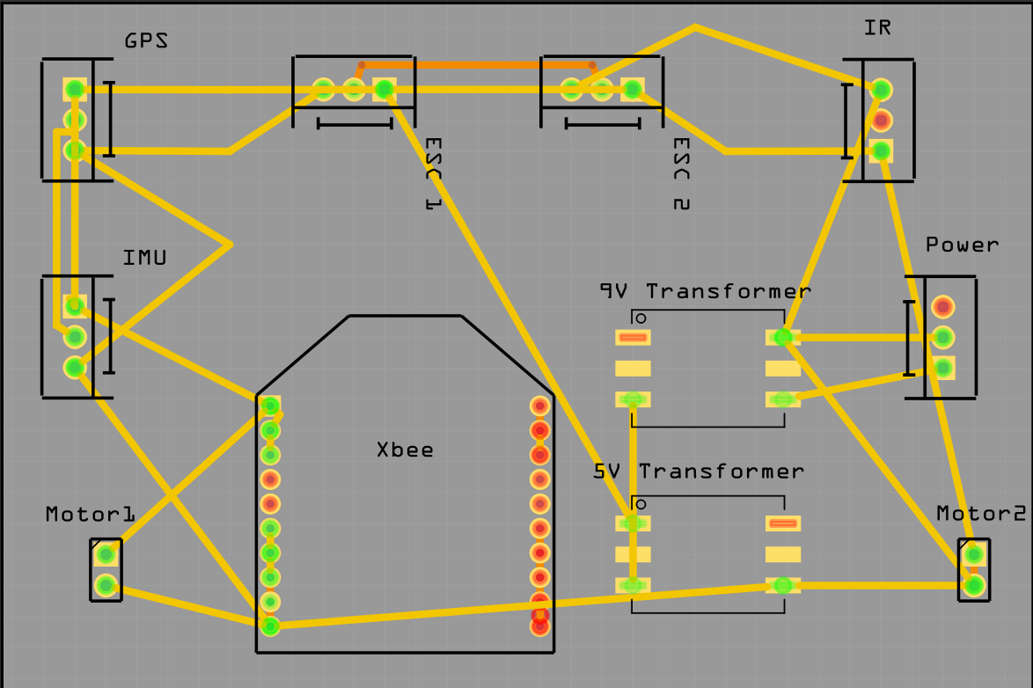
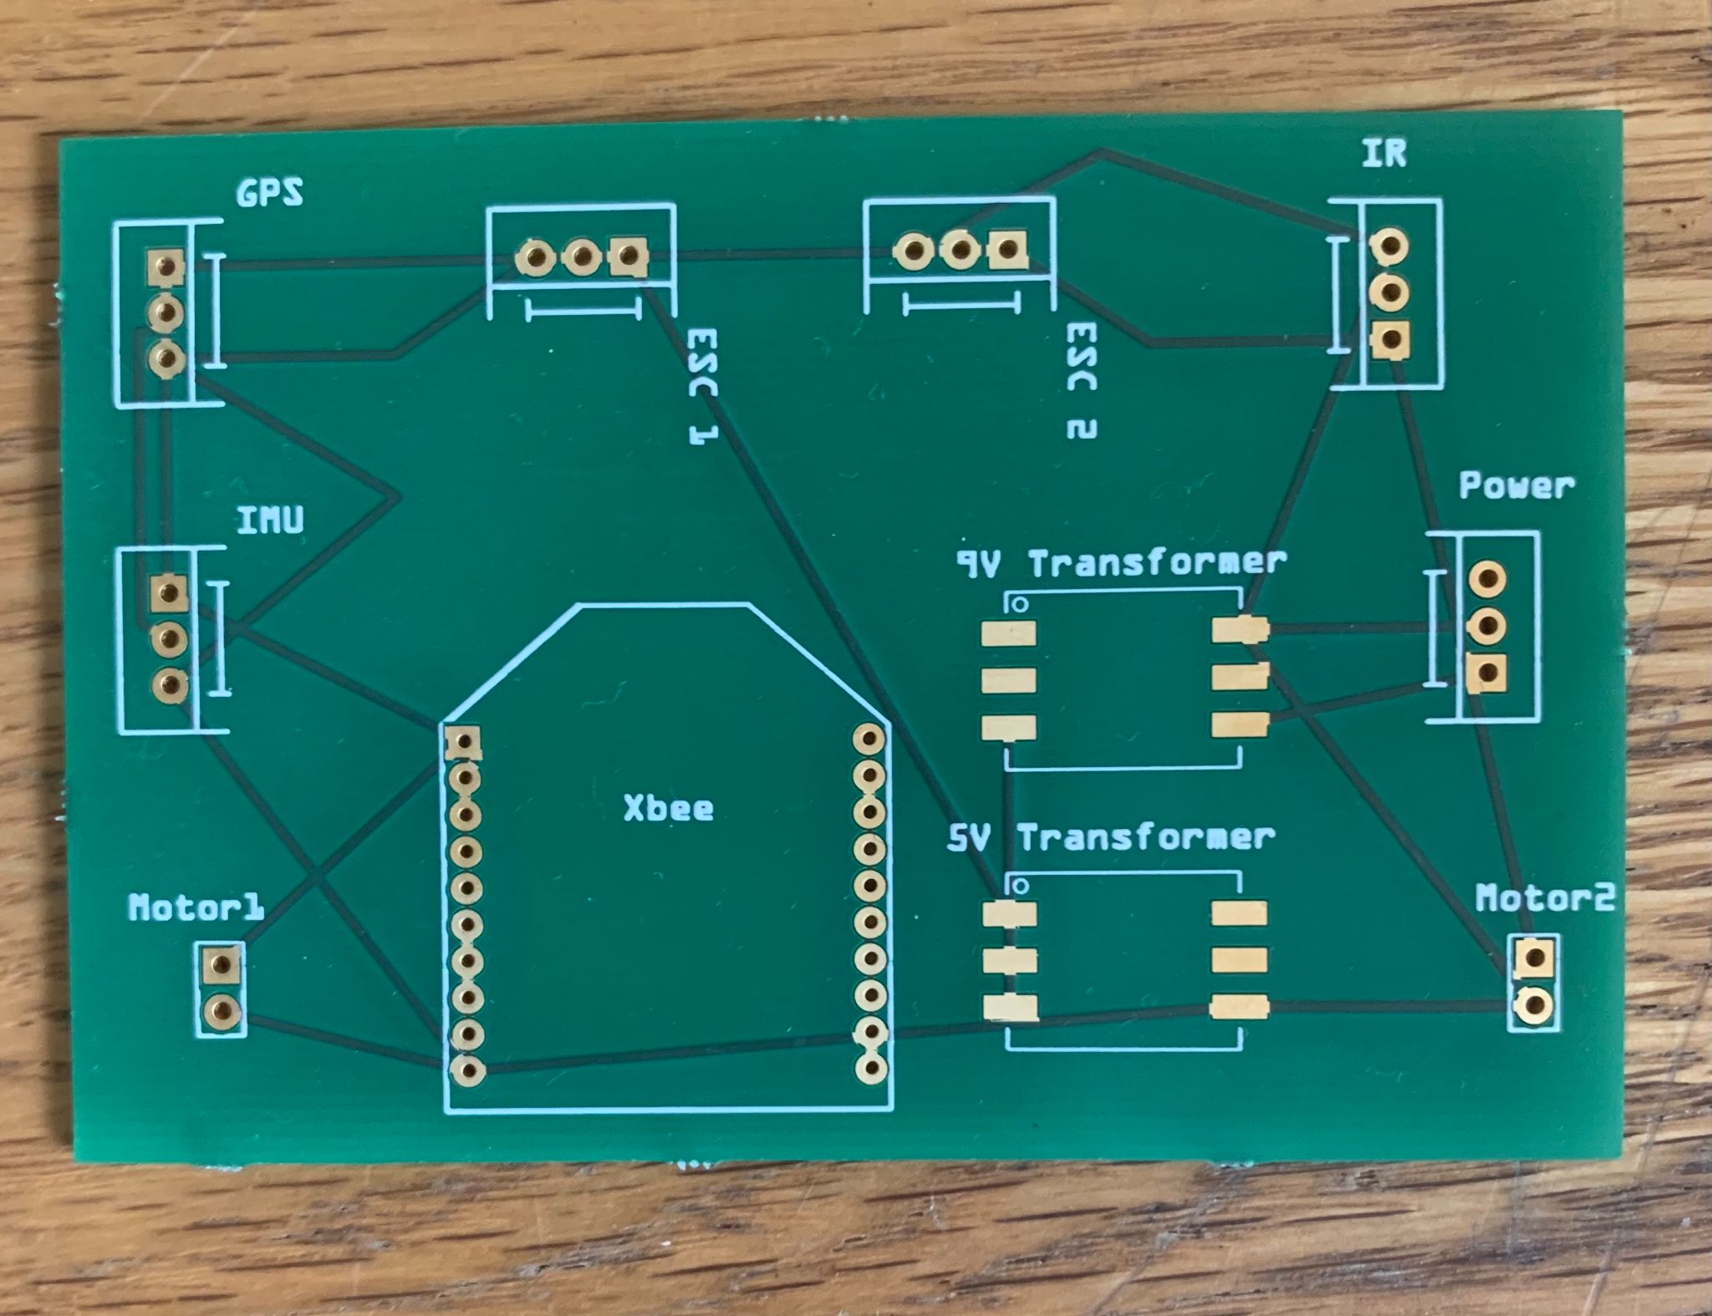
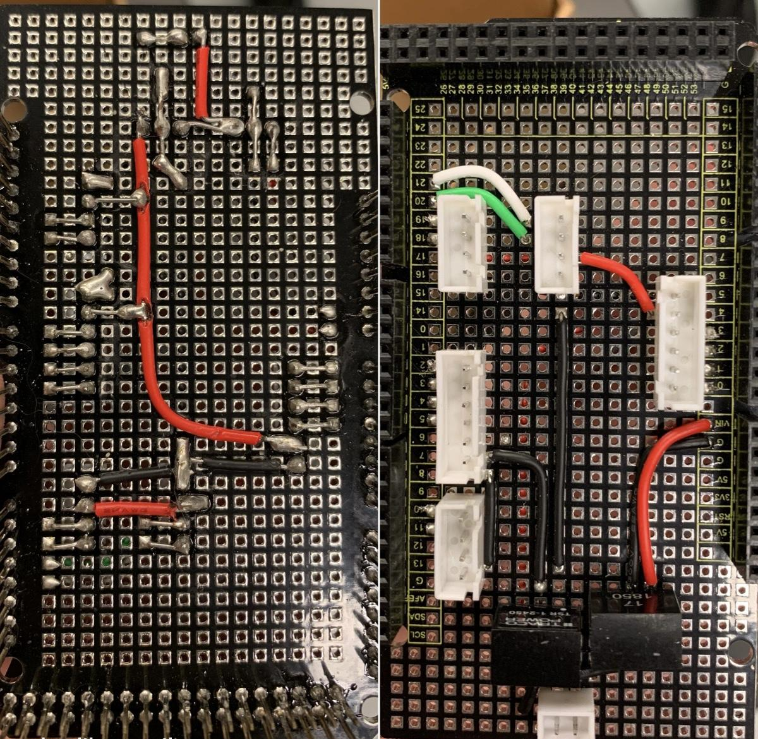
PCB Development
Current implementation is an Arduino Board
Cheaper
Durability
Less Manual Labor Required
Easy to adjust
Mass print options available

Slide 12
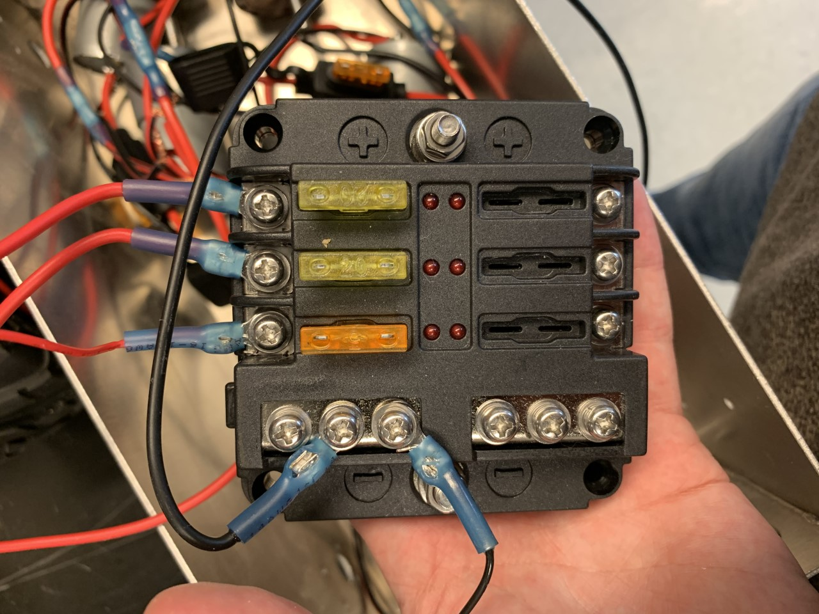
Component Burnout Prevention
Graduate Student provided a burnout problem
  Motors Burnout/Failure
What caused this failure
  Draws 0.664A through the ESC to power two motors with one ESC
  When disconnection occurs during high usage total amperage in the ECS connects to a motor and burns out the components
How to prevent
  Implementation of Fuse Box into circuitry

Slide 13
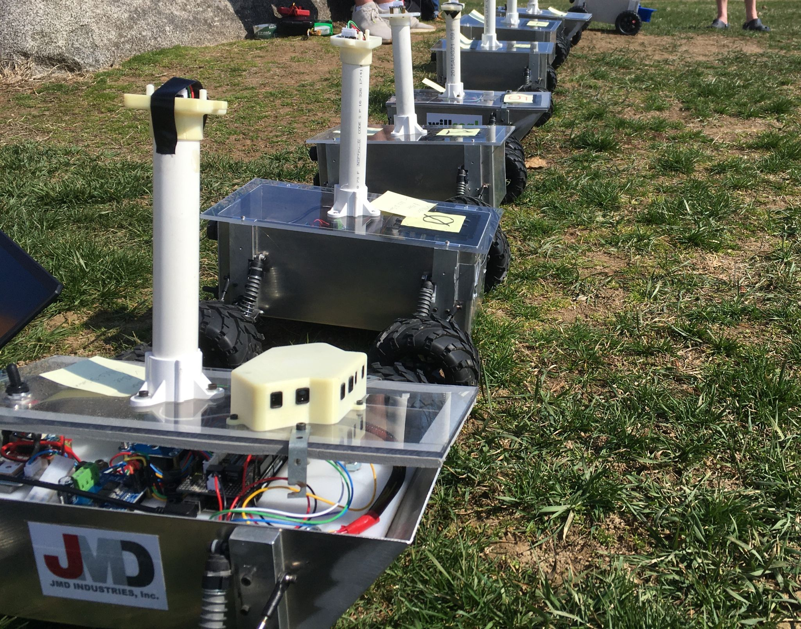
Future Work
Improved Shielding
Filter using Two IMUs
PCB
Fuse box

Slide 14
