Slide 1
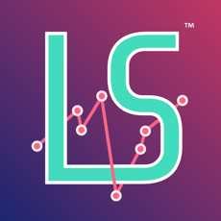
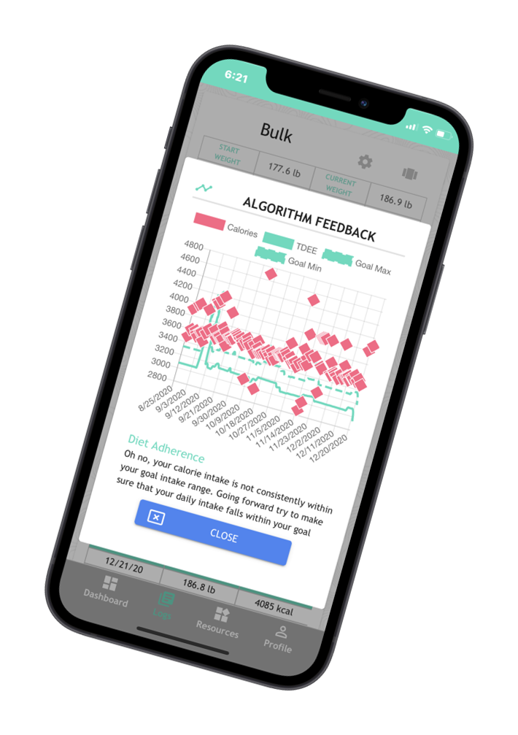
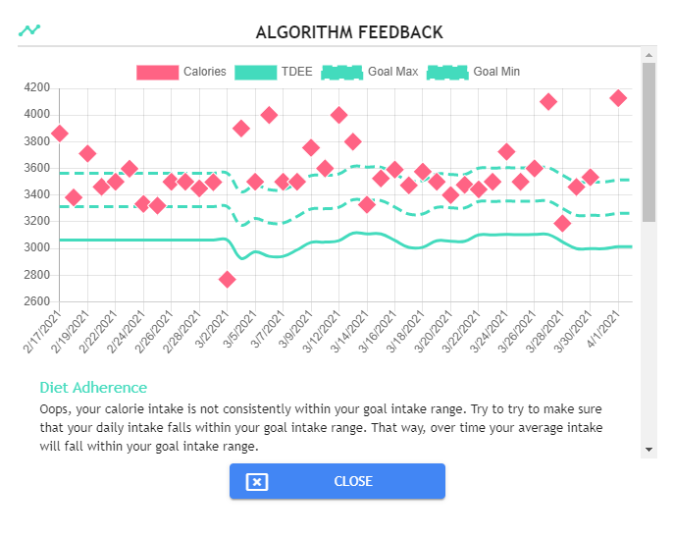
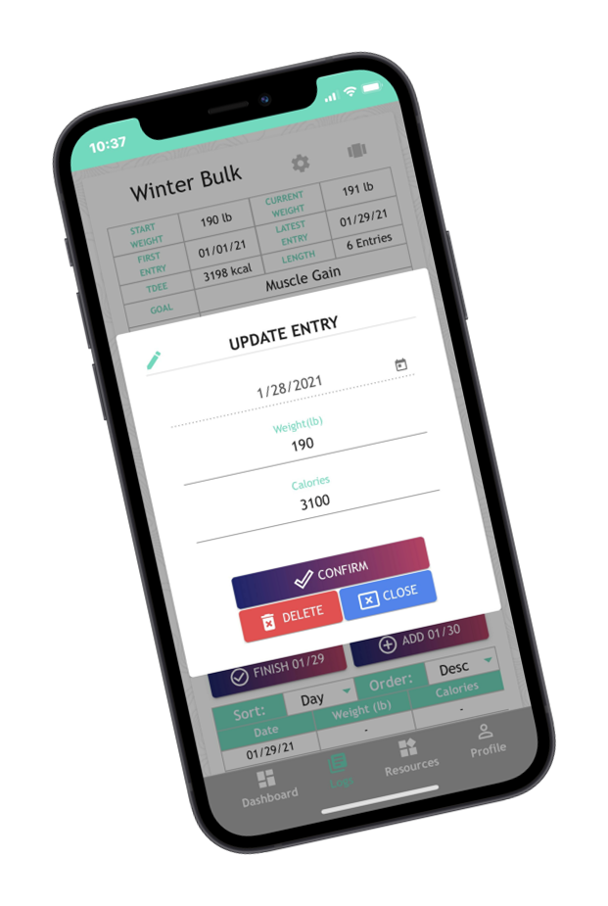
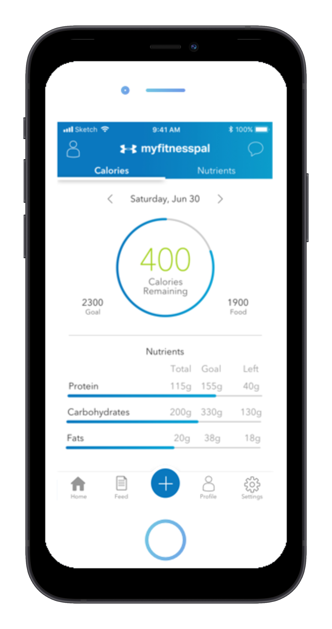
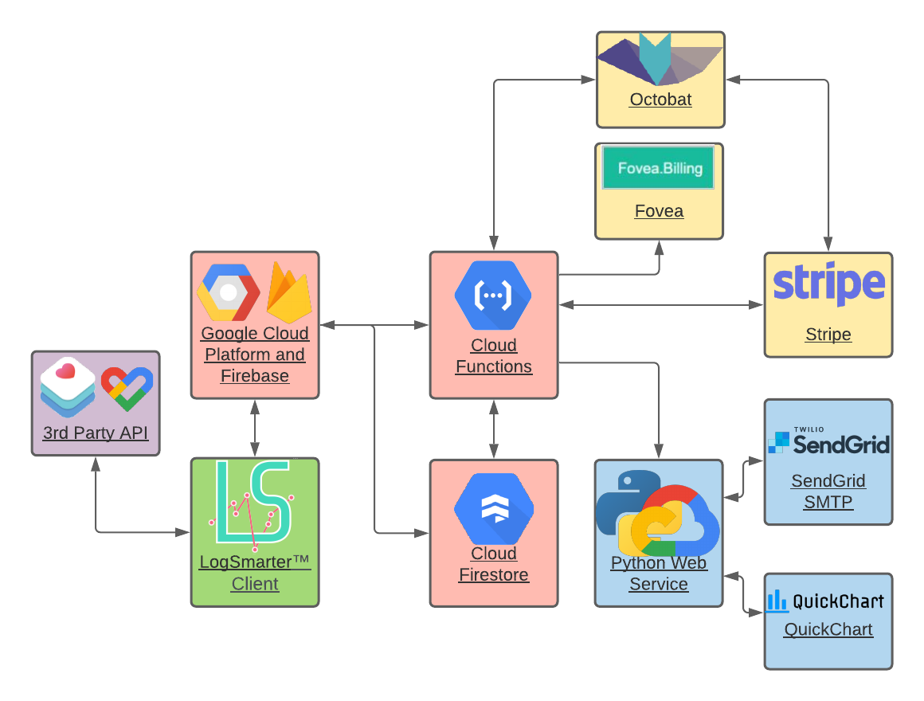
LS_ADAPT-Automating Data After Physical Transcription
Ryan Lefebvre, Bryan Choate, Keelan Piispanen, Bowen Bilodeau
Advisers: Professor Benedetto, Dr. Brandon Roberts
Department of Computer Science University of New Hampshire
LogSmarter.net
WHAT IS LOGSMARTER?
PROJECT IMPLEMENTATION
PROJECT RESULTS
Cross platform AI nutrition coach that uses machine learning
Real software with 1700+ users!
Sync with Google Fit and Apple health
Send algorithm feedback through email
Original App:
6+ clicks to enter data and receive feedback
Current App:
Only 2 clicks to enter data and receive feedback
CONCLUSION
PROBLEM
Faster data entry
Faster feedback
Users complained that manually inputting their data is tedious
CURRENT STATUS & NEXT STEPS
VALIDATION CRITERIA
TM
Improved UX: Number of clicks
Data syncing already live in production
Goal to deploy email feedback June 2021
ARCHITECTURE
LogSmarter Client: User syncs with 3rd party API and opts-in to email feedback
Cloud Function (Email): Send user’s data to Python webservice
Cloud Function (Sync): Request user data from 3rd party app, and update our database
Cloud Firestore: Database to store user’s nutrition data
Python Web Service: Create a chart with the user’s data through QuickChart, then sends an email with SendGrid email API
Octobat, Stripe, Fovea: Billing, taxes and micro-transactions
GOAL
Reduce time it takes to:
Enter data
Receive algorithm feedback

