Slide 1


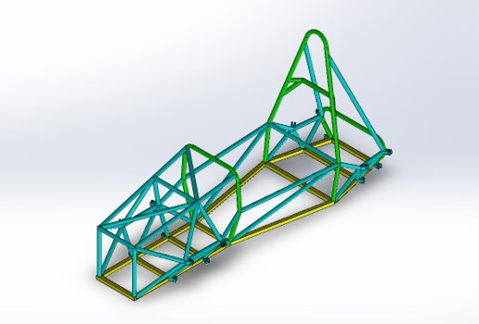
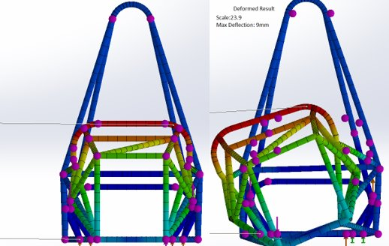
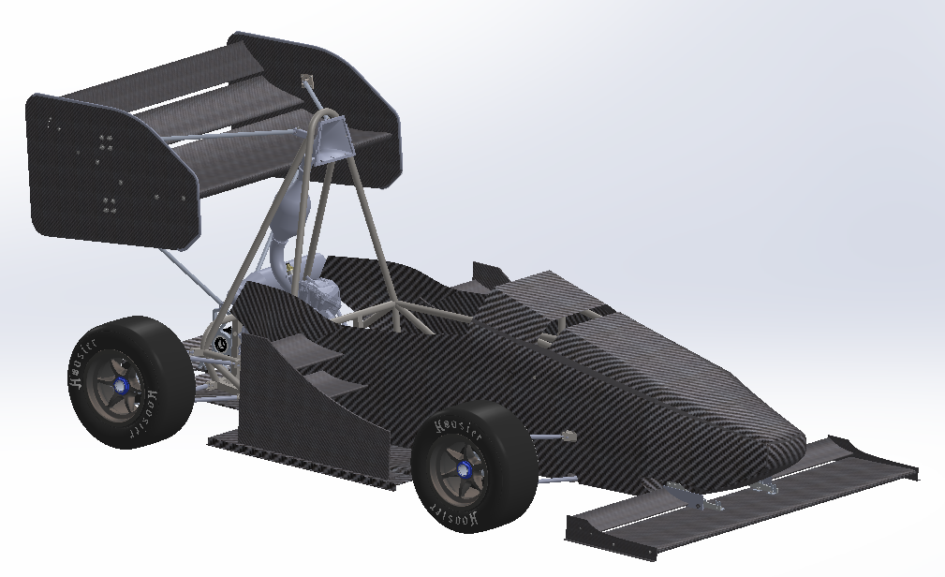
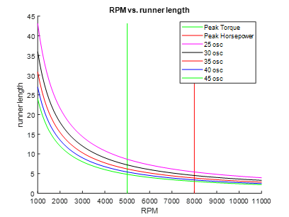
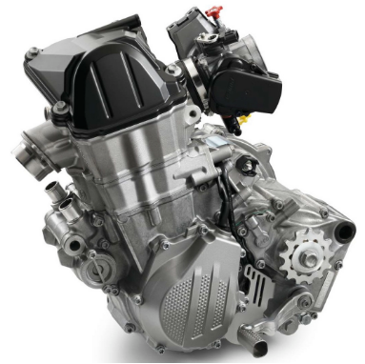
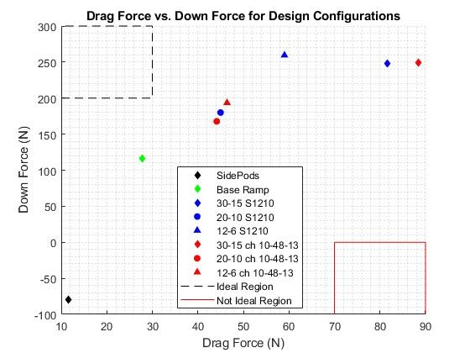
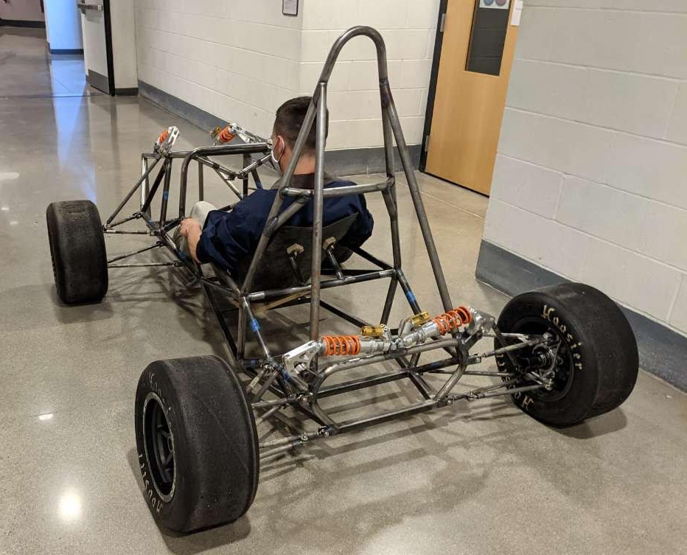
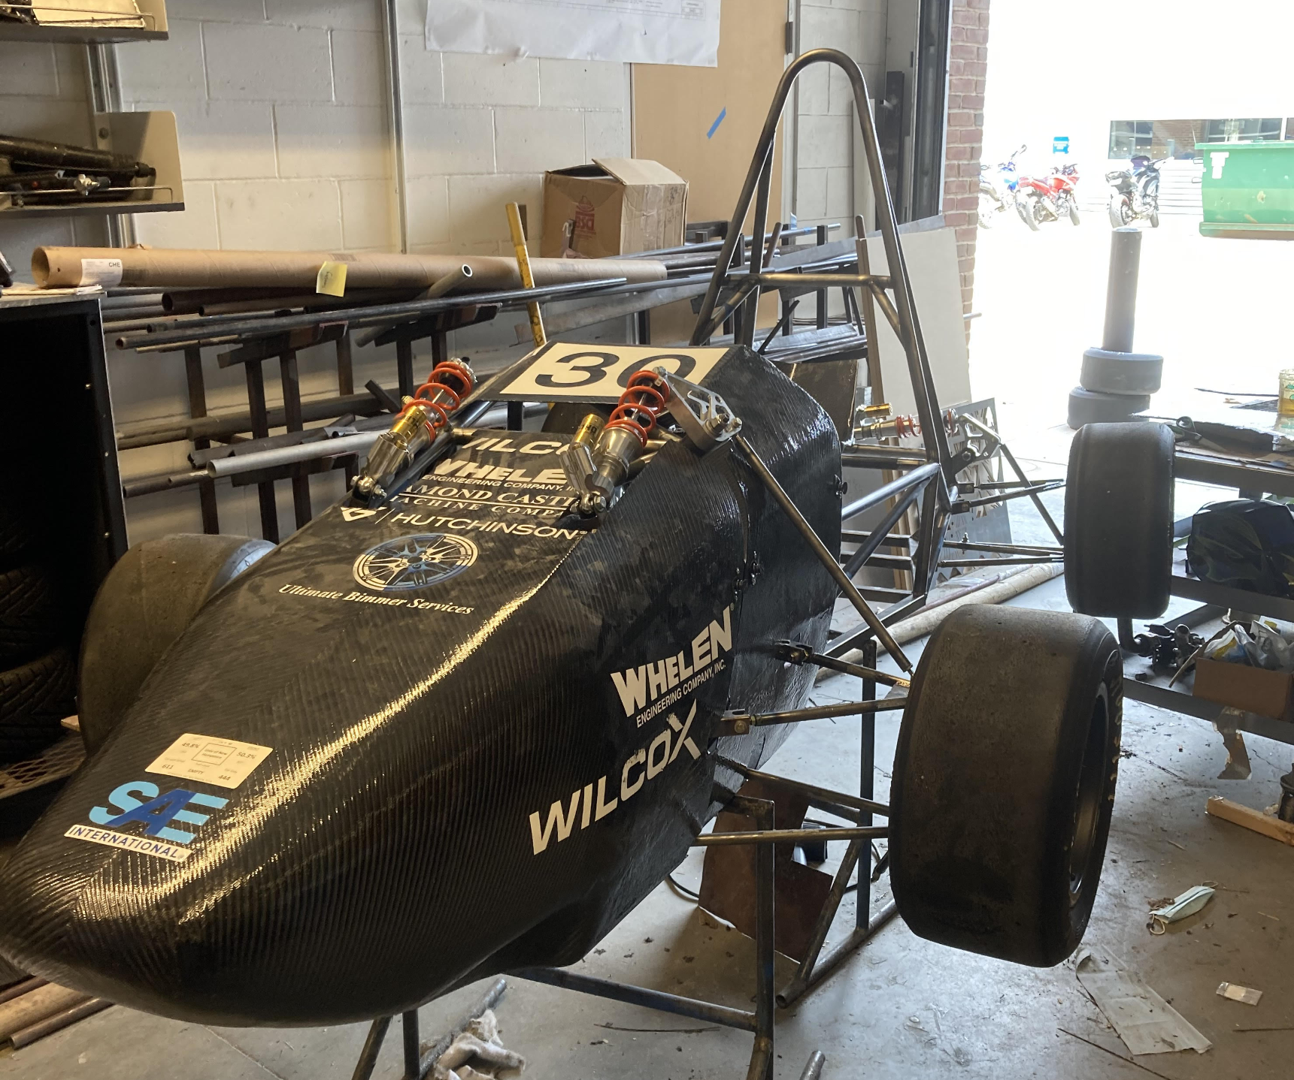
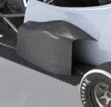
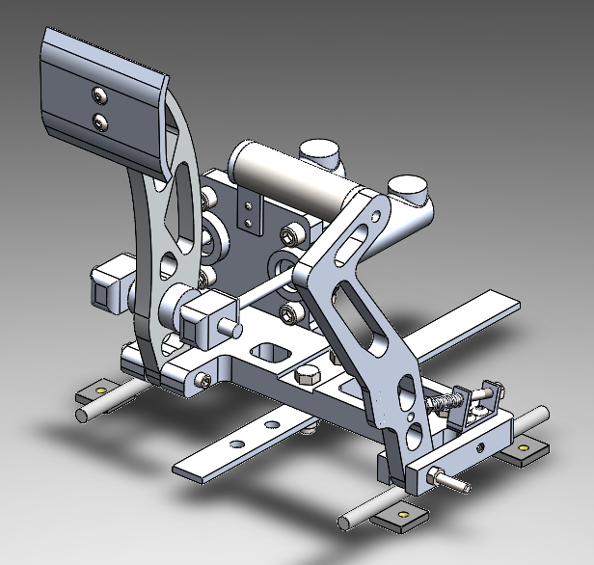
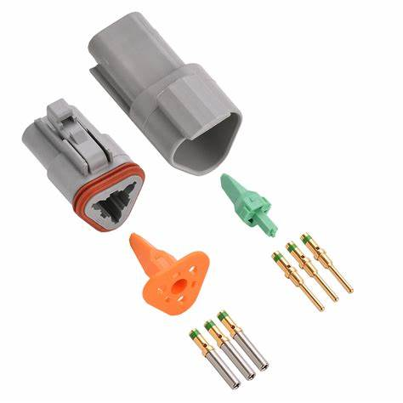
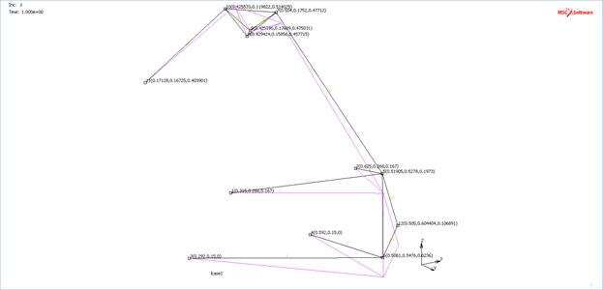
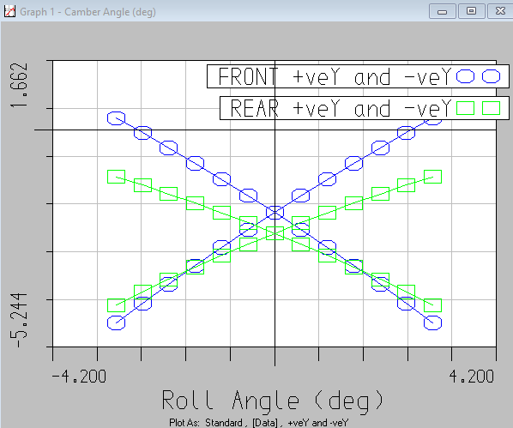
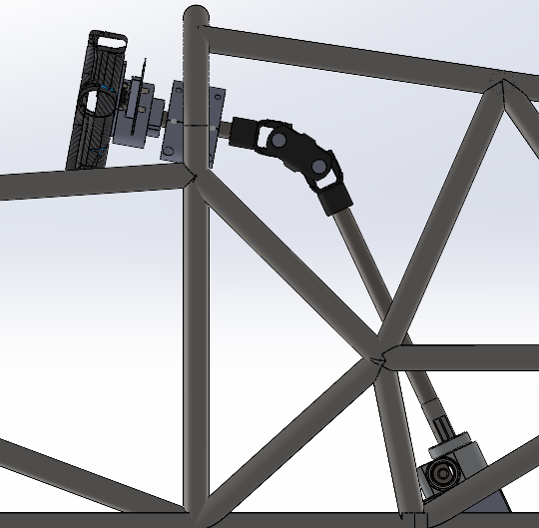
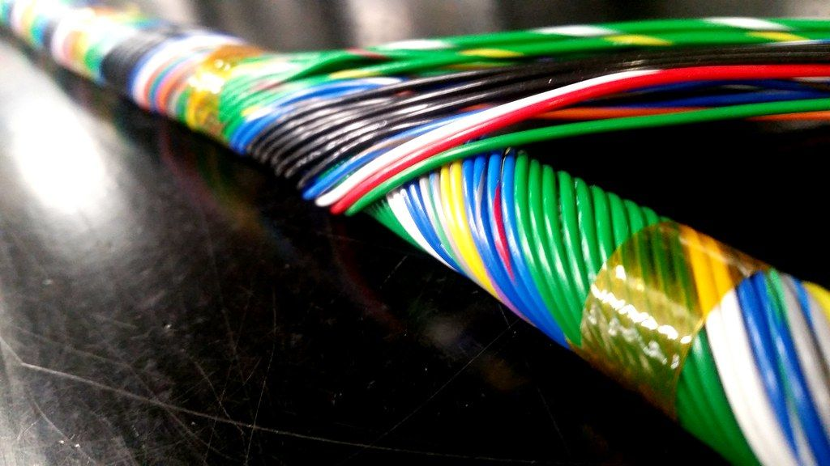
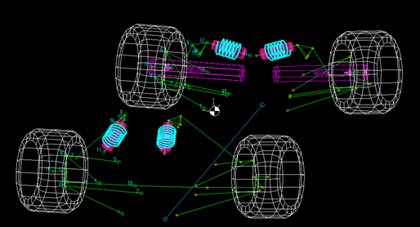
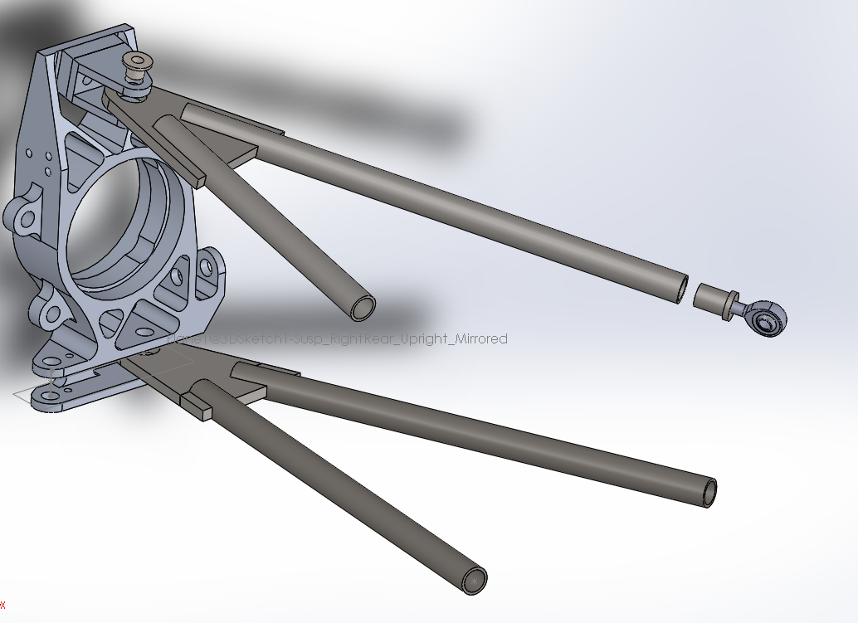
UNH Precision Racing Team 2021
Frame
College of Engineering and Physical Sciences
Mechanical Engineering Department
Powertrain
Construction:
  AISI 1020 steel
  Base 1" x .65 Wall Square
  Hoops 1"x .95 Wall tube
  Other: 1"x .95 Wall tube
Design
  Goal: 10 time the tortional rigidity of the suspension
  Tortional Rigidity: 3550 [Nm/Deg]
  Allows for optimal suspension mounts
  Fits a driver of the 95th percentile
  Adheres to SAE rules
Team Members
Project Managers: Patrick Anderson, Timothy Ziadeh, Cooper Spaulding
Controls: Patrick Anderson, Sungjoon Shinnishi
Frame: Thomas Miller
Aerodynamics: Timothy Ziadeh, Cooper Spaulding, David Swan, Sawyer Banley-Bill
Powertrain: DJ Simoneau, Nelson Kim, John Gallo
Suspension: Jarrod Arruda, Justin Lomba, Jacob Dow
Faculty Advisor: Todd Gross
Engine
  2017 KTM 450 SX-F
  Max Torque : 34lb-ft @ 7000 RPM
  Max Power: 53 HP @ 9500 RPM
  Naturally aspirated, 93 Octane
  High torque at low RPM's and linear power curve makes driving easier for inexperienced drivers
Drivetrain
  Chain Drive
  Drexler Limited Slip Differential
Cooling System
  Rear mounted 2 core aluminum radiator with fan mounted on the rear side
  Fans are controlled by the ECU and automatically turn on when specific temperature is reached
RPM vs. Intake Runner Length
Aerodynamics
Increased Structural Integrity of:
  Multi-element Rear Wing
  Multi-element Front Wing
  Diffuser
  Body/Nose Cone
Re-designed:
  Side Pods into Side Ramps
  Mounting designs
Side Aero Package Design Considerations
Overall Aero Package
  Coefficient of Lift: -4.93
  Coefficient of Drag: 1.71
  Lift to Drag Ratio: -2.88
2018-2019 Car
2020-2021 Car
Suspension
Purpose
  Resist chassis roll – maximize tire contact patch with road
  Roll center placement prioritizing responsiveness
  Minimize roll center migration, increase stability/predictability
  Select coilover to achieve desired ride frequency and roll rate
  Adjustability: static camber, ride height, toe
Geometry Selection
  Double wishbone, Short-Long Arm (SLA), camber gain in bump
  Front bell-crank repositioned out-of-plane to improve packaging
Component Modeling & FEA
  Reusing steering rack, coils, tires, F&R uprights, axles, CV joints, differential
  SolidWorks 3D modeling - FEA and kinematics in MSC Marc Mentat, MATLAB, & LOTUS Shark
  Forces from Calspan tire data used to predict dynamic forces
Manufacturing
  Waterjet in Olson Center, finish machining in CEPS machine shop
Controls
Electronics
Pedal Assembly
  6061-T6 Aluminum pedals and plates to withstand 2000N force from the driver
  Mounted on sliding rails for easy adjustments to accommodate the 95th percentile male
Electronically Actuated Shifter
  Depressing the clutch between shifts is not required after launching the car
  Up shifts will be around 400ms
  Utilizing ignition cut in ECU tuning to unload clutch
Steering Column
  Utilizes double universal joint designed for automotive steering shafts
  4130 alloy steel steering shaft for its compatibility, strength, and the low difficulty for welding and machining
  Rack mounted behind the front axle to improve turn-in response
Engine Management
  Microsquirt standalone Engine control unit
  Dual injection for better fuel control and atomization
  Variable Reluctance crankshaft position sensor
  Ignition cut for launch control and shifting
  Closed loop fuel and idle control
Wiring Harness
  Breaker protected circuits for easy reset and short protection
  Concentrically twisted harness
  Deutsch connectors for IP67 protection and high cycle life
  Crimped wire connections for greater strength than solder

