Slide 1
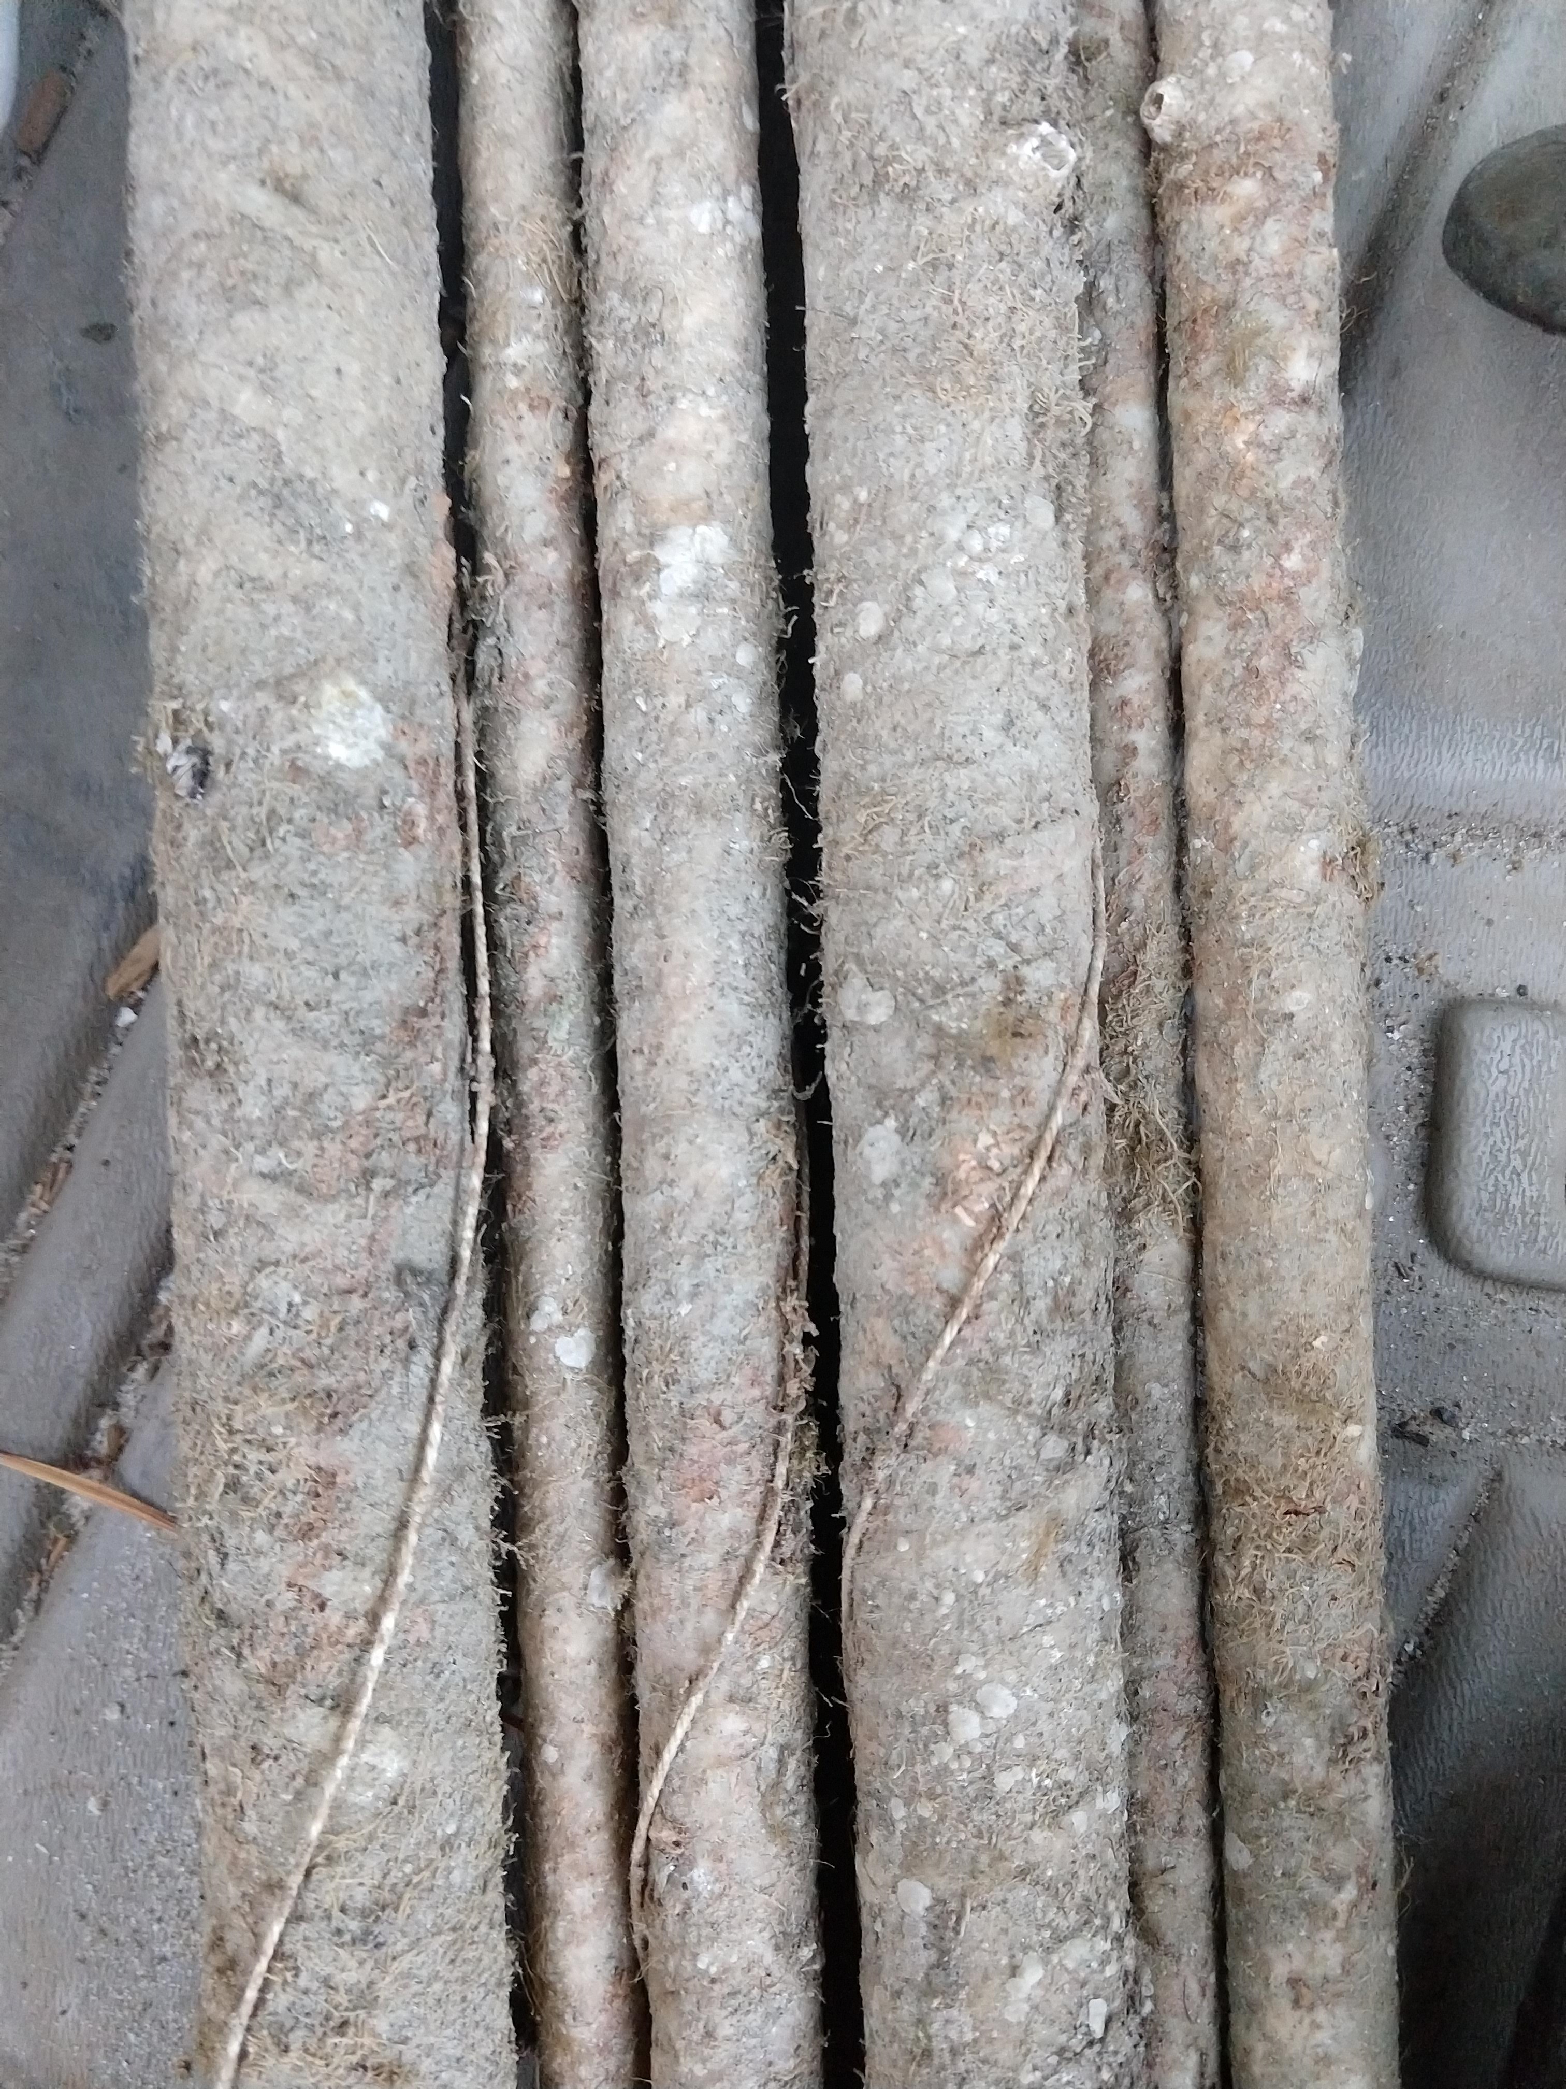
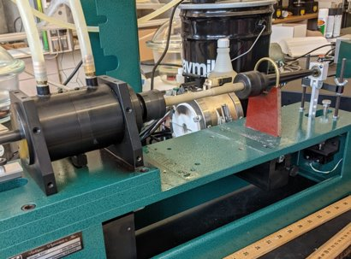
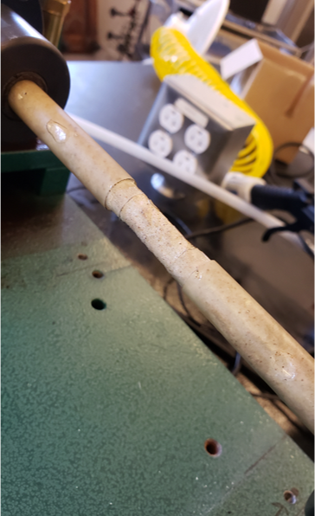
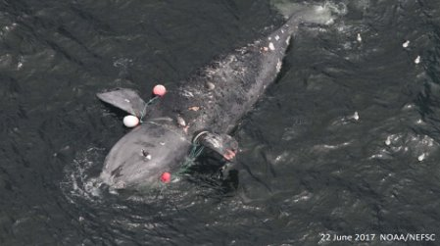
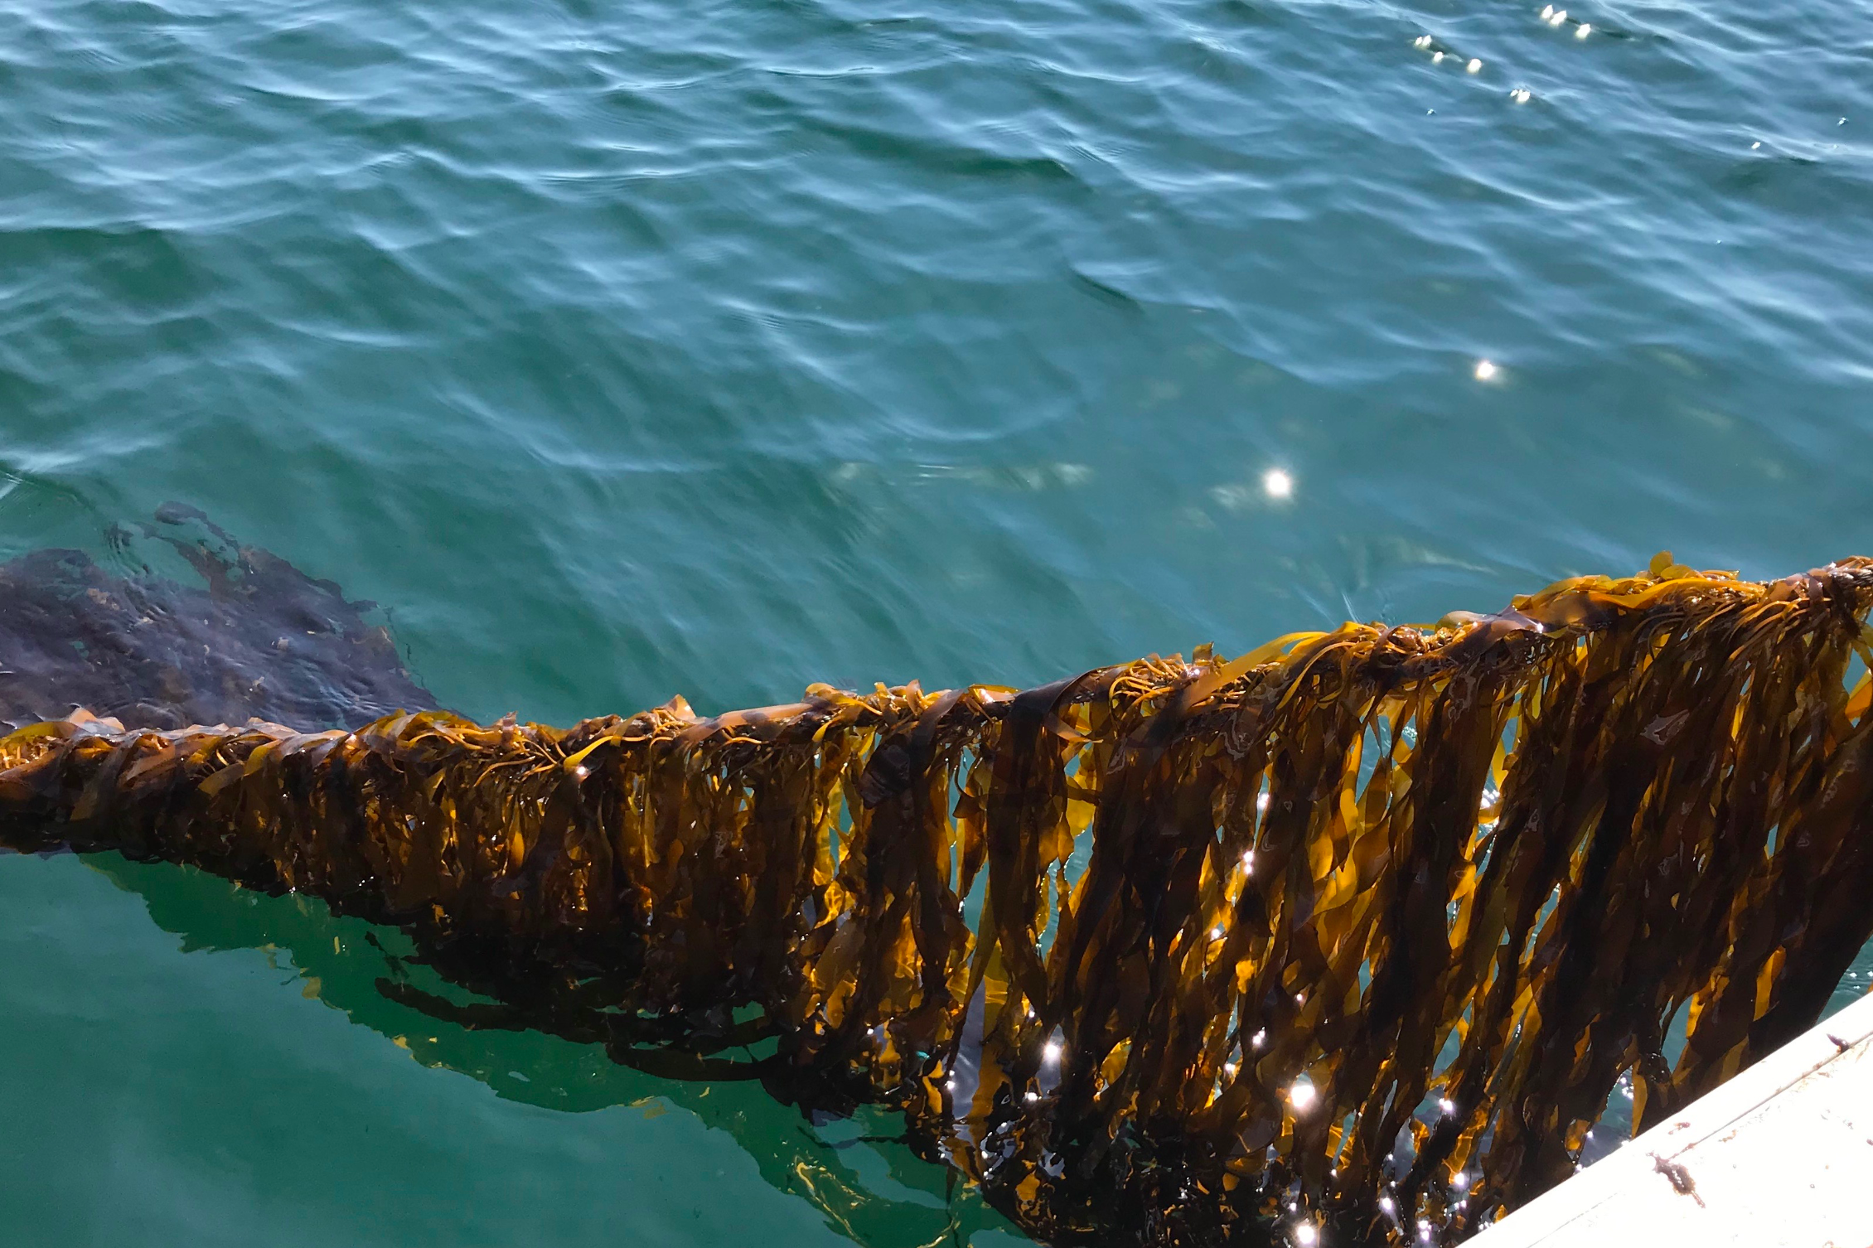
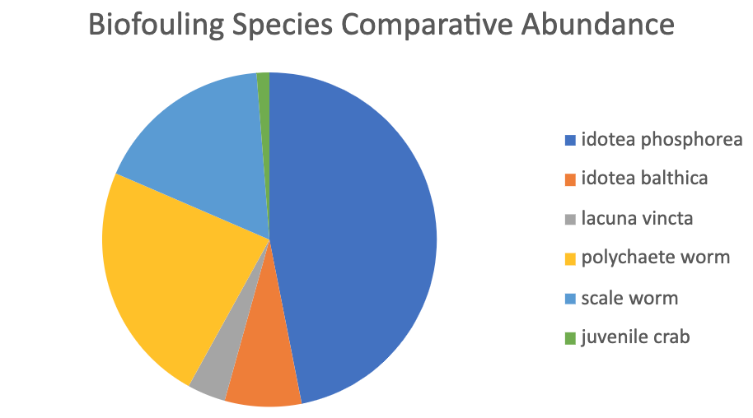
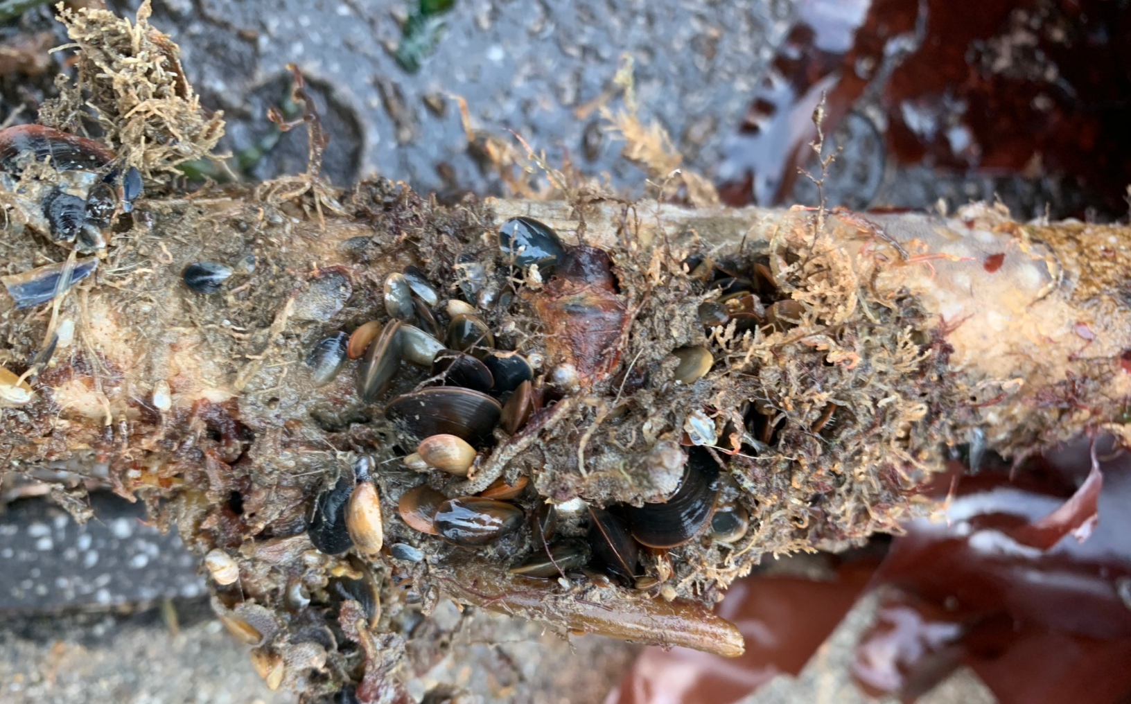
Composite Lines for Kelp Aquaculture
Olivia Luthringer, Haley Fong, Emma Kross, Garrett Frohman, Rachel Barden
College of Engineering & Physical Sciences, University of New Hampshire
Background & Introduction
Engineering Design – Line Terminations & Composite Line Choice
Offshore kelp aquaculture is a burgeoning field with the potential to allow farmers to produce a sustainable and high yield crop which does not require the land and fresh water resources that traditional agriculture necessitates. However, ropes from offshore kelp farming could pose an entanglement threat to marine mammals such as the North Atlantic Right Whale. In an effort to mitigate these potential risks, our team aims to replace fiber ropes in aquaculture systems with composite lines. Our goal is to design a composite line that will break if impacted by a large marine animal, like a whale, but will also be strong enough to support the growth of kelp and withstand the forces of the ocean.
Our research over this past year has focused on TUF-BAR, a corrosive-free fiberglass rebar. The mechanical properties of these bars eliminate marine mammal entanglement by breaking as the result of a collision. During a collision, the composite line will snap instead of wrapping around a marine mammal, which will reduce the risk of drowning but may increase abrasive skin wounds.
The design of this research focuses on the biological and engineering aspects of using composite lines. Biological objectives included identifying biofouling species that accumulated on the composite lines and researching how those biofouling organisms could affect the composite and kelp growth. Comparing the kelp growth, attachment of holdfasts and biofouling on common line types to the composite lines was also explored. Engineering objectives focused on the mechanical ability of the TUF-BAR rods, which included laboratory fatigue and tensile tests, scanning electron microscopy, and field-testing.
Choice of Composite:
The composite selected for our research is TUF-BAR, a fiberglass rebar composed of vinyl ester and E-CR glass fiber. No previous research has been published on the long-term effects of seawater on vinyl ester and fiberglass rebar, so we researched the interactions of seawater on composites to figure out which composites could remain strong enough to survive normal ocean conditions but break during a whale interaction. According to our research, our conclusion is that the TUF-BAR rebar is unlikely to break in less than a year under typical ocean conditions, and is likely to break in the event of an interaction with a whale.
Technologies Used:
Two fatigue testing machines were used: RBF-40HT and RBF-200HT
To create molds which were used to pot samples in epoxy: ABS 3D printer
To test strength of composite terminations: Instron Universal Testing Machine
Composite Terminations:
Proper mounting of the mooring system involved the design and development of terminations. The design is composed of two aluminum plates with a 10mm hole in the middle for the composite rod to fit in. There are eight bolts on the terminations, which are torque wrenched to a force of 200 in-lb. Terminations were designed to withstand the natural forces of the ocean. Our target goal was to withstand at least 4000 lb
tensile force. Following Instron tension tests, the target goal was met, and the terminations failed at almost exactly 6000 lbf. These terminations will be mounted to the seabed, and act as the anchors for the mooring system.
Fatigue Testing:
Students conducted experiments testing the fatigue strength of the exposed and unexposed rods. The experiments were meant to test each rod at 10% of its minimum breaking strength (MBS), which is about 87 lb-in, for 10 million cycles. This moment was chosen because it is roughly similar to the typical forces which would act on this rod in the ocean during periods of significant kelp growth. Due to machine repairs in process on the higher-capacity RBF machine, the unexposed rod sample was tested on the RBF-40HT running at 3% MBS, about 26 lb-in. The sample ran for 10 million cycles and did not break. After the RBF-200HT was repaired, students began testing an exposed rod sample at 57 lb-in, about 6.5% of MBS. This test is currently ongoing.
Our Goals & Project status
kelp growth & biofouling on Composite lines
Goals: To create composite lines for kelp aquaculture that are strong enough to support the cultivation of kelp, withstand the force of the ocean over at least one year, and is able to break if encountered by a large marine animal, such as a North Atlantic Right Whale. This is to make sure efficient aquaculture can be conducted in an open ocean system, without causing damage to the natural ecosystem or lifeforms in the area.
Current project status: The exposed rods are still currently undergoing fatigue testing in the RBF-200HT and this will continue after we graduate this May. This is to see if the rods can withstand the force of the ocean over a year. Further biological research and field experiments surrounding the holdfasts of the kelp and their ability to attach to the composite lines would be useful in the development of this kelp aquaculture system.
Species Identification
algaes | mollusca | arthropoda
Ascophyllum nodosum | Anomia simplex | Balanus eburneus
Capsosiphon grornlandicum | Crepidula fornicate | Caprella mutica
Chaetomorpha picquotian | Lacuna vincta | Eurydice pulchra
Chlorophyta | Mytilus edulis | Idotea balthica
Choetomorphia linum |  | Idotea phosphorea
Coralina officinalis | annelida | juvenile crab
Dasysiphoria japonica | Lepidonotus squamatus
Fucus distichus | Nereis pelagica
Laminaria longicruris
Palmaria palmata | bryozoans
Palmaria palmata | Membranipora membanacea
Ulva compresa | Tricellaria inopinata
Ulva intestinalis
Zostera marina
Methods & Techniques:
Biofouling that accumulated on the composite lines of a previously deployed test structure at the UNH AquaFort was carefully removed and frozen to take back to the lab. Organisms were identified and recorded from the images taken using various identification books and online resources. The biofouling effects of the organisms identified were then compiled into a report. A second experiment was designed to study kelp growth and biofouling accumulation on the composite lines compared to two common types of lines used in kelp aquaculture systems: nylon and polypropylene. Two of each line material were secured vertically into the water, where one of each was seeded with skinny kelp to ensure growth. The experiment was monitored by staff members at the UNH pier and data was collected by Haley and Emma biweekly. The data that was recorded consisted of kelp length and width on each line, biofouling present, holdfast growth and attachment, pictures taken of the full lines, and GoPro videos while the lines were still underwater to record active biofouling as many species swim off the lines when they are retrieved from the water.
Credits & Acknowledgments
We would like to give thanks to NH Sea Grant and the UNH Mechanical Engineering Department for their generosity in funding and supporting this project through the Undergraduate Ocean Research Projects class. We would also like to acknowledge the US Department of Energy’s ARPA-E program for funding the project (award no. DE-AR0000923) for which this work was a component.
Effect of biofouling on composite lines :
Our observations from the experiment so far have shown that presence of biofouling and overall kelp growth on composite lines is comparable to growth found on typical aquaculture lines including polypropylene and nylon. The rope experiment is still ongoing to track differences in holdfast attachment to the composite material compared to the other line types as well as the differences in kelp growth and biofouling presence.

Slide 2
Background and Introduction
Kelp aquaculture is a burgeoning field with the potential to allow farmers to produce a sustainable and high yield crop that does not require the land and freshwater resources traditional agriculture does. However, ropes from offshore kelp farming have the potential to pose an entanglement threat to marine mammals such as the North Atlantic Right Whale. In an effort to mitigate these risks, our team aims to replace fiber ropes in aquaculture systems with composite lines. Our goal is to design a composite line that will break if impacted by a large marine animal, like a whale, but will also be strong enough to support the growth of kelp and withstand the forces of the ocean.
Our research over this past year has focused on TUF-BAR, a fiberglass rebar. The mechanical properties of these bars have the potential to eliminate marine mammal entanglement by breaking as the result of interaction with a whale. If a whale were to encounter the composite line, it will snap instead of wrapping around a marine mammal, which will reduce the risk of tangling and subsequent lacerations or drowning. The design of this research focuses on the biological and engineering aspects of using composite lines. Biological objectives include identifying biofouling species that accumulated on the composite lines, researching how the biofouling organisms could affect the composite materials and kelp growing on the lines, looking into kelp holdfast attachment, and completing an experiment to collect data on how kelp and biofouling grows on the composite material compared to nylon and polypropylene ropes which are typically used in kelp aquaculture systems. Engineering objectives focused on the mechanical vitality of these rods: toxicity, durability, laboratory testing (tensile, fatigue, microstructure), and field-testing.

Slide 3
Goals and Project Status
Goals:
Develop technology for composite lines to substitute typical fiber rope mooring lines to minimize the risk of marine mammal entanglement
Test performance of composite lines in laboratory environment (including terminations and fatigue testing)
Test composite lines in an offshore deployment
Study resins after offshore exposure (toxicity, deterioration, biofouling communities)
Understand whale entanglement mechanics
Project Status:
The exposed rods are still currently undergoing fatigue testing in the RBF-200HT and this will continue after we leave this May.
This is to see if the rods can withstand the force of the ocean over several years.
Further biological research and field experiments investigating the holdfasts of the kelp and their ability to attach to the composite lines would be useful in the development of this kelp aquaculture system.

Slide 4
Engineering Design – Composite Lines
Choice of Composite:
TUF-BAR
Fiberglass rebar composed of vinyl ester and E-CR glass fibers
Ultimate goal: confirm that TUF-BAR can survive at least one year in seawater under typical ocean conditions and will break in the event of a whale collision
Fatigue Testing:
Testing goal: to test each rod (unexposed and exposed):
At 87 lb-in, ~10% of its minimum breaking strength (MBS)
The reality: unexposed rod sample was tested on the RBF-40HT
At 26 lb-in, ~3 % of its MBS
For 10 million cycles – did not break
Students have begun testing an exposed sample:
At 57 lb-in, ~6.5% of MBS
This test is ongoing
Notes:
Rachel

Slide 5
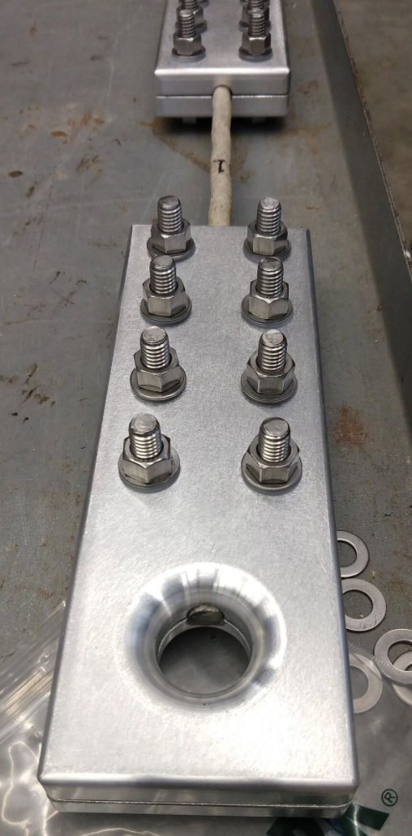
Engineering Design – Composite Terminations
Composite Line Terminations:
Serves as the intersection between the anchor and the rest of the mooring system.
Two aluminum plates bolted together and torqued to 200 in-lb.
Target goal of 4000 lb. in tension
Testing on Instron machine showed terminations withstood 6500 lb. in tension

Slide 6
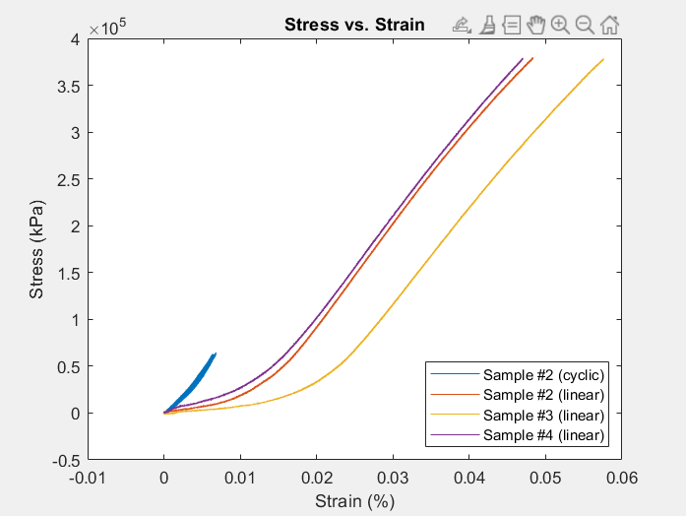
Engineering Design – Composite Terminations

Slide 7
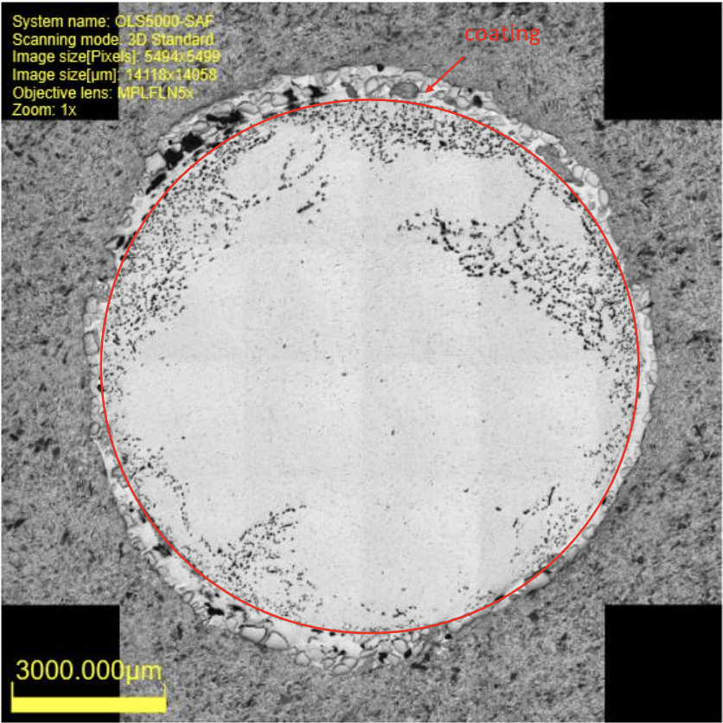
Engineering Design – Microscopy Analysis of
Unexposed and Exposed Samples
Microscopy Analysis:
Cross-sections of both unexposed and exposed samples were examined.
Evidence of porosity was found in exposed lines (deployed Jan 2020 – Oct 2020)
Potential Signs of Biofouling
Evidence of damage to fibers and widening of pores
Hypothesized that water entered the rod and expanded over time.

Slide 8
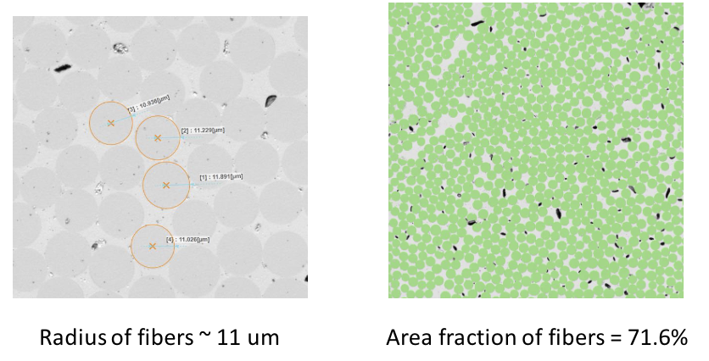
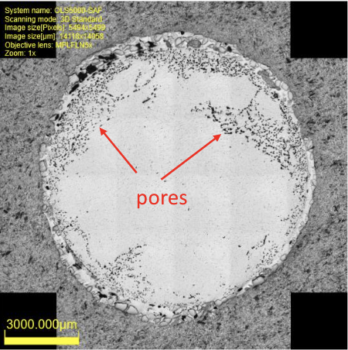
Engineering Design – Microscopy Analysis of
Unexposed and Exposed Samples
Unexposed Rods:
Pore Locations on the Sample

Slide 9
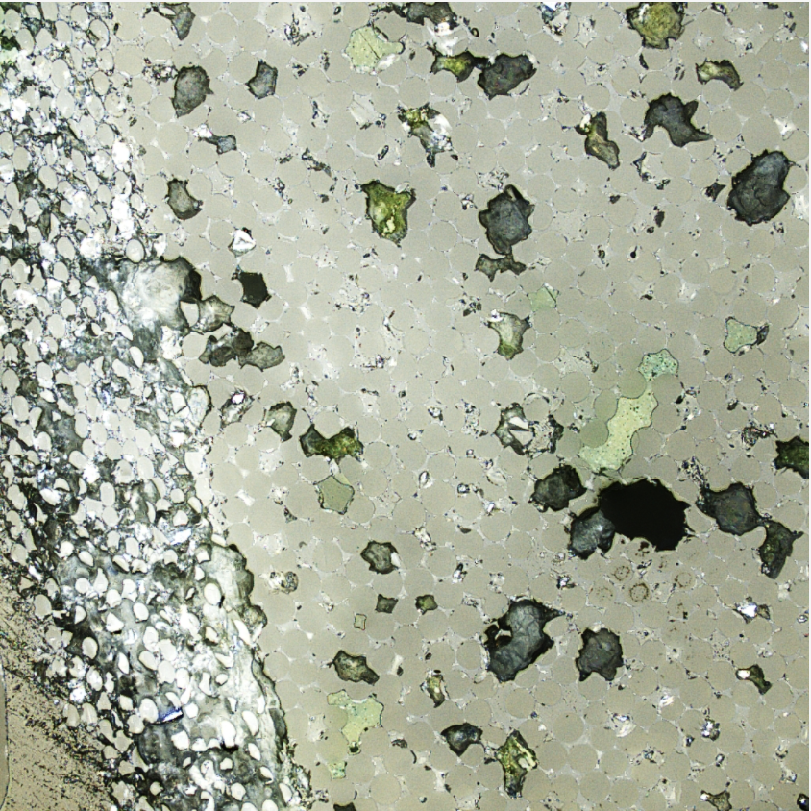
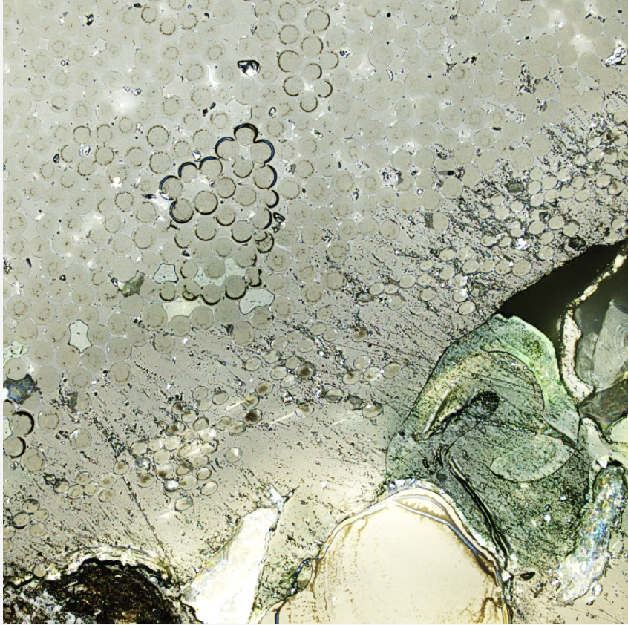
Engineering Design – Microscopy Analysis of
Unexposed and Exposed Samples
Biofouling
Exposed Rods:
Fiber Damage

Slide 10
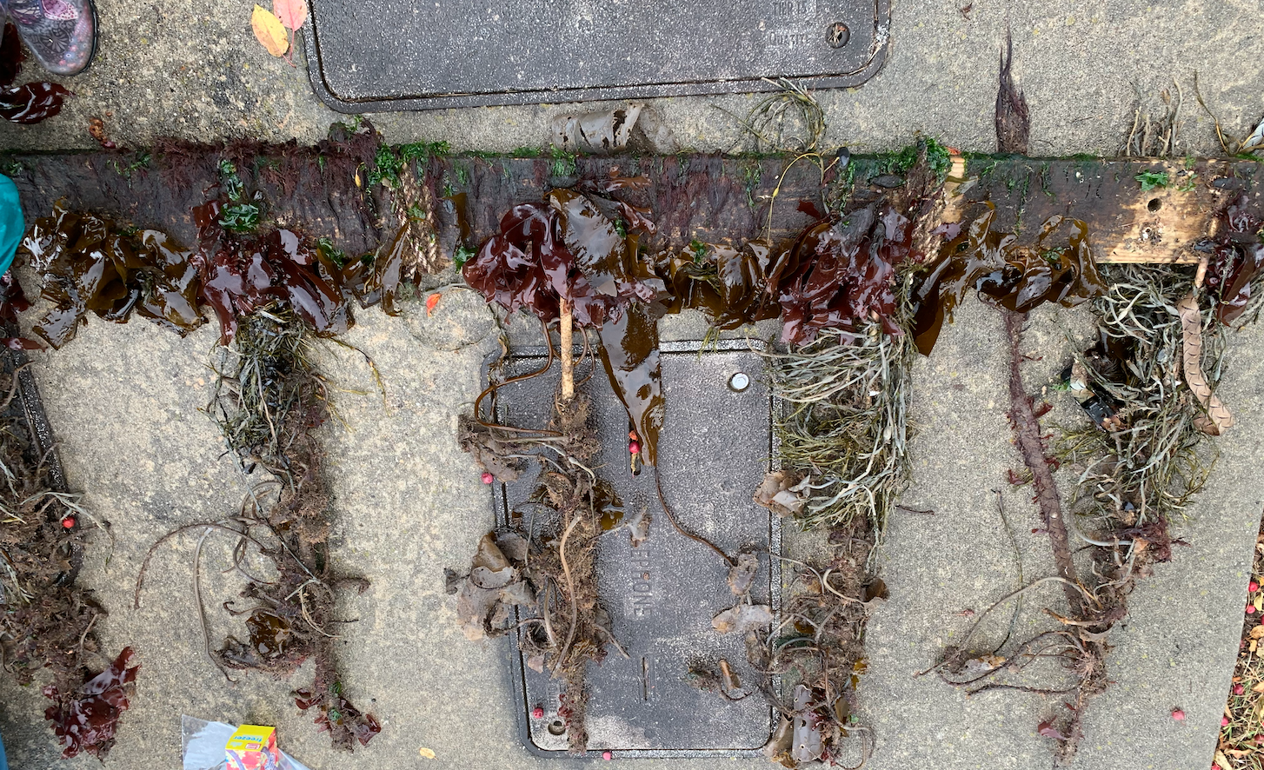
Biology – Kelp Growth and Biofouling
Biofouling that accumulated on the composite lines of a previously deployed test structure at the Aqua fort was carefully removed and frozen to take back to the lab. The deployed lines were removed after typical growing season so there was no kelp left on them only colonized organisms.
Organisms were identified and recorded from the images taken using various identification books and online resources.
The biofouling effects of the organisms identified were then compiled into a report.
It was found that some of the organisms identified are known to out compete kelp for space including brown micro algae and skeleton shrimp
We also found that invasive bryozoans grow on the kelp which causes more drag and a greater potential for kelp to tear off.
algaes | mollusca | arthropoda
Ascophyllum nodosum | Anomia simplex | Balanus eburneus
Capsosiphon grornlandicum | Crepidula fornicate | Caprella mutica
Chaetomorpha picquotian | Lacuna vincta | Eurydice pulchra
Chlorophyta | Mytilus edulis | Idotea balthica
Choetomorphia linum |  | Idotea phosphorea
Coralina officinalis | annelida | juvenile crab
Dasysiphoria japonica | Lepidonotus squamatus
Fucus distichus | Nereis pelagica
Laminaria longicruris
Palmaria palmata | bryozoans
Palmaria palmata | Membranipora membanacea
Ulva compresa | Tricellaria inopinata
Ulva intestinalis
Zostera marina

Slide 11
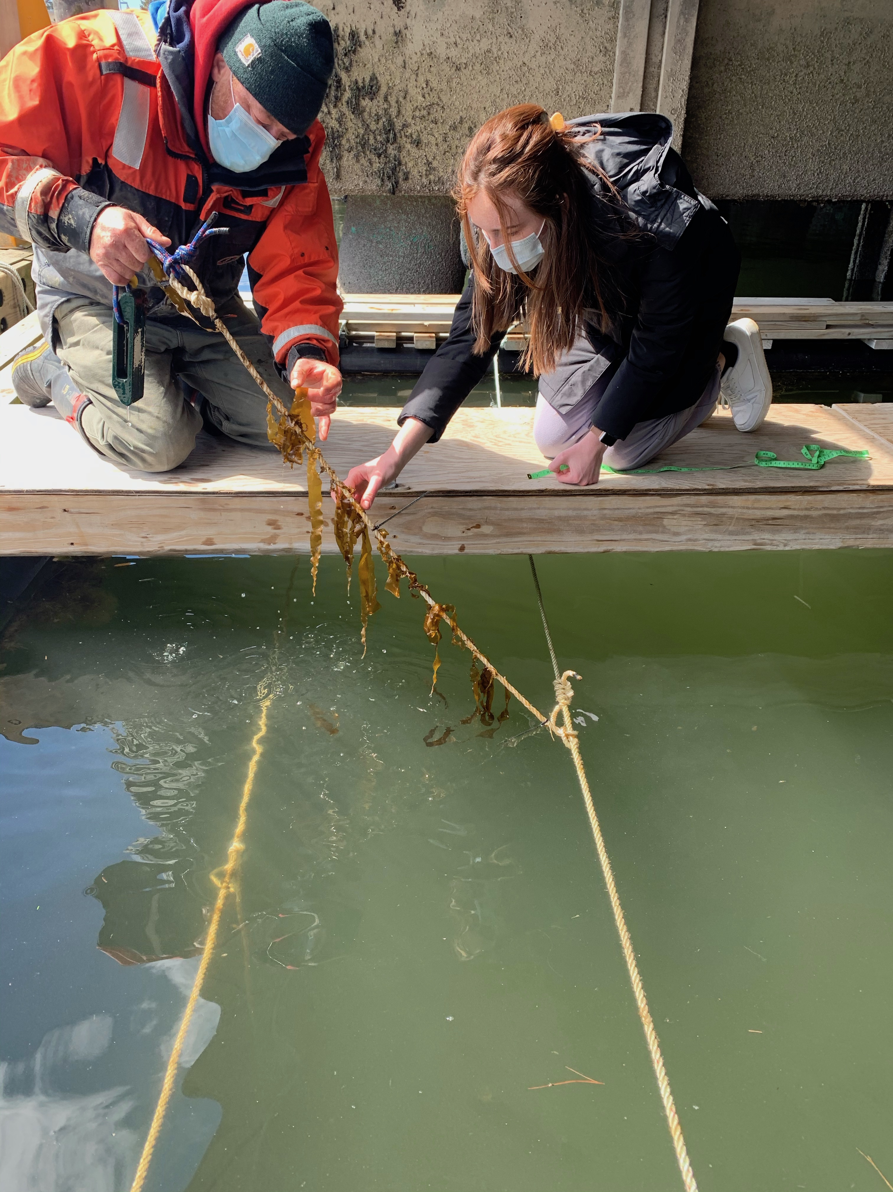
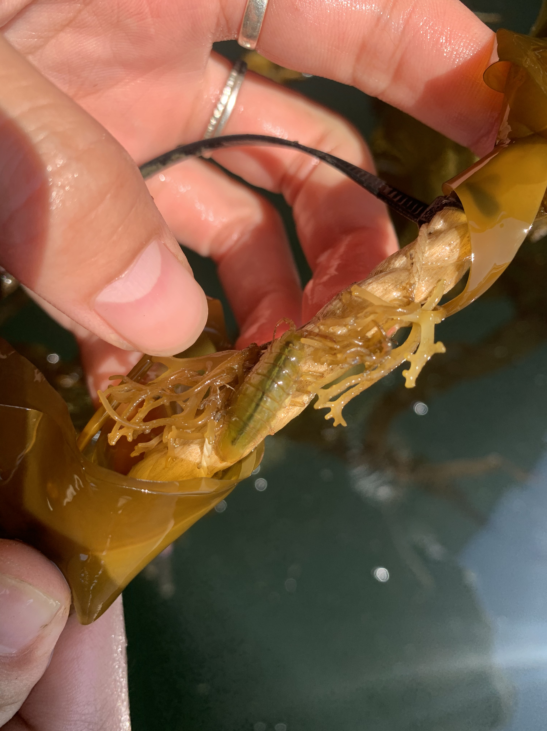
Biology – Experiment
Goal of Experiment:
to compare kelp growth and biofouling accumulation on composite lines compared to different types of lines commonly used in aquaculture systems
Design of Experiment:
6 lines placed in the water off the UNH Pier
2 lines of each type were deployed, 1 of which was seeded with kelp
Line types:
Composite
Polypropylene
Nylon
Observations: (taken biweekly)
Kelp growth measurements
GoPro videos
Pictures

Slide 12
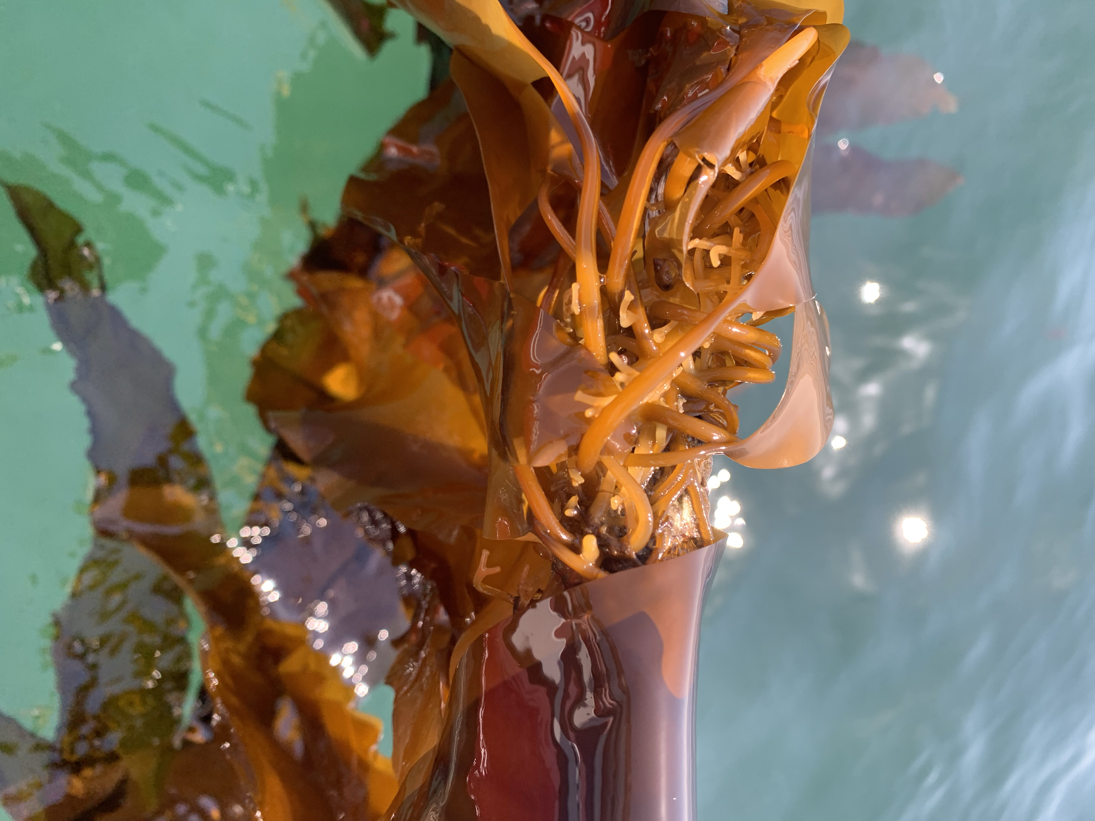
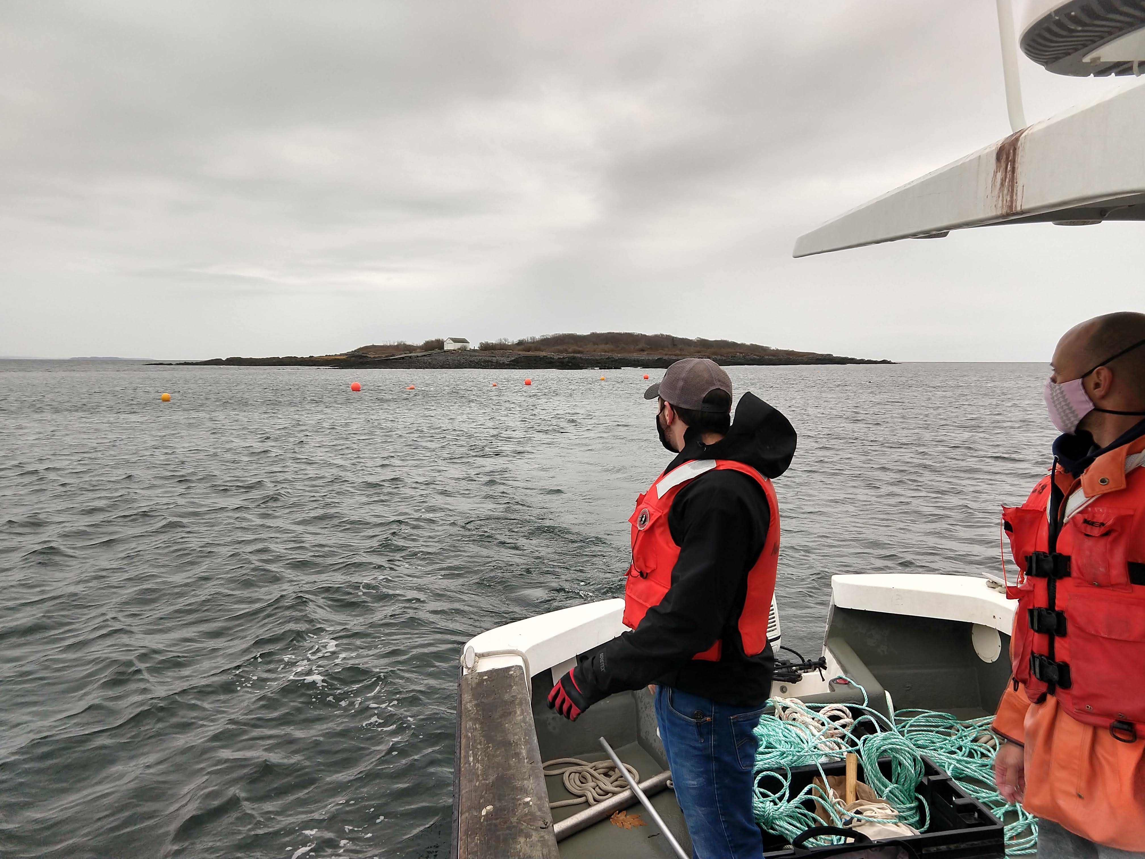
Conclusion and Acknowledgements
We would like to give thanks to:
NH Sea Grant and the UNH Mechanical Engineering Department for their generosity in funding and supporting this project through the Undergraduate Ocean Research Projects class.
We would also like to acknowledge the US Department of Energy’s ARPA-E program for funding the project (award no. DE-AR0000923) for which this work was a component.

