Slide 1




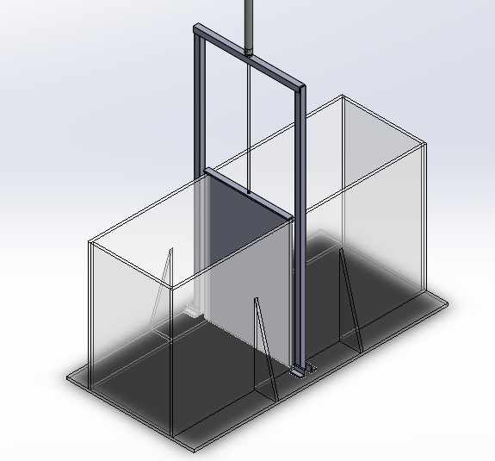
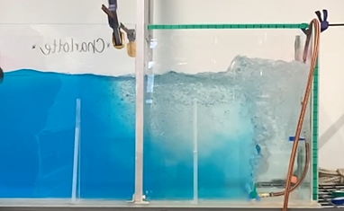
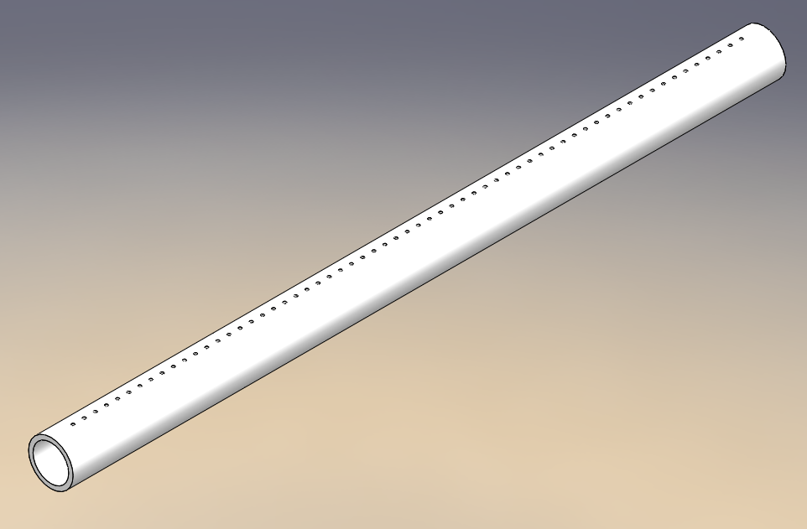
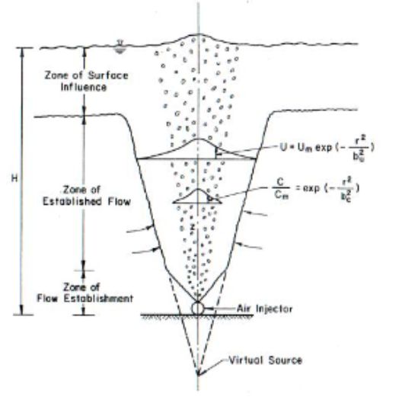
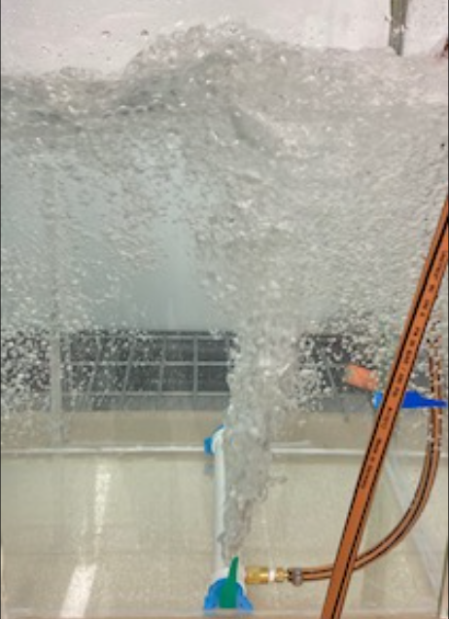
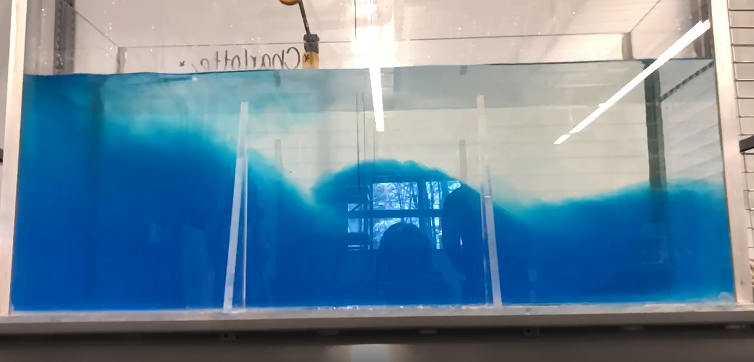
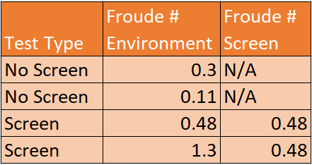


Efficacy of Bubble Screens on Turbidity Control
Matthew Dowling, Sean Gillam, Derek Goulet, Magdalyn Kosalek, Michael Monahan, Jason Robidoux
Advisor: Professor Tracy Mandel
University of New Hampshire | College of Engineering and Physical Sciences
INTRODUCTION
EXPERIMENTAL SETUP
EFFICACY OF SCREEN
Environmental impacts of turbidity include smothering of aquatic flora and fauna and excessive nutrient transport
Current practices to control turbidity levels during dredging include the use of silt curtains, which pose technical and environmental problems [1]
An alternative approach to controlling turbidity during dredging operations is the use of bubble screens (Fig. 2), which manage sediment through discouraging sedimentation
Approach: design and construct a testing tank and bubble screen tubing, create a density current, and test the efficacy of the bubble screen apparatus
The following questions are addressed:
Can a bubble screen effectively disrupt the flow of a density current?
What types of density current (Froude numbers) flow can be simulated through the experimental design (i.e., supercritical or subcritical)?
Which bubble screen orifice design most effectively blocks a turbid current?
The experimental setup consisted of:
16x24x48” Acrylic tank
Pneumatic lock mechanism (Fig. 3)
3/4x16” Bubble screen orifices with varying hole patterns (Fig. 6)
Salt water, freshwater, and dye
The following measurements were taken:
Depth averaged current velocity (u)
Salt & Fresh water density (ρ)
Current height (h) & total depth (H)
Supplied pressure to bubble screen
Visual interpretation of experiments showed:
The bubble screen can partially deflect a density current for a limited amount of time (Fig. 5).
Turbulent mixing occurred at the surface from bubbles, which appeared to drive the observed escape of dense fluid from the curtained area
Figure 3: A SolidWorks design of the complete experimental setup
METHODS
Figure 6: A SolidWorks model of bubble screen with 1/16” holes spaced ¼” on center.
Prior to test: The side of the tank without the bubble screen was filled with fresh water, a known amount of salt, and dye coloration
Density of salty fluid calculated using hydrometer; Pneumatic system allowed for bubble screen to form before lock release; monochrome cameras set-up for analysis
During test: Lock released, high speed imaging and video of density current undergone for visual observations
Analysis: density difference, depth averaged velocity, and height of density current used to characterize experiment with environmental Froude number
Figure 5: After releasing the lock, the gravity current is shown initially being held back by the bubble screen.
CONCLUSION
There is promise in real world applications for bubble screens. The bubble screen has sufficient performance in the regime of the experiments done, with mixing occurring at the surface due to turbulence. Iteratively performing future experiments will provide a more comprehensive understanding of the conditions that a bubble screen is effective in.
Subcritical flow was mainly displayed when creating these density currents, and the flow velocity was found to increase when the bubble screen was implemented in experiments.
The model bubble screen with holes of 1/16" diameter and ¼" on center spacing proved to be most effective in decreasing surface turbulence while maintaining a vertical wall of bubbles.
Figure 4: The bubble screen run at 10 PSI, before release.
Figure 1: Gravity current flowing under freshwater after the lock mechanism has been released.
Figure 2: Schematic flow field of proposed bubble plume [1].
RESULTS
FROUDE SCALING
Table 1: Nondimensional Fr numbers.
Froude number (Fr) shows the balance between inertial and gravitational forces in a fluid [4].
Environmental flow can be characterized by:
Fr > 1 – Supercritical flow (steep slope, which is not physical in our case, i.e., external circulation current produced by bubble screen)
Fr < 1 – Subcritical flow (shallow slope, no external currents, is expected)
The gravity current was created by a relative density difference $\left(\frac{Δ\overline{ρ}}{ρ_{o}}\right)$, in $g^{′}=g\left(\frac{Δ\overline{ρ}}{ρ_{o}}\right)$.
From the Fr number, the following was found:
The bubble screen appeared to increase the depth averaged velocity of the density current (and Fr number); likely due to circulation cells induced by the bubble plume.
With no screen, the Fr number produced expected values of subcritical flow
RECOMMENDED FUTURE WORK
Scaling of Environment
$$Fr=\frac{\overline{u}}{\sqrt{g^{′}h}}$$
Scaling of Bubble Screen
$$Fr_{q}={\left(\frac{q_{a}^{2}}{g^{′}H^{3}}\right)}^{\frac{1}{3}}$$
Using sediment in a control scenario
Creating a matrix of experiments running through varying different parameters (water depth, relative density difference, etc.) while maintaining constant Fr number
Vary bubble screen angle of attack
Develop MATLAB code that automates the process of computing density current speed from video, and outputs Fr numbers.
Investigate alternative environments (current on both sides, changing current direction, etc..)
Averages of different configurations were tested to observe Fr number variance. Order of magnitude bubble screen Fr numbers [1] were estimated for experiments including the screen.
REFERENCES
[3] R. Ramsdell. “RE: Rescheduling of Meeting.” Personal Email (Nov. 19, 2020).
[4] P. Kundu, I. Cohen, and D. Dowling, Fluid Mechanics. Waltham, MA: Academic Press, 2012.
[5] MAE. Class Lecture, Topic: “Gravity Currents.” School of Engineering, University of California, San Diego, CA.
[6] M. Nakai & M. Arita, “An Experimental Study on Prevention of Saline Wedge Intrusion by an air Curtain in Rivers,” Journal of Hydraulic Research, 40:3, 333-339, Feb. 2010.
[7] JC Ogilvie, D. Middlemiss, MW Lee, N. Croussouard, and N. Feates, “Silt curtains - a review of their role in dredging projects,” HR Wallingford.
[8] A. Mendzil, “Micro bubble curtains: impact on Sediment Dispersal,” SEACAMS2 Project (SC2-R&D-SU03). Swansea University, pp. 19, 2018.
ACKNOWLEDGEMENTS
[1] S. Tekeli & W.H.C. Maxwell, “Physical Modeling of Bubble
Screens,” Journal of the Waterway Port Coastal and Ocean Division, Feb., pp. 48-64, 1980.
[2] M.G. Wells & R.M. Dorrell, “Turbulence Process Within Turbidity Currents,” Annual Review of Fluid Mechanics, pp. 53:59-83, 2021.
The bubble screen team would like to thank Great Lakes Dredge and Dock for their continued support and discussions, including: Robert Ramsdell, Gregory Sraders, Washington Bryan, and Michael Beton. The team also extends thanks to our advisor, Prof. Tracy Mandel.

