Slide 1

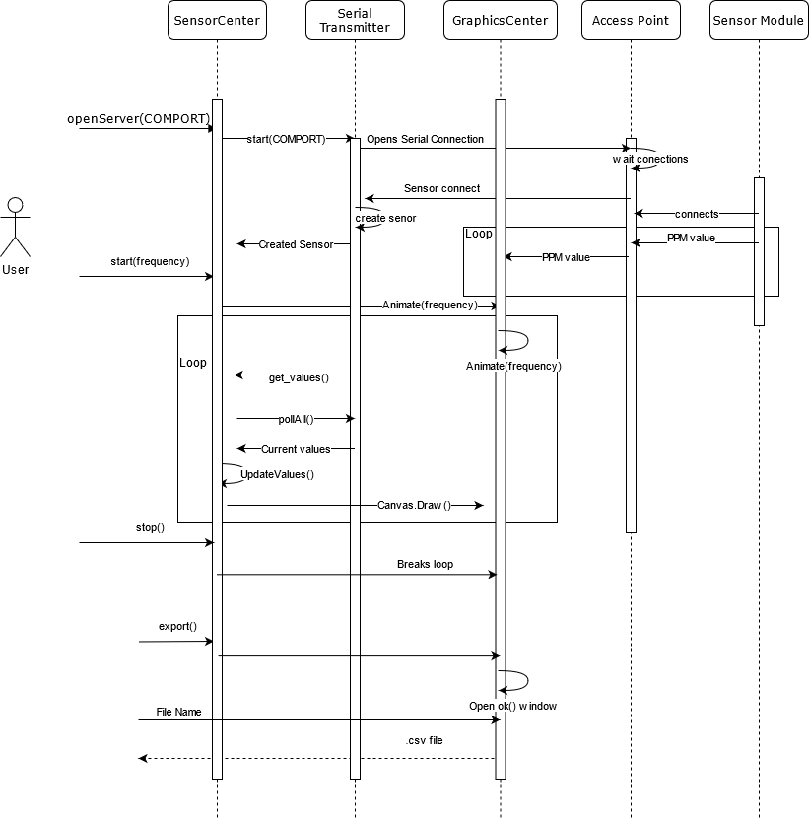
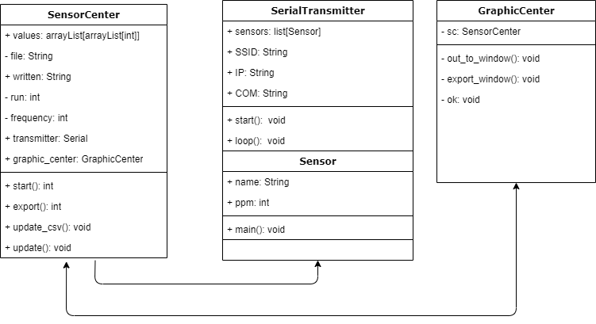
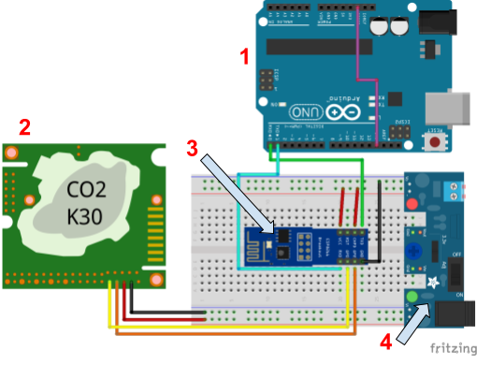
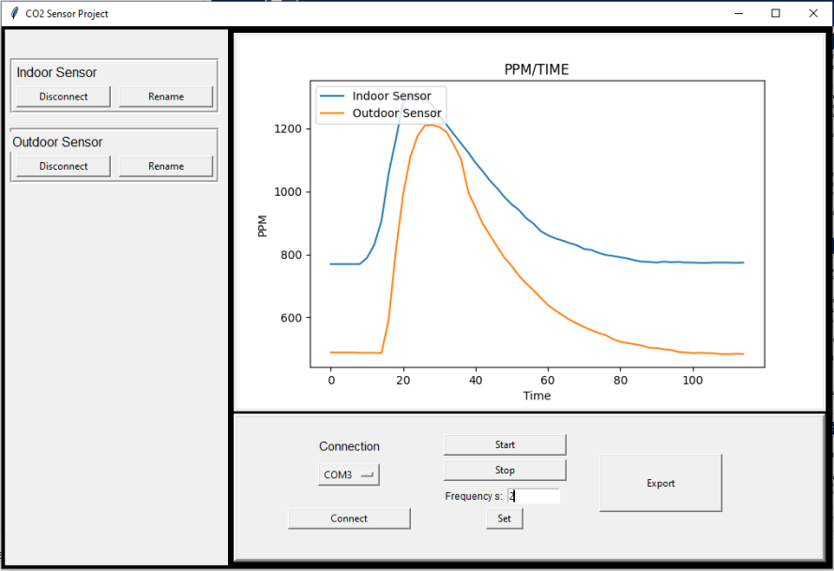
CO₂ Sensor Software
Aurora Desmarais, Jordan Felt, Uri-Jaun Hall
Introduction
Software Design and Flow
Status
This project supports a mechanical engineering research experiment that is measuring the transport of aerosol particles indoors to simulate airborne travel of the COVID-19 virus. The experiment includes releasing CO₂ through masks in a room and gathering data with CO₂ sensors placed at various locations. Our project is to improve the setup and develop a similar application to GasLab. The GasLab software collects data from the CO₂ sensors at specified intervals and displays it in real time. Currently, the sensors are connected via USB and are synchronized on the host computer which is running GasLab.
The goal is to increase the efficiency of data collection by decreasing setup time due to the sensors and creating software that can be used easily for synchronizing the sensors together and taking data at specified intervals.
Completed product features
The user will be able to:
Interact with the CO₂ sensors through the GUI
Wirelessly connect all sensors to the host system
Start and stop polling the sensors
Request the data to be exported to .CSV
Change the polling interval for the sensor
See in real-time graphing of each sensor’s collected data
Connect multiple sensors
Specify the COM port that the Wi-Fi access point is connected to
Have the ability to disconnect and rename connected sensors
Future Work
Scaling the number of connected sensors to more than 20
3D printing module holsters for the hardware
Sensor identification with LED pulse
Dynamic resizing of GUI button spacing
Additional options for .CSV exports
Restoring previous sessions
Extending the software to be compatible with multiple types sensors
Figure 2 UML Class Diagram
Software Design
Our current model of the host system consists of three main classes: SensorCenter, SerialTransmitter, and GraphicsCenter. SensorCenter is the main application which handles the basic functionality of retrieving and storing the data received from the sensors.
The SerialTransmitter Class alongside some Arduino code handles setting up and maintaining a socket server for the sensor modules to connect to and receive raw data.
The GraphicsCenter class is responsible for creating the GUI. It graphs the data in real-time and allows for the user to create data logging sessions.
Figure 1 Sequence Diagram
Hardware Diagram and GUI
Conclusion
2
Our ideal outcome is that 90% of users - Mechanical Engineering students in particular - will find our software and setup much easier to use than the GasLab software.
We aim to have this software readily available for future projects needing CO₂ data collection.
We plan on presenting our software to the GasLab developers to demonstrate on how we expanded on their current design. The purpose is to gain experience with software collaboration and receive feedback from professional developers.
Hardware Overview
1
An Arduino UNO WiFi Rev.2 connected to the host system acts as an access point for all ESP8266 Wi-Fi modules. The CO₂ K30 Sensor emits data over the Wi-Fi module to the Arduino. The sensor, WiFi module, and a power supply are configured as a modular unit. An additional Arduino can be connected to each unit for debugging purposes(as shown in Figure 3).
The ESP8266 Wi-Fi module has two I/O pins which serve to read and write to the Rx and Tx pins of the K30 CO₂ sensor. The microcontroller on the module is used to store the code that collects and sends the data to the access point.
The power supply in use is the HW-131 which is connected via a barrel connector to an AC adapter or a battery setup. The K30 has an operating voltage of 5V and the ESP8266 has one of 3.3V, so any power supply that can meet those requirements would work for this system.
3
Acknowledgements
Figure 3 Hardware Diagram
[1] Arduino UNO: Allows serial monitor output for debugging
[2] CO₂ K30 Sensor
[3] ESP8266: Wi-Fi module with microcontroller
[4] HW-131: Power supply
Figure 4 Graphical User Interface
[1] Connected sensors
[2] Real-time graphing of collected data
[3] User session control and connection settings
Sponsor: Todd Gross
Mechanical Engineering
Advisor Prof: David Bennedetto
Team:
Aurora Desmarais Computer Science
Jordan Felt Computer Science
Uri-Jaun Hall Computer Science
In Collaboration with: Mechanical Engineering Students

