Slide 1

A Novel Approach to Assessing Total Electromagnetic Field Exposure From Radiation Sources
Alhussein Al-Jawad
Advisor: Kent Chamberlin, Ph.D

Slide 2
Overview
Motivation/Goals
Background Information
Methodologies
Acquired Data
Discussion
Conclusions
Acknowledgments and References

Slide 3
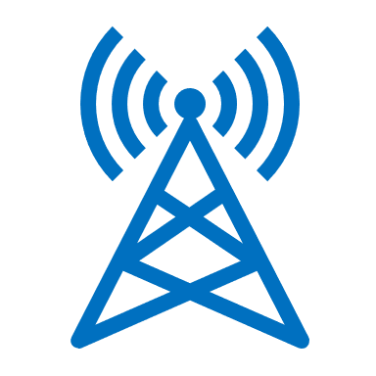
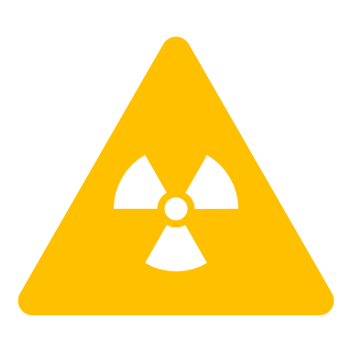
Motivation/Goals
Increasing risks of low-intensity electromagnetic fields
  FCC current exposure limits are not sufficient
  Certain health risks are not accounted for
  Peer-reviewed studies show risks well below thresholds
Goals
  Simulating an environment with multiple RF sources
  Time-average power and high-peak pulses

Slide 4
Background Information: Ionizing Vs. Non-ionizing Radiation
Classification
Examples
Radio Frequency Signals

Slide 5
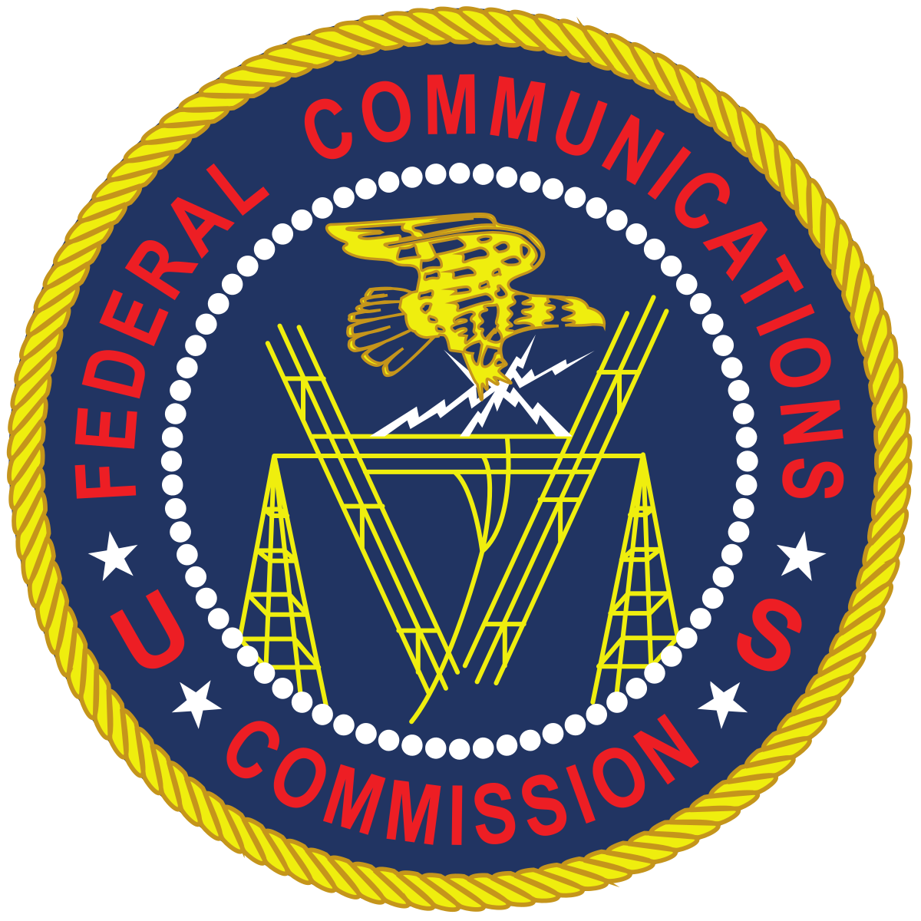



Background Information: Existing Standards and Guidelines
(Note: Theses standards have been shown to be insufficient)
Agencies
Exposure limits by medical bodies are several orders of magnitude lower
FCC
  Procedures
  Concerns
This Photo by Unknown Author is licensed under CC BY-SA
This Photo by Unknown Author is licensed under CC BY-SA

Slide 6
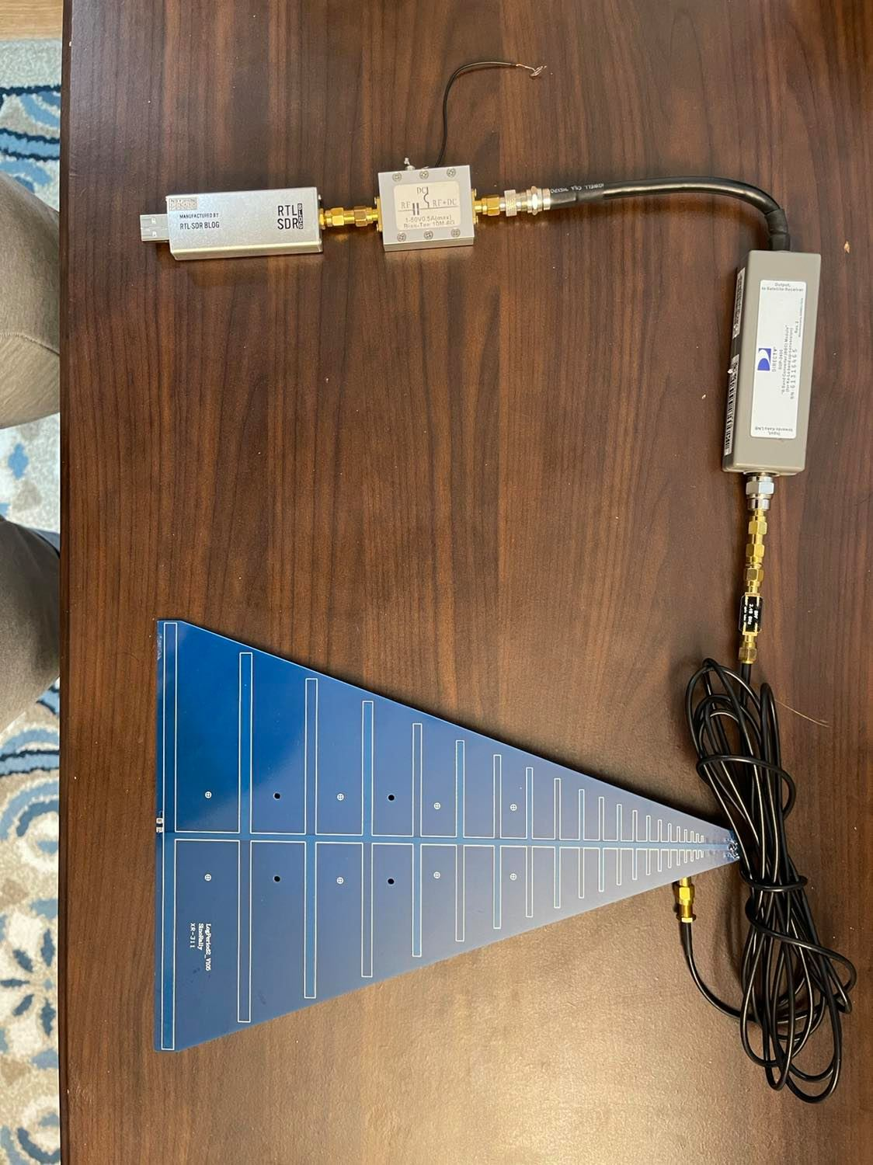
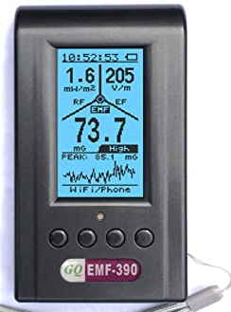

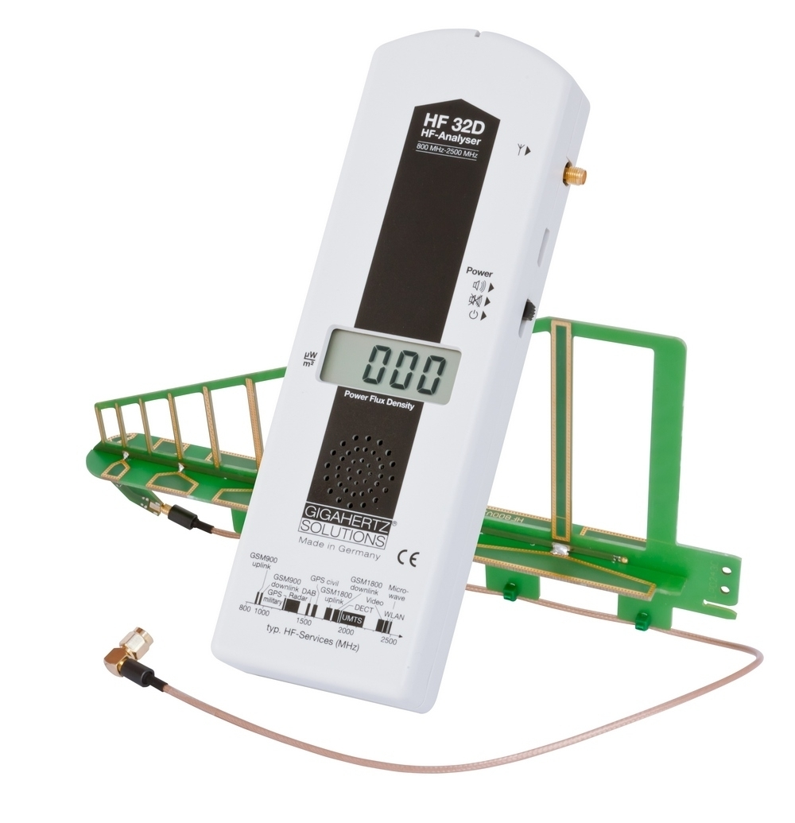
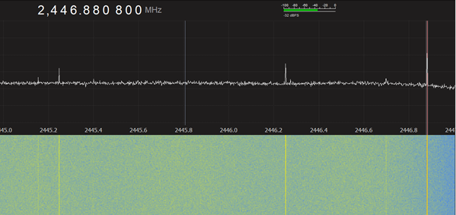
Methodologies: Measurement Devices
2.45Ghz BP Filter
Mixer
GQ EMF-390
Bias Tee
600MHz-16Ghz antenna
RTL SDR
HF32D RF Analyzer

Slide 7
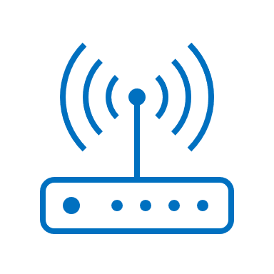

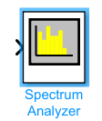
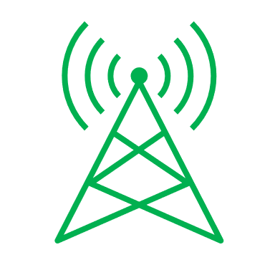

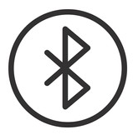
Methodologies: Simulation
Frequency
Wi-Fi
Modulation Scheme
LTE
# Users
.
.
.
.
.
Bluetooth

Slide 8
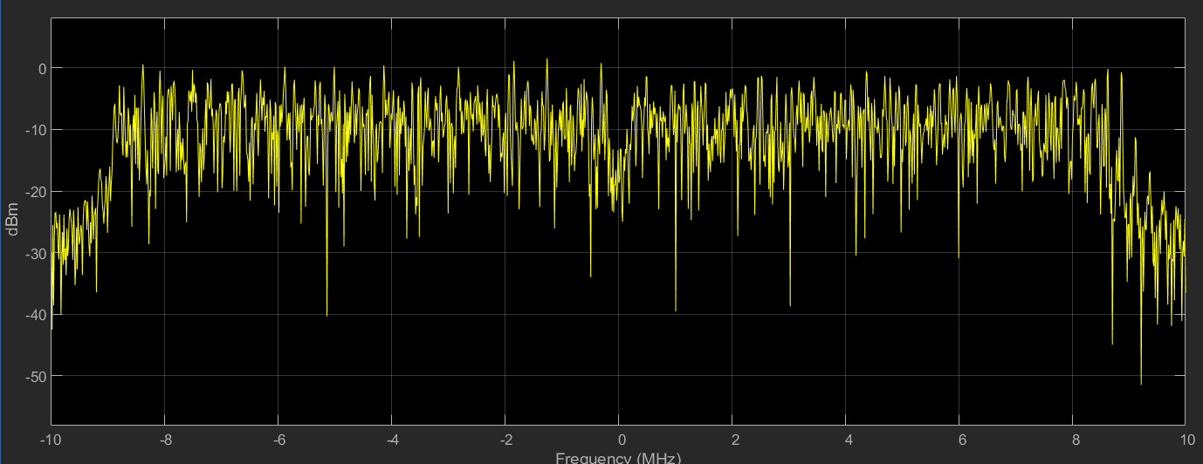
Acquired Data: Frequency and Time Scopes
MATLAB Simulation
  Wi-Fi, LTE (4G), and Bluetooth
  Existing protocols
Frequency spectrum of a typical Wi-Fi signal
Time scope of a typical Wi-Fi signal

Slide 9
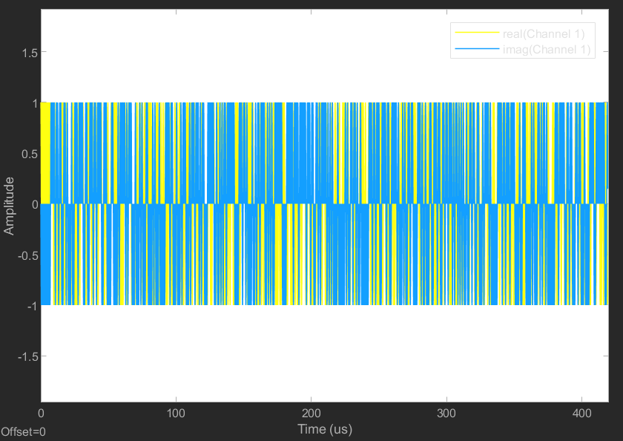
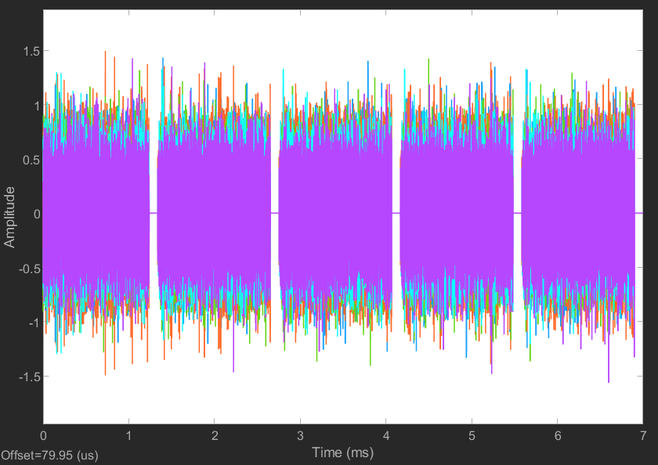
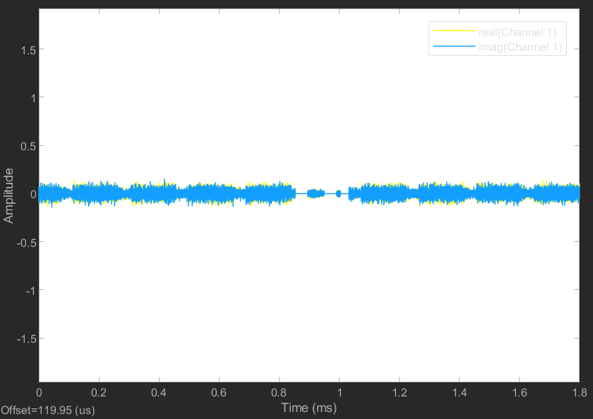
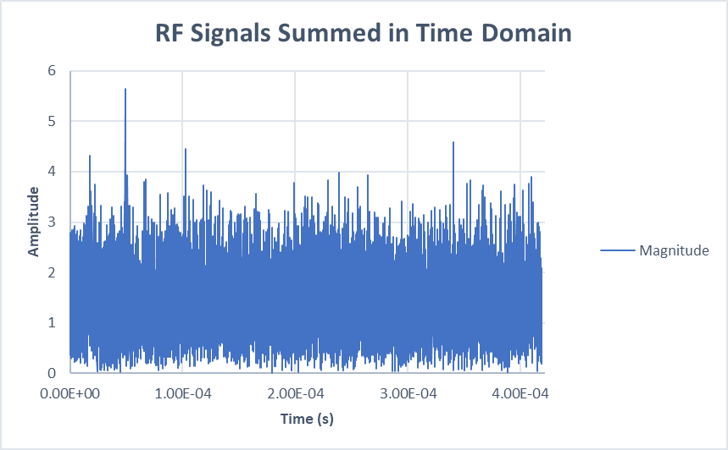
Acquired Data: Simulations
Bluetooth Signal Time Scope
Wi-Fi Signal Time Scope
LTE Signal Time Scope
+
+
=

Slide 10
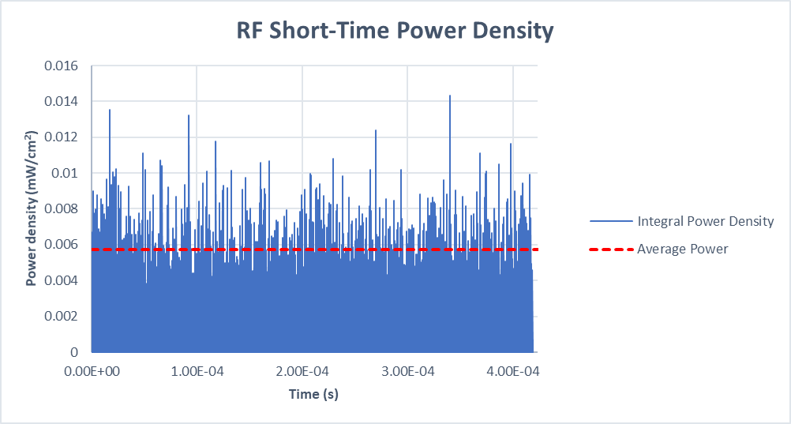
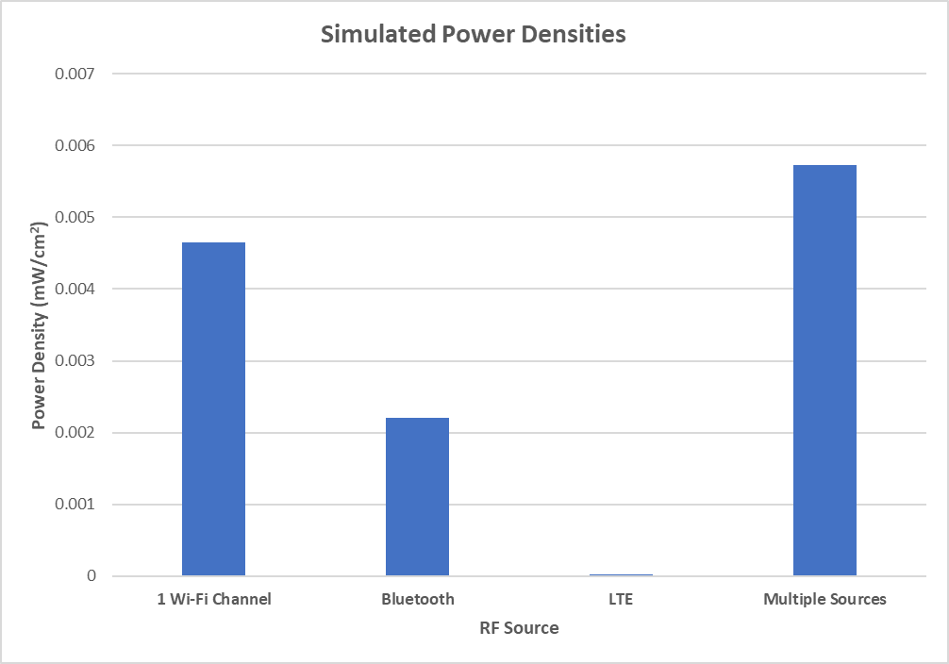
Acquired Data: Analysis
Power density
  Instantaneous vs. time-average power
  Not accounted for in current
  Average power density can easily fall under the regulation limits

Slide 11

Conclusions
Radiation exposure techniques
Health effects associated with existing techniques
New communication technologies
Future efforts

Slide 12
References
[1] Patrick Abrami, Kenneth Wells, Gary Woods, James Gray, Tom Sherman, Denise Ricciardi, Brandon Garod, Carol Miller, David Juvet, Kent Chamberlin, Bethanne Cooley, Michele Roberge, Paul Héroux, “Final Report of the Commission to Study The Environmental and Health Effects of Evolving 5G Technology,” 2020.
[2] I. Belyaev et al., “EUROPAEM EMF Guideline 2015 for the prevention, diagnosis and treatment of EMF-related health problems and illnesses,” Reviews on Environmental Health, vol. 30, no. 4. 2015, doi: 10.1515/reveh-2015-0033.
[3] D. E. McCarty, S. Carrubba, A. L. Chesson, C. Frilot, E. Gonzalez-Toledo, and A. A. Marino, “Electromagnetic hypersensitivity: Evidence for a novel neurological syndrome,” International Journal of Neuroscience, vol. 121, no. 12, pp. 670–676, 2011, doi: 10.3109/00207454.2011.608139.
[4] B. W. G. 2012, “Biolnitiative 2012: A Rationale for Biologically-based Exposure Standards for Low-Intensity Electromagnetic Radiation,” 2012.
[5] Naren, A. Elhence, V. Chamola, and M. Guizani, “Electromagnetic Radiation Due to Cellular, Wi-Fi and Bluetooth Technologies: How Safe Are We?,” IEEE Access, vol. 8, pp. 42980–43000, 2020, doi: 10.1109/ACCESS.2020.2976434.

Slide 13

Questions
aba1011@wildcats.unh.edu

