Slide 1

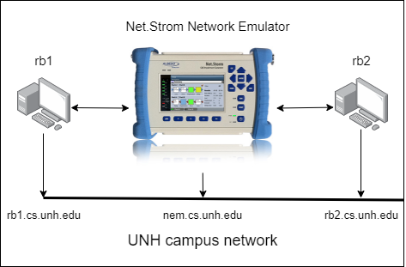
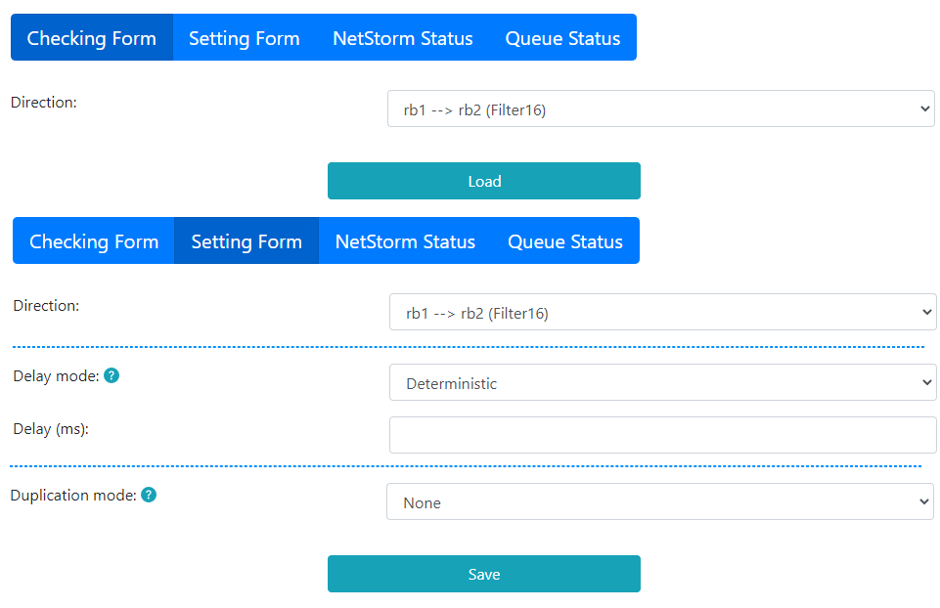
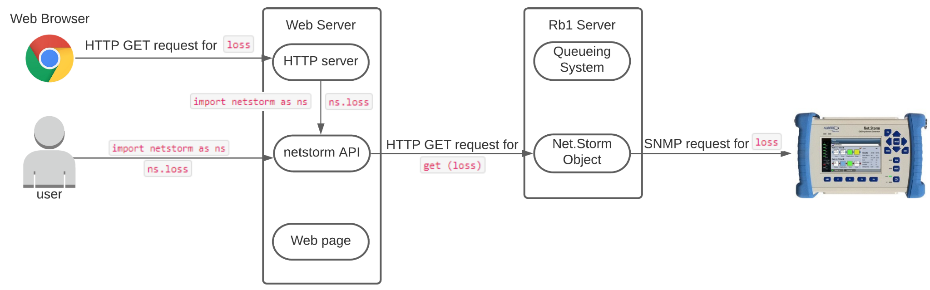
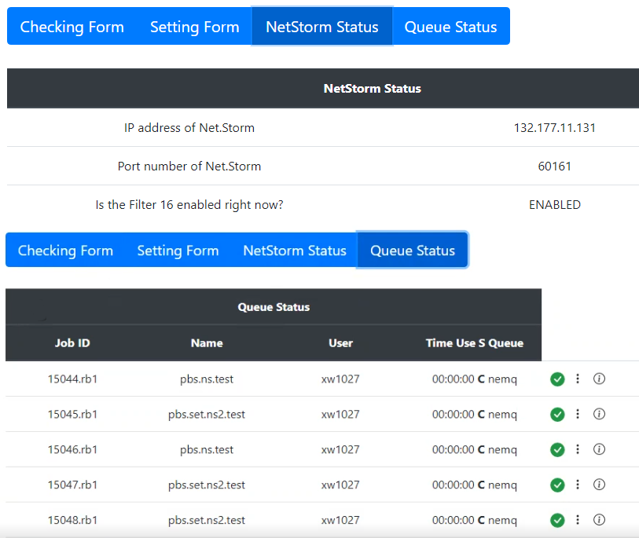
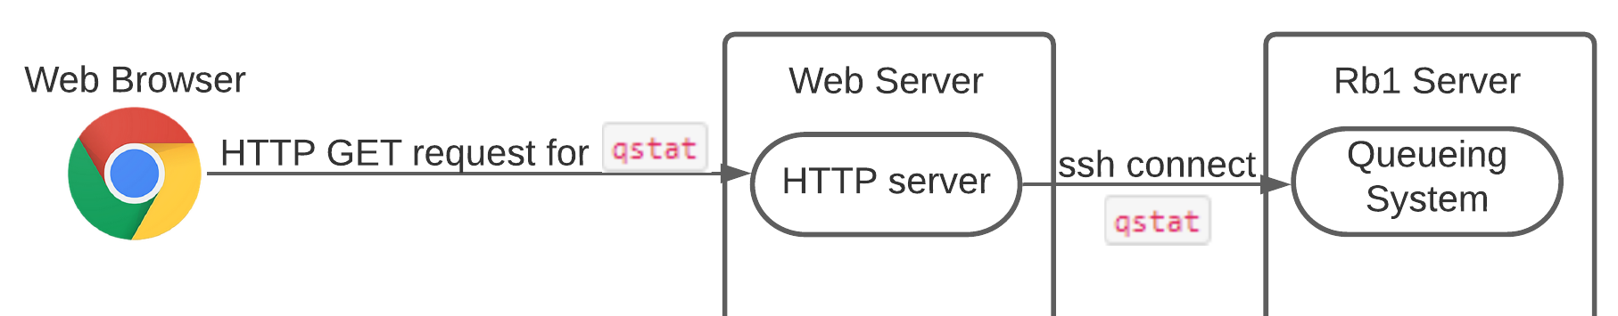

Protocol Performance Testing Automation
Web application for networking emulator: Net.Storm
Team Members: Xueliang Chen, Garrick Craft, Yuhui Wu
Project Advisor: Radim Bartos
Department of Computer Science, University of New Hampshire
Introduction
Deliverables
Achievements
Net.Storm Object
HTTP REST server that acts as a facade for the Net.Storm’s SNMP interface.
Python API that communicates with the REST server.
Website
Webpage that allows graphical configuration of the Net.Storm.
HTTP server that hosts the website and communicates with the Net.Storm Object using the API.
Queueing System:
Portable Batch System (PBS) that runs experiment tasks automatically.
Location of Net.Storm
Data Flow
Combined Pages for checking and setting form
Background: The Albedo Net.Storm™ is a network emulator capable of simulating network impairments. It is used as part of a testbed where students run protocol performance experiments using the Net.Storm to introduce network impairments.
Problems
The Net.Storm has an SNMP interface, but students need prior knowledge of SNMP to use it.
The GUI software students use to configure the Net.Storm needs to run on the same subnet as the Net.Storm, so it is hard to access the Net.Storm from outside of campus.
Multiple students could use the testbed at the same time and interfere with each other.
Data flow diagram for checking the loss of network from Net.Storm
Pages for the state of task queue and NetStorm Status
Next Steps
Front-end:
Add a login page so that students can login with their UNH account, instead of running the code to get authorization.
Create a user guide for the webpage and make a FAQ page to help with troubleshooting.
Back-end:
Finish documentation for the API so that it can be maintained after the project is over.
Complete the functions in the job queueing system with the more stabilized outcome for security purposes.
Data flow diagram for checking queueing system status
Goals
Technology Involved
Create an API that hides the SNMP functionality needed to configure the Net.Storm.
Create a website to configure the Net.Storm and host it on the UNH network to allow off-campus access
Integrate a job queueing system to force experiments to be run sequentially.
HTML5 & CSS3 & JavaScript:
  Basic code for web page development
BootstrapVue:
  Framework used in web page
Bash:
  Shell Script for interacting with PBS
Python:
  API for Net.Storm Object
  Net.Storm Control API
Flask & Python:
  HTTP server for Website and Net.Storm Object

