Slide 1
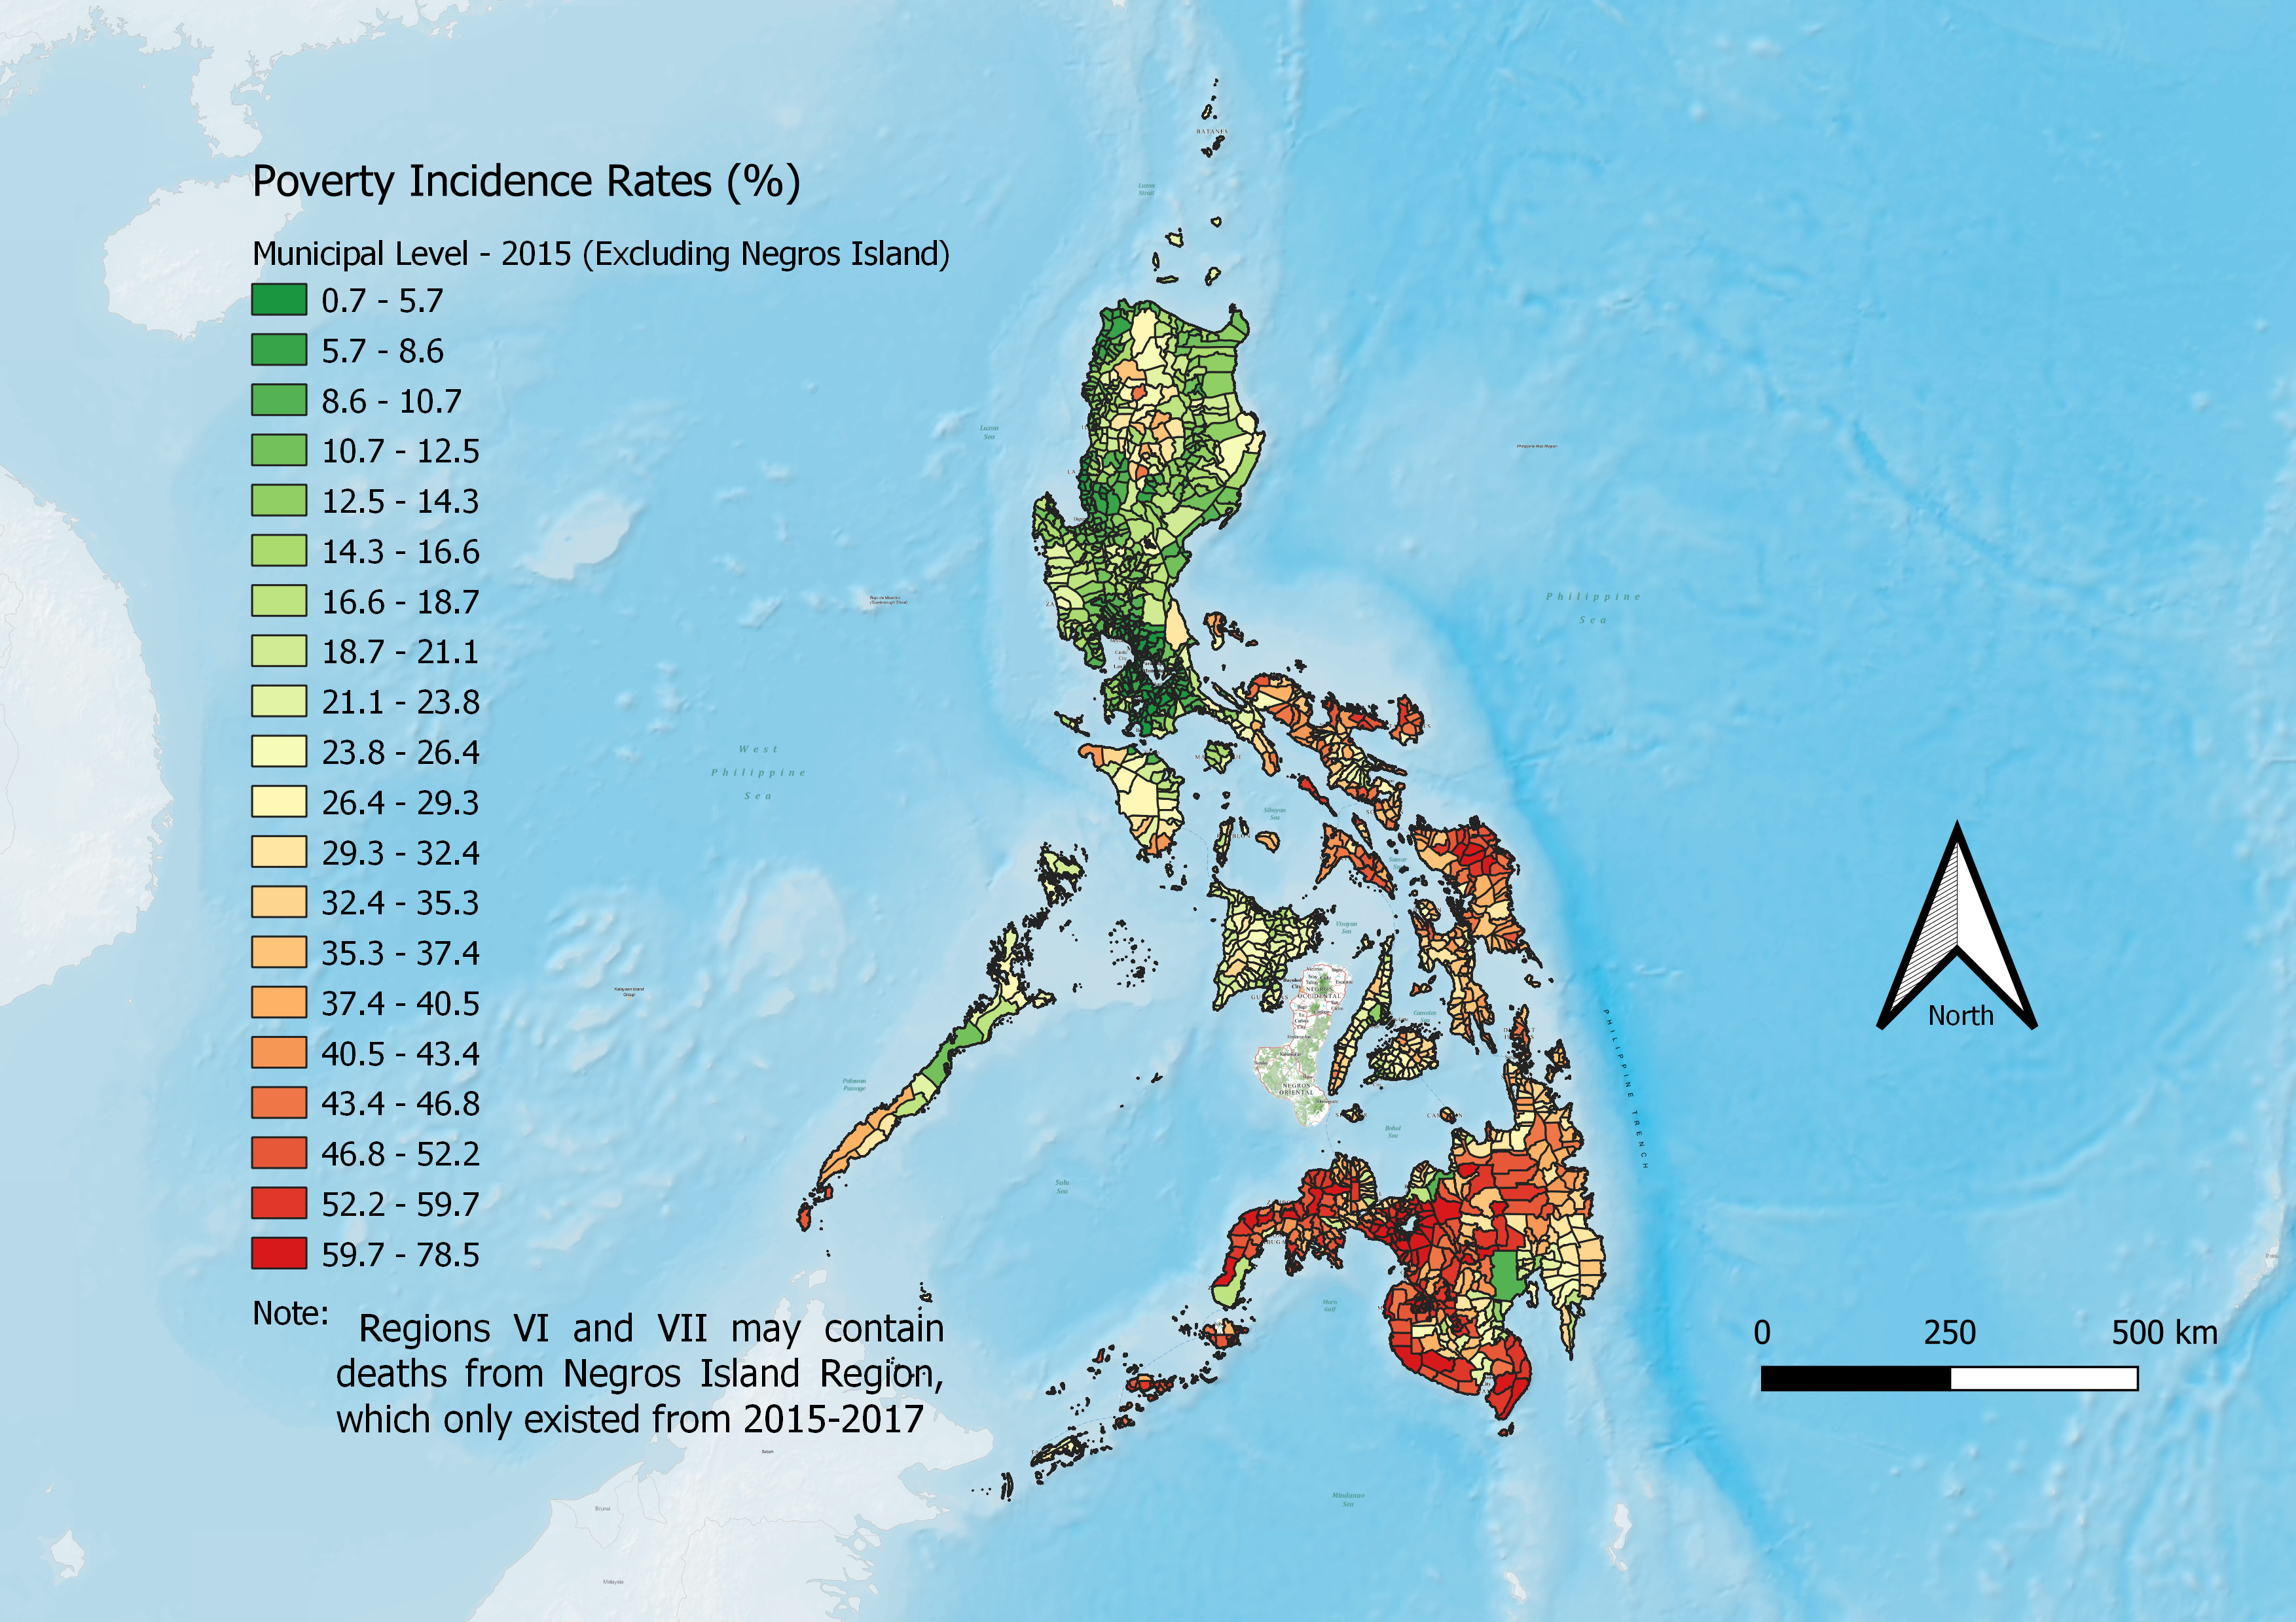
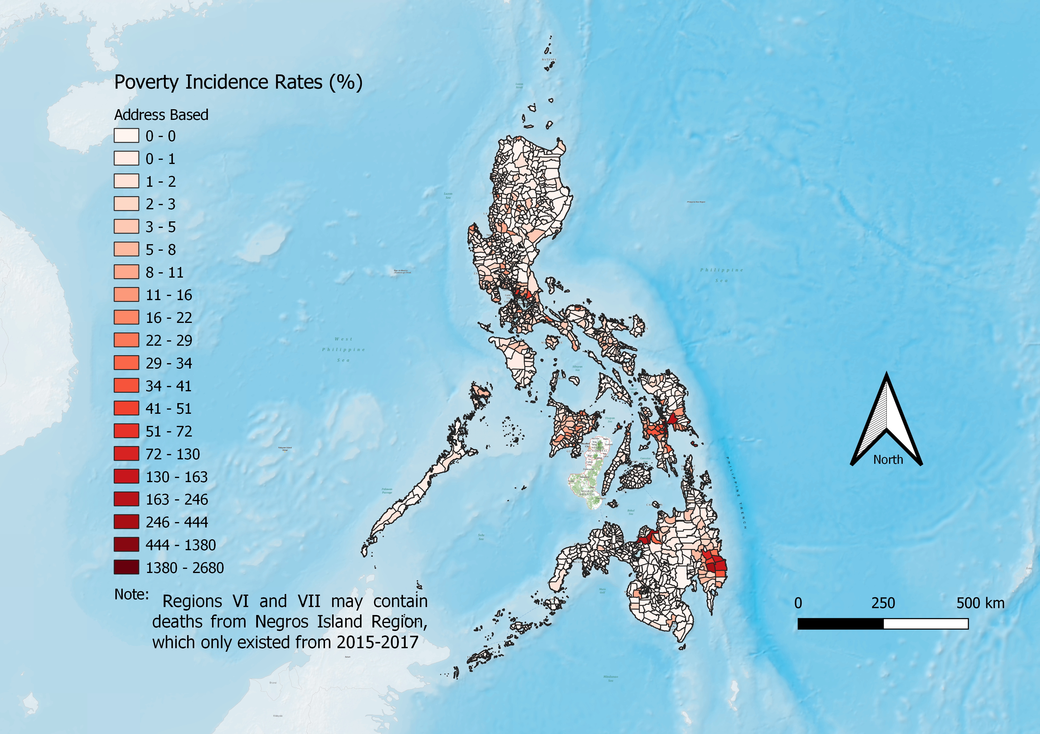
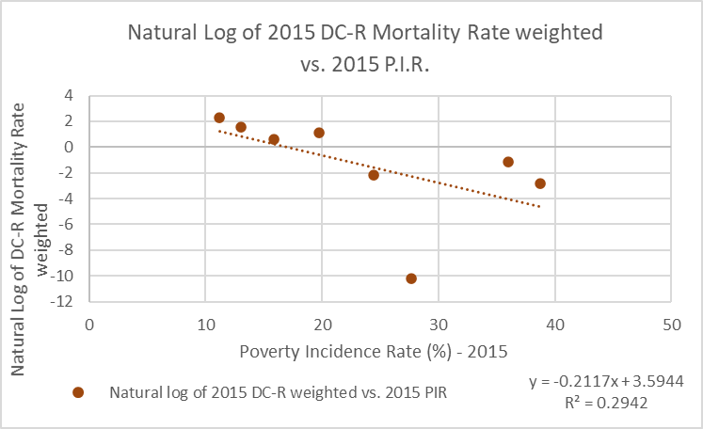
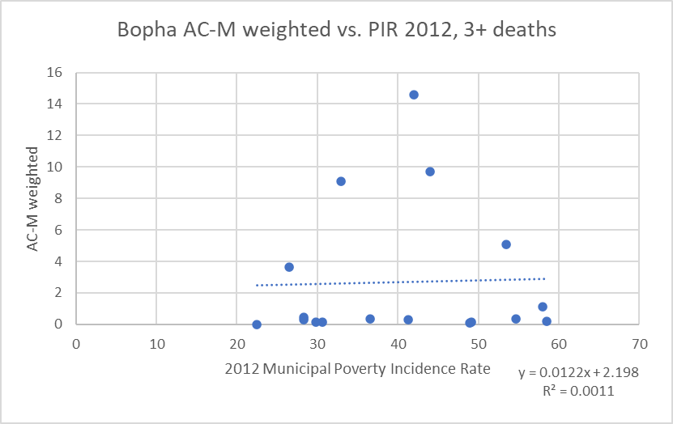
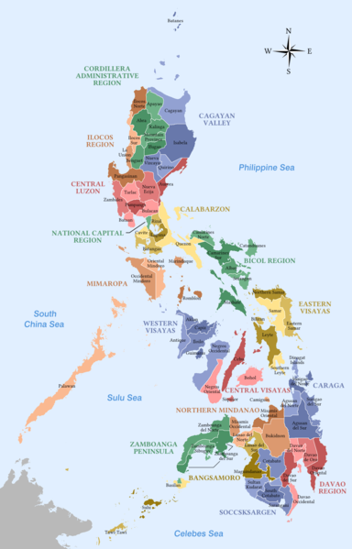
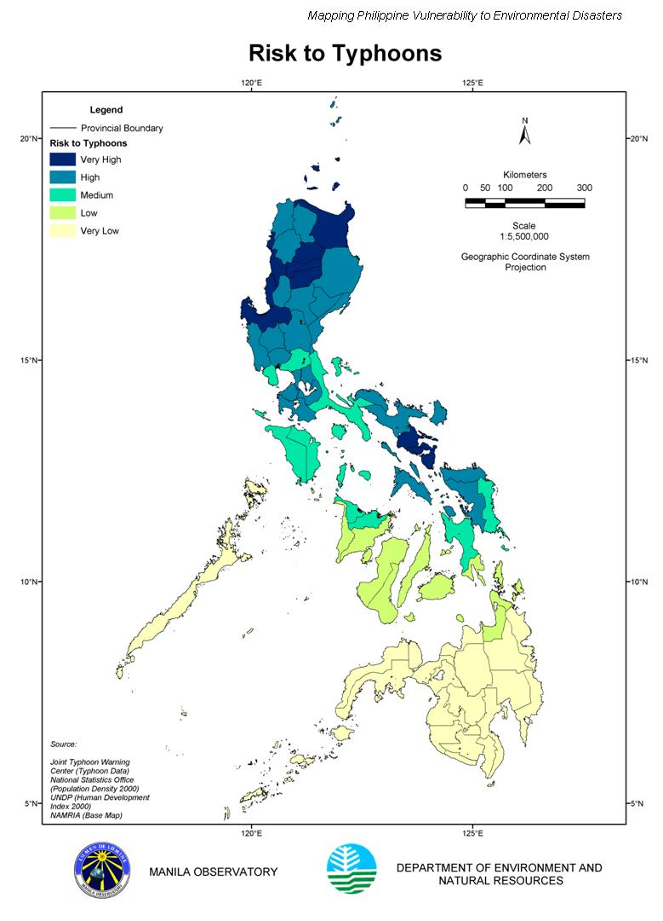
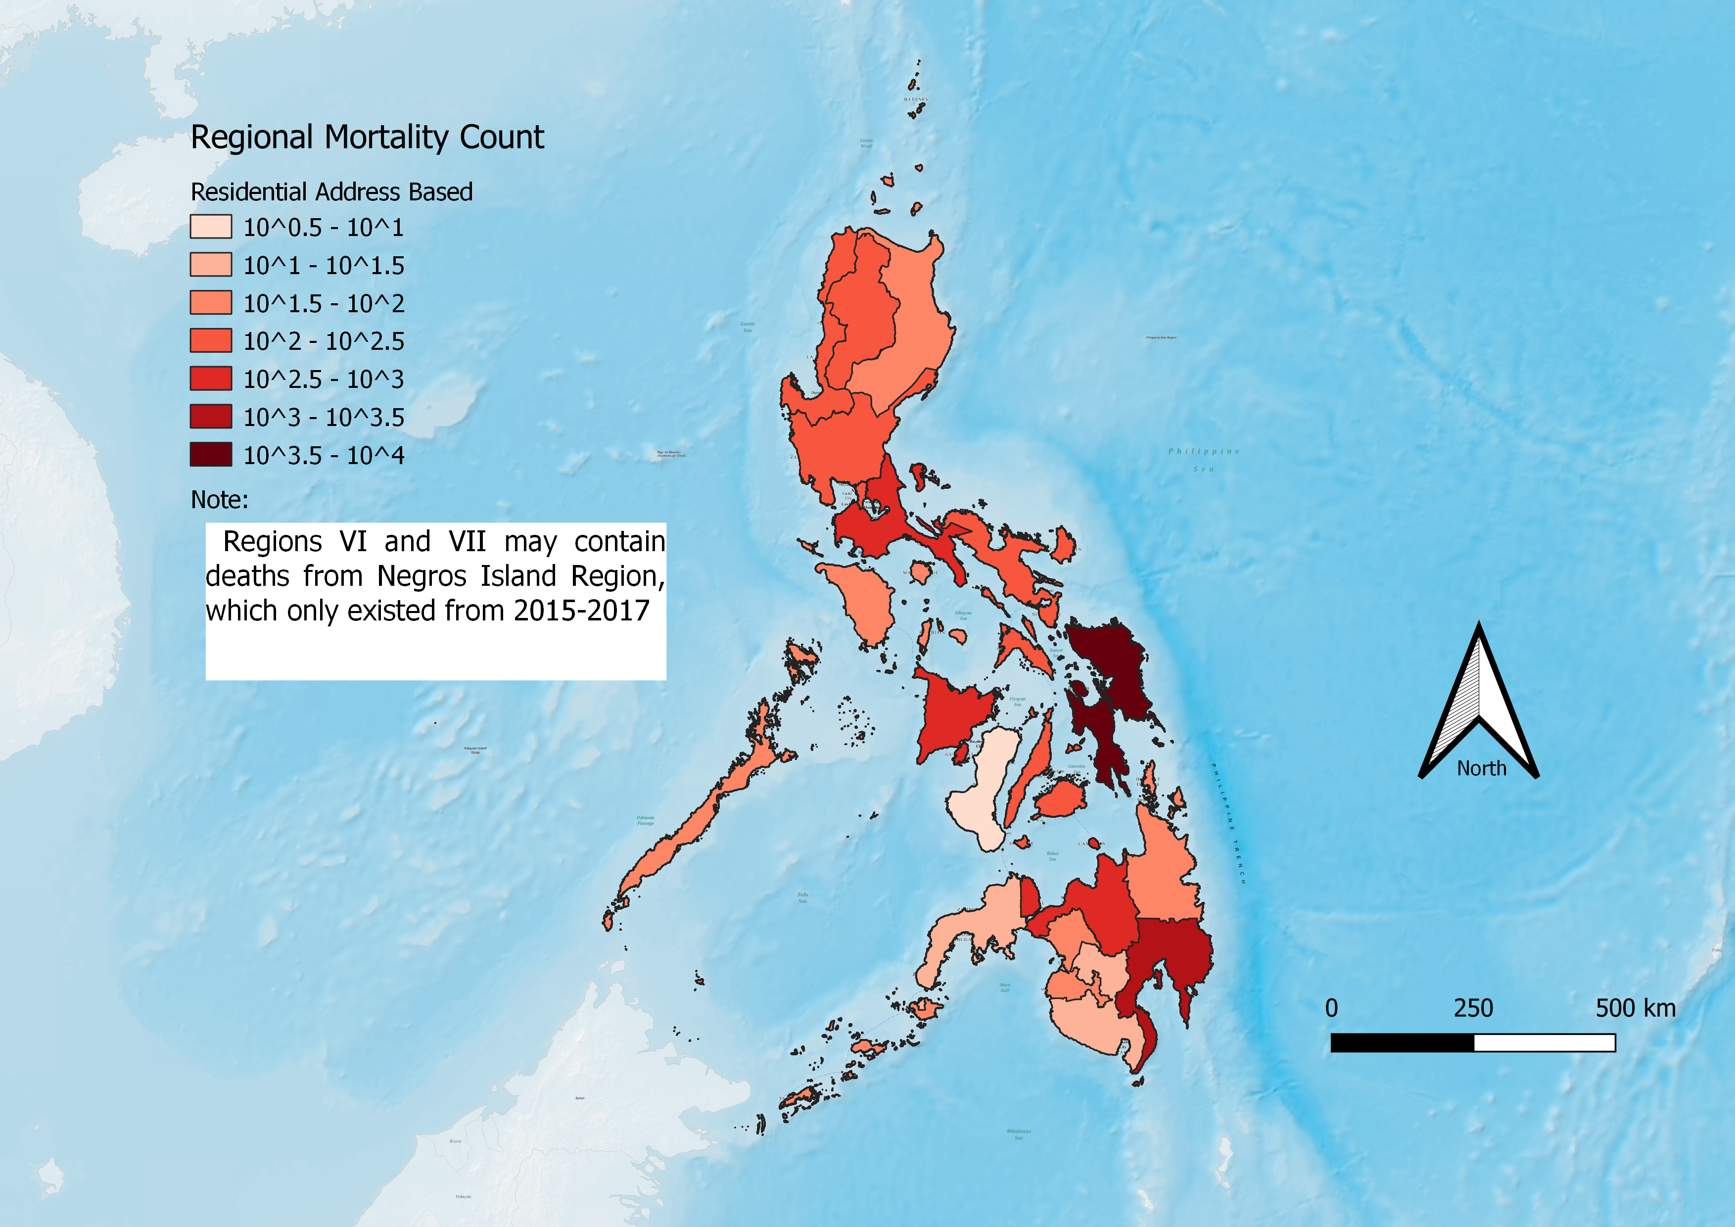
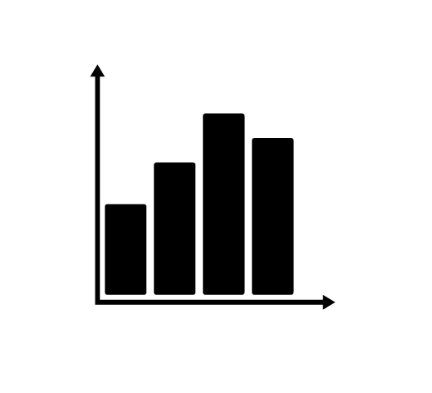
Exploring the Relationship between Poverty Levels and Typhoon Mortalities in the Philippines Ian Desmarais Advisor: Dr. Kyle Kwiatkowski Department of Civil and Environmental Engineering, University of New Hampshire, Durham, NH 03824
Abstract
Mapping at the Municipal level
Constructed Database
The purpose of this project is to construct a mortality database that includes where and how people died during typhoons from 2004-2015. The next step is to find any relationships between the database and existing statistics available in the Philippines. The Philippines was selected for study because it is one of the most disaster-prone countries in the world, with meteorological events composing, on average, roughly a third of disasters. Climate change and shore modification have intensified the strength of typhoons and increased storms’ potential damage capacity. Studies on storm pathing in the region found storms forming closer to the Philippines and landing increasingly in the Visayas and Mindanao regions, which typically see less typhoons than other areas of the Philippines. These regions also contain some of the poorest and most populous areas of the Philippines. Of the studies reviewed that have looked at the correlations between poverty/economic development, all of them found that at both the national and subnational level, mortality rates are higher in less developed areas and countries. This study used situation reports produced by the Philippines government during disasters to map typhoon deaths and number of people affected across the Philippines. These were then compared to poverty incidence rates of the corresponding administrative unit and year. No correlation was found using linear regression and semi-log plots while controlling for areas affected and population affected at the regional and provincial levels.
2015 Municipal Poverty Incidence Rates
Municipal Level Mortality Count - AC
Constructed Database
10,509 entries
86 Storm entries
33 missing or non-final situation reports
~9,700 entries at the municipal level (AC)
2013 and after typically use DC instead of AC
Assumed entry was AC if unidentifiable
EM-DAT
15,911 total deaths
Includes 1000+ TY. Haiyan deaths not listed in final sitrep
~4,000 entries from missing sitreps
Does not define affected populace
Methodology
Regional Versus Municipal Level Analysis
Conclusions
Transcribe mortality data and affected populace count into excel and pair with associated administrative code. Decide if address given is residential address (AC) or the location of death (DC).
Find mortality rate: $Mortality Rate= \frac{Mortality Count of code}{Affected Populace of code}$
Find weighted mortality rate: $Weighted Mortality Rate= \frac{Mortality Count of code ∗Affected Pop. of code}{Total Affected Populace}$
Group data based on the closest poverty incidence rate assessment (2006, 2009, 2012, 2015).
Compare the counts and rates to the code’s poverty incidence rate.
Remove outliers and analyze individually if lower administrative level data is sufficient.
Chart #2 Sub-Title Here
No correlation between poverty incidence rate and mortality rate or count found
Issues:
No strict definition of “affected populace”
No other statistics available for substitution
Admin code changes created some issues since they changed twice
Next Steps:
Analyze using more detailed controls
Population density
Storm Intensity
Storm Proximity
Petition the Philippines for more statistics, situation reports, and clarification on affected populace
Chart #1 Sub-Title Here
Taking the natural log of the weighted mortality rate yielded the highest correlation.
Municipalities with more than 3 deaths, however, this run had less correlation when taking the natural log.
Map of the Philippines
sTAMD Simulations
Acknowledgements
Regional Mortality Count Versus Risk Assessment
To the right is a map of the Philippines. The northern island is Luzon, where Manila is located. The Visayas includes Western, Central, and Eastern Visayas where Typhoon Haiyan ravaged Southern Leyte. The southernmost island portion is Mindanao, where Typhoon Bopha landed. Typically, Northern Luzon (Luzon is the northern island) and the Bicol region are the most common places for typhoons. Constant revision of administrative codes and boundaries is a challenge when working with older storm entries, especially at the municipal level. Differences in naming, spelling, and languages can also contribute to issues in reporting.
Regional Mortality Count - AC
Dr. Aaron Opdyke PhD, PE, MIEAust, MASCE - Lecturer at the University of Sydney, Humanitarian Engineering - School of Civil Engineering
University of Sydney Winter Research Internship Program
Risk assessments for typhoon hazards, as seen to the right, often assess Mindanao as being in low-risk zones (yellow) and Luzon as being high-risk zones (dark blue). With typhoon pathing changes, these maps will need to be updated. To the left you see that the Eastern Visayas and southern Mindanao have the highest mortality counts.
However, mortality count does not directly translate to an increased risk assessment.
References
Map of the Philippines by Sanglahi86, distributed under a CC-BY 2.0 license 4.0
Guha-Sapir, D. (June 2020). EM-DAT Tropical Cyclones 2005-2015_06_15_2020, EM_DAT, CRED, Brussels, Belgium. – Custom Report
Manila Observatory. (2003). Risk to Typhoons, Manila Observatory, Quezon City, Philippines.
NDRRMC. (2004-2015). Typhoon Situation Reports. Philippines government, Philippines.

