Slide 1
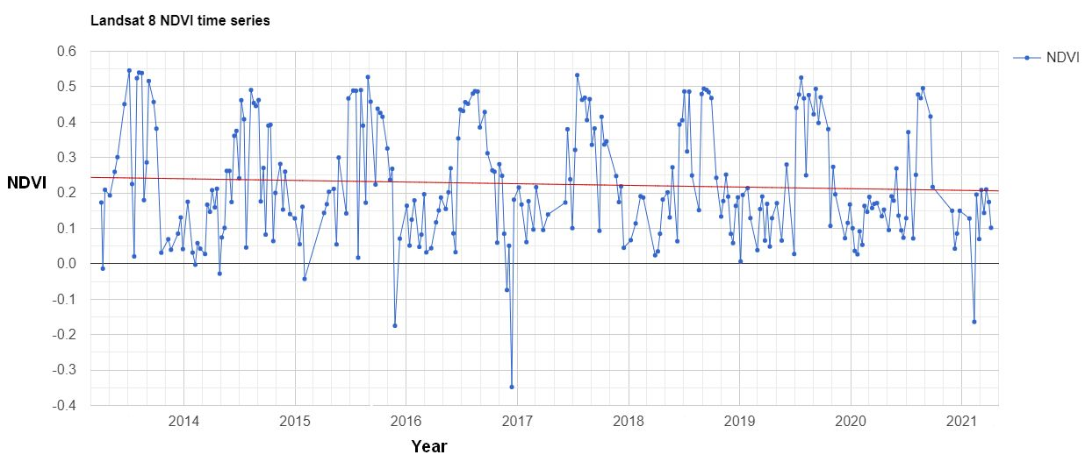
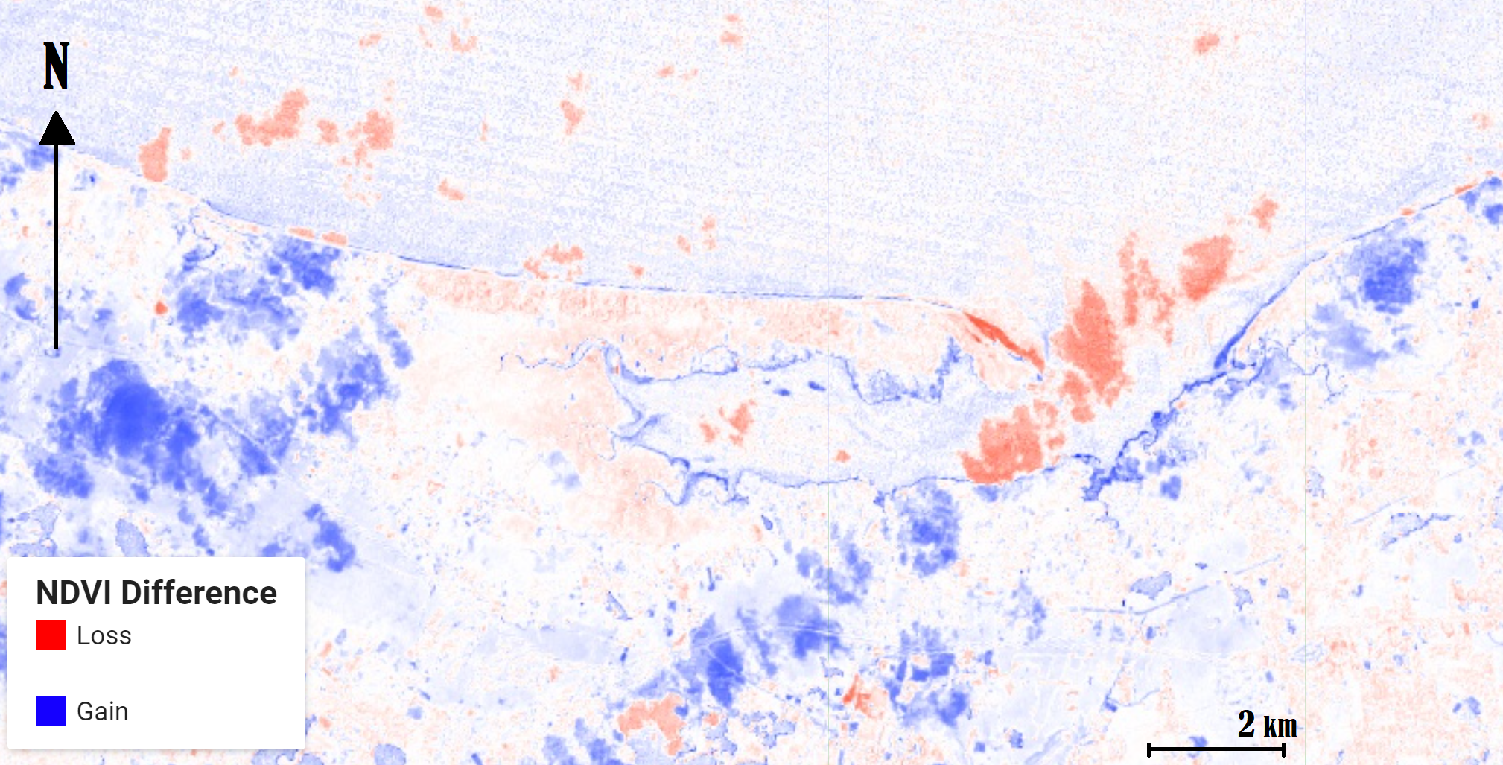
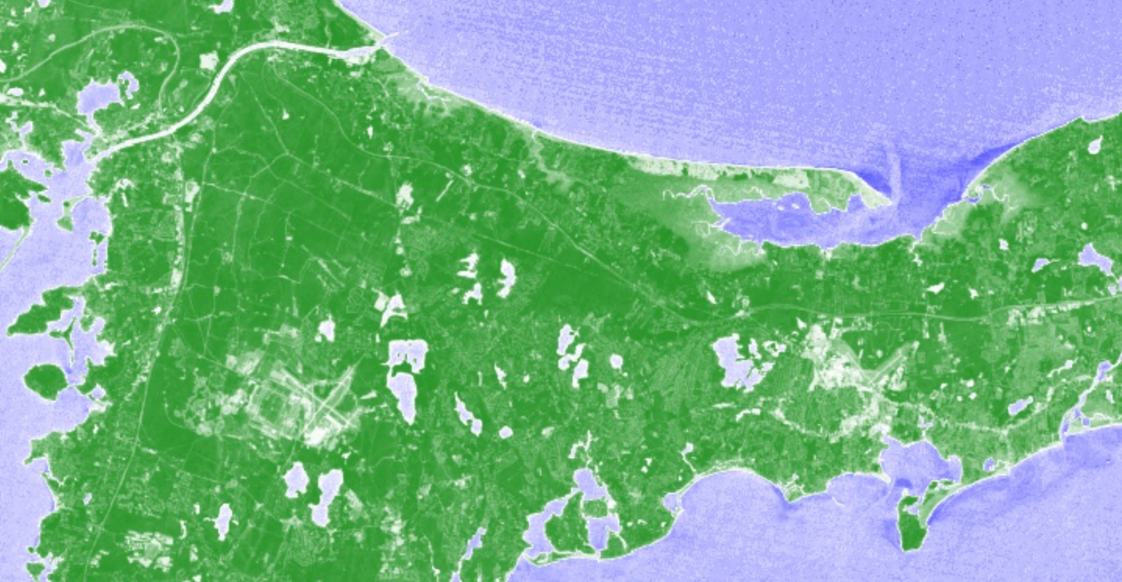
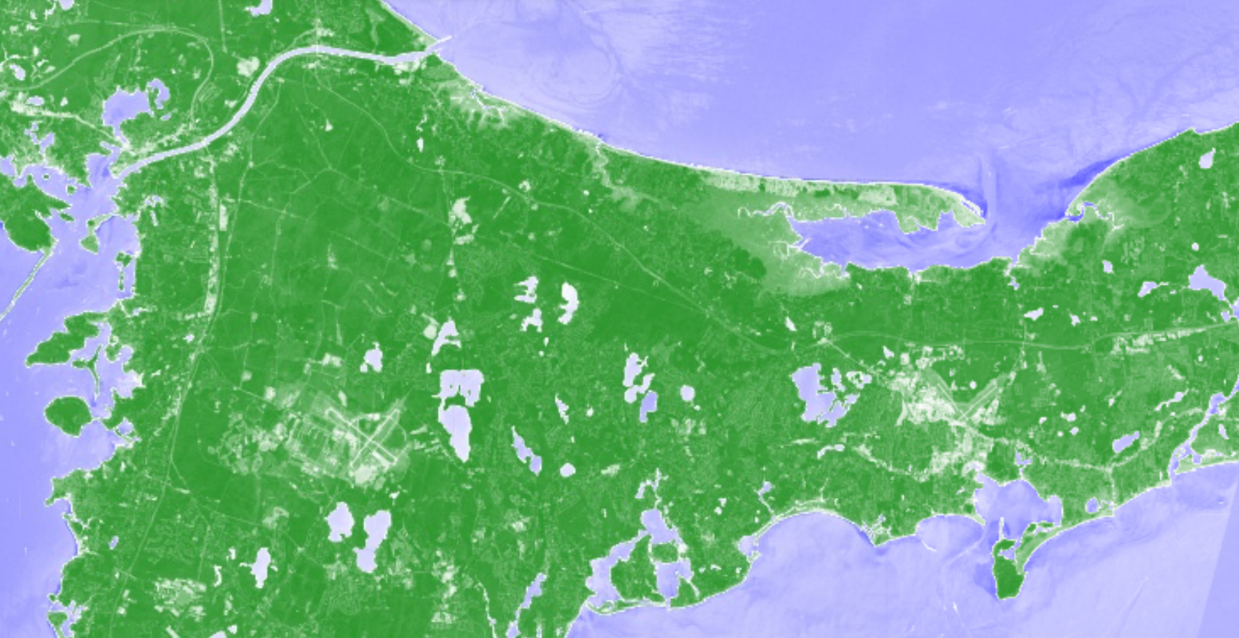
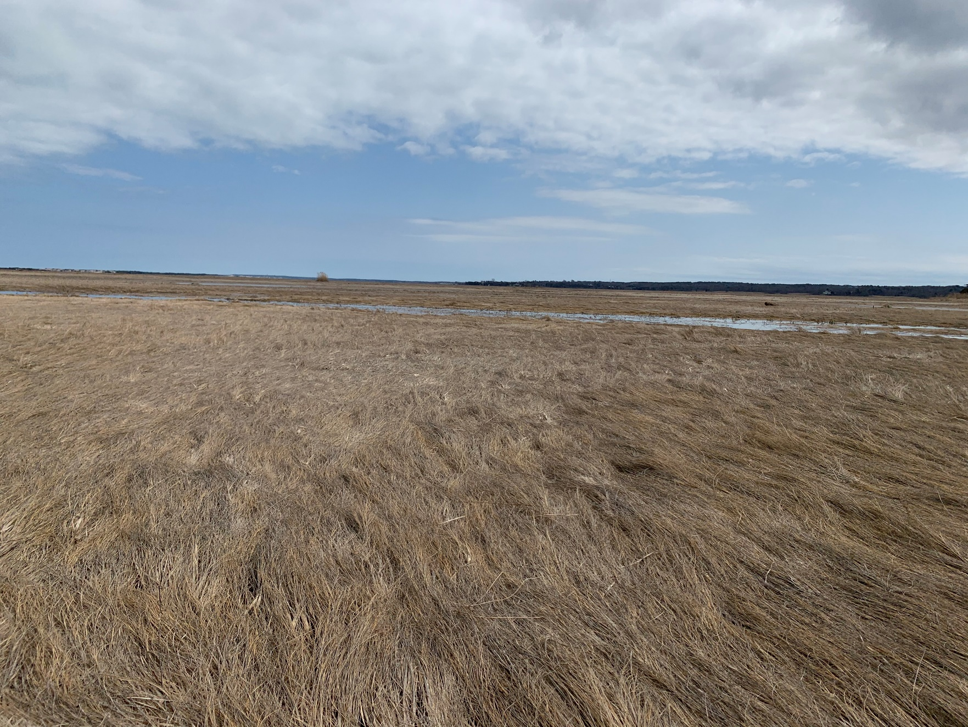
Cape Cod’s Changing Shoreline An Analysis of Barnstable Harbor Salt Marsh
Quinton Hazard, Earth Science Department, University of New Hampshire
abstract
methods
results
Cape Cod could be facing crisis due to a warming climate and rising sea levels. It is well established that many high value properties are located along the coast. These residential and commercial plots, however, are not the only thing at risk. The Capes coastal wetlands provide valuable habitat for wildlife, serve as nurseries for fish and shellfish, store floodwaters, and protect shorelines against damage from storm surges. Additionally, salt marshes are valuable for climate change mitigation because they remove carbon dioxide from the atmosphere and convert it into salt marsh vegetation. This survey aimed to quantify the change in health of Cape Cod’s biggest salt mash, located around Barnstable Harbor. A Google Earth Engine script that was created to test the hypothesis will also be useful for providing a baseline for the future. This was another goal of the project. The study takes place over 20 years, with images dating back to 2001. It was hypothesized that a degradation of the salt marsh would be apparent. To test this, NDVI imaging was compared from the start of the study to current. The results showed a small effect in the same direction as hypothesized: a gradual decline in salt marsh density over the past 20 years.
In order to analyze the overall health of the Great Salt Marsh in Barnstable Harbor, a normalized difference vegetation index (NDVI) was conducted. On board the Landsat satellites used in the analysis are different optical sensors measuring different spectral ranges of reflected light. The bands used to calculate NDVI are near infrared and red wavelengths, although these differ depending on the Landsat number. Different Landsat image collections had to be used depending on which satellites were the most current for the desired time period.
$$NDVI= \frac{(NIR−RED)}{(NIR+RED)} , where NIR=near infrared$$
A normalized difference provides a value between -1 and 1 naturally, so values closest to 1 have the highest possible density of green vegetation. Values near zero means no vegetation, while negative values show as bodies of water.
To plot this using Google Earth Engine multiple Landsat images were imported; since the analysis starts in the 1970’s the earliest satellite is Landsat 1. The image collections were then filtered to show the best scenes with the least clouds during the summer months. New variables were created using band select, so these variables could be used in the NDVI formula. Using normalized difference code and visualization parameters the layer was added to the map. Note: the layers were not stretched to maintain the bounds of the index. Looking at properties for each layer, Unix time of the image was converted to real time. An almanac provided information about tide levels for the day. Constant tide phase across all images was a requirement. This prevented confusion surrounding areas exposed at low tide and hidden during high tide.
Max NDVI values decreasing with time over the past 9 years. Data specific to Landsat 8
Gradual decline in vegetation density for Barnstable Harbor salt marsh.
R² = 0.0045 for timeseries, trendline drops from .245 to .201
Bands Used in NDVI Calculation:
Landsat 1:
Band 7 = NIR
Band 5 = Red
Landsat 7:
Band 4 = NIR
Band 3 = Red
Landsat 8:
Band 5 = NIR
Band 4 = Red
A time series plot for max NDVI vs time was generated using Google Earth Engine. This required adding bands to the existing Landsat 8 image collection then using plot function, along with visualization parameters for the chart, the chart was printed to the console. From there this was exported out of GEE.
A difference layer was created to show the regions of the salt marsh that changed, either positively or negatively. This was done by simply subtracting the NDVI layers from each other, since they have the same range (-1, 1).
introduction
discussion
The general purpose of the survey was to identify if there was any change in the health of Cape Cod’s salt marshes, specifically targeting Barnstable Harbor. This area is located on the North side of the peninsula and is the most concentrated area of salt marsh on Cape Cod. Previous studies indicate 36% of The Cape’s historical salt marsh have been lost or severely downgraded. The analysis is important not only because this is where I grew up, but also because salt marsh is significant as a carbon sink. The hypothesis was that over time, both the quality and quantity of the salt marsh would decline.
Although the hypothesis was proven correct, there are some things to take into consideration. Landsat imaging progressively get more advanced with the advent of each new satellite. This allows for more spectral bands, and thus a smaller range of wavelengths. Initially, analysis was planned to start in 1972, with Landsat 1; The range of the bands was too large, so comparing NDVI from 1972 to 2020 is not accurate. This is useful to have as depiction of the shape of the shoreline is still visible, although lower quality.
Future Use: The script will continue to be update after this summer, and seasons to come. I will hopefully work with this project again in my career. No specific cause was identified to be the source of the degradation. Furthermore, prevention methods and restoration would be the next step in the project.
Code Links:
NDVI Layers: https://code.earthengine.google.com/44313399746dd7b0ace870a2f8596ece
NDVI Timeseries: https://code.earthengine.google.com/f788b12abe6573dbb861ff622681420f
Rising sea level threatens these vulnerable habitats. Existing only in specific tidal zones, a dramatic rise would lead to disappearance of the marsh. Urbanization along the coastline leaves no room for the marsh to retreat. There has been discussion about other causes for salt marsh dieback including invasive purple marsh crab, pathogens, and soil properties.
NDVI datasets from 2001 and 2014, respectively. Note: urban areas show up white, areas of dense vegetation dark green.
References
“Salt Marsh Restoration.” Association to Preserve Cape Cod, apcc.org/our-work/science/salt-marsh-restoration/.
Bertness MD, Holdredge C, Altieri AH. Substrate mediates consumer control of salt marsh cordgrass on Cape Cod, New England. Ecology. 2009 Aug;90(8):2108-17. doi: 10.1890/08-1396.1. PMID: 19739373.
Smith, Stephen M. “Multi-Decadal Changes in Salt Marshes of Cape Cod, MA: Photographic Analyses of Vegetation Loss, Species Shifts, and Geomorphic Change.” Northeastern Naturalist, vol. 16, no. 2, 2009, pp. 183–208., doi:10.1656/045.016.0203.
“High Marsh Dieback.” National Parks Service, U.S. Department of the Interior, 26 Feb. 2015, www.nps.gov/caco/learn/nature/high-marsh-dieback.htm.
Watson, E B et al. “Anthropocene survival of southern New England's salt marshes.” Estuaries and coasts : journal of the Estuarine Research Federation vol. 40,3 (2017): 617-625. doi:10.1007/s12237-016-0166-1
Photo of Salt Marsh in early spring. NDVI reflectance for this time would be low, max NDVI values occur in Summer Months
Bertness MD, Brisson CP, Bevil MC, Crotty SM (2014) Herbivory Drives the Spread of Salt Marsh Die-Off. PLoS ONE 9(3): e92916. https://doi.org/10.1371/journal.pone.0092916
Coverdale, Tyler C., et al. “Regional Ontogeny of New England Salt Marsh Die-Off.” Conservation Biology, vol. 27, no. 5, 2013, pp. 1041–1048., doi:10.1111/cobi.12052.

