Slide 1
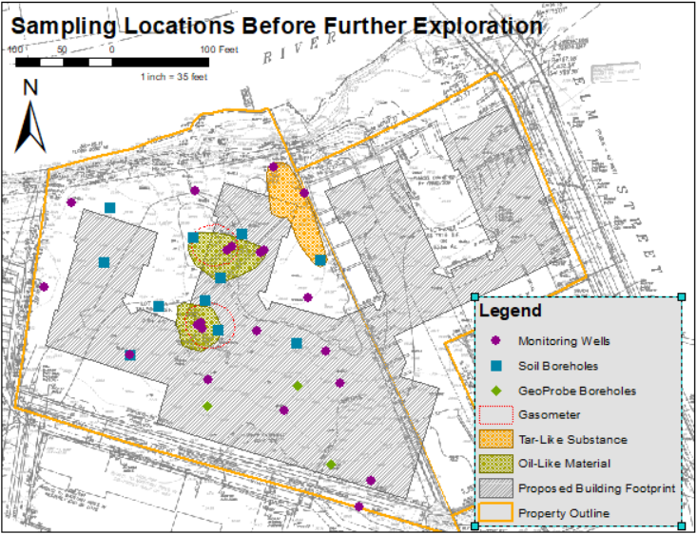
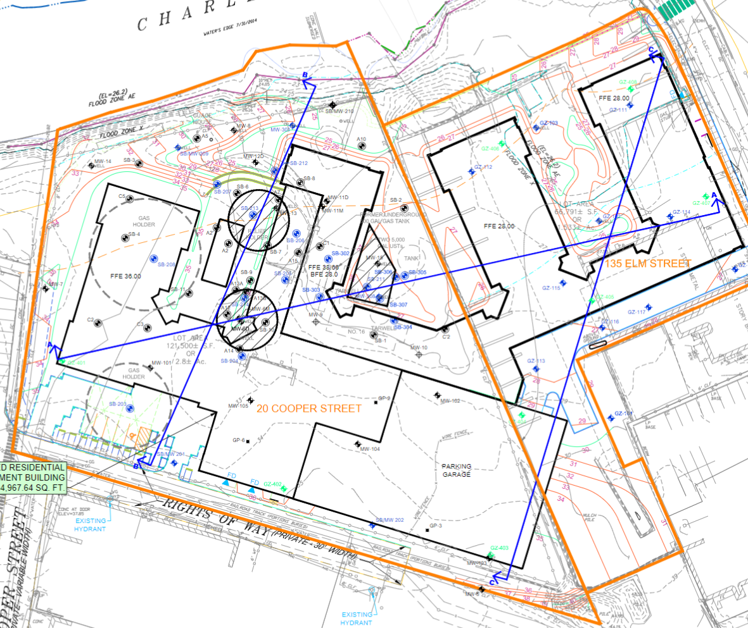
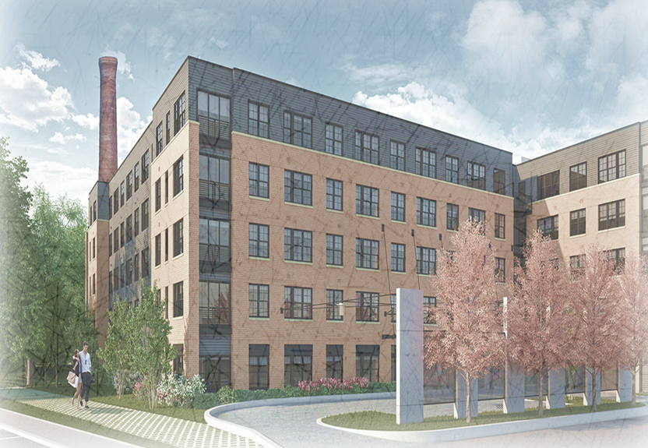
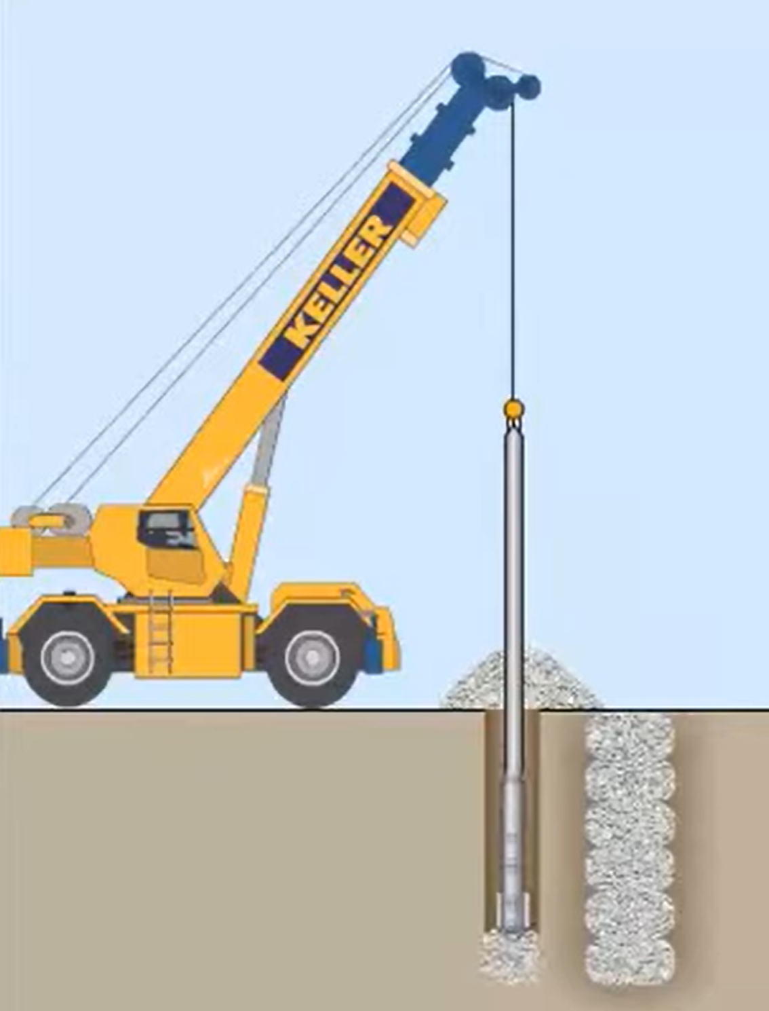
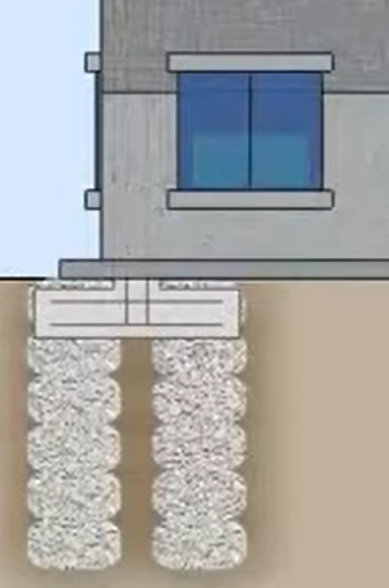
Construction of Luxury Apartments over a Former MGP Site
Waltham, MA
Isaac Colcord • Dylan Erasmus • Steven Rizzo • Nicholas Whitley
Jay Hodkinson, Project Sponsor • Dr. Jean Benoit, Faculty Advisor
Department of Civil and Environmental Engineering, University of New Hampshire, Durham, NH 03824
Introduction
Environmental Report
Geotechnical Report
The client is interested in purchasing two parcels of land in Waltham, MA for development of a luxury apartment building, along with an attached parking garage.
Soil and groundwater conditions are impacted by past remediation efforts and site usage for manufacturing. The client requests recommendations for hazardous waste remediation and foundation construction that can be provided within the most reasonable budget and timeframe.
Using existing data and further explorations, a geotechnical and environmental report will be produced that provides analyses of the soil and groundwater on the site and recommendations for the client. Previous environmental reports on the site were provided by GZA GeoEnvironmental and were reviewed and analyzed by the project team.
These reports will address current contaminants exceeding regulatory levels, suggestions for remediation options, and recommendations for construction of the building’s foundation.
Based on boring logs completed by GZA, the soil characteristics from the site are as follows:
“Up to about 20 feet (but generally about 10 feet) of granular fill consisting of loose to dense sand, gravel and silt, with trace amounts of organic material, and miscellaneous debris, a discontinuous layer of organic soils up to about 6 feet thick (but generally less than 3 feet thick, where encountered) of organic silt and/or peat with sand; overlying, Natural glacial till deposits, consisting sand, silt and gravel.“
With these soil characteristics, the key challenge for the foundation is reducing the settlement of the structure and incorporating the gasometers into the foundation design.
Area 1
Area 2
The following contaminants were found on-site in excess of MCP (Massachusetts Contingency Plan) regulatory levels: lead, beryllium, petroleum hydrocarbons, blue and purple dye, physiologically available cyanide, benzene, ethylbenzene, and naphthalene.
Groundwater testing found low concentrations of barium, nickel, zinc, arsenic, and vanadium.
The highest levels of contamination appeared to be in proximity to the gasometers and tar well.
Geotechnical Recommendations
Remediation Recommendation
With the site characteristics specified, the best geotechnical solution for this project would be to use rammed aggregate piers. These are a form of soil remediation that will strengthen the bearing capacity of the soil, while allowing the use of standard mat footings.
Soil is removed by augur and may be disposed of off-site if contaminated. This method costs under $500,000, approximately 50% of the cost of traditional piles, and installation has a comparable timeline. It is rapid, adaptable
to the site, and has been
shown to be effective.
The capped gasometers will
provide enough structural
support on their own, so
additional supports will not be
required at those locations.
Existing Site Conditions
Area 1 contains oil-like substances that will have the most potential impact on the Charles River since it is migrating downgradient to the river. The MCP requires remediation to a minimum of 15 feet bgs (below ground surface). The 2 locations with the hydrocarbon-contaminated soil will require about 100,000 cubic feet of soil to be excavated and disposed of in a landfill.
Area 2 contains tar-like substances, which create another region of concern by exceeding MCP regulations. This location will require a minimum depth of 3 feet bgs and will require approx. 8,000 cubic feet of soil excavation.
Capping is recommended for the two gasometers. Removing the gasometers would be costly and time consuming, while capping will seal the contaminants underground and provide structural support.
The site is the former site of a manufactured gas plant and a crayon manufacturing facility. The gas plant is responsible for the existence of underground brick gasometers where gases were contained when the plant was in operation.
The site exists on the bank of the Charles River, which flows through Boston. The proximity to the river adds a layer of regulatory protections to the site. Since the site’s aquifer flows in a northeastern direction, into the Charles, contaminated groundwater cannot be pumped back into the ground without treatment.
Likewise, contaminated soil cannot be left in piles on the surface in locations where rain can wash contaminants into the river.
References: (1) Google Maps. (2017). (2) Apartment in Construction. Longview Fibre Company. (2005). (3) Field Investigation Report. Provided by Hodkinson, Jay. (2015). (4) Existing Conditions Plan Provided by Hodkinson, Jay. (2015). (5) Grading Plan Mass.Gov. (2018). (6) Current Regulatory Limit. Massachusetts Department of Environmental Protect. (2014). (7) Massachusetts Contingency Plan. Clean Earth Inc. (1990). (8) Soil Recycling and Disposal Services.
Contact Information: Isaac Colcord ijc1007@wildcats.unh.edu, Dylan Erasmus dje1005@wildcats.unh.edu, Steven Rizzo scr1020@wildcats.unh.edu, Nicholas Whitley nrw1009@wildcats.unh.edu

