Slide 1
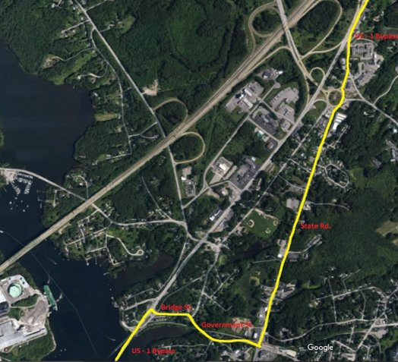
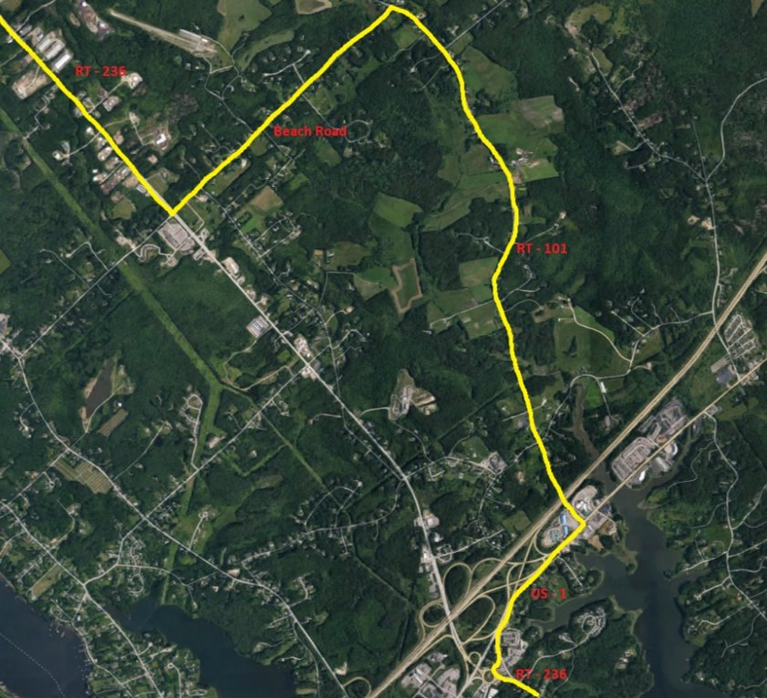
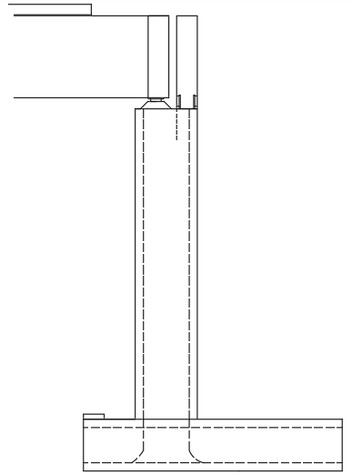
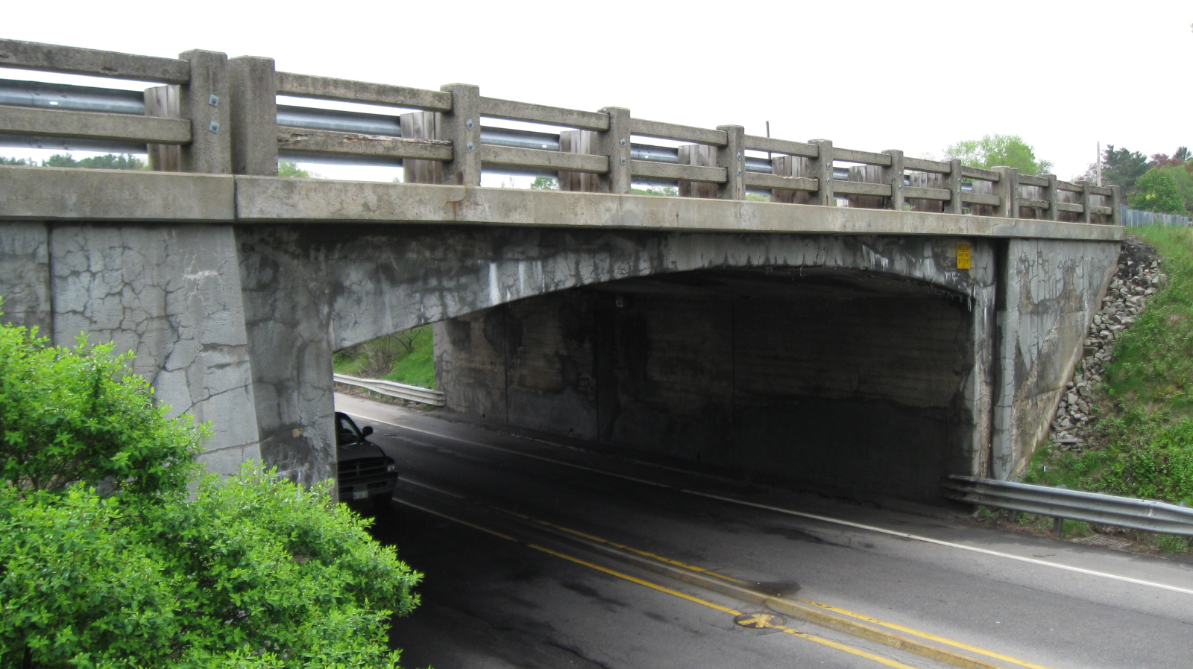
US Route 1 Bypass Bridge Replacement Over Route 236 Kittery, Maine Christopher O’Leary (PM), Troy Thirkell, Dillon Eberhardt, Joshua Landry, Nicholas Eagan Project Advisor: Matthew Low P.E. Project Sponsor: Samuel White P.E.
Background
Detour Routes
Prestressed Beam Design
Due to location and traffic volume on RT 236 and RT 1 Bypass Accelerated Bridge Construction (ABC) methods will be implemented to minimize impacts to local businesses and travelers. The construction timeline from beginning to end of closure of RT 1 is to be about a one-month period. The design alternatives will meet current MaineDOT bridge overpass and roadway design guidelines. The scope of this project addresses the current problems the bridge has and how these problems will be resolved by increasing the vertical clearance, width underneath the bridge, addition of a raised median, widened shoulders and additional horizontal clearance for the possible future addition of a sidewalk along RT 236.
Because this project involves temporary shutdown of two major routes, two detour alternatives were created (one for each road). The major factors that influenced the final alternatives were commute time, miles added, and proximity to local business.
Based on the superstructure recommendation for a 28D NEXT Beam, a preliminary prestressed beam design was completed for the proposed bridge. The bridge will consist of seven 10’ wide beams that are 54’ long. This makes the effective overhang of the 70’ wide bridge 3’. Using the AASHTO Bridge Design Code and moments generated from an HL-93 Truck, the following moments and factors were calculated.
HL-93 Truck and Live Load Moment:
828 ft-kips
Beam Dead Load Moment:
741 ft-kips
Composite Dead Load Moment:
8 ft-kips
Total Dead Load Moment (MDC):
748 ft-kips
Wearing Surface Dead Load (MDW):
0 ft-kips (not included with NEXT D)
Total Controlling Moment (AASTHO Strength I):
2138ft-kips
RT 1-Bypass Alternative (Both Directions)
Rt 236 Alternative (Both Directions)
Structural Recommendations
Existing Conditions
Substructure
The existing bridge is a cast-in-place concrete rigid frame with stone facing that was constructed in 1942. The existing span of the superstructure is 47 feet 4 inches with a vertical clearance over RT 236 of 13 feet 10 inches at the edge of either side of the roadway and 14 feet 7 inches in the center of the span and a clear travel way of 75.5 feet on RT 1 Bypass and 42 feet 2 inches on RT 236. On the bridge, all primary structural elements are sound but have minor section loss, map cracking, spalling, active leakage causing efflorescence, delamination, and scour, which resulted in the following grades based on their condition: Substructure- 5; Deck- 4; and Superstructure- 4, these grades follow the FHWA coding criteria. The most recent Average Annual Daily Traffic (AADT) counts showed an averaged total of 10,930 vehicles traveling on RT 1 Bypass daily and 33,990 vehicles on RT 236.
Precast Concrete Abutments were chosen due to the reduction in construction time which is essential for an ABC Project as well as the reduction of deck joints which proves to be a common area of deterioration in bridges
Cost Analysis
Item | Cost
Substructure | $500,000
Superstructure | $563,000
Demolition/Removal | $175,000
Approaches | $234,000
Detour | $300,000
Preliminary and Construction Engineering | $560,000 ($280,000 each)
Mobilization (structure + approaches) | $238,000
Miscellaneous (field office, etc.) | $421,000
Total (rounding included) | $3,000,000
Pre-Fabricated Concrete Abutment
Superstructure
Precast NEXT D Beams were the chosen superstructure for this bridge. This alternative allows for fast placement, while limiting concrete pours/ curing time. 10' wide beams with a 9" closure pour factored in were used to meet the bridge span of 54' and 70" width. The beams also have the smallest depth of all alternatives considered and this allows for the vertical clearance under the bridge to increase.
Bridge Section using NEXT D Beams
Cost Analysis was determined based off a slope intercept analysis method divided into 21 major aspects of this project. Pricing for materials was determined using Hodgson Mills pricing and quantities for materials.
Bridge Elevation using NEXT D Beams

