Slide 1

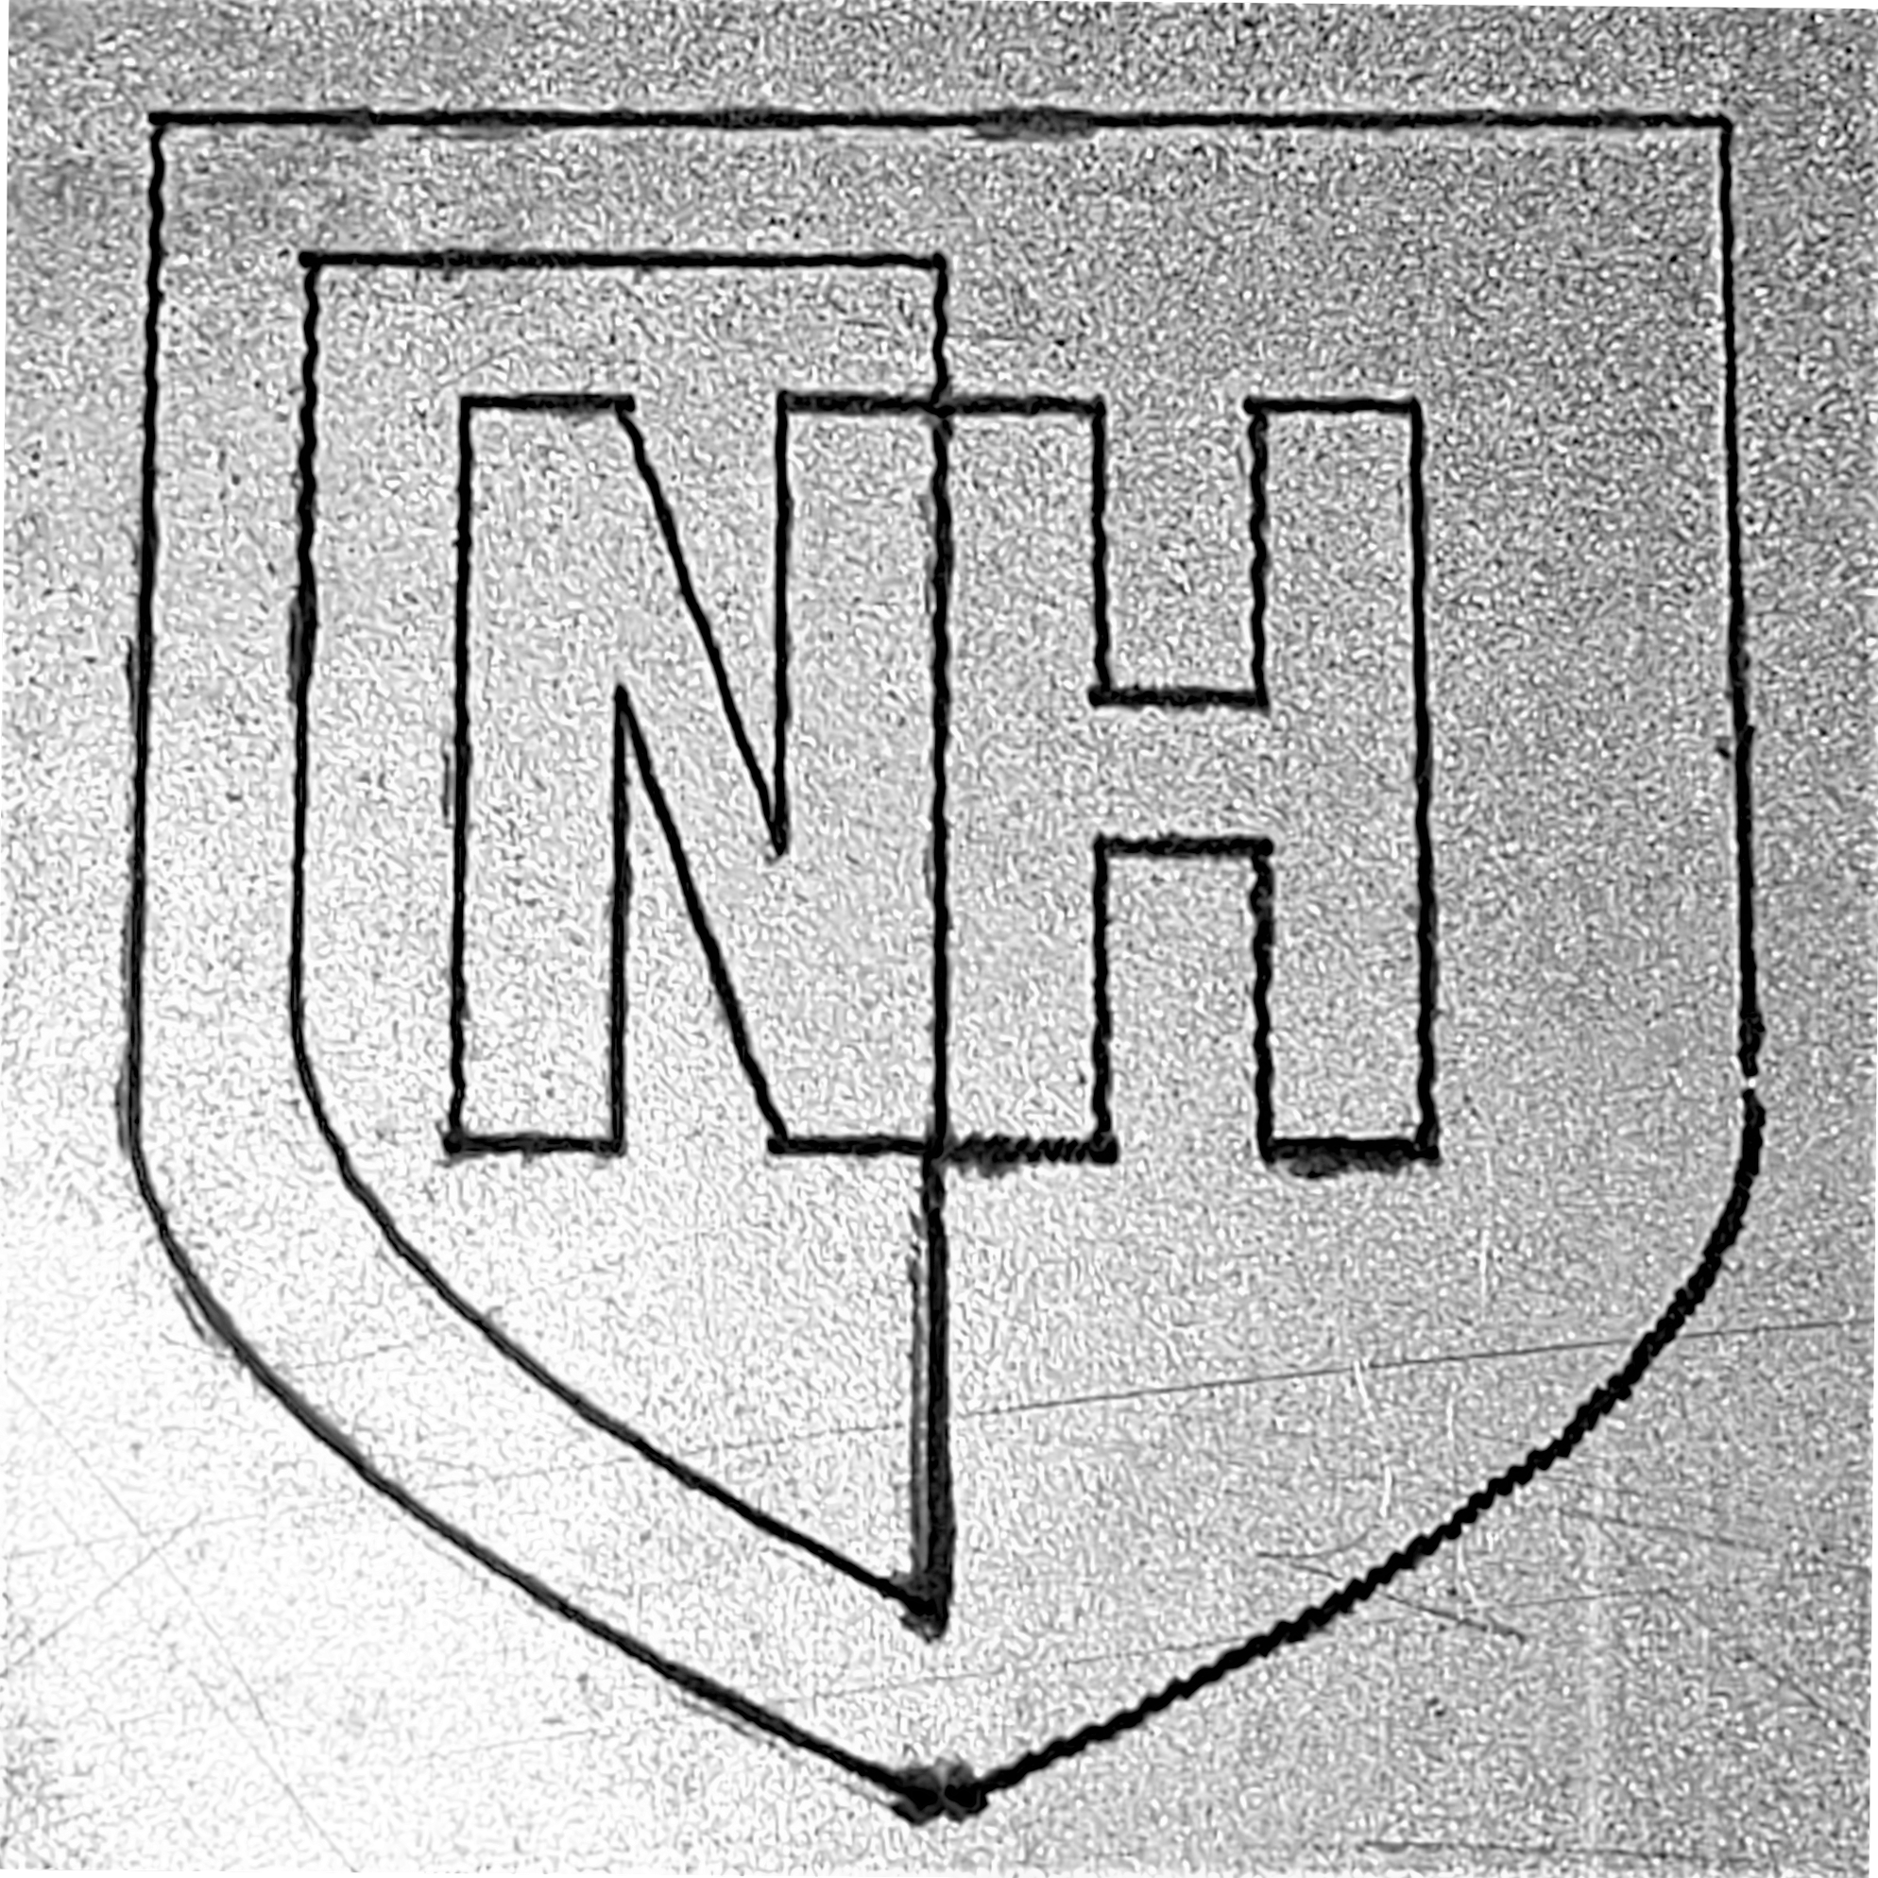
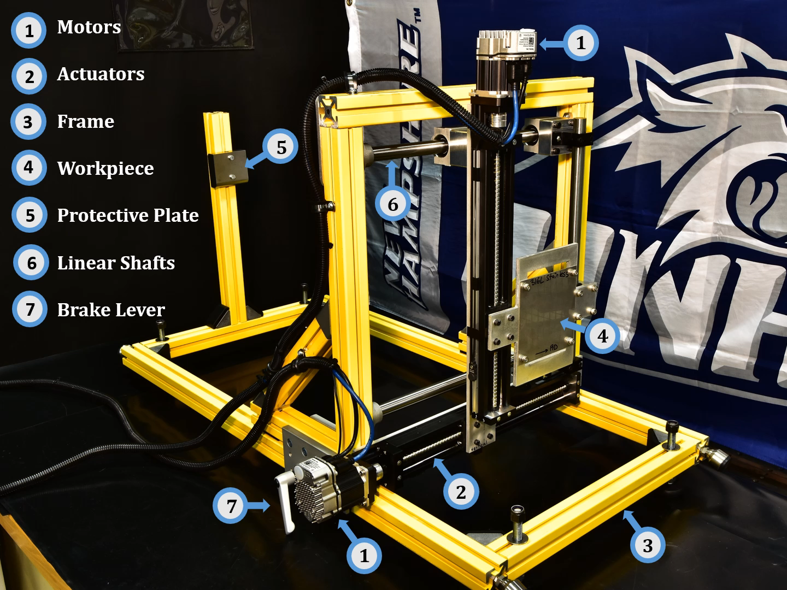
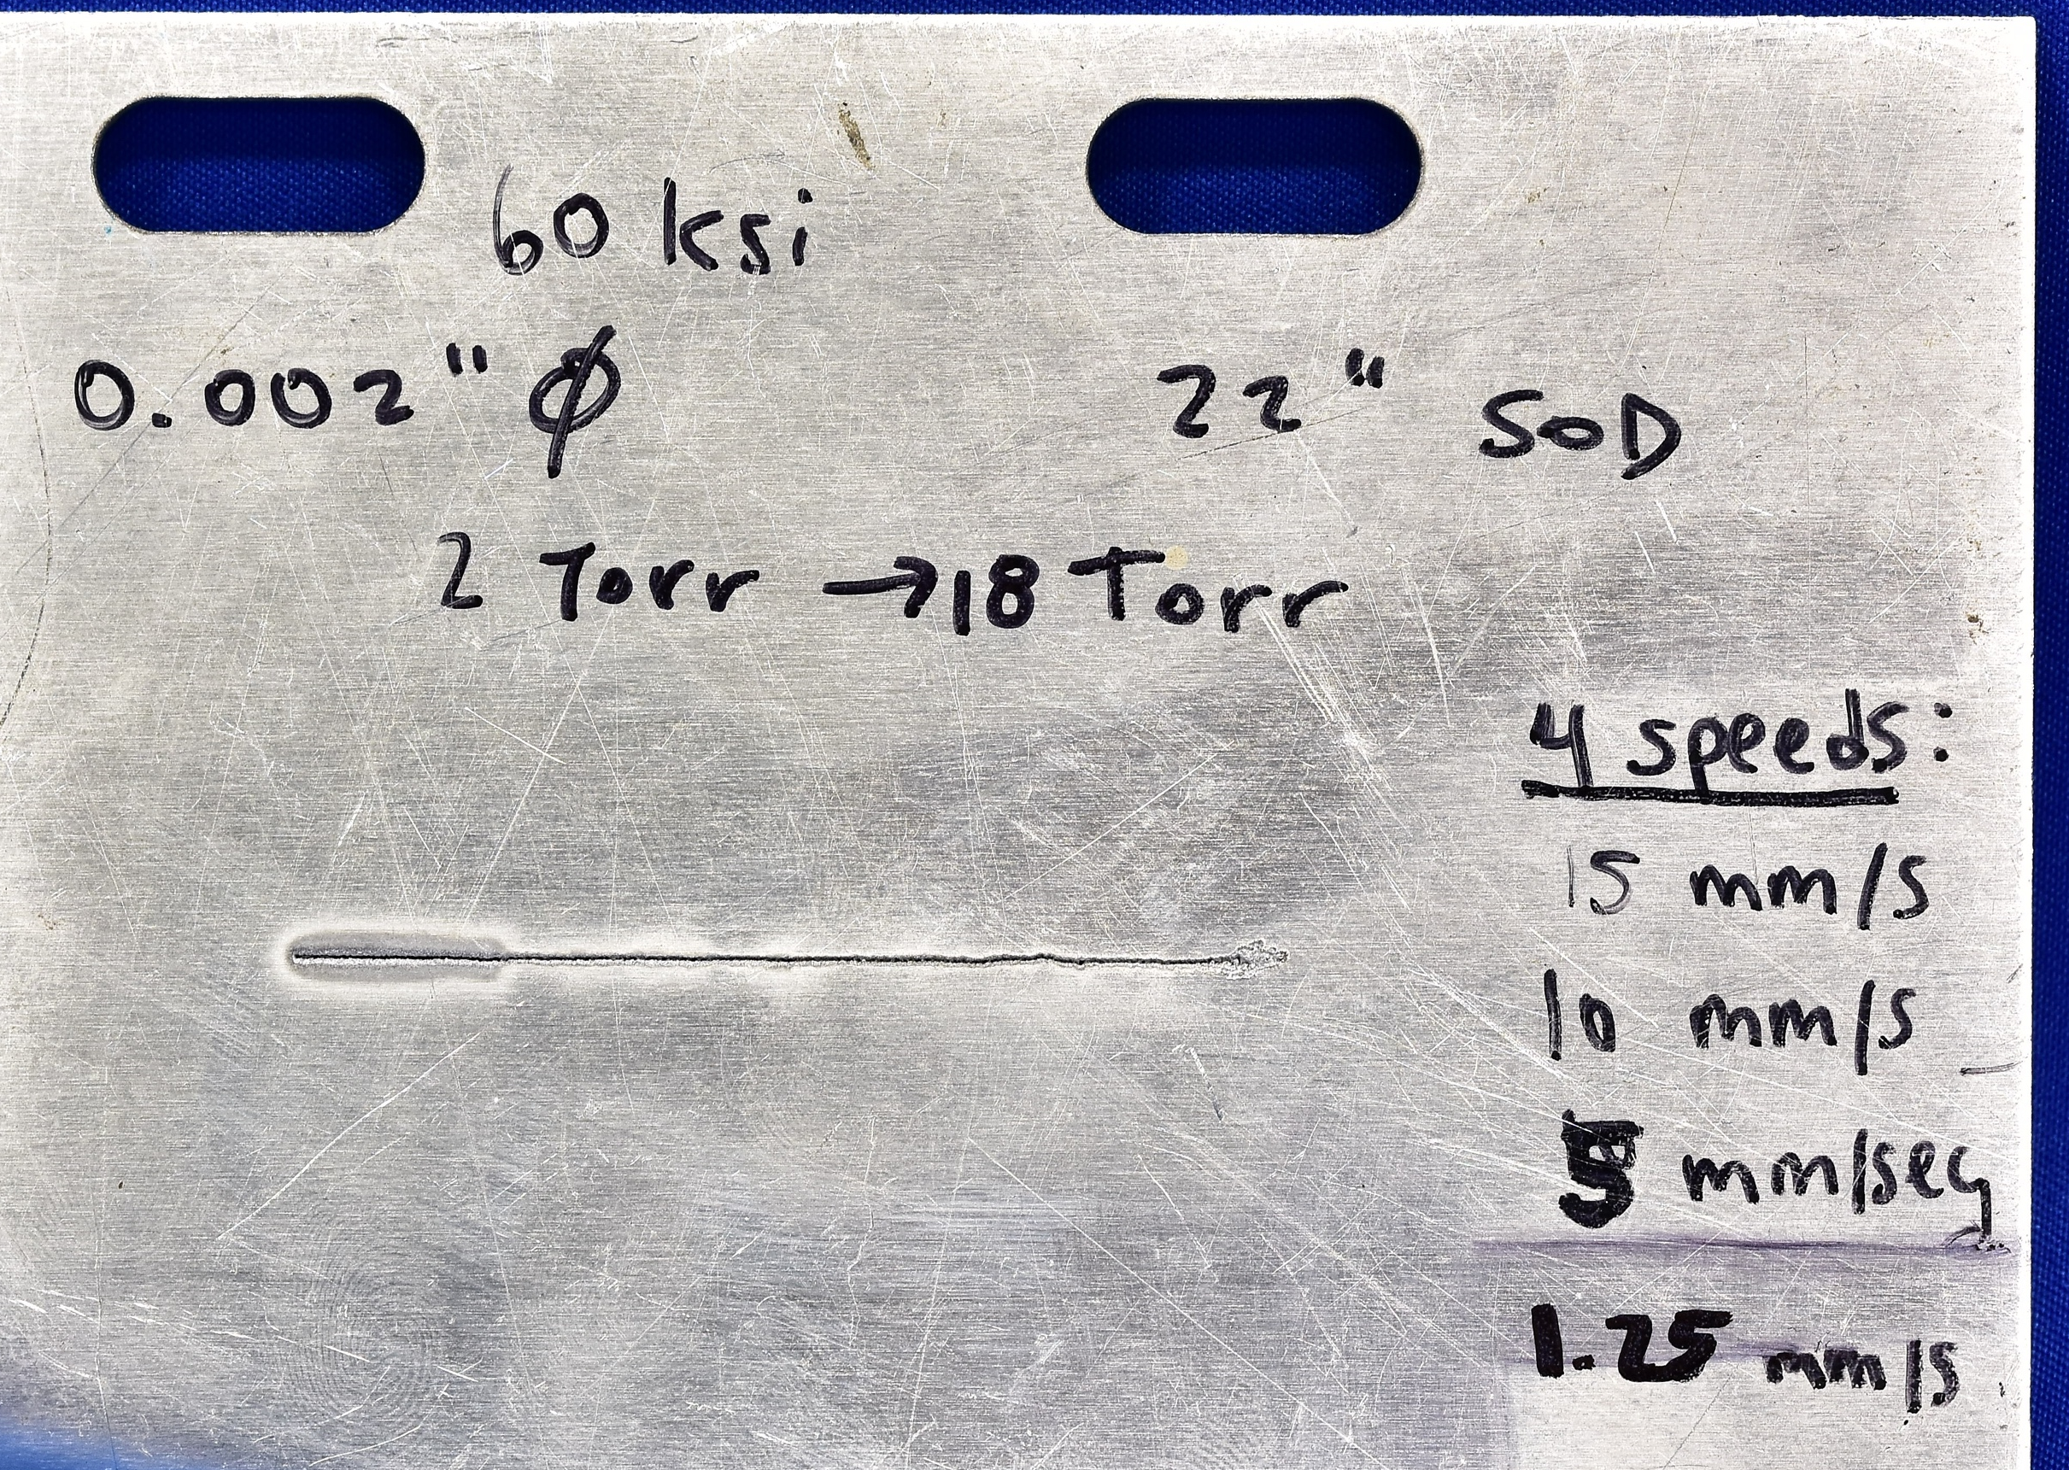
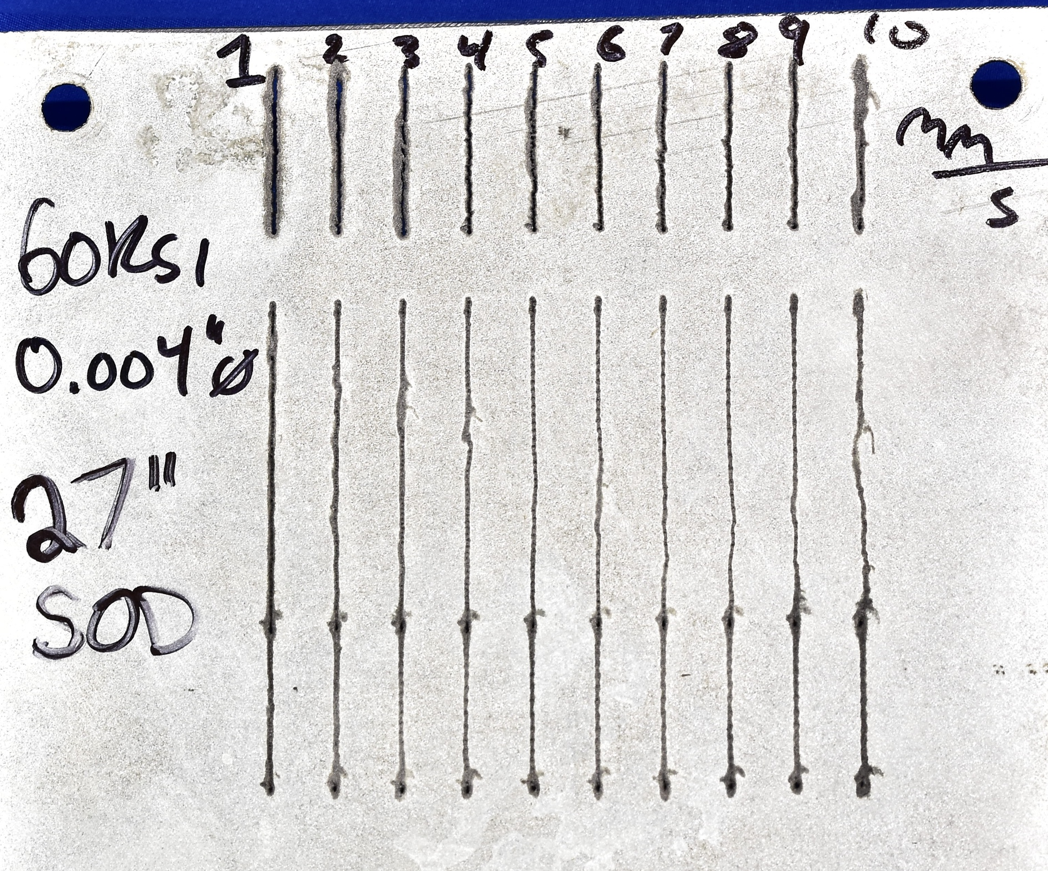
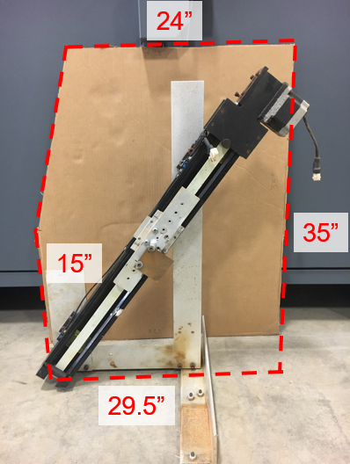
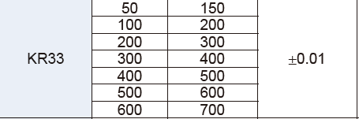
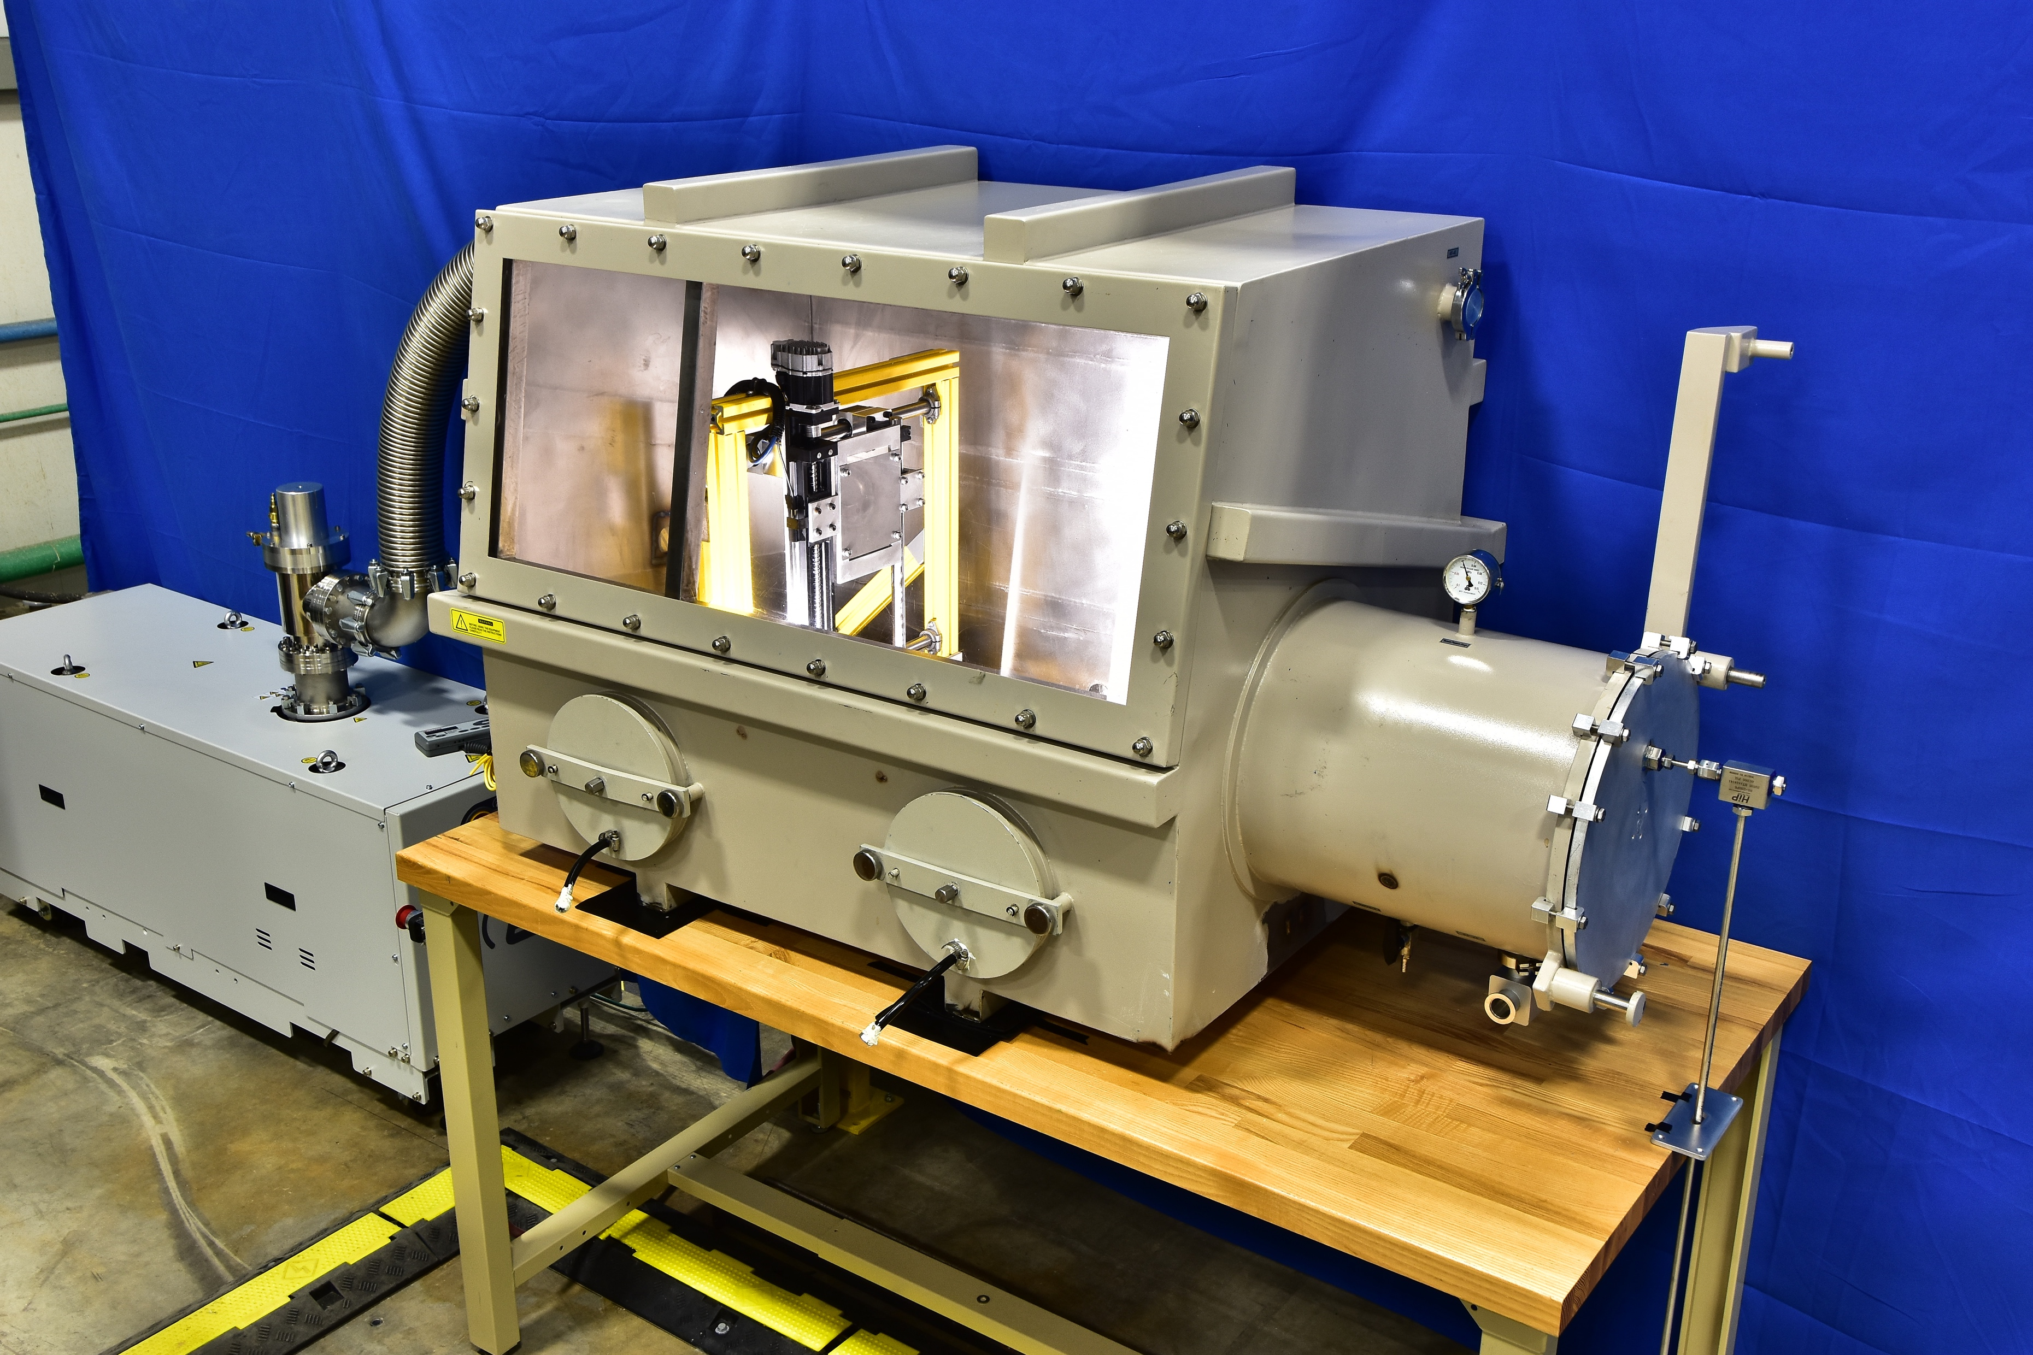
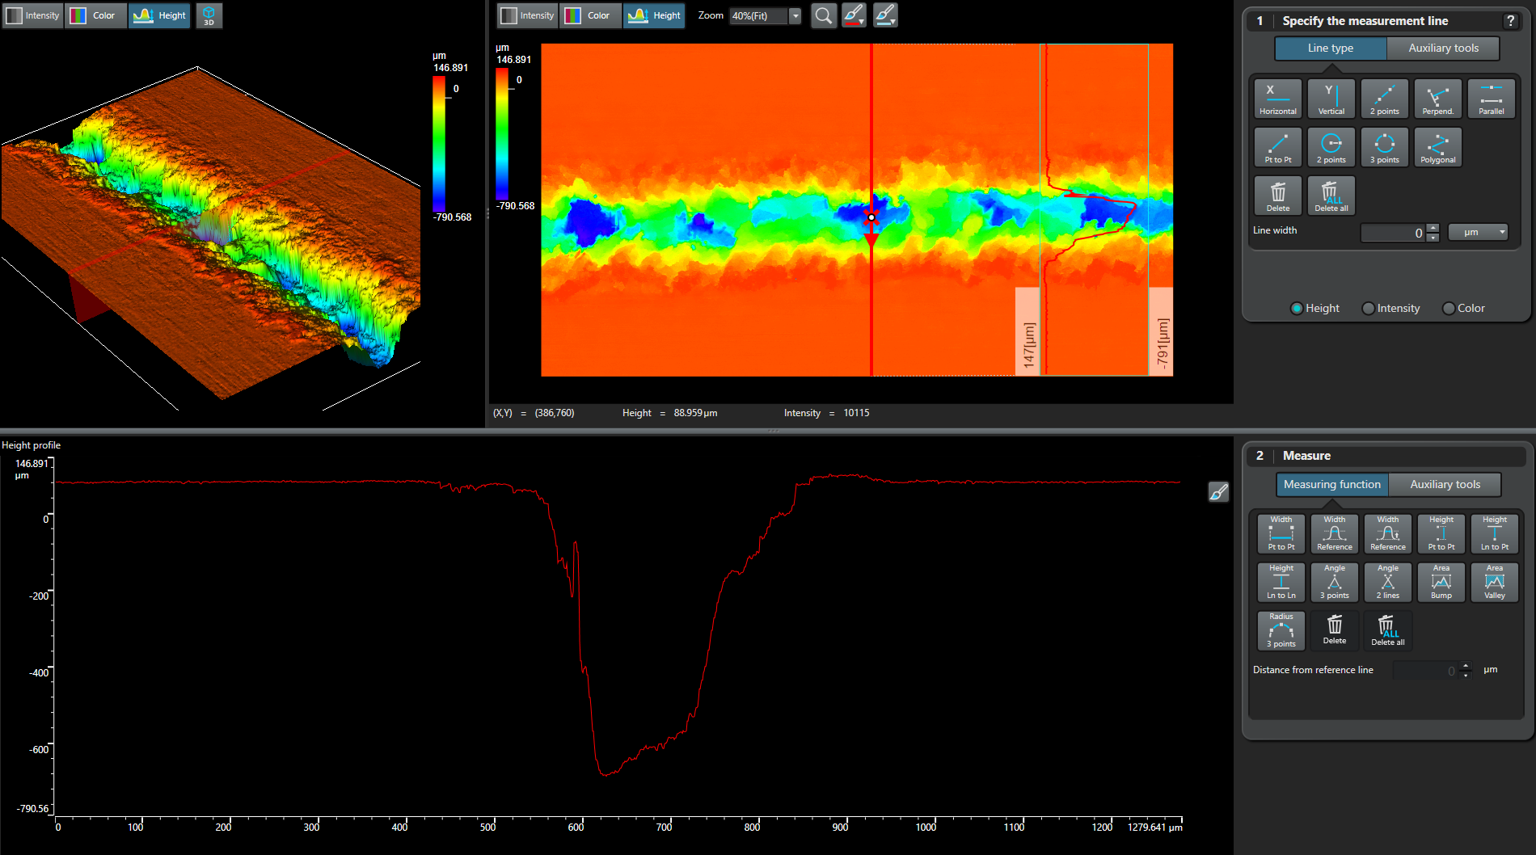
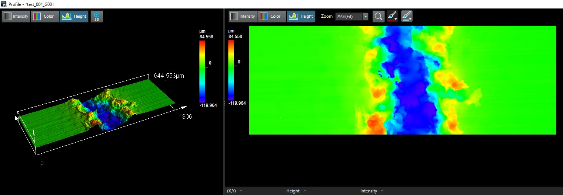
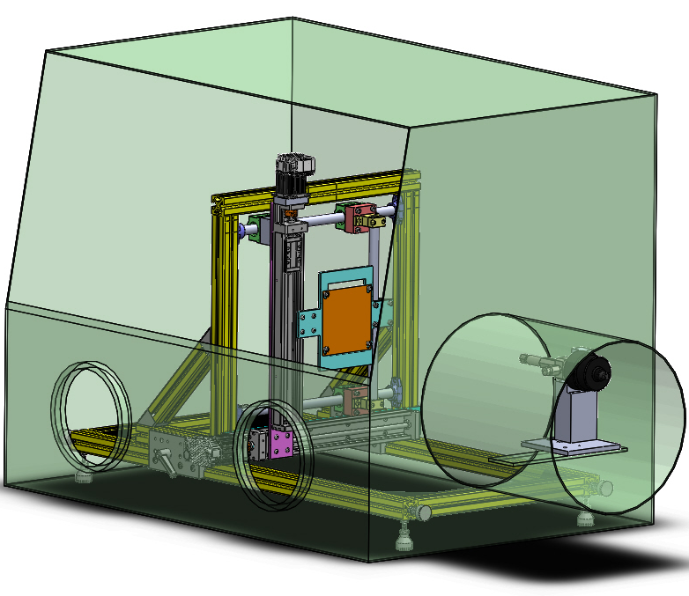
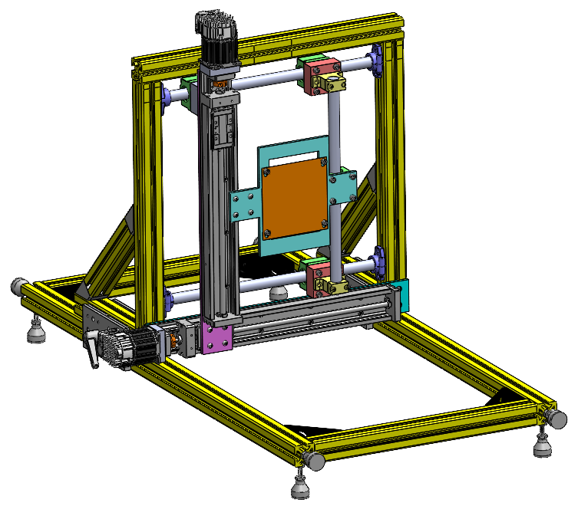
Traverse System for Water Droplet Machining
Ali Al-Jewad, Nathan Daigle, Sohani Demian, Giovanni Guglielmi, Jordan Hoffman
Advisers: Professor Brad Kinsey, Professor Wei Wei Mo, Ben Mitchell
Mechanical Engineering, University of New Hampshire, Durham, NH 03824
Introduction
Completed Traverse System
Testing Specimens
Time lapse
Testing Specimens
Water Droplet Machining (WDM) is a novel manufacturing process comparable to traditional abrasive waterjet machining (AWJ) which uses highly pressurized water to cut a workpiece. AWJ abrasive is financially and environmentally expensive. WDM eliminates the need for abrasive by operating inside a vacuum chamber to eliminate air resistance. In WDM, the workpiece moves on a traverse system while the jet remains stationary.
Vacuum chamber cross-section
New (left) and original (right) test specimens cut in WDM process
New (left) and original (right) test specimens cut in WDM process
Original traverse system
Accuracy Testing
 | Programmed Displacement (mm) | Measured Displacement (mm) | Displacement Percent Difference (%) | Elapsed Time (seconds) | Programmed Velocity (mm/s) | Calculated Velocity (mm) | Velocity Percent Difference (%)
Trial 1 | 100.000 | 100.050 | 0.050 | 10.090 | 10.000 | 9.916 | 0.846
Trial 2 | 100.000 | 99.650 | 0.350 | 10.030 | 10.000 | 9.935 | 0.650
Trial 3 | 100.000 | 99.830 | 0.170 | 9.950 | 10.000 | 10.033 | 0.331
Design Criteria
Spatial limitations:
  Fits inside vacuum chamber
  Varies in speed between 0.1 mm/s and 200 mm/s
  Survives high humidity and reduced pressure
  Handles high density/mass samples (up to 2.2 kg)
  Accommodates samples 100 mm square, 1-15 mm thick
  Avoids axis drive components and water jet interference
Ergonomic considerations:
  Workpiece secures easily to traverse system
  Easily programmable cutting speed and location within chamber
Measurement uncertainties:
  Minimizes uncertainty due to change in relative position between traverse system and vacuum chamber
  Compares actual and target motor speed
Model No.
Stroke (mm)
Rail length (mm)
Repeatability(mm)
Material Removal Testing
Water Droplet Machining Set-up
Original Traverse System Improved Traverse System
Isometric view of trench on workpiece
Isometric view of trench on workpiece
CAD Model
Traverse system
Traverse system in vacuum chamber
Top view of trench on workpiece
Top view of trench on workpiece
Vacuum pump
Vacuum chamber
High pressure water inlet
Dwell pockets
More consistent trench depth
Traverse system
Conclusions and Future Work
Acknowledgements
Improved traverse system enables cutting two-dimensional shapes and multiple cuts per specimen
Further analysis of dwell pocket phenomenon
Environmental impact comparison of WDM and traditional waterjet via Life Cycle Assessment and Life Cycle Cost Assessment
This work has been performed with support from Ben Mitchell, Professor Brad Kinsey, and Professor Wei Wei Mo along with the US National Science Foundation through award CMMI-1462993.

