Slide 1


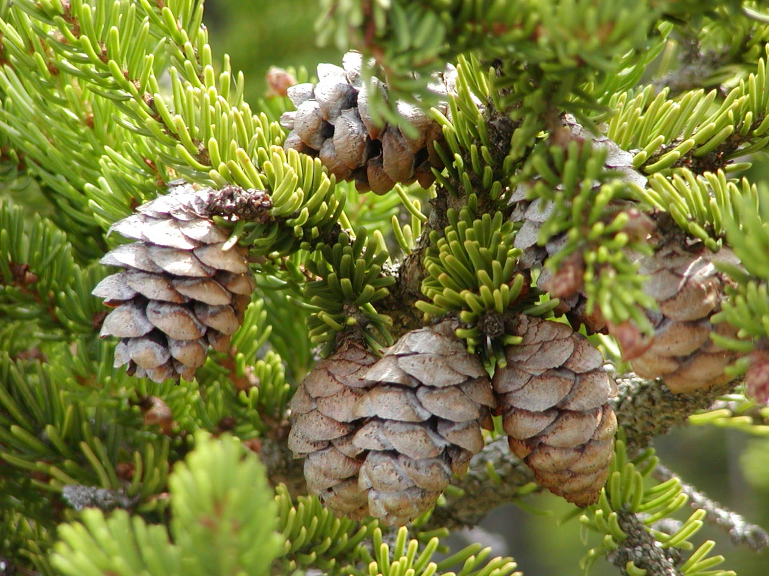
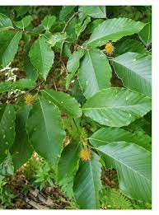

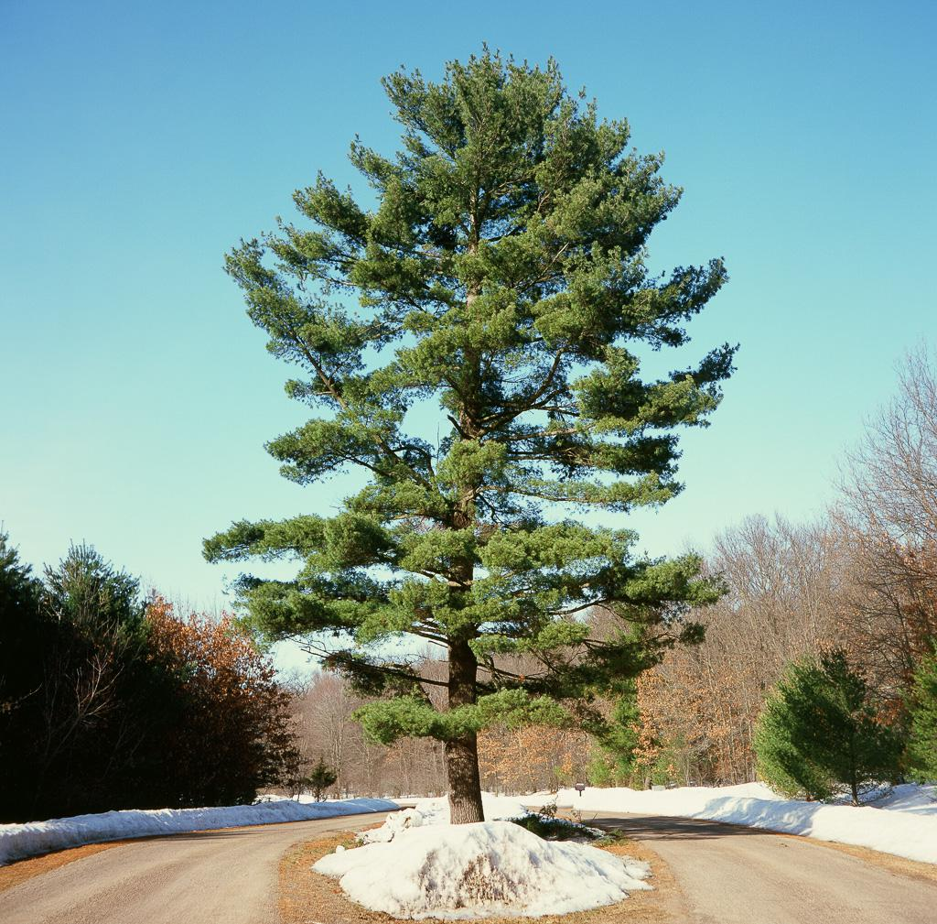
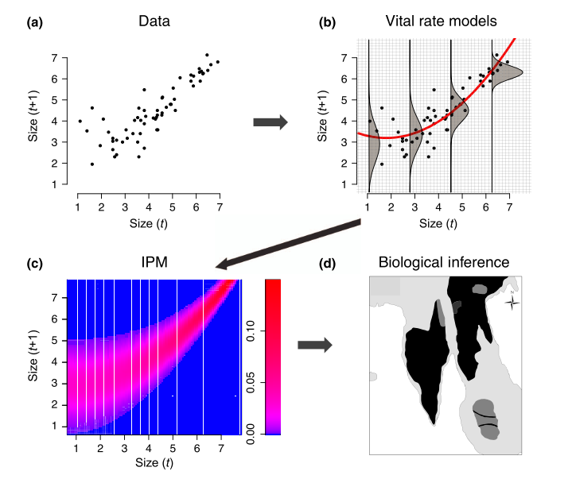
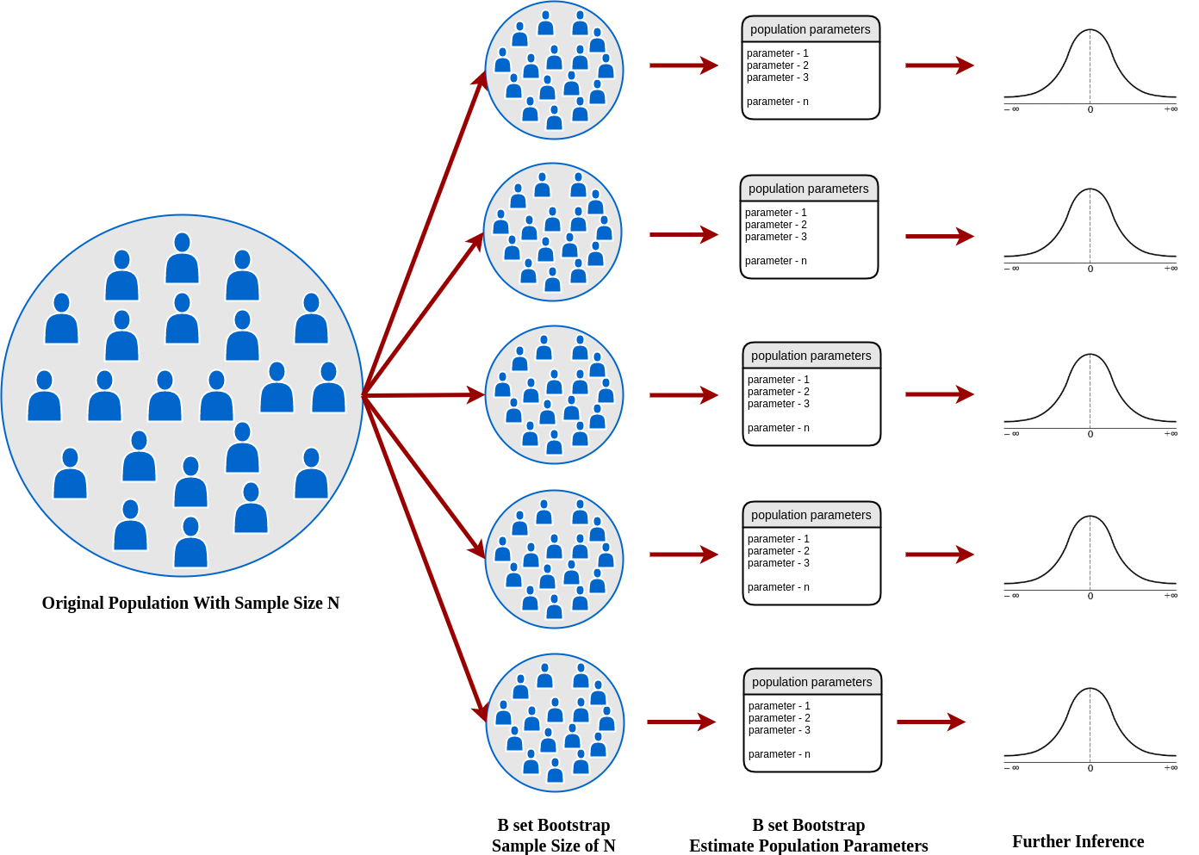
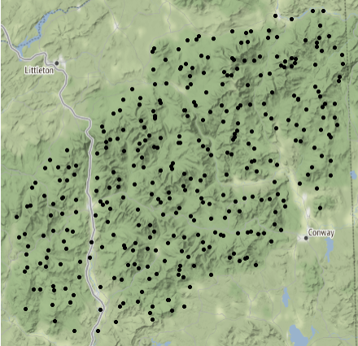
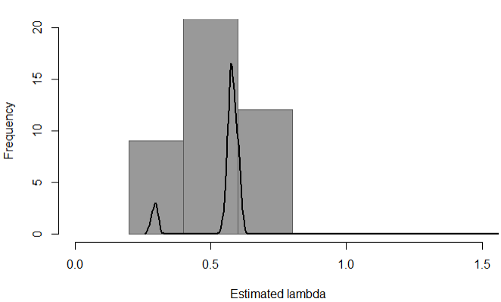
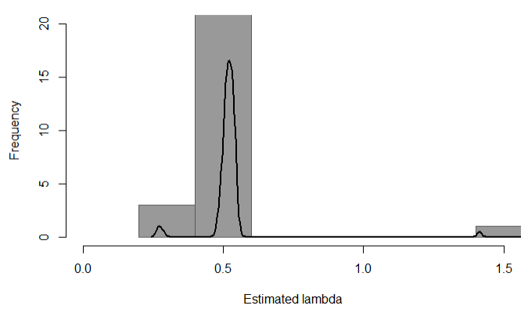
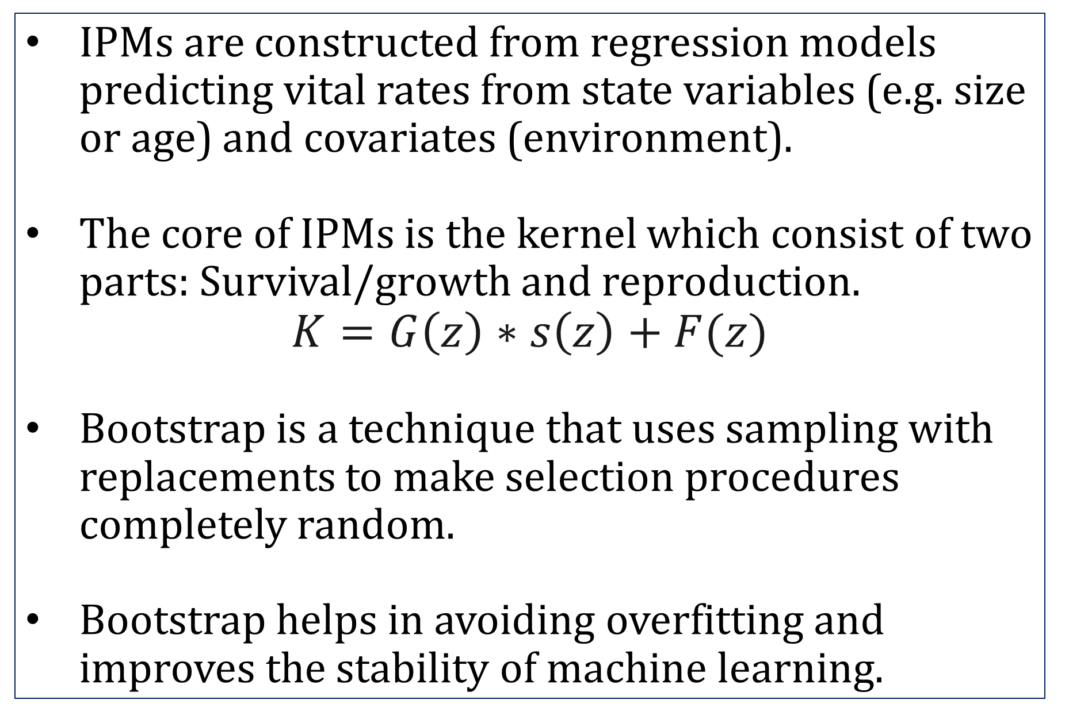
Using IPMs To Model Tree Growth In The White Mountain National Forest
Yingjie Ma
Advisor: Dr. Marek Petrik
Department of Computer Science, University of New Hampshire, Durham, NH 03824
Place your Project Logo Here
Introduction
Types of trees modeled
Results
Population ecologists rely on statistical models in order to see how populations change over time.
There are many models that have been used to resolve this issue. But here we present a new framework for predicting the growth rate of trees, the knowledge is based on Data-driven Modelling of structured populations (2016).
Integral projection models (IPMs) use information on how an individual’s state influences its vital rates to make population projections.
Red Spruce
American Beech
Red Maple
White Pine
The growth rate of Red Spruce is 65%, and average diameter is 8.52 inches.
The growth rate of American Beech is 72%, and average diameter is 9.39 inches.
The growth rate of Red Maple is 67%, and average diameter is 9.88 inches.
The growth rate of White Pine is 63%, and average diameter is 18.4 inches.
Methodology
IPMs and Bootstrap
Conclusions
IPMs are constructed from regression models predicting vital rates from state variables (e.g. size or age) and covariates (environment).
The core of IPMs is the kernel which consist of two parts: Survival/growth and reproduction.
$$K=G\left(z\right)∗s\left(z\right)+F(z)$$
Bootstrap is a technique that uses sampling with replacements to make selection procedures completely random.
Bootstrap helps in avoiding overfitting and improves the stability of machine learning.
The declining rate for these tree is around 28-37% every 5 years.
The Lambda is mostly between 0.5 and 0.6 which means that the forest are growing overall.
The death rate is high in large trees. White Pine is a large tree compare other three types of trees; it has a high death rate.
Data
sTAMD Simulations
Acknowledgements
Results: Growth Rate
Red Spruce
American Beech
Thanks for computer science department.
Dr. Marek Petrik gave me a lot of encourage and help during this project.
The project was built upon Ben’s project.
References
Ellner, Stephen P., et al. Data-Driven Modelling of Structured Populations A Practical Guide to the Integral Projection Model. Springer International Publishing, 2016.
The data used are from the USDA (U.S. Department Of Agriculture) Forest Service.
The location of the data is specifically limited to the White Mountains National Forest.
Tree’s data were remeasured every 5-6 years.
Trees within each plot are uniquely identified and can be tracked.
Within this data, we looked at two species: Red Spruce and American Beech.

Slide 2

This poster template provided courtesy of
UNH ESRC Poster Printing Services
Trust us to make your poster look GREAT!
Website: http://posters.unh.edu
Poster Guide: http://goo.gl/1E7TJY
DELETE THIS SLIDE BEFORE PRINTING

