Slide 1

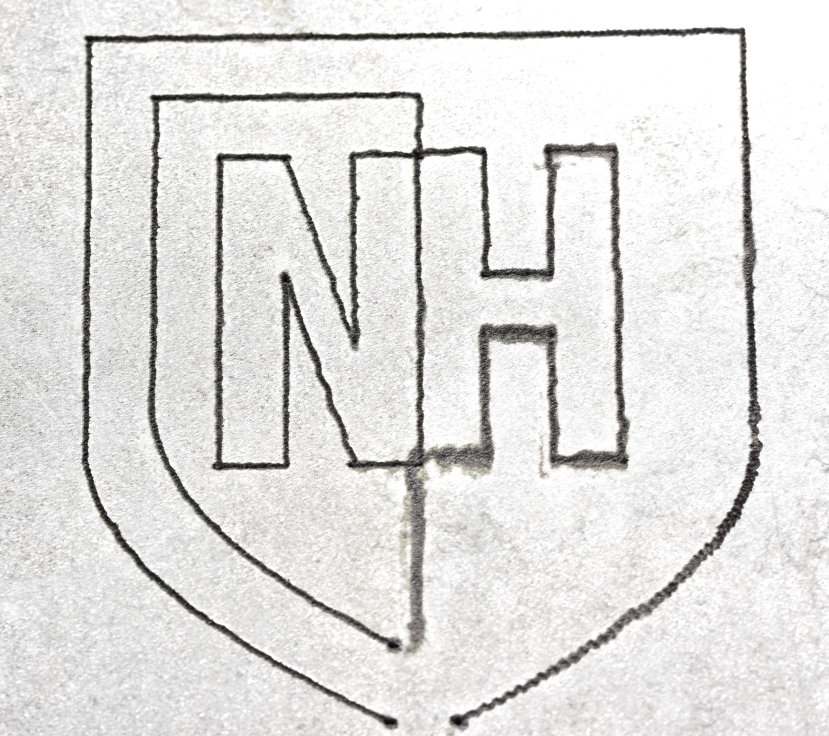
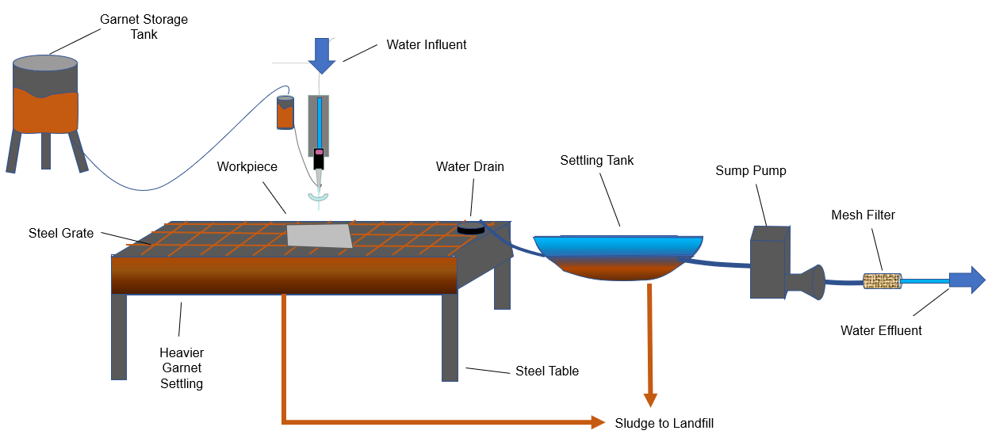
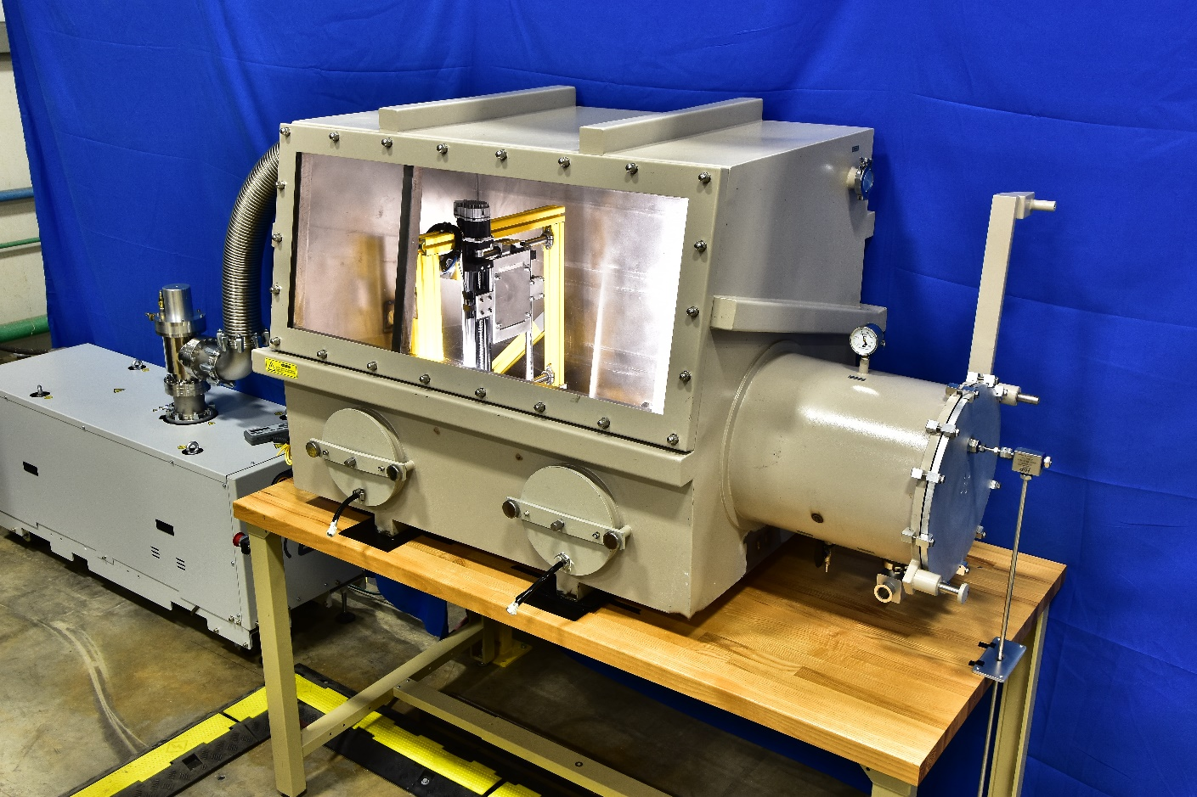
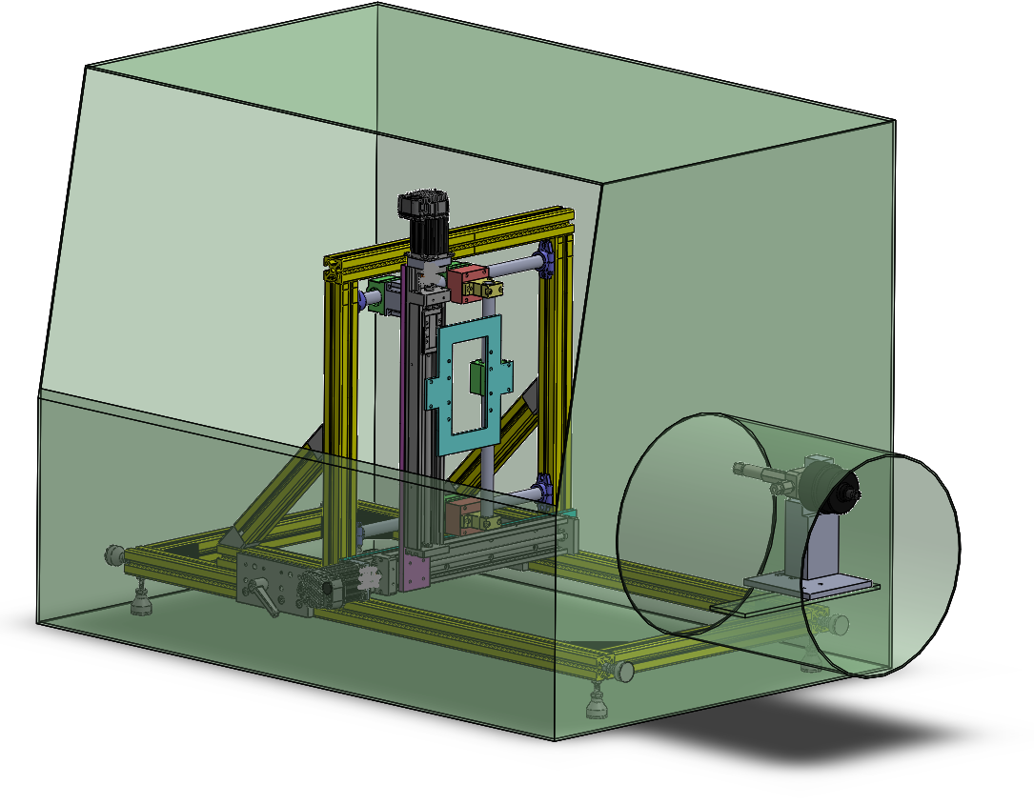
Environmental and Economic Life Cycle Assessments of Water Droplet Processing and Traditional Waterjet Cutting
Giovanni Guglielmi, Sohani Demian, Jordan Hoffman, Ali Al-Jewad, Nathan Daigle
Advisors: Dr. Brad Kinsey, Dr. Weiwei Mo, Benjamin Mitchell
Civil and Environmental Engineering, University of New Hampshire, Durham, NH 03824
Introduction
Waterjet Systems of Study
System Boundary
In 2018, worldwide crude steel production reached 1,809Mt [1]. With metal production and consumption increasing, it is important to note their processes because they have significant global effects on the environment and economy.
Waterjet cutting is a modern form of cleaning or cutting a certain material. This innovative process is used extensively as it poses a reduced environmental threat [2].
Abrasive Waterjet (AWJ) uses a mixture of abrasive particles and a high jet stream of water to cut metal.
Water Droplet Machining (WDM) is conducted on a custom-built waterjet machine that uses high-speed water droplets to cut metal. This process is driven by a Plateau Rayleigh Instability, where a stream of water naturally splits into water droplets after a certain distance traveled [3, 4].
Abrasive Waterjet (AWJ)
Water Droplet Machining (WDM)
Vacuum Chamber
Vacuum Pump
Water Inlet
Traverse System
(Left) Formation of abrasive slurry before reaching the workpiece.
(Right) Systemic process for AWJ operation.
(Left) Exterior of the WDM.
(Right) Model displaying the interior traverse system of the WDM.
LCA Results
LCCA Results
Objectives
Perform a comparative life cycle assessment (LCA) on both the AWJ and the WDM.
Perform a life cycle cost assessment (LCCA) on both machines
Conduct sensitivity analyses on key inputs of the machines.
Methodology
WDM has higher environmental impacts than the AWJ per every 100 meters of metal cut.
For both waterjets, the operation and maintenance phase is responsible for about 50-60% of the lifetime environmental impacts.
WDM has higher costs than the AWJ per every 100 meters of metal cut.
Electricity and abrasives are dominant components in the WDM’s and AWJ’s life cycle costs, respectively.
Functional Unit = 100 meters of a 1.15mm thick 316L stainless-steel plate.
Life Cycle Assessment:
  Manufacturing/Assembly Phase
  Operation and Maintenance Phase
  End-of-Life/Disposal Phase
Life Cycle Cost Assessment (LCCA):
  Net Present Value (NPV)
Sensitivity Analyses:
  Abrasive Rate
  Service Life
  Electricity Usage
  Water Rate
Acknowledgements
Sensitivity Analyses
A great thank you to Dr. Mo, Dr. Kinsey and Benjamin Mitchell for support in this research along with the U.S. National Science Foundation through award CMMI-1462993.
Abrasive Waterjet (AWJ)
Water Droplet Machining (WDM)
Impacts | Adjusted Abrasive Use (-50%) (lb/min) | Adjusted Electricity Use (-50%) (kWh) | Adjusted Electricity Use (+50%) (kWh) | Adjusted Water Use (+50%) (L/min) | Adjusted Water Use (-50%) (L/min) | Adjusted Lifetime (+50%) (Years)
GWP | -38.2% | -24.7% | +24.7% | +0.01% | -0.01% | +0.31%
Ozone Depletion | -74.7% | -0.003% | +0.003% | +0.0078% | -0.0078% | +7.0%
Smog | -75.1% | -6.39% | +6.39% | +0.004% | -0.004% | +0.075%
Acidification | -59.7% | -16.3% | +16.3% | +0.004% | -0.004% | +0.064%
Eutrophication | -74.3% | -2.60% | +2.60% | +0.0073% | -0.0073% | +0.25%
Carcinogenic | -52.3% | -4.16% | +4.16% | +0.027% | -0.027% | +0.83%
Non-Carcinogenic | -78.9% | -3.83% | +3.83% | +0.0084% | -0.0084% | +0.99%
Respiratory Effects | -63.8% | -12.1% | +12.1% | +0.018% | -0.018% | +0.064%
Ecotoxicity | -78.6% | -3.59% | +3.59% | +0.0014% | -0.0014% | +2.7%
Fossil Fuel Depletion | -38.6% | -24.2% | +24.2% | +0.0043% | -0.0043% | +0.18%
LCCA | -33.7% | -16.4% | +16.4% | +2.50% | -2.50% | -21.46%
Impacts | Adjusted Lifetime (+50%) (Years) | Adjusted Water Use (+50%) (L/min) | Adjusted Water Use (-50%) (L/min) | Adjusted Electricity Use (-50%) (kWh) | Adjusted Electricity Use (+50%) (kWh)
GWP | -74.7% | +0.094% | -0.094% | -48.9% | +48.9%
Ozone Depletion | -34.4% | +5.84% | -5.84% | -5.98% | +5.98%
Smog | -1.4% | +0.17% | -0.17% | -48.0% | +48.0%
Acidification | -0.49% | +0.075% | -0.075% | -49.4% | +49.4%
Eutrophication | -17.6% | +1.37% | -1.37% | -23.4% | +23.4%
Carcinogenic | -23.8% | +0.814% | -0.814% | -11.2% | +11.2%
Non-Carcinogenic | -9.63% | +0.58% | -0.58% | -34.8% | +34.8%
Respiratory Effects | -2.98% | +0.23% | -0.23% | -45.5% | +45.5%
Ecotoxicity | -13.3% | +0.75% | -0.75% | -32.2% | +32.2%
Fossil Fuel Depletion | -0.39% | +0.041% | -0.041% | -87.9% | +87.9%
LCCA | -18.37% | +0.97% | -0.97% | -25.65% | +25.65%
References
[1] W. S. Assocation, “World Steel Association Home.”
[2] Y. Hu et al., “Mechanism and experimental investigation of ultra high pressure water jet on rubber cutting,” Int. J. Precis. Eng. Manuf., vol. 15, no. 9, pp. 1973–1978, 2014.
[3] B. R. Mitchell, J. C. Klewicki, Y. P. Korkolis, and B. L. Kinsey, “Normal impact force of Rayleigh jets,” Phys. Rev. Fluids, vol. 4, no. 11, pp. 1–23, 2019.
[4] P. Coullet, L. Mahadevan, and C. S. Riera, “Hydrodynamical models for the chaotic dripping faucet,” J. Fluid Mech., vol. 526, pp. 1–17, 2005.
Abrasive use is the most sensitive AWJ parameters analyzed
Electricity use and lifetime are the most sensitive WDM parameters analyzed

