Slide 1
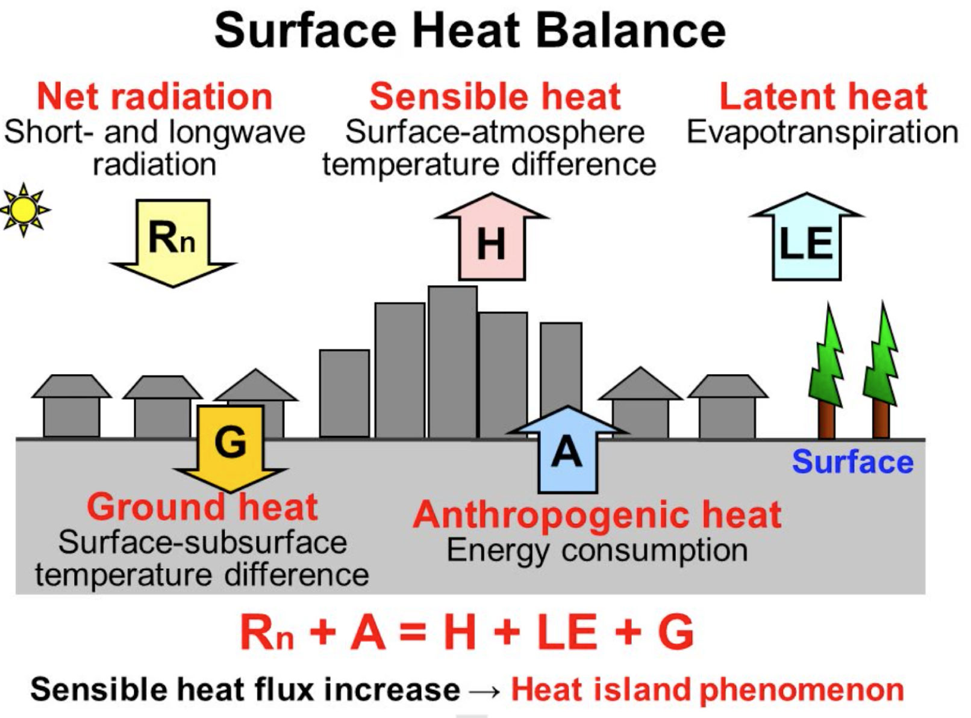
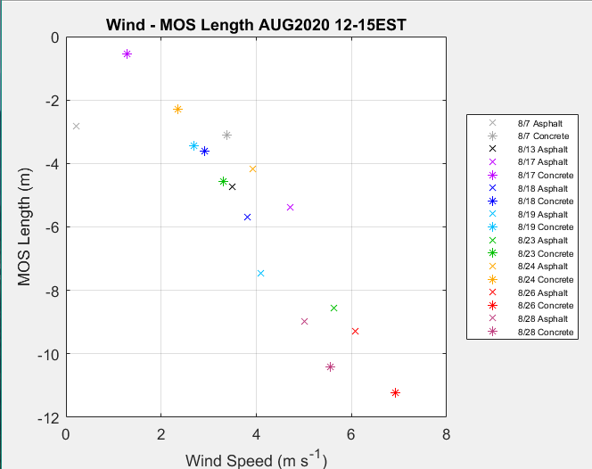
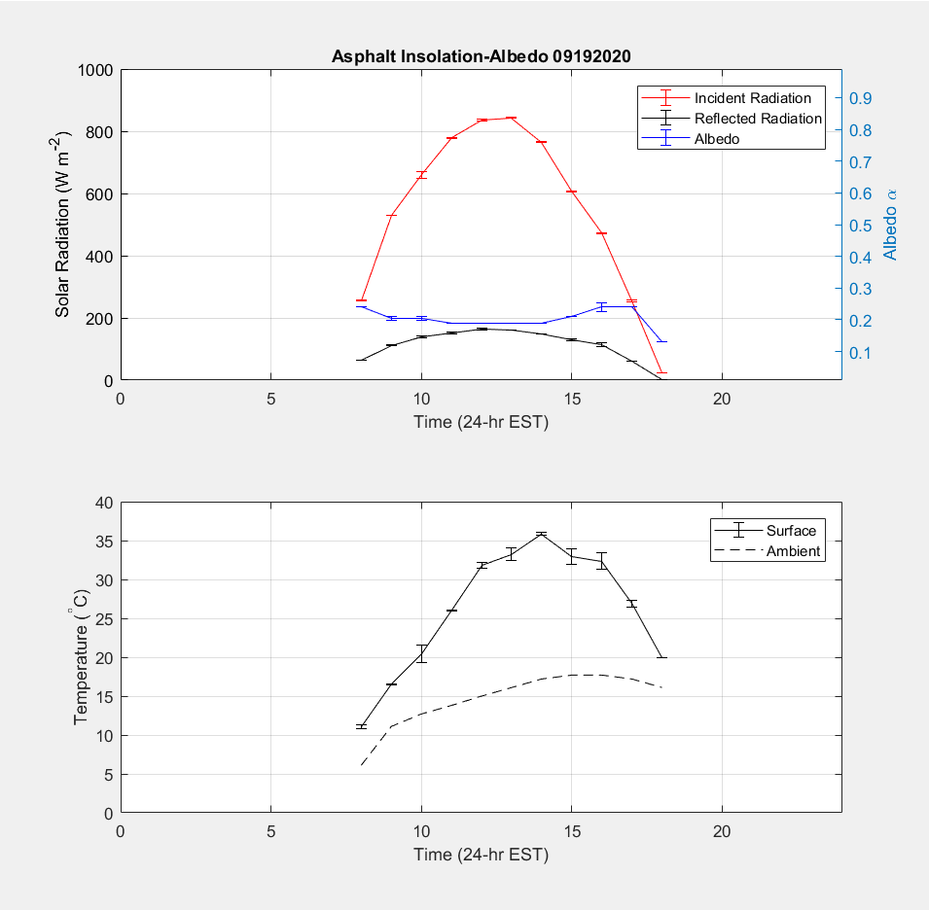
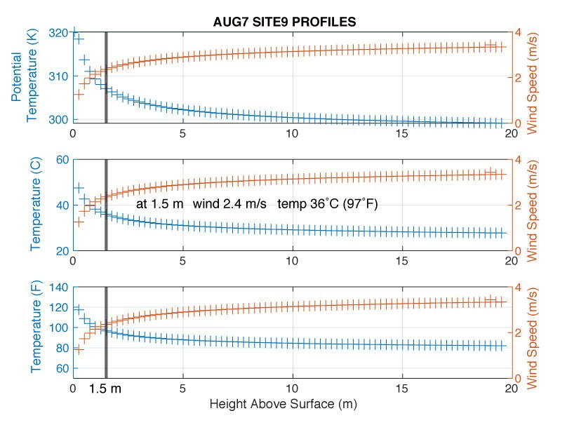
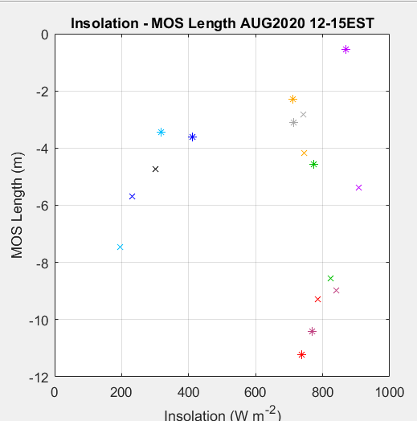
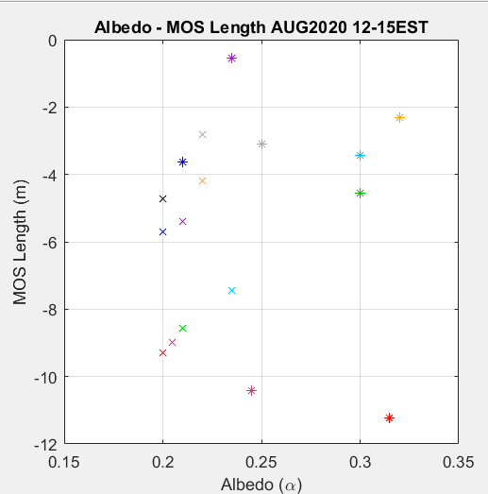
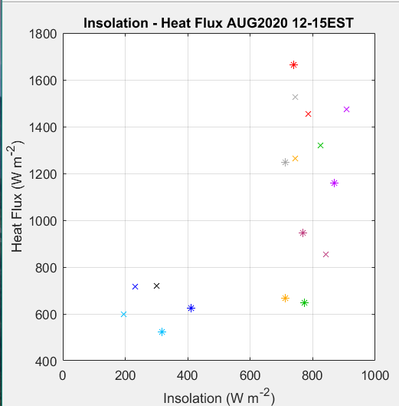
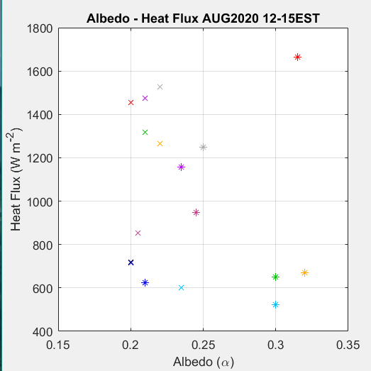
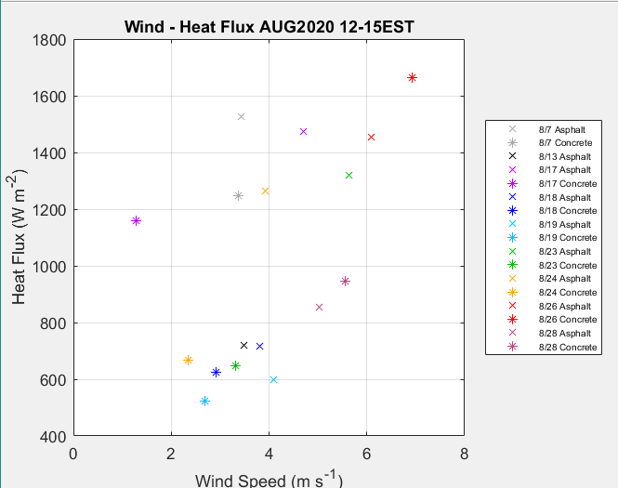
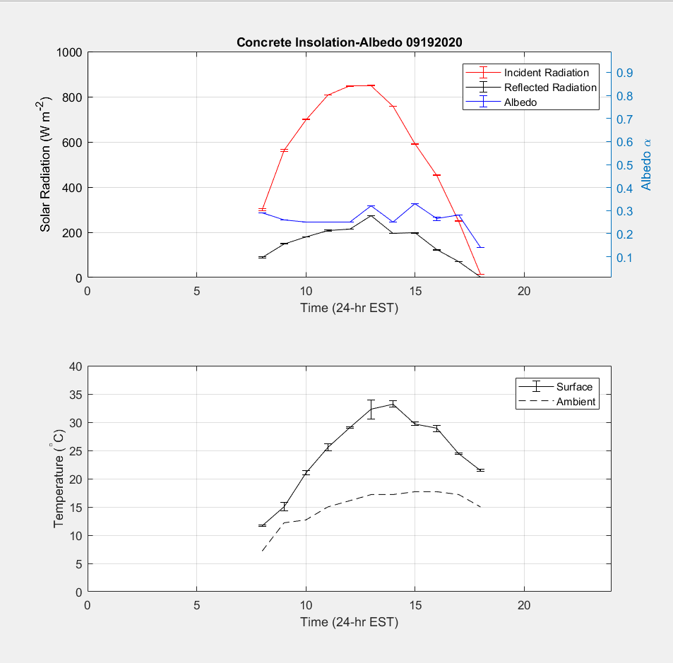
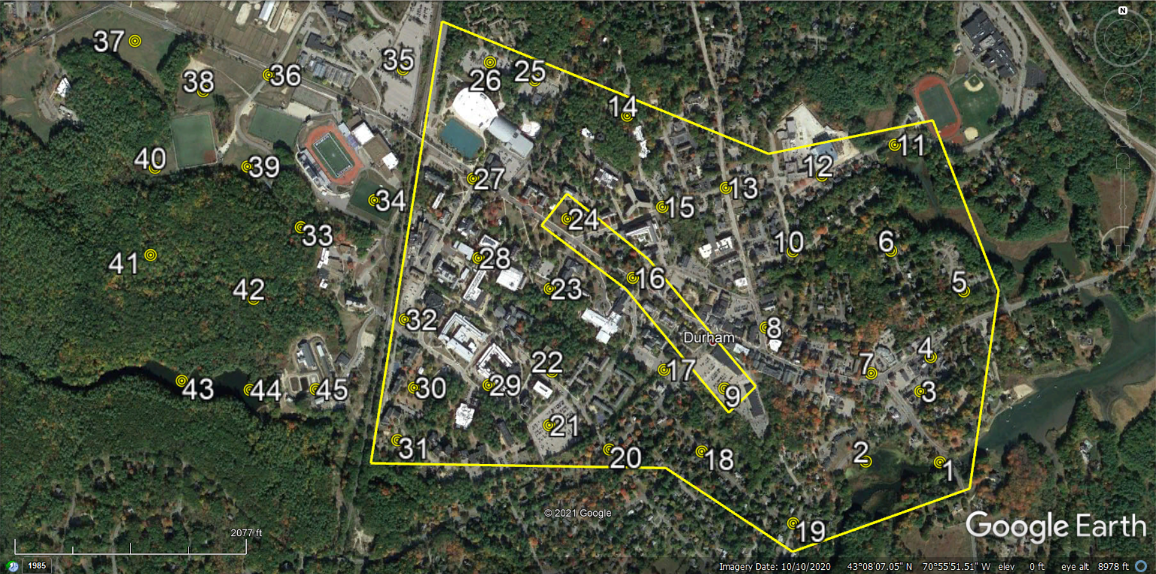
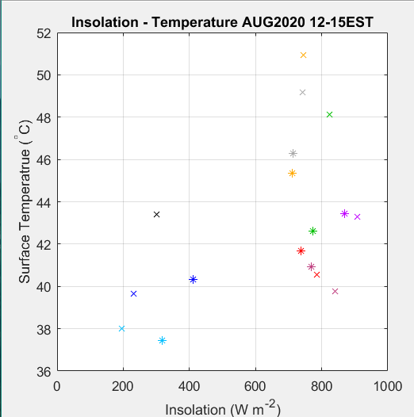
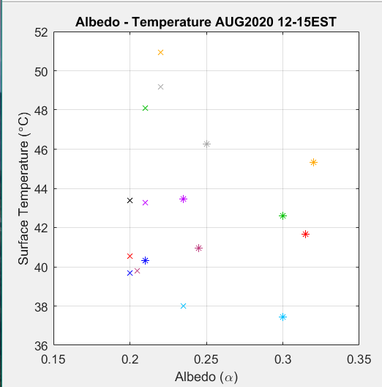
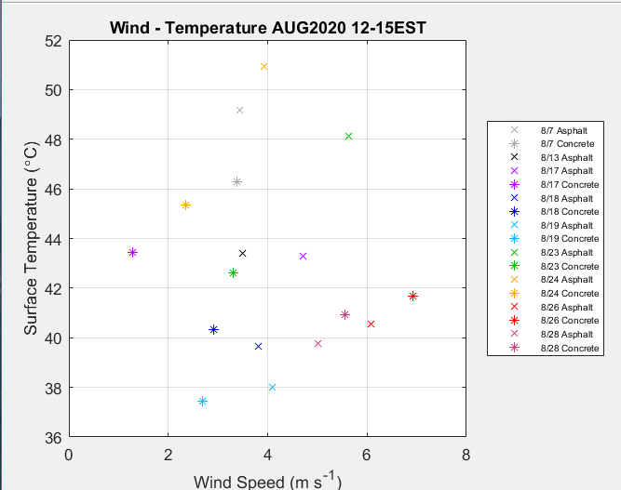
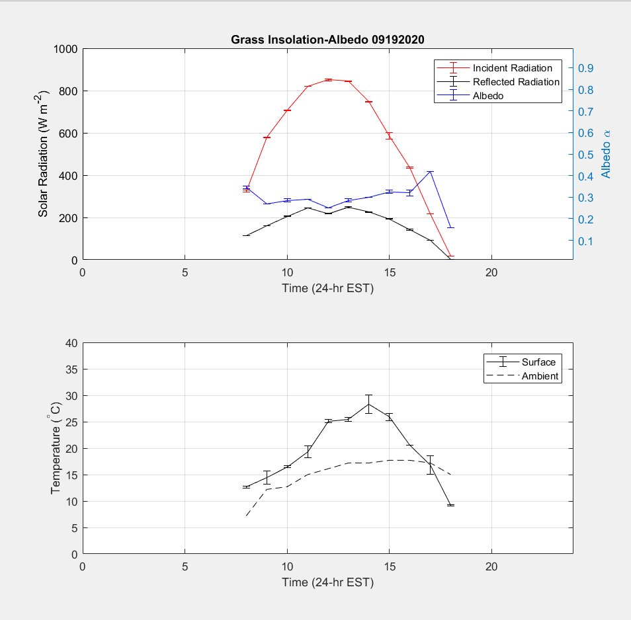
Analysis of Urban Heat Flux in Durham NH
Connor Melican
Mentor: Dr. Katharine Duderstadt, Earth Systems Research Center
Department of Earth Sciences, University of New Hampshire, Durham, NH
Introduction
Analysis
Summary
Observations at the community-level are integral for mitigating the effects of climate change. Land development in cities and towns poses a dilemma; while infrastructure and roads improve an area's functionality, they also induce the potential for urban heat island (UHI) effect. During warmer seasons, UHI effect can lead to sustained, above-average surface temperatures at our residences and businesses, increasing costs to cool buildings
i)
ii)
iii)
The observations and analysis show the following:
Albedo is most consistent during the time interval of an hour before to an hour after solar noon, and this tendency was used to isolate the nominal data collected during each day’s sampling in August.
Generally, asphalt and concrete were similar in surface temperature and albedo, although values varied among sites due to material grade and age.
Drought caused considerable variability in albedo at grass sites, and occasionally temperatures comparable to that of asphalt and concrete sites.
Water sites had consistent conditions during the entire sampling period.
In the diurnal study, the grass site reached equilibrium between the surface and air temperature before both the asphalt and concrete sites.
Days with greater wind speeds resulted in higher surface turbulence boundaries, which agrees with the MOS theory.
Kato, 2008.
and public health risks from heat. This project demonstrates how communities can use local observations to reduce UHI effects as we prepare for future climate change.
Figure 1. Examples of i) statistical correlations; ii) diurnal variations; and iii) temperature and wind profiles (of what a person may experience at 1.5 m, or the influence on Cooling Degree Days at floors of a building).
Methods
Results
45 sites in UNH/Durham (asphalt, concrete, grass, water).
Measurements of solar radiation (Apogee MP-200 pyranometer) and surface temperature (Kintrex IRT0424 infrared thermometer).
NWS and NOAA meteorological datasets.
MATLAB and Excel for statistical analyses, calculations of surface heat flux, and wind and temperature profiles.
Monin-Obukhov Similarity (MOS) Theory to approximate non-dimensional mean flow/temperature in surface layer
Figures 2-10 provide examples from data collected at site 9 (asphalt) and 16 (concrete) during August 2020 from 12pm-3pm local time. Figures A-C compare solar radiation, albedo, and air and surface temperatures collected during September 2020 from 8am-6pm local time.
Discussion
Fig. 2
Fig. 3
Fig. 4
Fig. A
This pilot project demonstrates how local observations might inform local efforts to mitigate UHI effect. The project could be scaled up by including a team of observers to enable greater time and spatial resolution, using a moisture sensor at grass sites to address latent heat flux effects, and measuring air, wind, and temperature profiles to compare with MOS calculations. Ideally, continued observations could form an archive of surficial warming data trends of local land covers. To mitigate local UHI effect, upcoming campus/town developments, such as Durham’s Master Plan, should heed the following choices: strategic, minimized use of impervious surfaces (i.e. similar ground/roofing pavement materials); avoid clustering impervious surfaces (e.g. developing 66 Main Street); use energy harnessing technologies in impervious surfaces (e.g. groundwater heat pump under new parking lot of Oyster River Middle School); use roof cooling paints on applicable buildings; maximize green-spaces while diversifying vegetation species to increase drought resistance (i.e. less one grass type lawns); and have “smart buildings” (automated thermostats in academic/residential halls).
during non-neutral conditions. This approach has parameterized variables dependent on stability classes and can be applied in a micrometeorological scope, such as MOS length (height at which turbulence is generated more by buoyancy than wind shear). Thermodynamic assumptions included dry air, no vertical wind, and same surface roughness height and length for asphalt and concrete.
Fig. 5
Fig. 6
Fig. 7
Fig. B
References & Acknowledgements
Fig. 8
Fig. 9
Fig. 10
Fig. C
• Jacobson, M.Z., 2005. Fundamentals of Atmospheric Modeling, 2nd ed. Cambridge University Press, Cambridge.
• Kato, Soushi (2008), Surface Heat Balance Analysis by using ASTER and Formosat-2 data, presented at National Cheng Kung University.
• National Center for Environmental Information (NCEI) Automated Surface Observing System (ASOS) 5-minute data.
I wish to thank Dr. Elizabeth Burakowski, Dr. Scott Ollinger, and Dr. Joel Johnson
for providing their expertise, guidance, comments, and time.

