Slide 1
The role of bioavailable dissolved organic nitrogen cycling at Station ALOHA in the subtropical North Pacific Ocean
Ben Cotton
Advisor: Dr. Robert Letscher

Slide 2
Introduction
POM :
Particulate Organic Matter
DOM:
Dissolved Organic Matter
Redfield Ratio: C₁₀₆N₁₆P₁

Slide 3
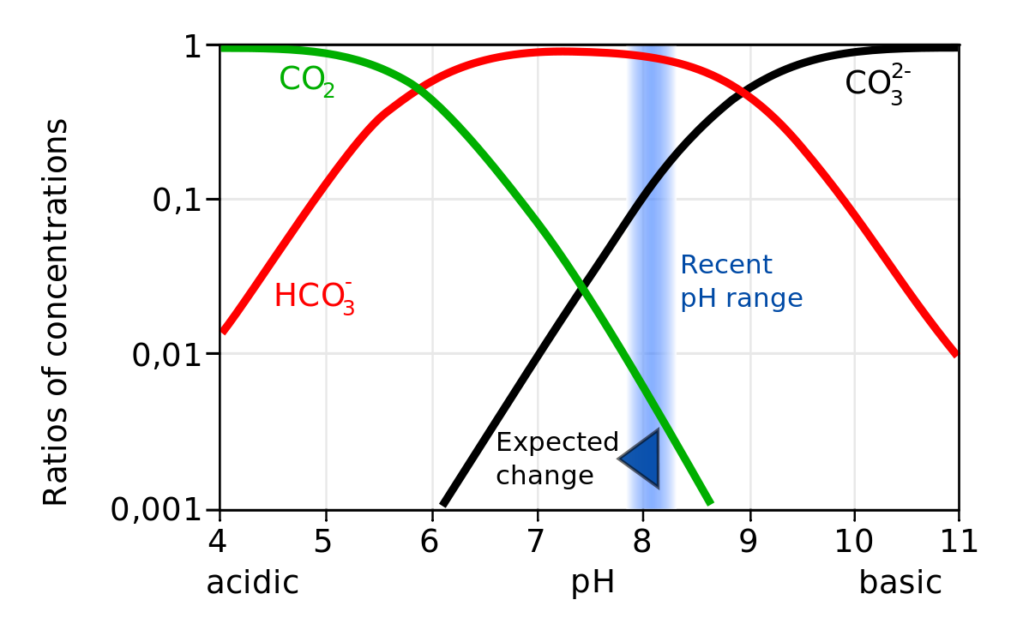
Dissolved Carbon
Consists of:
Carbonate(CO₃²⁻)
Bicarbonate (HCO₃⁻)
Carbon dioxide (CO₂)
Carbonic acid equilibria
Acidification of sample converts all carbon stores to CO2
Can then be directly measured
[TDC] = [DOC] + [DIC]
Bjerrum plot

Slide 4
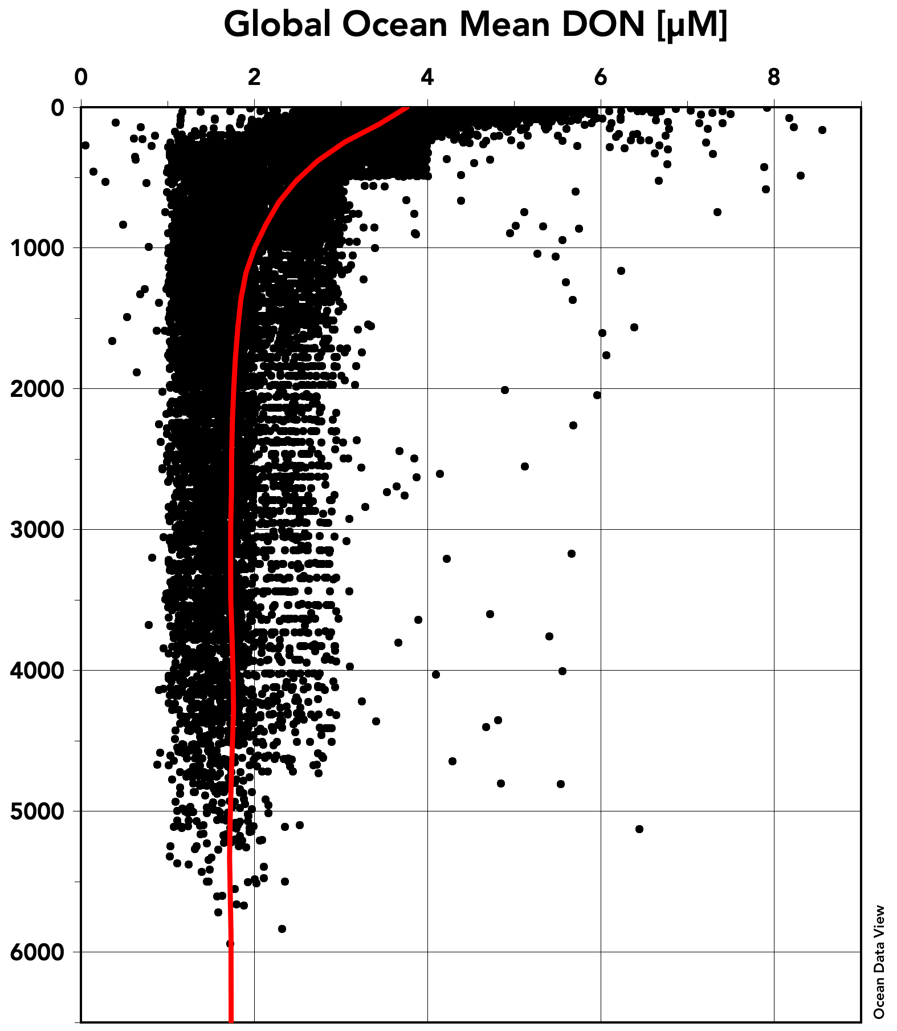
Dissolved Organic Nitrogen
[DON] = [TDN] – [DIN]
[bDON]
v.s.
Refractory [DON]

Slide 5
Motivation
Bioavailable Dissolved Organic Nitrogen (bDON)
Target what we think bDON is composed of
Amino sugars, amino acids/proteins
Found in chitin and biomass
Acts to regenerate nutrients for phytoplankton
Releases nitrogen and phosphorus
Bacterial production
Recycled N for phytoplankton

Slide 6
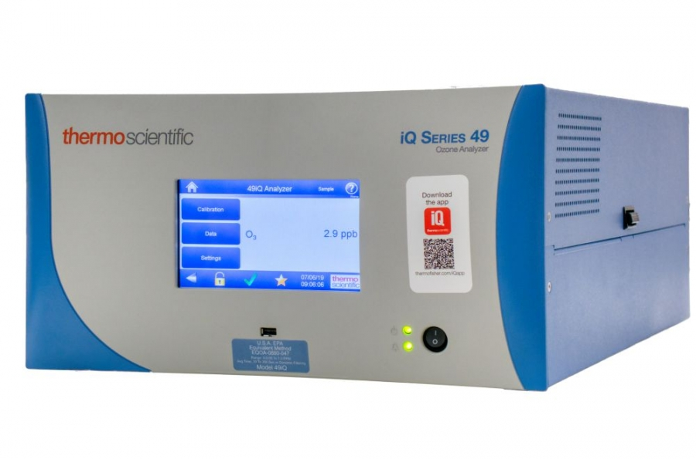
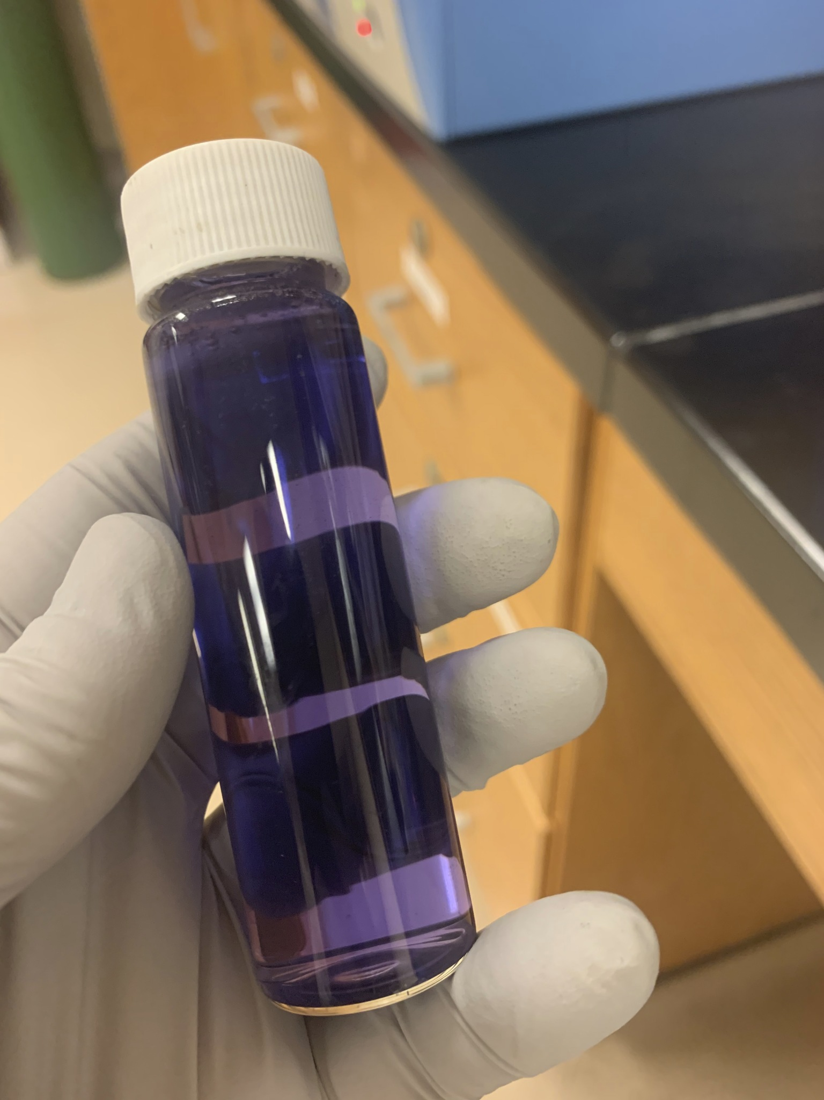
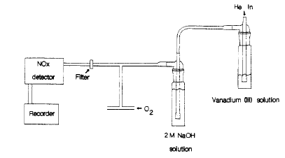
DON method
DIN measured with NOx box
Sample measured directly
Nitrate reduced to NO gas
Gas excited and resulting chemiluminescence is recorded in mV
Standards are run and compared to sample to obtain nitrate concentration
TDN (includes DIN and DON)
Potassium persulfate oxidizing reagent (POR)
Oxidizes all organic nitrogen (DON) to nitrate
Measured the same as DIN method
[DON] = [TDN] – [DIN]

Slide 7
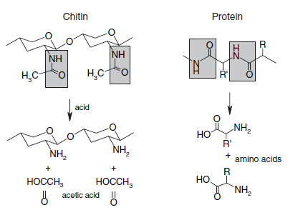
bDON Method
Acid hydrolysis to cleave amide linkage
Resulting free amine can be bound to ortho phthaldealdihyde (OPA)
Reagent which fluoresces under UV light
Fluorescence intensity is proportional to concentration of biologically utilized nitrogen (bDON)

Slide 8
Analytical uncertainty
DOC precision ~1%
Concentrations between 40µM - 70µM
DON precision ~5% - 10%
Concentrations between 2µM - 4µM
Oxidation of DON when using the POR
Unsure whether 100% of nitrogen is converted to nitrate
Redfield Ratio: C₁₀₆N₁₆P₁

Slide 9
Results

Slide 10
Results
bDON precision:
Mean: 17.64%
Median: 13.07%

Slide 11
Conclusions
bDON depth profile mirrors the DON profile at lower concentration
%bDON decreases with depth
bDON consumed and remineralized with depth
25% - 75% ratio consistent with surface conditions
Anomalous sample at 350m depth
Non-local water mass from North Pacific
bDON characteristics differ from subtropical station ALOHA
Method believed to be accurate

Slide 12
Future Directions and Implications
Simple, low volume method to measure bDON
Easily implemented into field campaigns
Allows access to samples with limited detection (nM sensitivity)
Eliminate large sources of error
Precision ranged between 2-62%
Mean of 17.5% and median of 13%
Try to get measurement precision below 5 %

