Slide 1

Simulation of 10BASE-T1S Link Partner
Student: Tanner Fortier
Advisor: Dr. Messner

Slide 2
TABLE OF CONTENTS
1.
5.
Motivation
Reanalysis of Design
Reasoning behind the project
Simplification of our approach and design
2.
Overview
6.
Validation of Waveform
Explanation of project and its components
Testing components of project
3.
Approach
7.
Overall Status
Thought process behind completing the project
What has/needs to be completed
4.
Waveform Development
8.
Future Work
Process of building necessary bit stream
Additional applications and use cases

Slide 3
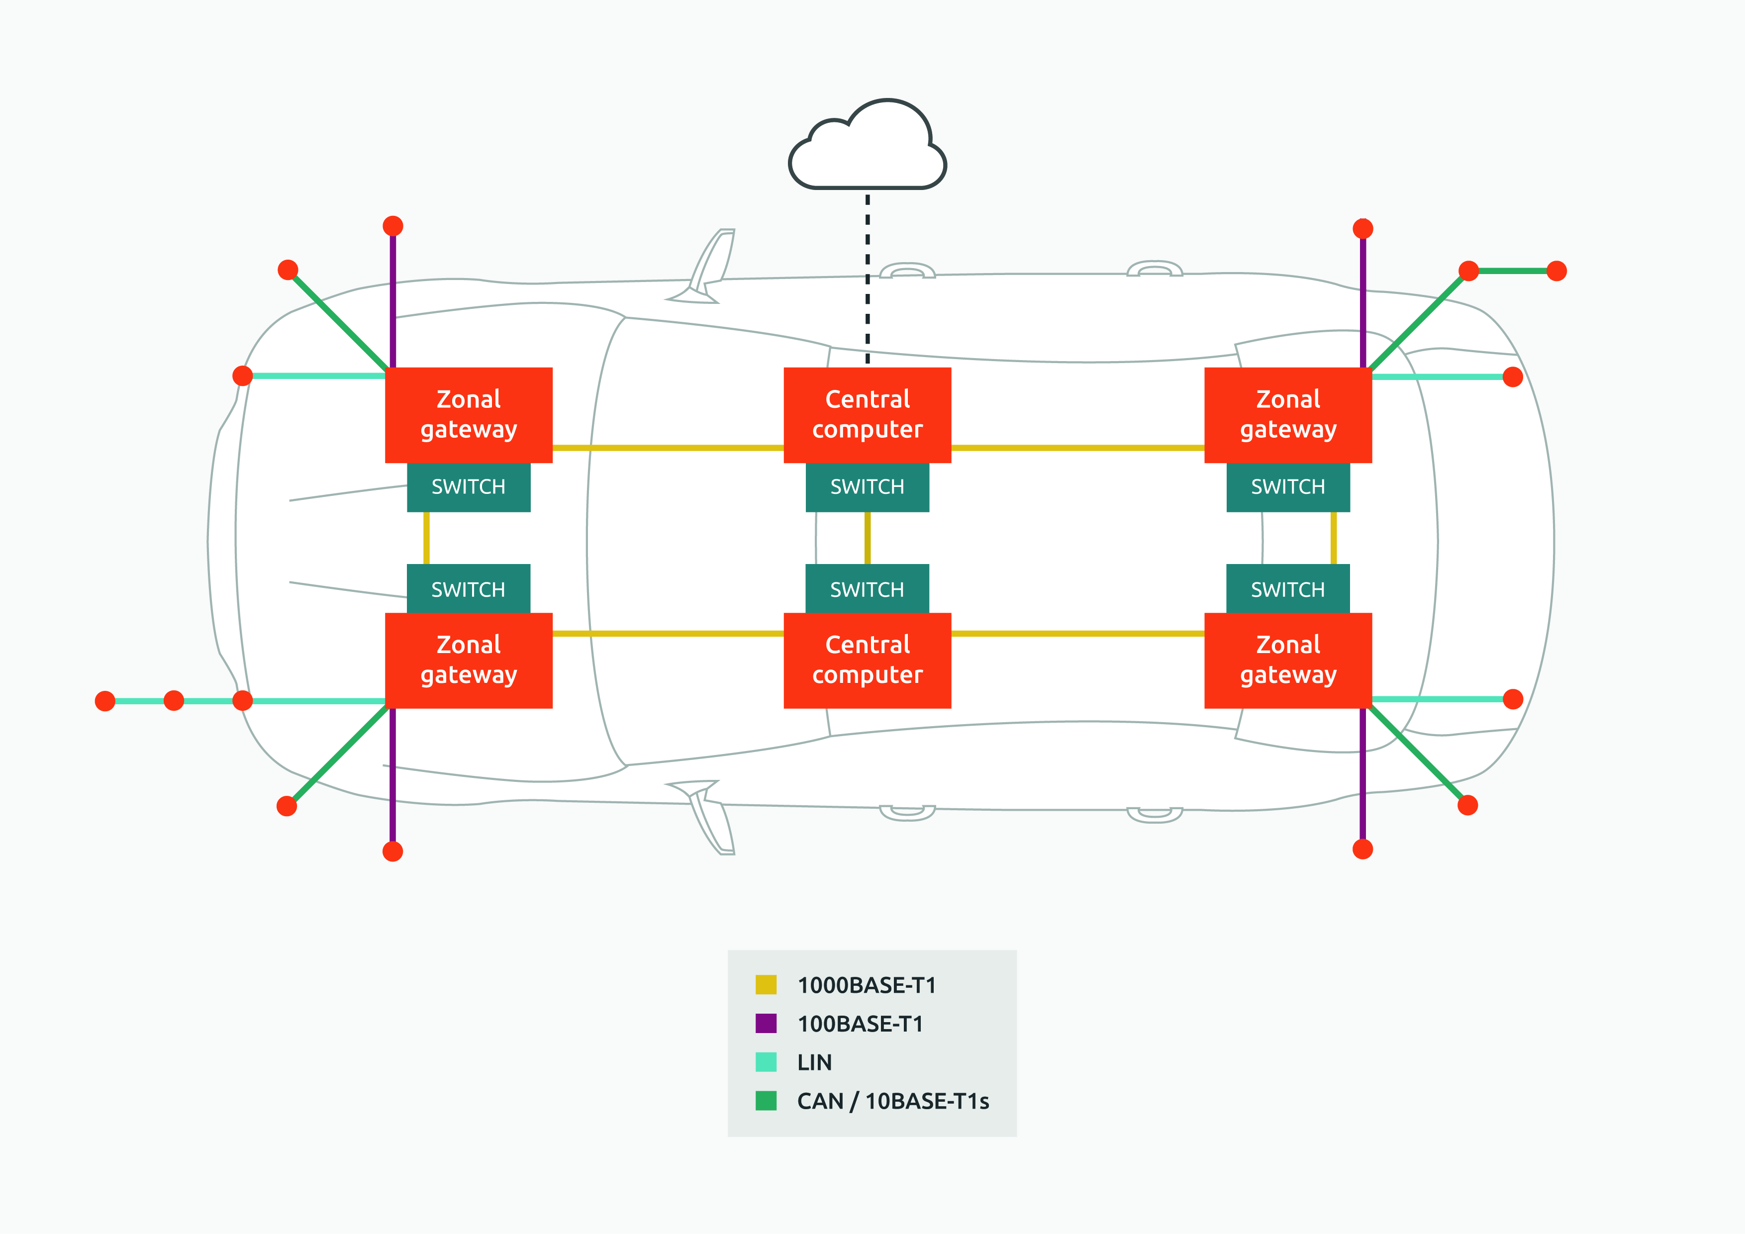

Motivation
Interoperability Lab
Conformance Testing
Automotive Industry and Industrial Automation
Short reach multidrop

Slide 4

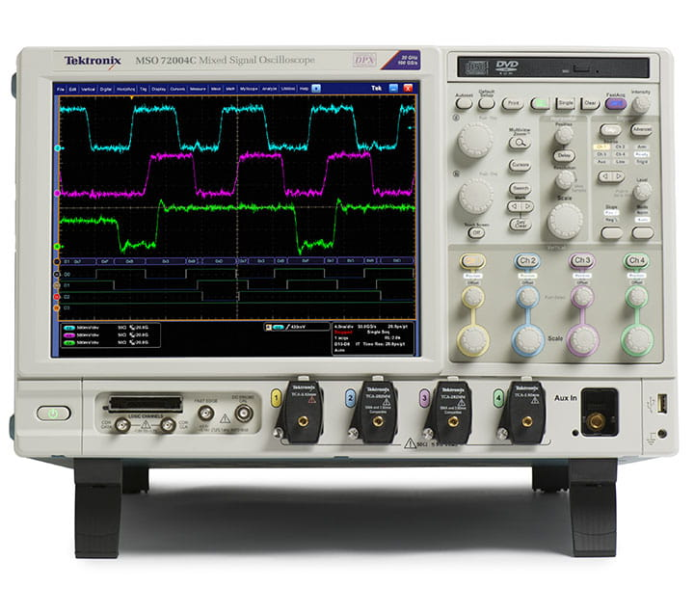
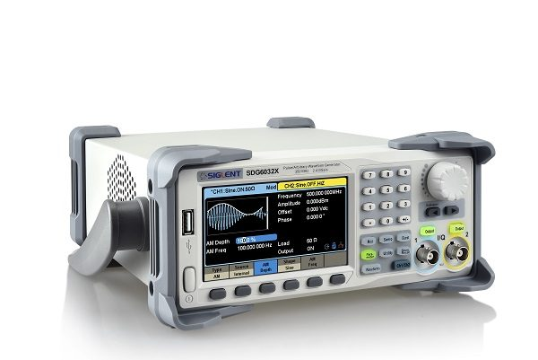
Overview
Software
MATLAB
NI-VISA (SCPI Implementation)
Mechanical System
Siglent SDG6000X
10BASE-T1S compatible device
Oscilloscope
Probes

Slide 5
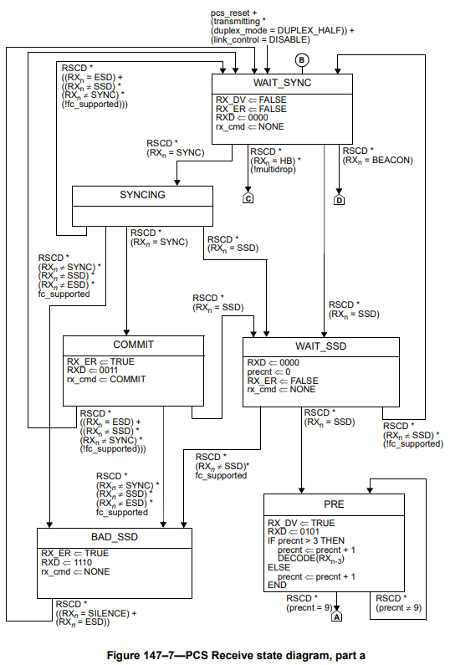
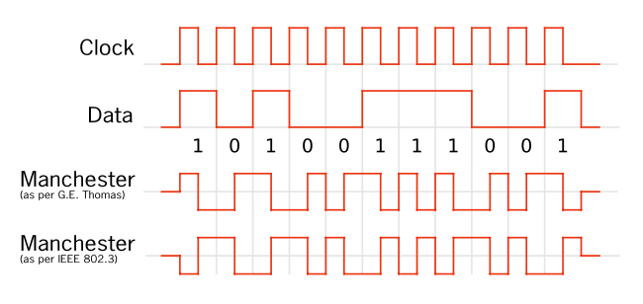
Approach
Review IEEE Clause 147
Operation of 10BASE-T1S Phy
IEEE 2 Level Differential Manchester Encoding, 4B5B encoding, 17 Bit Self Synch. Scrambler
Analyze state diagrams

Slide 6
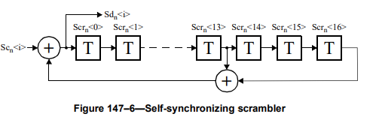
Waveform Development
Utilize MATLAB to build waveform
4B5B encoder/decoder
17 Bit scrambler/descrambler
DME encoder/decoder to offer better clock recovery

Slide 7
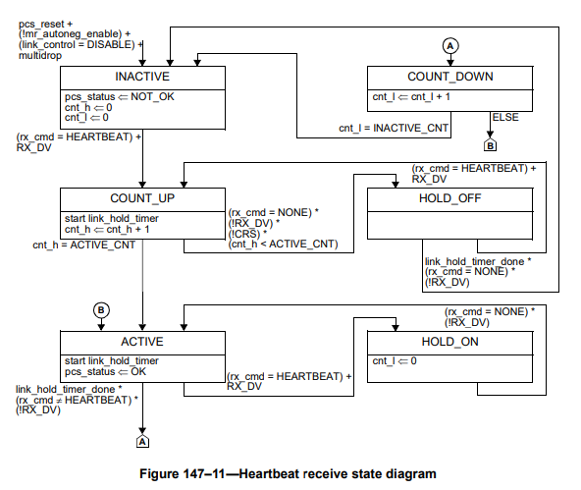
Reanalysis of Design
17bit self synchronizing scrambler not necessary
Operating under specific conditions
Device in slave mode without auto-negotiation
Possible to build waveform without 4B5B encoder
Rebuild waveform

Slide 8
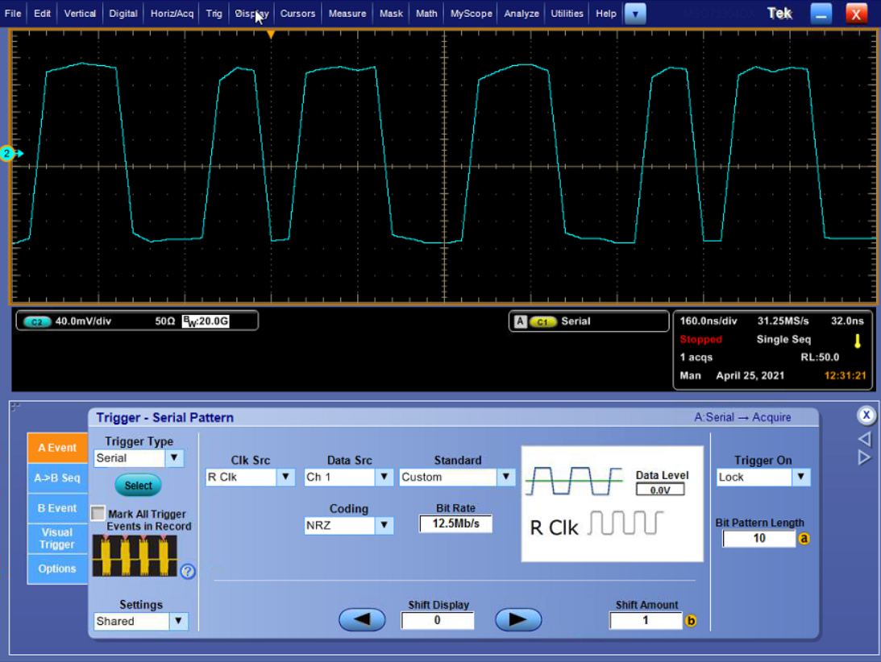
Validation of Waveform
Upload waveform to AWG
Verify output on oscilloscope
Utilize logic detection to find specific codeword
DME Encoded “HEARTBEAT”

Slide 9
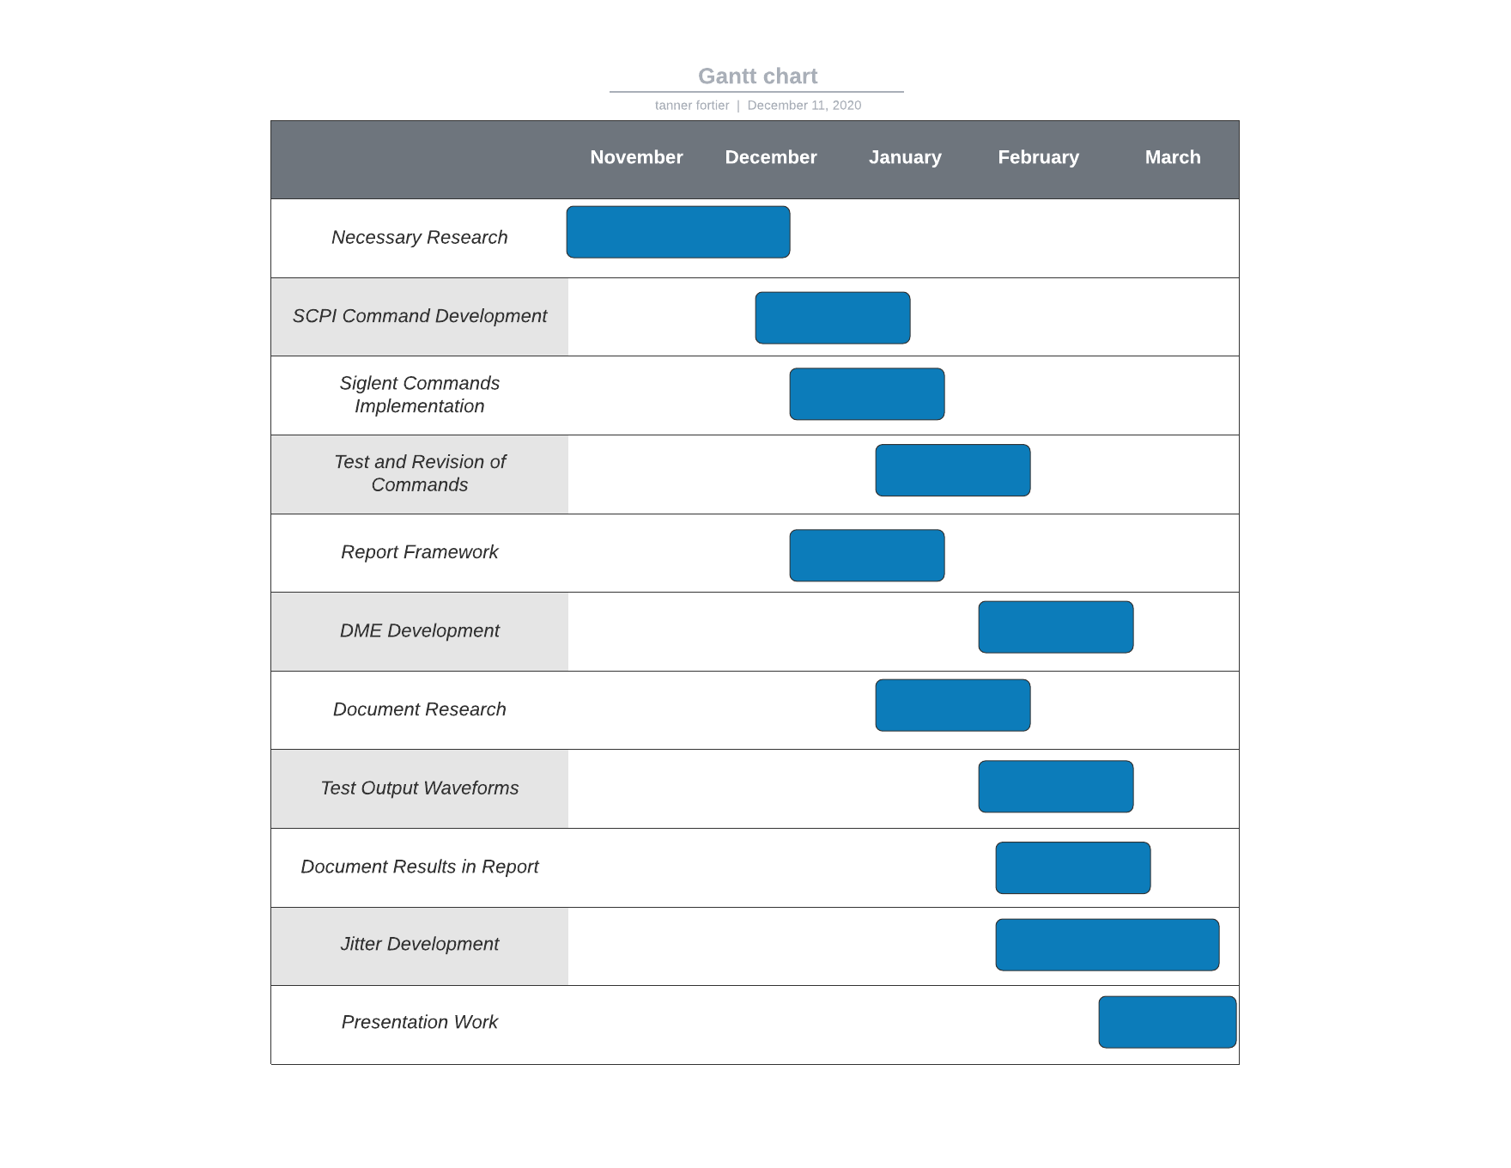
Overall Status
DME Development: Completed
Waveform Development: Completed
Test Output Waveform: Completed
Test on Vendor Device: Not Completed

Slide 10
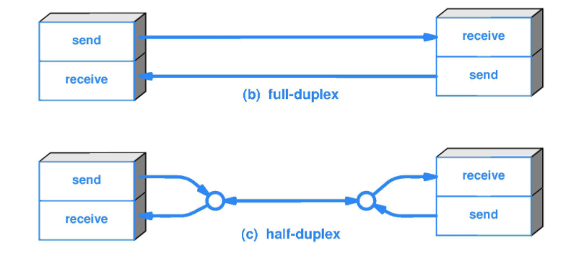
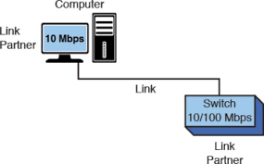
Future Work
Support for both master and slave operation
Half-duplex support – packet level implementation
Auto-negotiation support
Support for other SPE technologies

