Slide 1




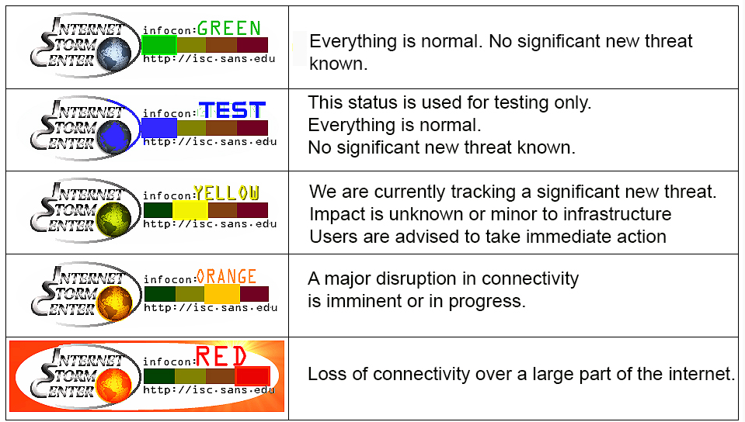

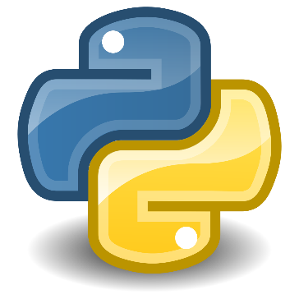

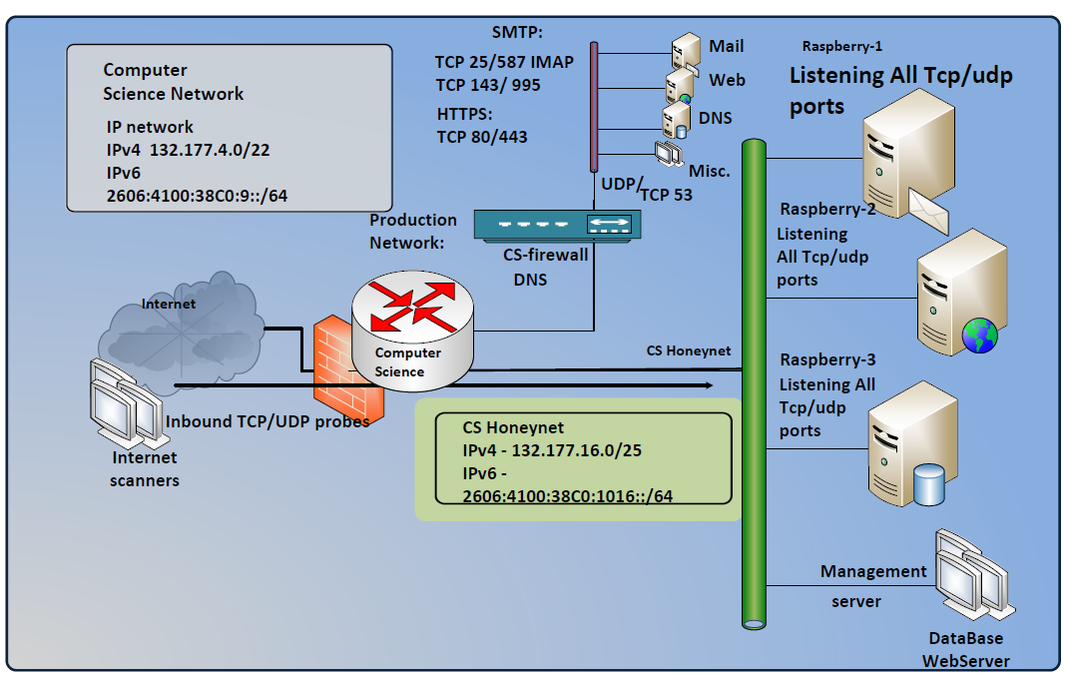
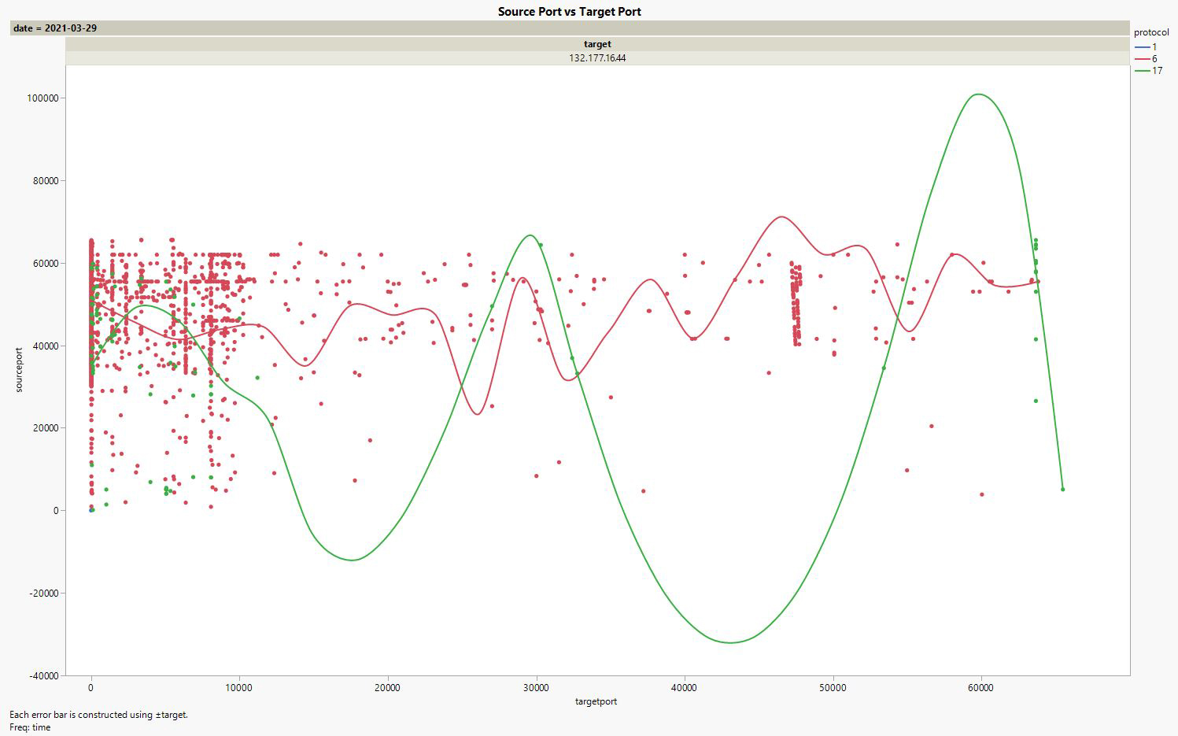
CS-Network “Probe” Monitor
Jackson Lucier, Garret Smith, Duncan McInnes
Department of Information Technology, University of New Hampshire
Introduction
Threat Analysis
Tools Used
UNH CS IT staff, wants to create a Virtual HoneyPot network to track incoming traffic to UNH. UNH receives thousands of requests every day and like many institutions scams and fraudulent activity are abundant. UNH cannot block incoming traffic by geographic region because many students attending UNH come from those regions. A HoneyPot is a computer system used to mimic likely targets of cyber attacks. By implementing a HoneyPot, the stakeholder will be able to monitor and display (graphically) incoming/outgoing traffic on a web server separate from UNH’s main network.
Data collected to the database on DShield, creates a threat score. “Potential” threat measurement is shown using a “color scale”. “Cowrie” emulates a UNIX system in Python, in high interaction mode (proxy) it functions as an SSH and telnet proxy to observe attacker behavior to another system.
Cowire: SSH and Telnet HoneyPot designed to log brute force attacks, future application is to further implement for “Brute Force DDoS testing”
Internet Storm Center: Organization which monitors the level of malicious activity on the Internet, creator of DShield
JMP: Statistical analytics tool used to create graphs
MySQL: Database organizer used to sort through logged network traffic
Python: Programming language used to create scripts and enact functionality
Raspberry Pi: Physical equipment to create HoneyPot
Probe Data Collected
Date and Time Data Collected
Source IP Address and Port Number
Target IP Address and Port Number
Results/Conclusions
Over a 24-hour period: 11:59am-11:59pm
The most amount of connection attempts is during early
Morning hours, specifically before 4:00am
Protocol 1 (port = 0, no SEND aspect) is only used during the initial test of all port ranges
Protocol 6 (port range, only SEND aspect) is the most used protocol for connection attempts
Protocol 17 (port range, looking for a service) is the most used and established
Compared Data Collected
Geographic Location
System Type
Previous Connection Attempts
Threat Score
System Design
* Image created by Internet Storm Center: https://dshield.org/infocon.html
* Image created by Scott Kitterman (UNH CEPS)
* Image created as part of CS-Network “Probe” Monitor Project

