Slide 1


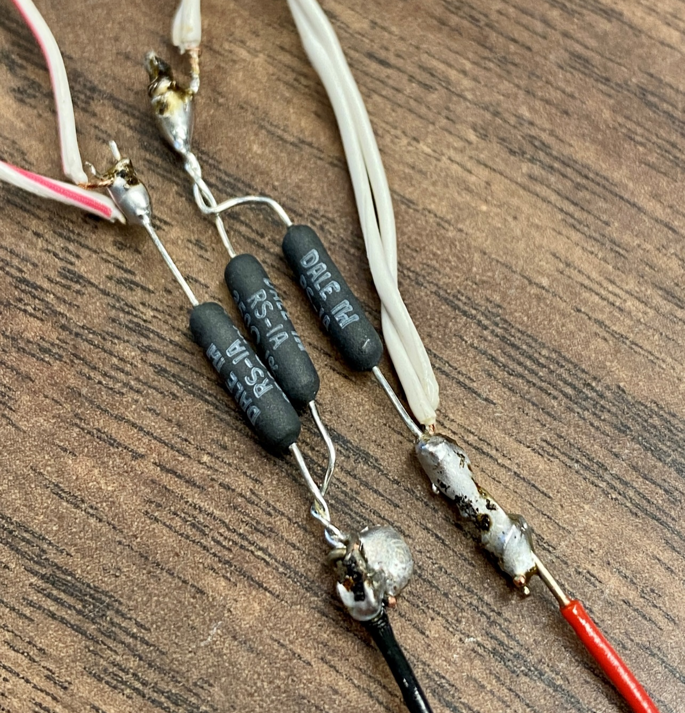
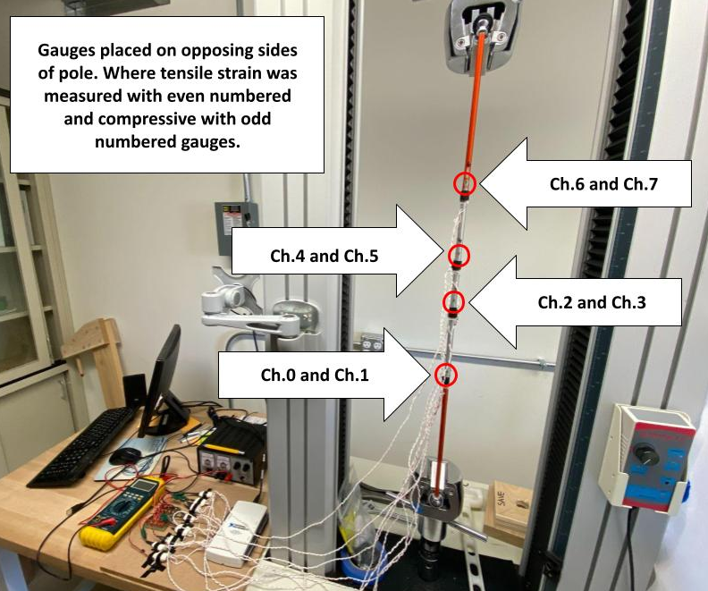
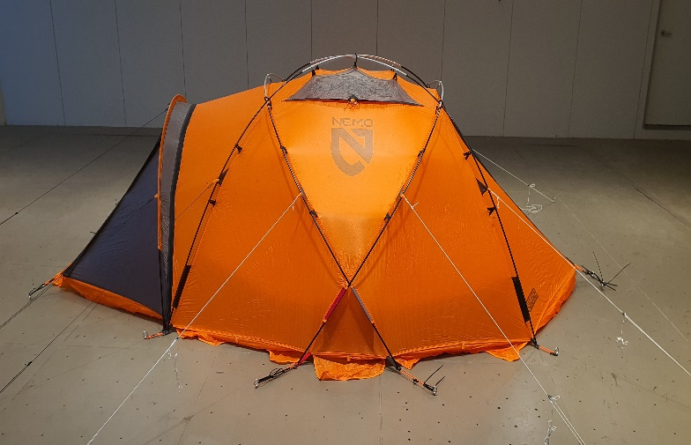
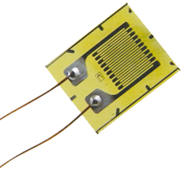
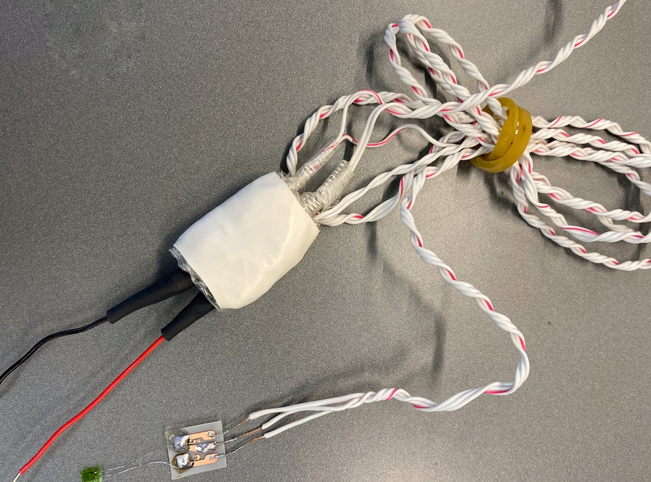
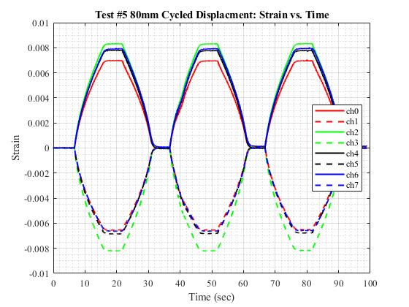
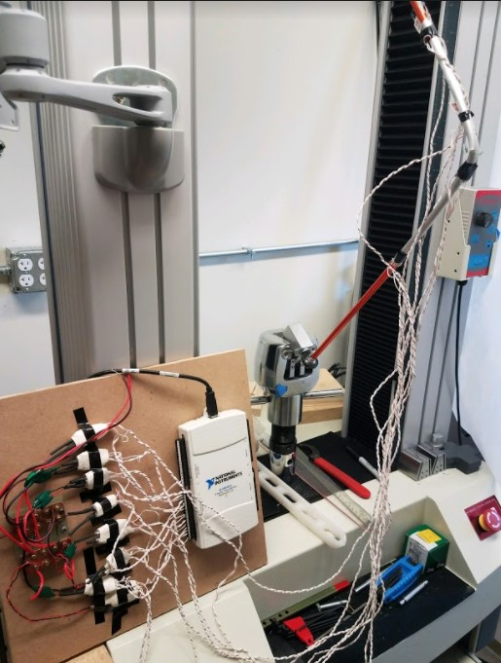
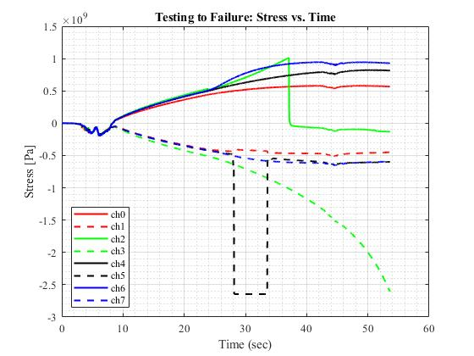
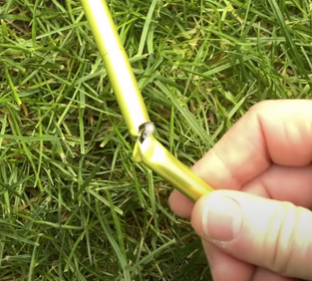
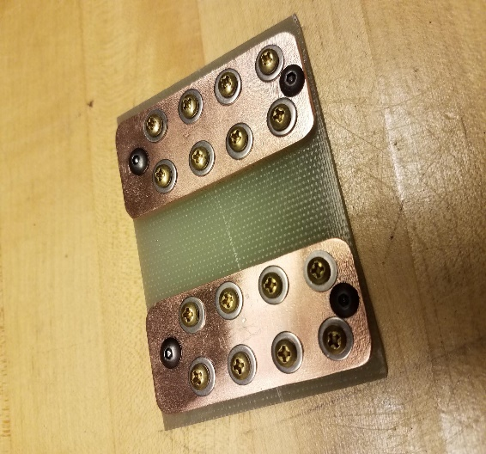
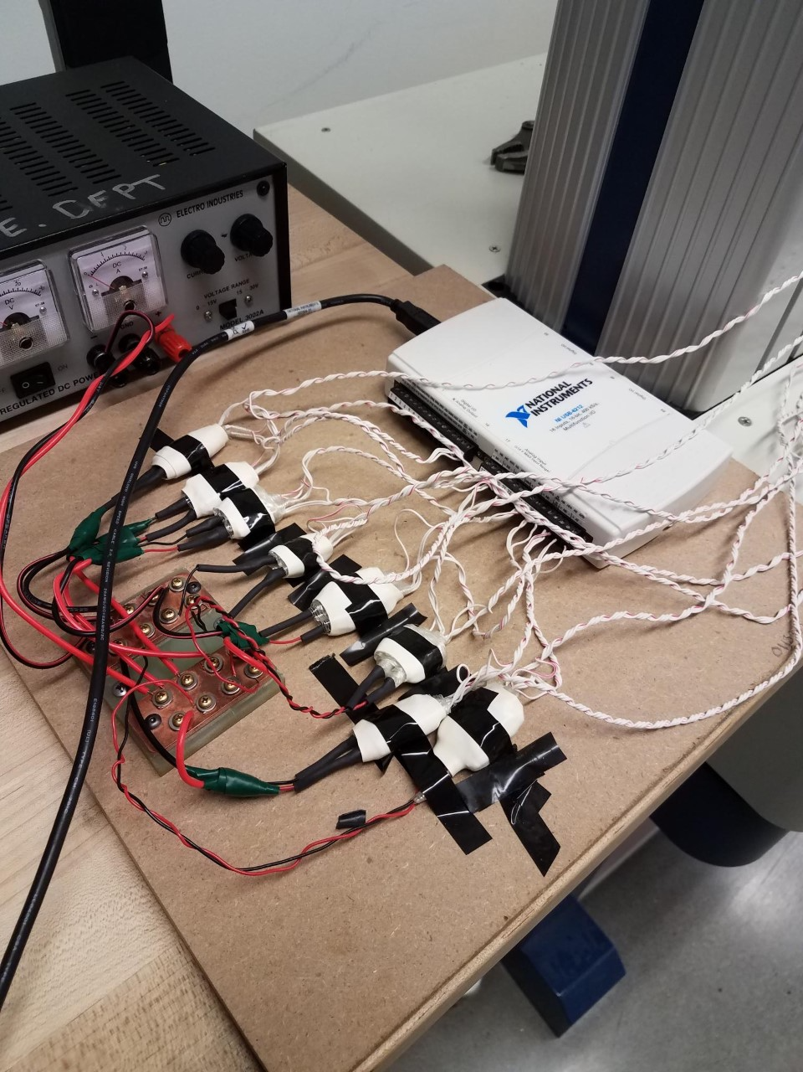
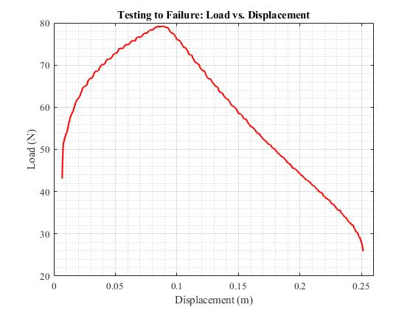
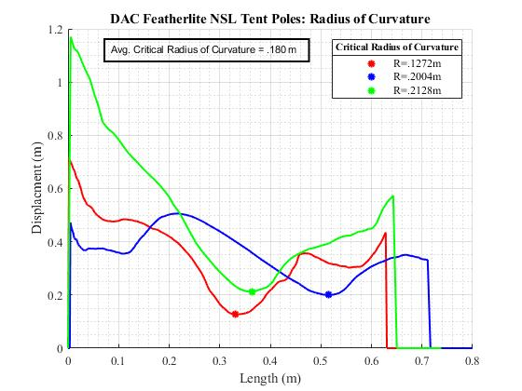
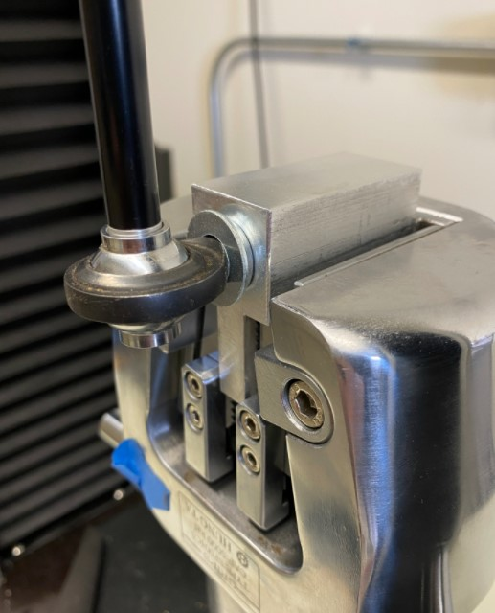
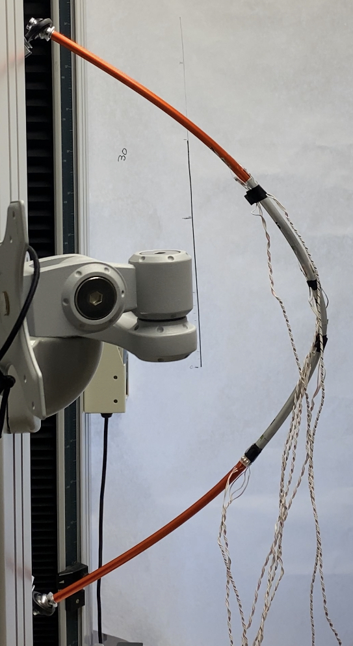
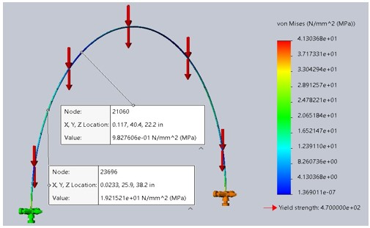
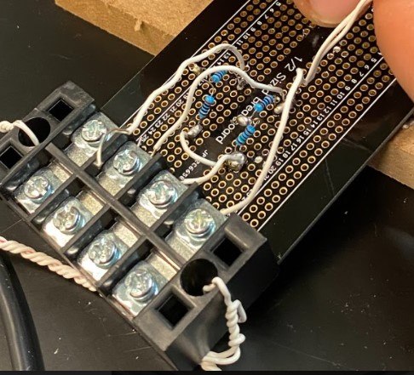
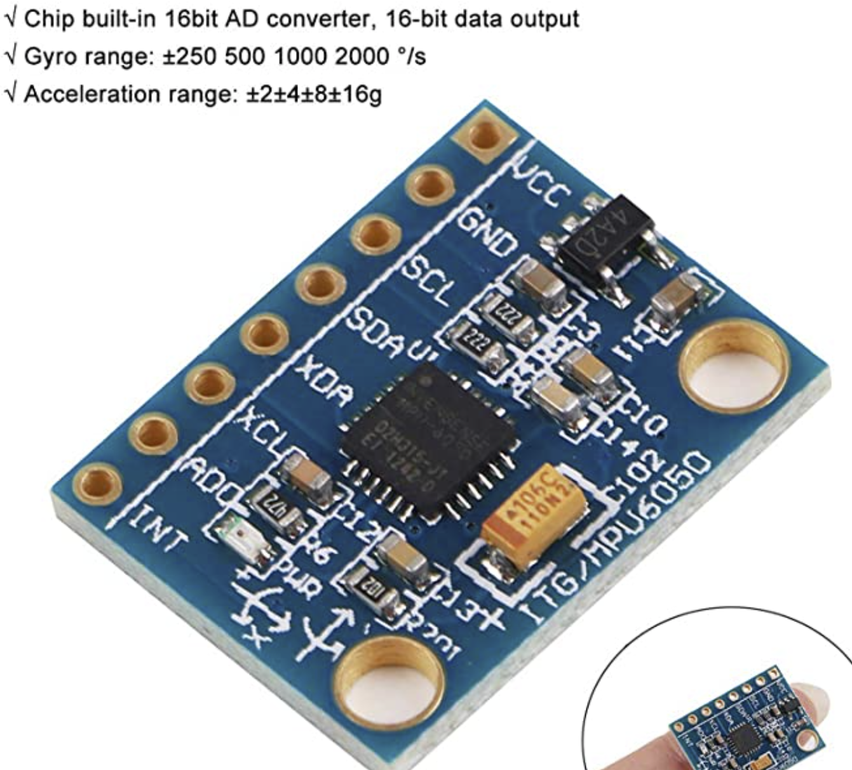
Dynamic Analysis of Tent Pole Structures
Cole Schoonover & Quinn Parker
UNH Mechanical Engineering, Capstone Research Project
Partnered with NEMO Equipment inc.
Introduction & Background
Testing Device Phase One
Experimental Results
Develop a testing device that can measure the dynamic response of tent pole architecture
Focus on future capabilities of being portable, durable and robust enough to operate in extreme environments
Based off NEMO’s universal testing machine, designed and manufactured a fixture to simulate expected failure modes and determined desired length of tent pole segments for testing
Determine optimum strain gauge configuration for axial bending application, by working with industry professional Kyowa
No breadboard wiring method for compactness.
Quarter bridge application for individual section measurement of both tension and compression.
Strain gauge “carrot” design, for impact and water resistance
Eight simultaneous gauge measurements
Engineered busbar parallel power supply
Repeat cycle testing proving system reliability
Critical curvature at failure point
Limitations of strain gauges
Gauges orientated on pole such that tensile strain was recorded with even numbers and compressive with odd.
Quarter Bridge configurations used to show both tension and compression and desired sensitivity.
Gauges are placed in areas of high stress concentrations discovered by radius of curvature analysis and field-testing results.
Research Objectives
Dynamic wind loading
Design and build a system with the ability to handle multiple gauges and multiple measurements.
Consider design restraints focused around protecting fragile electronic components and gauges from handling and the elements
Implement the curvature and strain system into an analysis
Test the gauges and system for reliability and repeatability
Figure #1 – Shows repeated UTM compression cycles to a displacement of 80 mm.
Figure #2 – Strain output as the pole was tested to complete failure.
Testing Method
Theoretical buckling analysis based on academia for long slender columns with a hollow cross section.
Programing different repeatable cycles on NEMO’s in house UTM. Providing critical Load vs. Displacement data as well as experimental control for loading applications.
Measuring the radius of curvature at failure to determine the minimum radius at which the poles experience buckling.
Half Bridge vs. Quarter Bridge Wheatstone bridge configurations for strain analysis.
Converting initial one gauge, breadboard device into the first iteration of “Carrot” while reducing size, increasing durability and reliability.
Conclusions & Phase Two
Figure #3 – Load vs. Displacement data collected from the Hung Ta, used in proof of concept in conjunction with known material properties for 7075-T6 Al.
Figure #4 – Video Analysis provided instantaneous radius of curvature, where the average segment of pole failed at a minimum radius of .180 m.
Good ability of hardware system to handle multiple gauges and inputs
NI-6212 limited to eight total channels for data input
Strain gauges are limited to a critical curvature of 0.3216 m
Durable “carrot” system and wiring setup
Acknowledgments
Special Thanks:
NEMO Equipment and Thomas Crosslin for assisting our project and allowing us access to their testing facilities and resources.
Professor Todd Gross, faculty advisor for taking us on.

