Slide 1
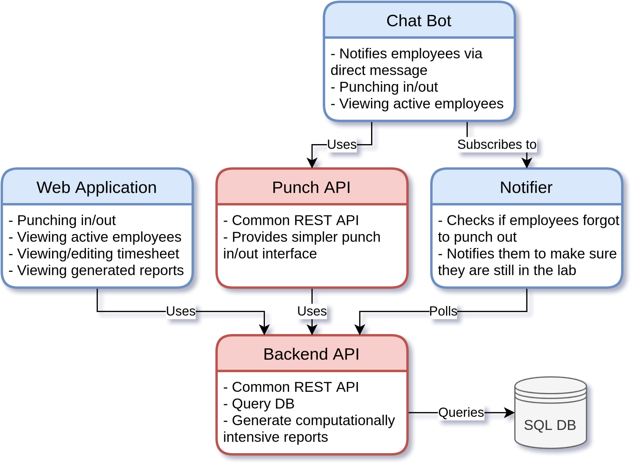
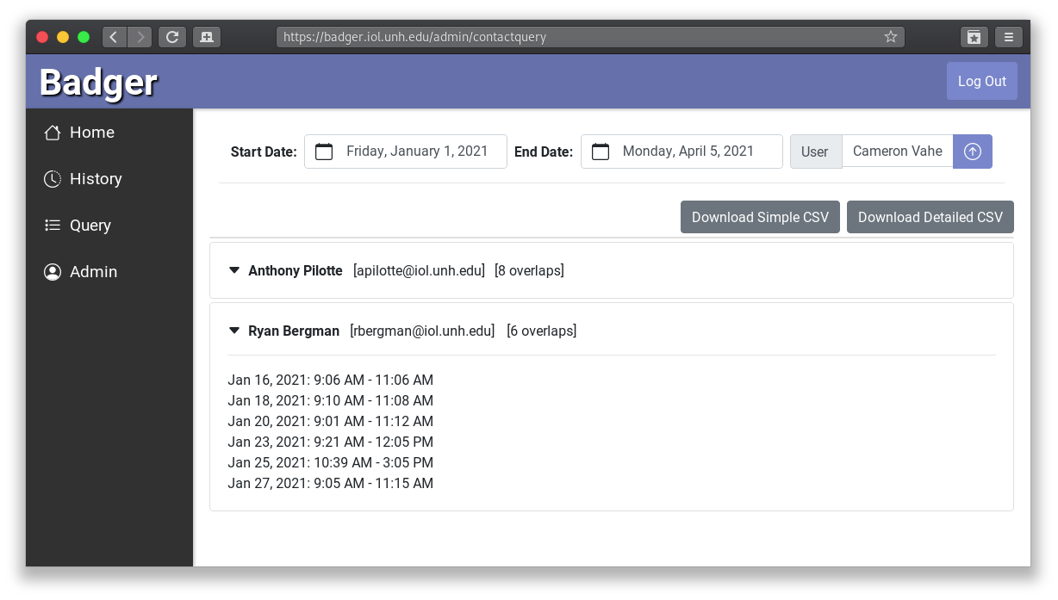
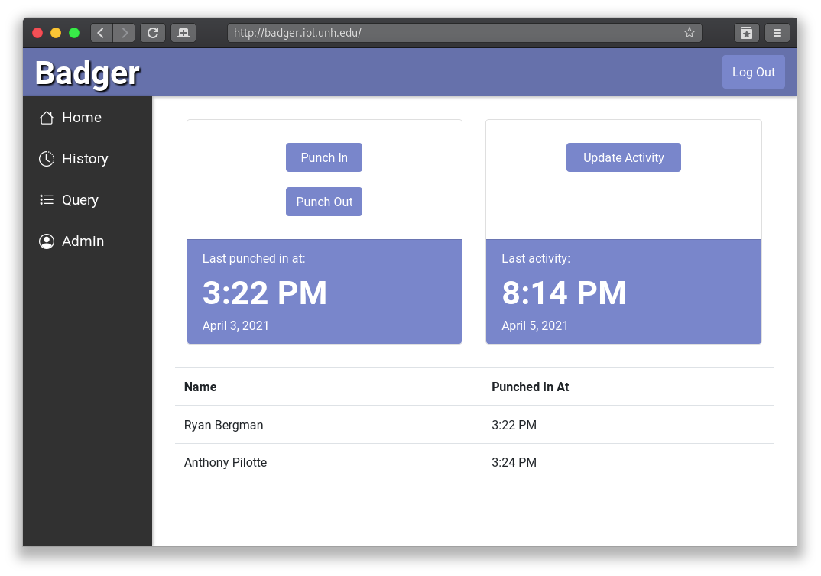
Badger: Employee Tracking System for COVID-19 Guidelines For use within the UNH-InterOperability Lab, sponsored by Daniel Moss Ryan Bergman (CS), Anthony Pilotte (CS), Cameron Vahe (IT), Christopher Trilling (CE) Department of Computer Science, University of New Hampshire
Abstract
Design
Badger Reports
COVID-19 has caused many companies to introduce new guidelines that employees and visitors must adhere to, such as capacity limits and contact tracing. One method of following and adhering to these requirements would be to create a system to track necessary statistics of employees.
Utilizing the existing InterOperability Lab’s employee database, the Badger system allows employees to indicate when they enter or leave the IOL’s building, adding information to a backend SQL database. Administrators can use the information to perform contact tracing functions that generate reports of who may have come into contact with COVID-positive marked employees. A notification system is responsible for informing employees if they have forgotten to mark their status, or if the building is nearing maximum capacity.
Results and Success
 | Without Badger | With Badger
Queries Performed By | IT Admins Only | Any Admin User
Query Method | 4 Manual SQL Queries on 2 Separate Databases | Easy-to-Use Web Interface
Efficiency | Results Manually Combined | Results Generated within Seconds
System in Action
Use Case 1: Contact Tracing
An employee tests positive for COVID-19. An admin is notified and navigates to the “Query” portion of the Web Application. They then select the employee’s name and the date range of the last two weeks. The Web Application requests a query from the Backend API, which instantly generates a list of all possible contacts within the last two weeks.
Use Case 2: No Punch-Out
An employee punches in at the beginning of their shift. At the end of their shift, they forget to punch out, resulting in inaccurate information. After a period of time, the Notifier will realize this, and notify the employee that they forgot to punch out.
Acknowledgements
Matt Plumlee: Project Advisor
Carl Gessau: Docker Specialist
David Weingart: Technical Consultant

