Slide 1



QuadX –Swarm (EE)
Project Advisor: Dr. May-Win Thein
Faculty Advisor: Dr. Se Young Yoon
Bartlett Hooper, Andrew Nguyen, Christian Talmo, Jeffrey Wansley III

Slide 2
Overview
Background
Project Objectives
Design process/research
Results/End Products
Future Work

Slide 3
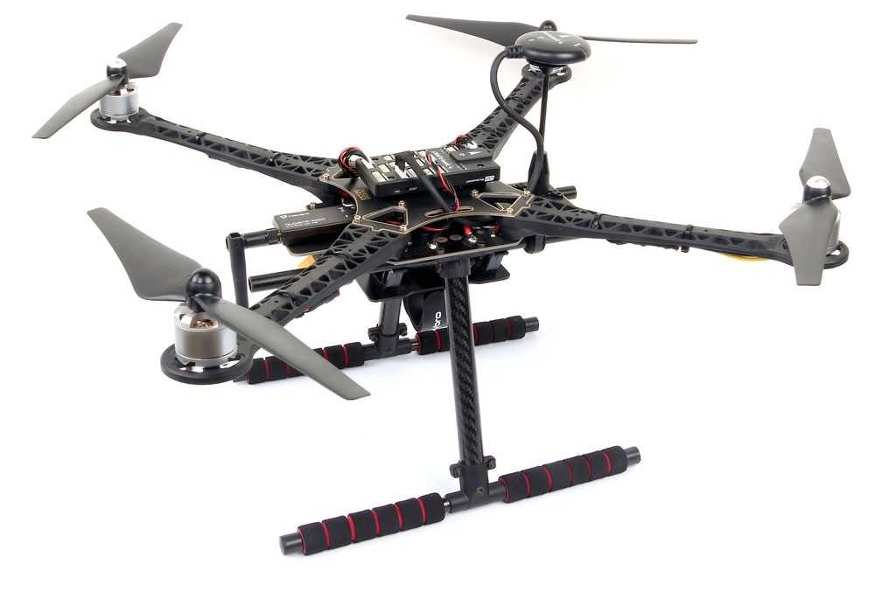
Background
Previous Quad-X Swarm teams:
  Successfully assembled quadcopter and achieved manual and autonomous flight
    Holybro S500 V2 Kit
    Pixhawk 4 Flight Controller
    Brushless DC Motors
    3 cell LiPo battery

Slide 4
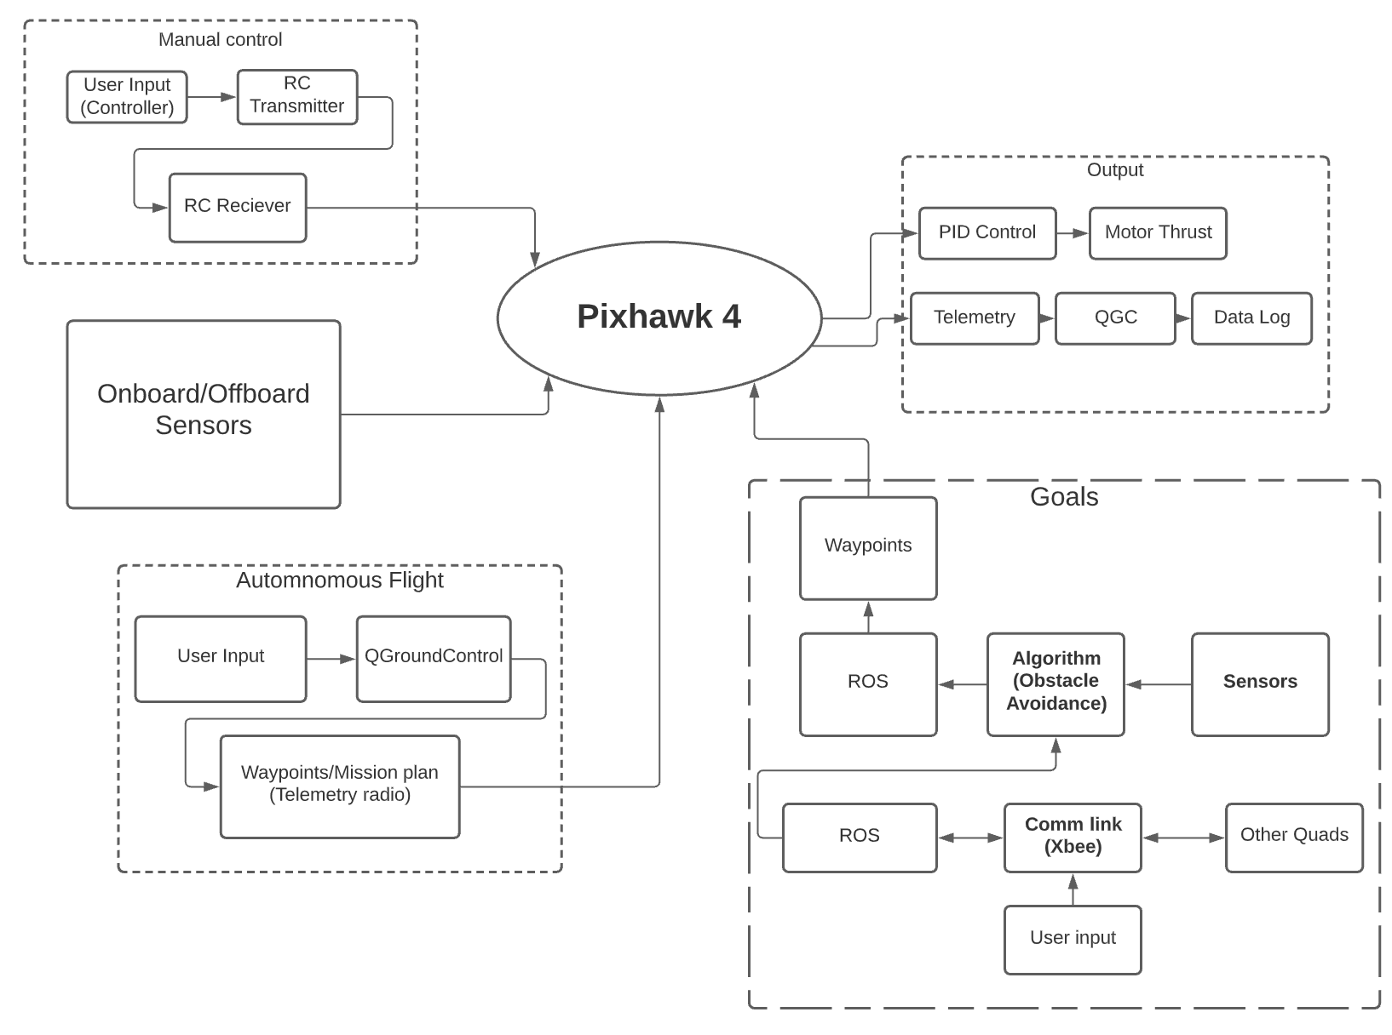
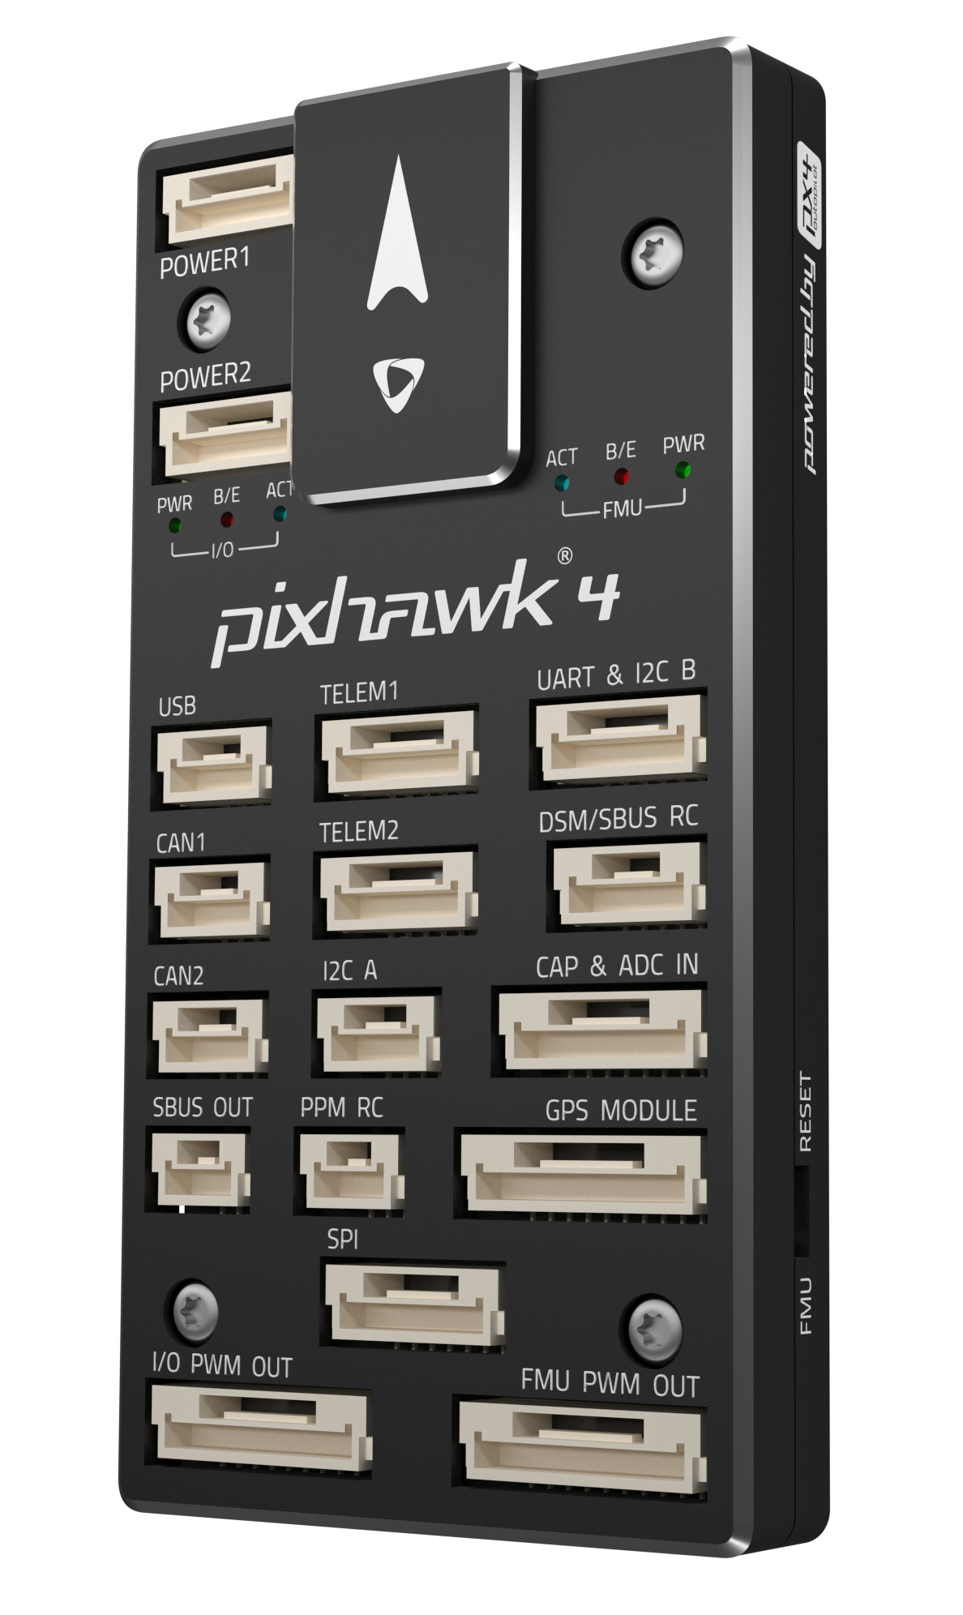
Background Cont.

Slide 5

Objectives
QUAD-X Swarm
  Environmental simulation of several UAVs at once and communication between these vehicles through WIFI/XBEE nodes
  Design, build, and test a quadcopter capable of weather resistance, withstanding impact, reaching locations accurately/efficiently, and transmitting information between quadcopters from air to ground
Electrical Engineering
  Gain Experience with Multi-discipline Engineering Projects
  Learn about Transceiver Operation and Develop a Communication Network for Quad-to-Quad and Quad-to-Base Data Transfer
  Research and Develop Sensor Integration necessary to Enhance Quad Capabilities

Slide 6
Collision Avoidance/Obstacle Detection System
Purpose: Increase Survivability/Capability of Quads
Design Goals
  Support Autonomous Quad Missions
  Cost Effective/Efficient
  Easily Reproduced and Implemented
End Product
  Desired: Prototype System Implemented and Tested on Quad
  Actual: Tested Off-board Prototype System and Documentation Demonstrating Functionality

Slide 7

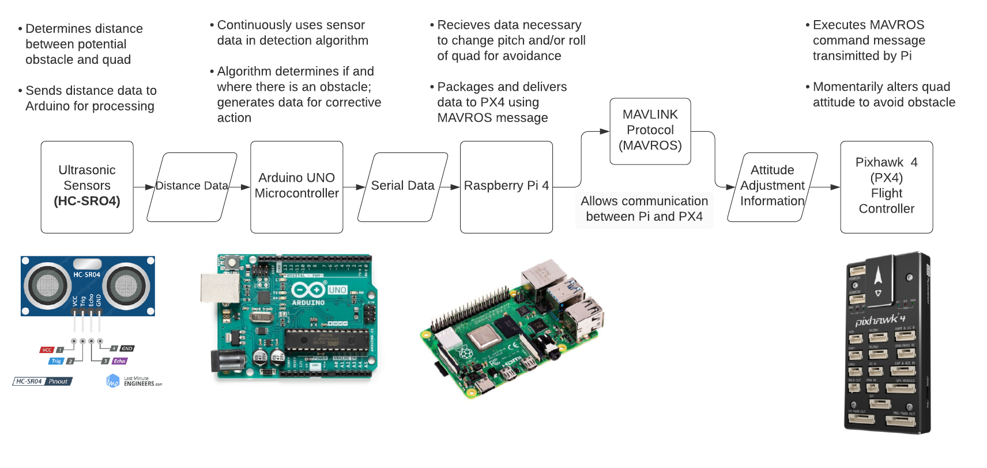



System Block Diagram and Description

Slide 8
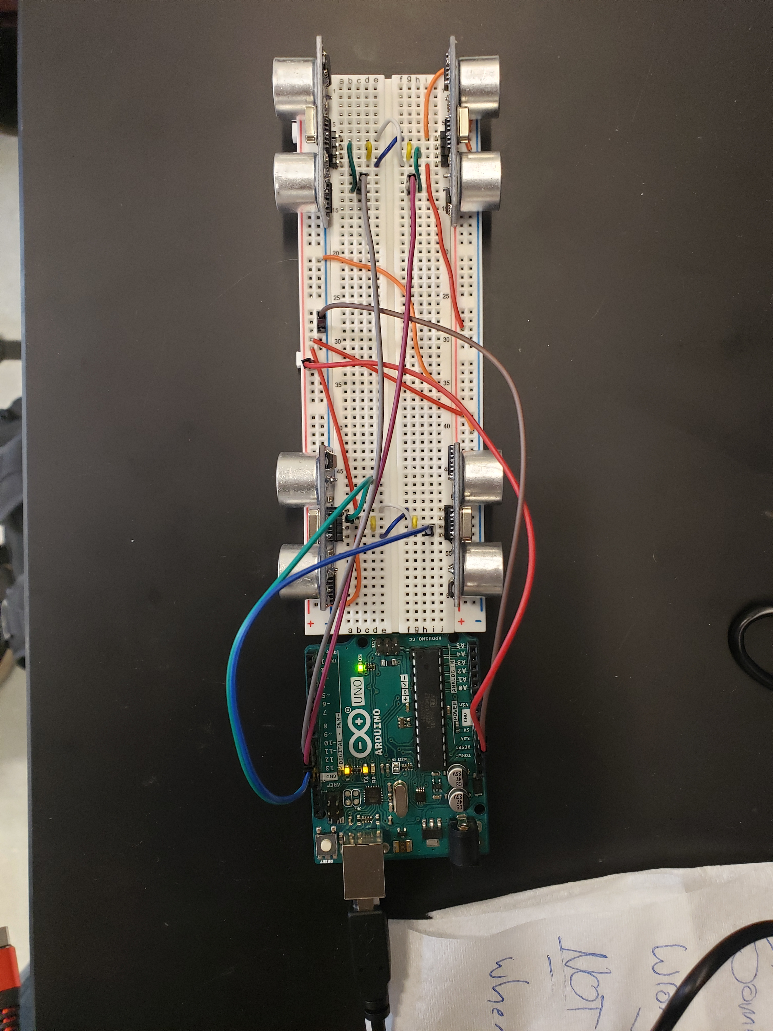
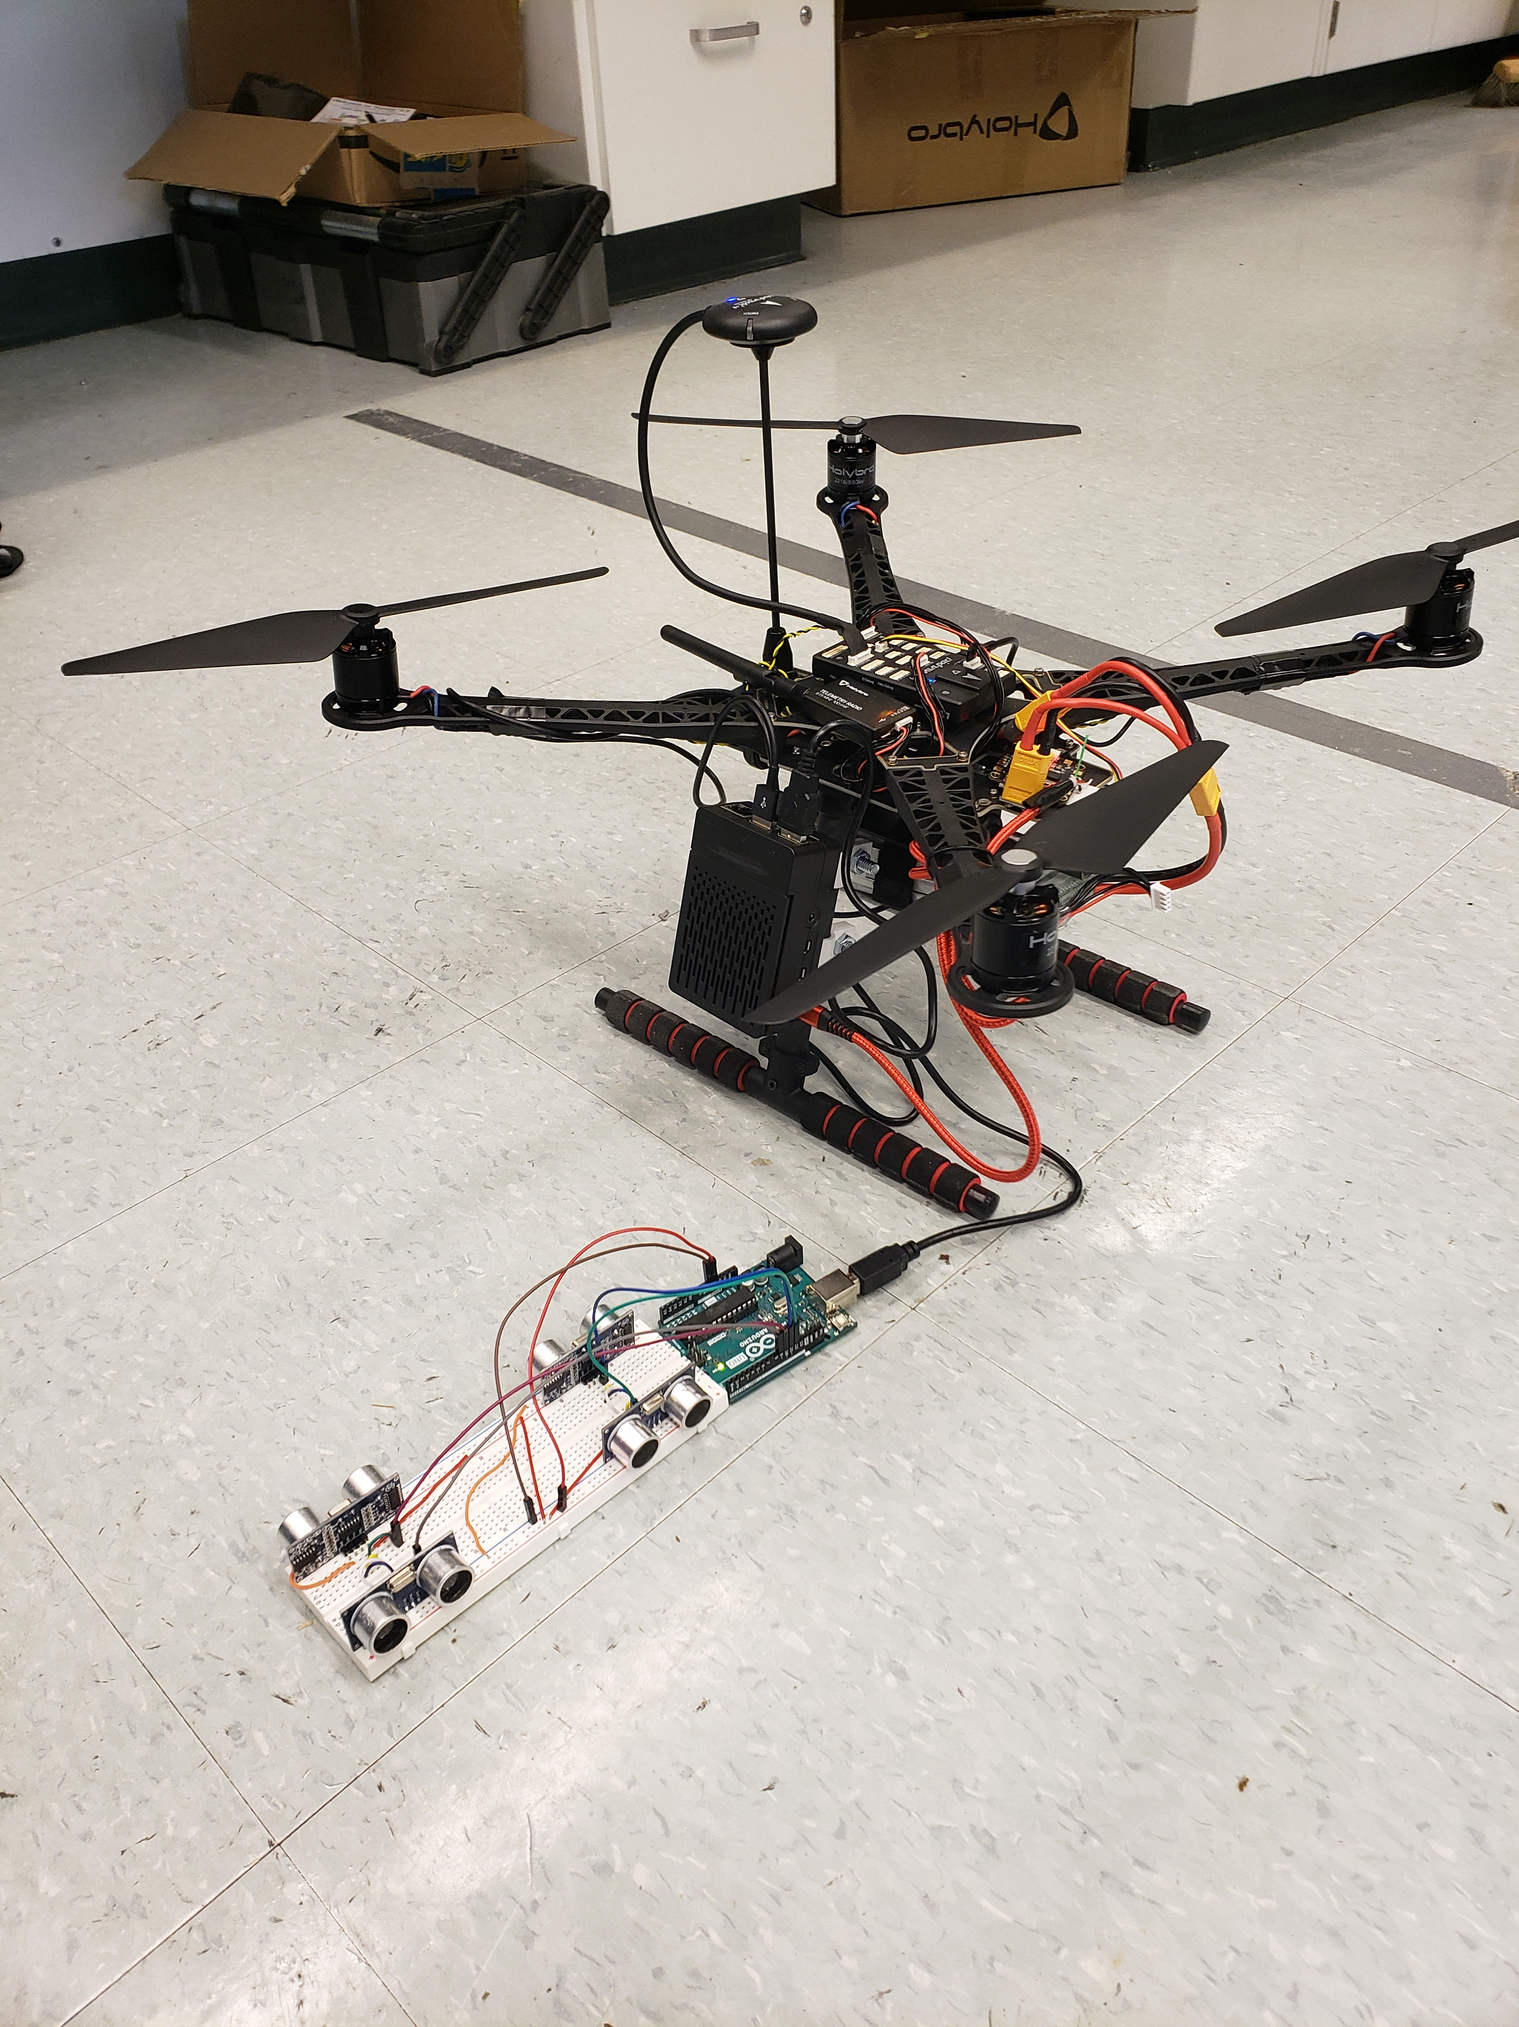
Final Product
Right
Back
Pixhawk
Legend
Green: Fully Operational
Yellow: Semi-Operational
Red: Not Operational
Raspberry Pi
Front
Left
Arduino
Sensors

Slide 9
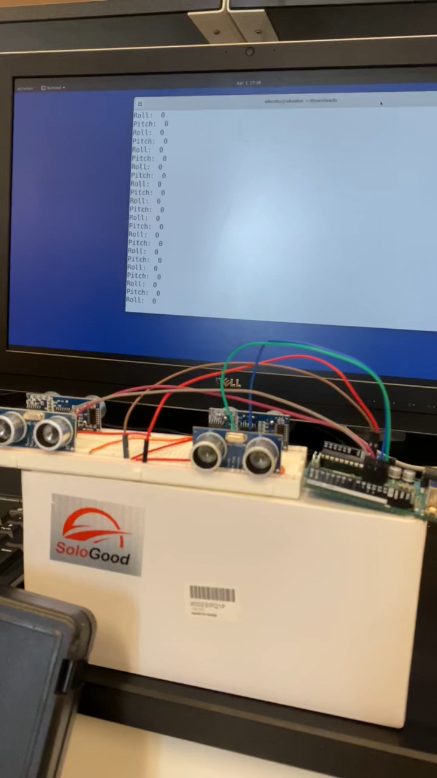

Slide 10
XBee Communication System
Purpose: Implement a Form of Communication using XBee Modules
Design Goals
  Support Autonomous Quad Missions
  Support Quad Swarm Capabilities
  Lightweight and Simple
  Easily Implemented and Reproduced
End Product
  Desired: Mesh Network using XBees Created, Implemented and Tested on Quads
  Actual: Tested Mesh Network Off-board and on Grounded Quad, Documentation Demonstrating Functionality, and Full Implementation Ready

Slide 11
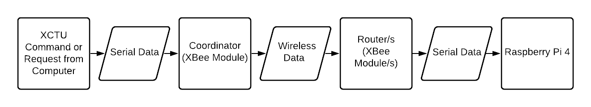
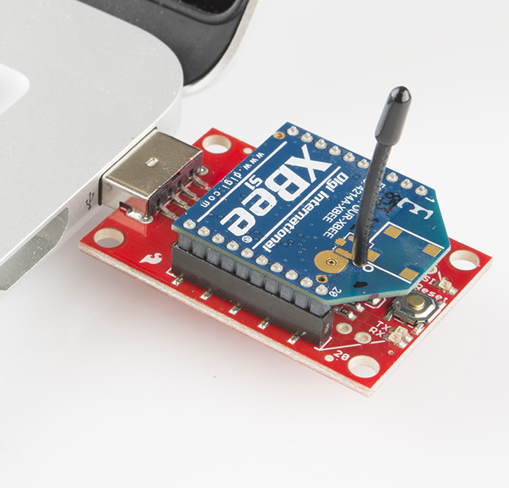
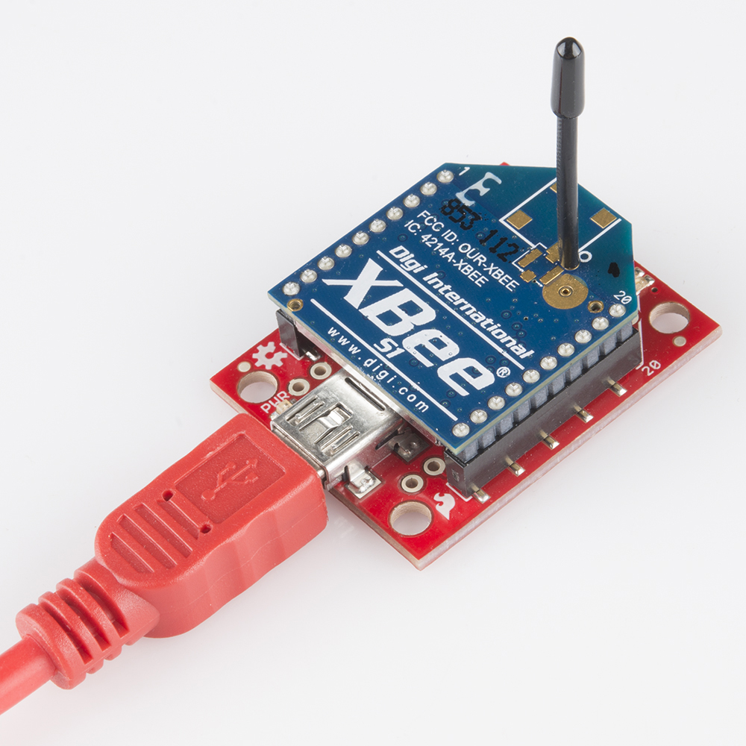
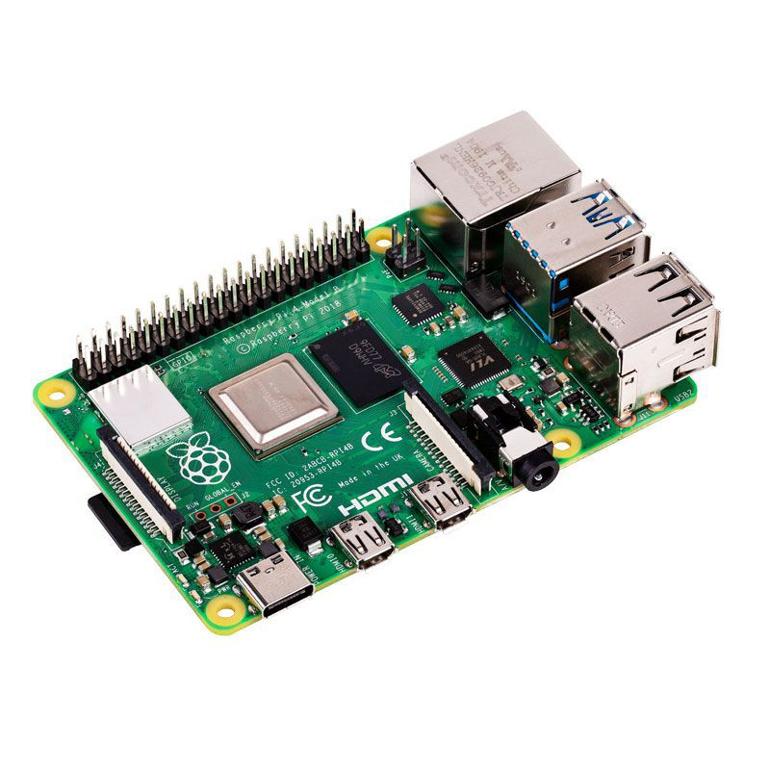
Communications System Diagram and Description
Sends messages, commands, or requests data from an XBee module
Receives command or request serially from XCTU
Sends command or request to one or all router XBee modules on the mesh network
Receives data from coordinator XBee module
Sends data serially to Raspberry Pi 4
Powers the router XBee module/s

Slide 12
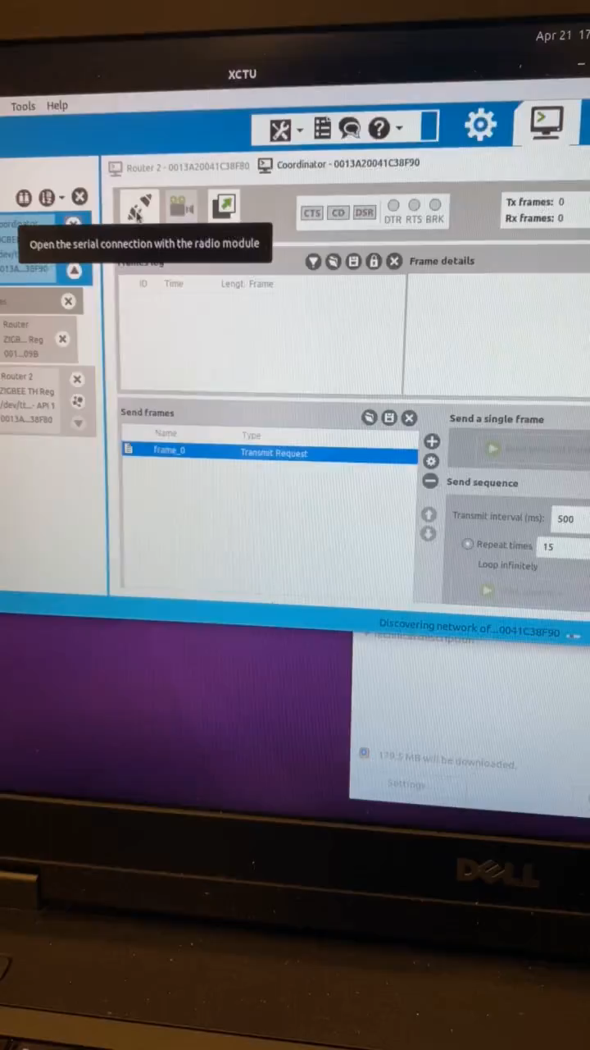
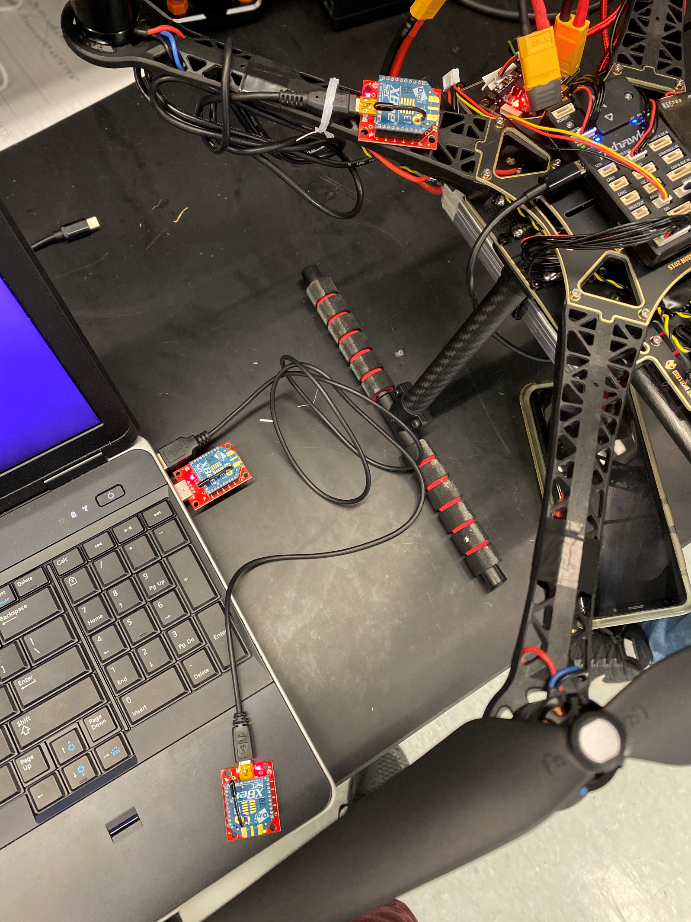
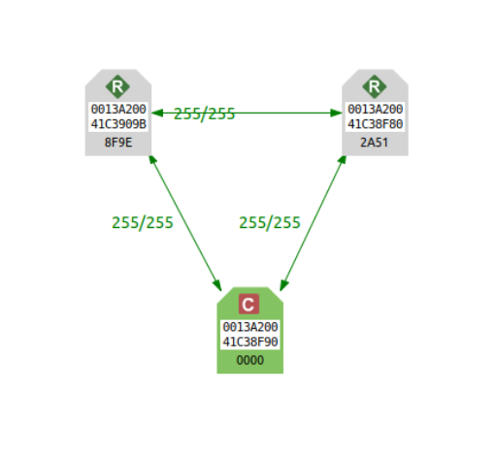
Demonstration of Communications System
Router 1
Coordinator
Router 2

Slide 13
Future Work
Collision Avoidance System
  Remove Arduino from system design
  Upgrade distance sensors
XBee Communications System
  Use Raspberry Pi to read and process messages, commands, and requests to transmit to the flight controllers
Integration of both systems onto the quads
Additional sensors implemented

