Slide 1
Teacher Self-reflection, Culturally Inclusive Pedagogy, and Multilingual Learners
Sumeyra Gok
Donna McNiff Brown
University of New Hampshire

Slide 2
Agenda
Warm up
Culturally inclusive pedagogy
Self-reflection
Takeaways

Slide 3
Mardsan Giberter for Farfie
Read the article
How did it make you feel? Would you able to answer questions based on this text?
What if we pre-taught some vocabulary and introduced the context?

Slide 4
Mardsan Giberter for Farfie
Glis was very fraper. She had dernarpen Farfle’s marsden. She did not talp a giberter for him. So, she conlanted to plimp a marsden binky for him. She had just sparved the binky when he jibbed in the gorger.
“Closty marsden!” she boffed.
“That’s a crouistish marsden binky,” boffed Farfle, “but my marsden is on Stansan. Agsan is Kelsan.”
“In that ruspen,” boffed Glis, “I won’t wank you your giberter until Stansan.”
1) Why was Glis fraper?
2) What did Glis plimp?
3) Who jibbed the gorger when Glis sparved the blinky?
4) Why didn’t Glis wank Farfle his giberter?

Slide 5
What do you see in the picture?
Binky
Giberter
We are celebrating a mardsan!

Slide 6
Culturally Inclusive Pedagogy
What is it?
Characteristics
Positive perspectives on parents and families
Communication of high expectations
Learning within the context of culture
Student-centered instruction
Culturally mediated instruction
Reshaping the curriculum
Teacher as facilitators
Https://www.brown.edu/academics/education-alliance/teaching-diverse-learners/strategies-0/culturally-responsive-teaching-0
“Culturally Responsive Teaching is a pedagogy that recognizes the importance of including students' cultural references in all aspects of learning” (Ladson-Billings,1994)

Slide 7
Classroom Strategies

Slide 8
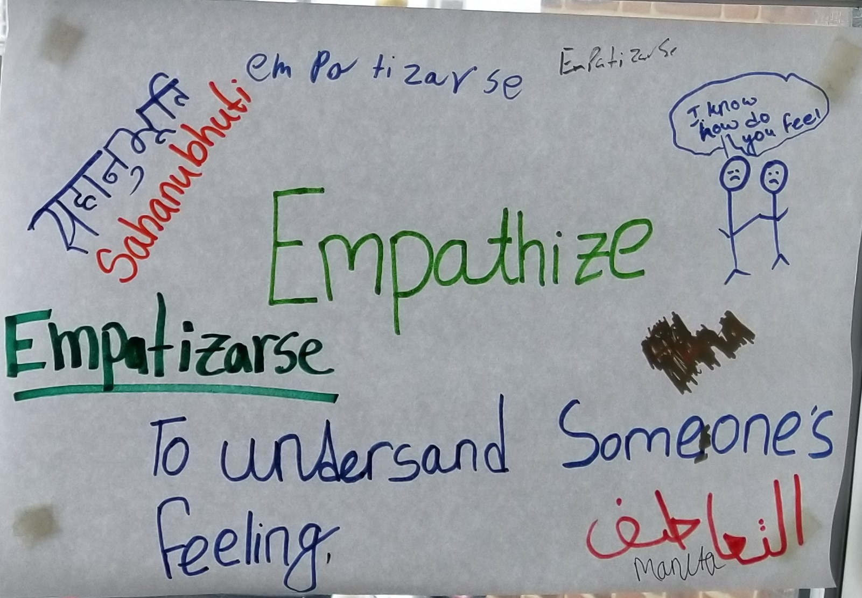
Multilingual Word Walls

Slide 9
Writing from photographs (CUNY Guide)
In this activity, the teacher gathers a collection of interesting photographs, preferably including different cultures and settings
The teacher, then, provides a photo to each pair in the class and asks students to uncover the hidden stories in them
This activity helps students practice their oral language and writing skills, and creates opportunities for students to talk about different cultures
What was taking place before the photographer took this photograph?
What took place after the photo was taken?
What feelings toward each other might the people in the photograph have?
What might be a conversation they have with one another?
Who do you think is the photographer? What might the photographer’s feelings be? What special moment do you think the photographer is trying to capture?

Slide 10
Drama and the Writing Process
In this activity, the teacher selects a passage for reading, preferably including different cultures and settings. Drama can be used before, during, or after reading.
Before: students can bring their prior knowledge to the stage. This allows all students to engage in thinking not only through language but through visuals about a given topic.
During: stop at a given point to ask students to act out how the characters may feel. Doing so allows opportunity for students to act out their understanding of the text in progress.
After: students engage in dramatized retellings of the story or create new variations from their personal cultural perspectives.

Slide 11
Self Reflection
Here are 3 internal tasks every teacher has to work through to uncover implicit bias;
Identify your cultural frame of reference
Widen your cultural lens
Identify your triggers
Hammond, 2015, 56.
Culturally inclusive teaching calls for an inward reflection by taking the “emotional risk” to examine your own deeply held beliefs that influence how you respond to students.

Slide 12
Self Reflection Tools
Explain the attributions you have about the student.
Write out or reflect on your feelings and thoughts when working with the student. Take into account the potential for misinterpretations resulting from deficit thinking, prejudice, and overgeneralizations
Consider alternative explanations by reviewing your documentation and reflections
Check your assumptions
Share your reflections with a colleague, parents, and/or community members
Meet the parents to learn more about the expected and observed behaviors at home
Make a plan
Continuously revisit this process to reassess your attributions and progress

Slide 13
REFERENCES
Hammond, Z. (2015). Culturally responsive teaching and the brain: promoting authentic engagement and rigor among culturally and linguistically diverse students. Thousand Oaks, CA: Corwin, a SAGE Company.
Ladson-Billings, G. (1994). The dreamkeepers. San Francisco: Jossey-Bass Publishing Co.
BROWN UNIVERSITY Culturally Responsive Teaching
CUNY GUIDE FOR EDUCATORS
CUNY on TRANSLANGUAGING
PODCASTS

Slide 14
Takeaways
Tell us about what you found useful
Is there anything else you wanted to learn more about?

