Slide 1
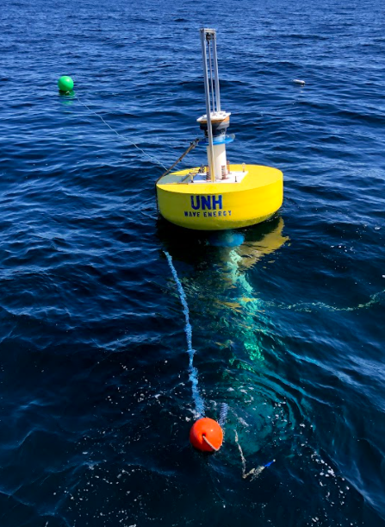
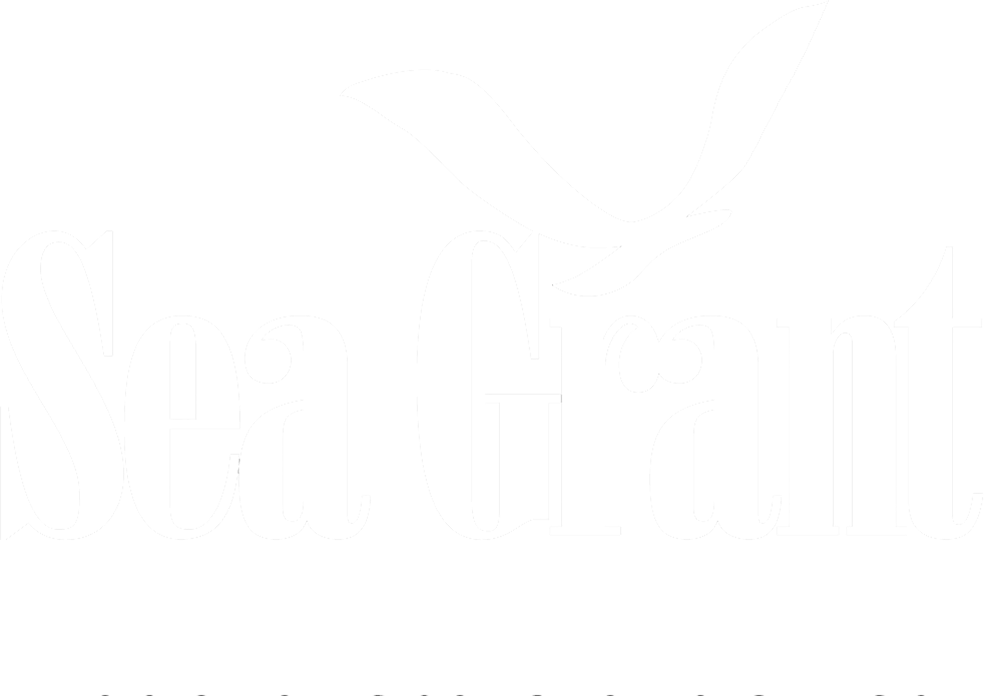

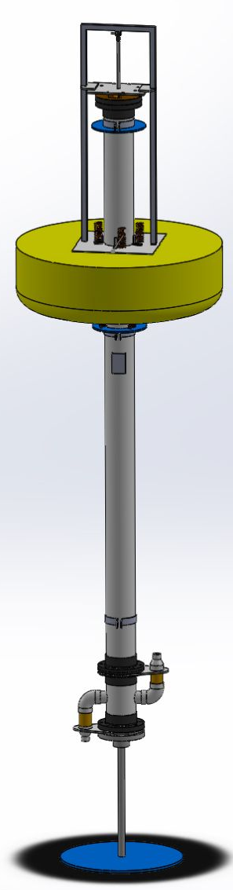
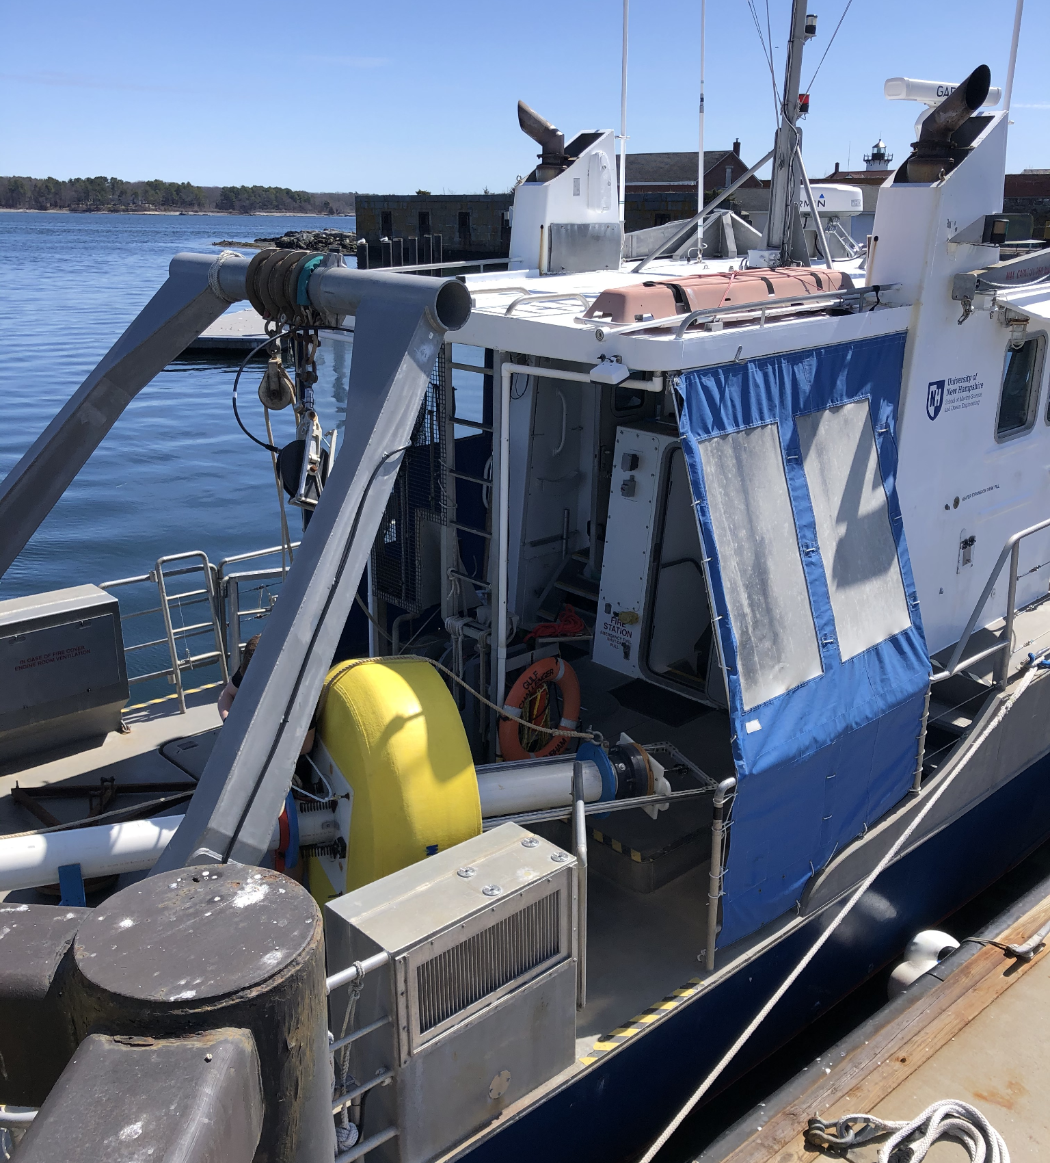
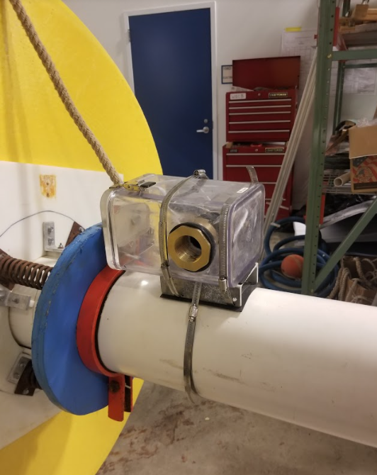
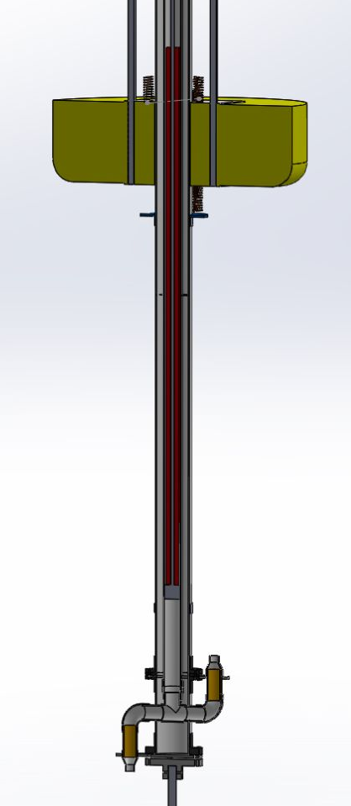
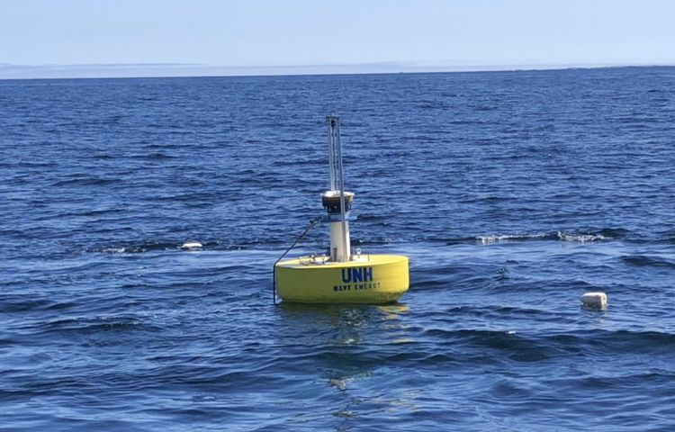
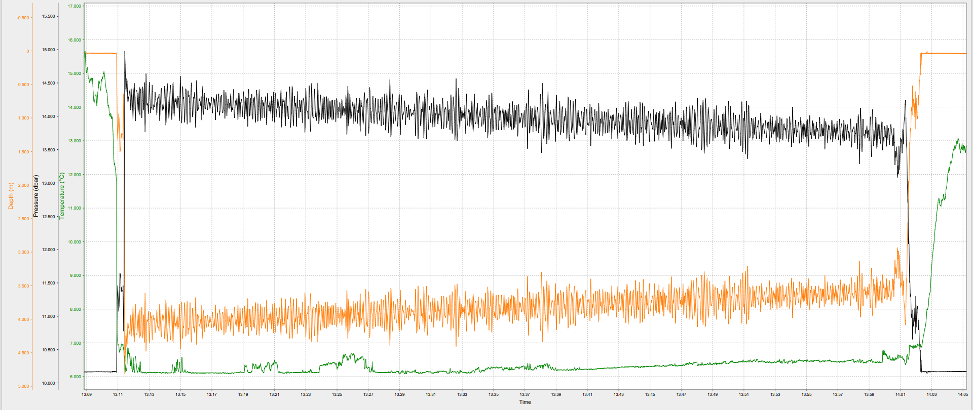
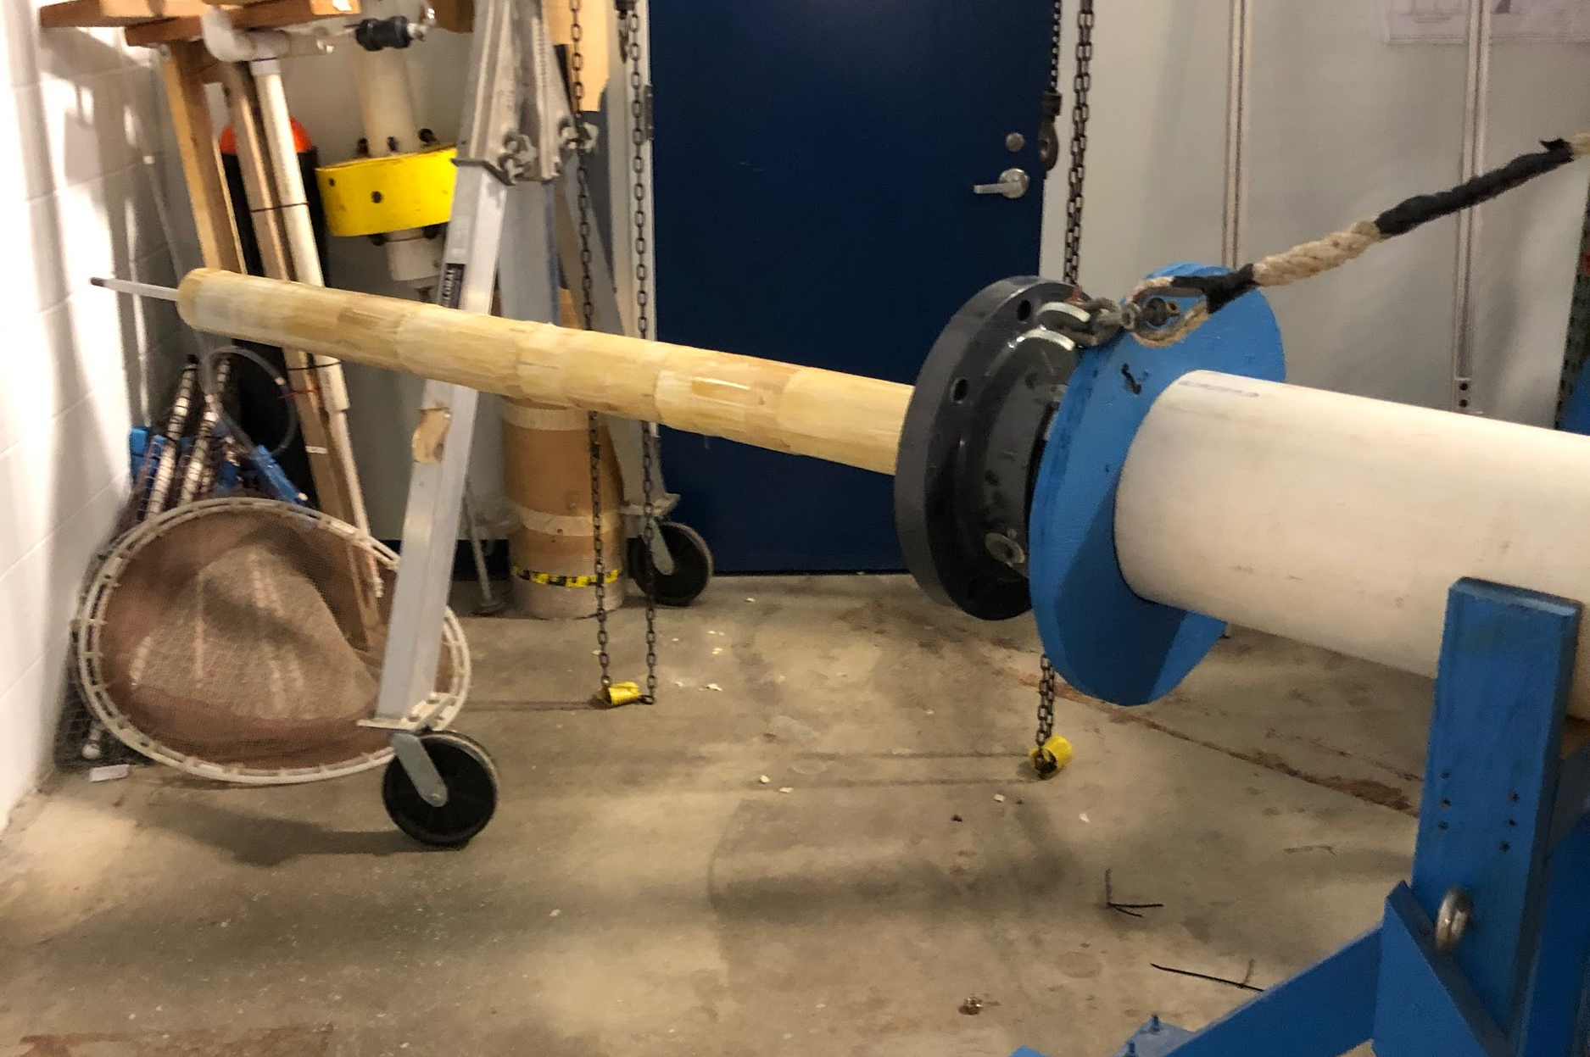
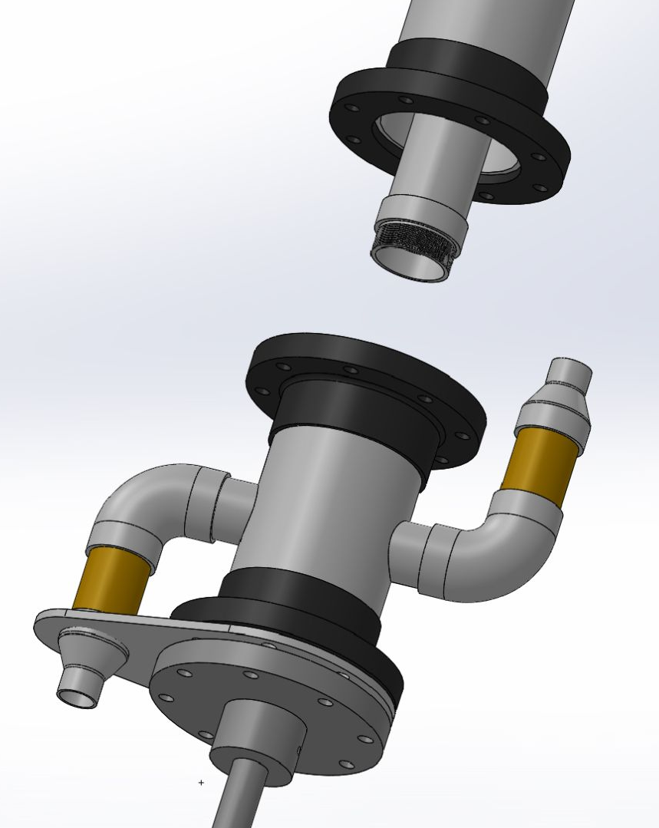
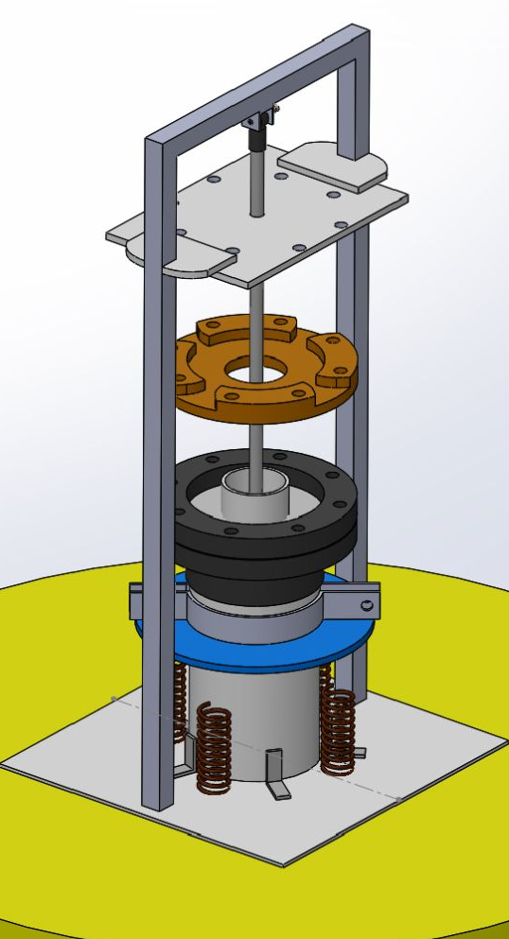
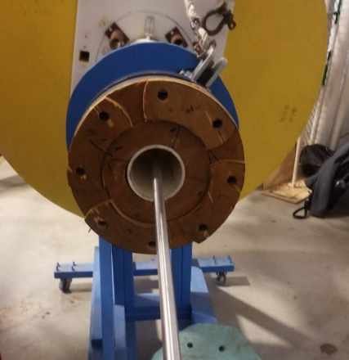
Wave Powered Water Pump
Project Members: Dakota Bouret (OE), Brian Thorne (ME), Rory Walsh (OE)
Advisors: M. Robinson Swift, John Ahern
Department of Ocean Engineering, University of New Hampshire
Mission
Hydrostatics
Deployment
Finish construction of Wave Powered Water Pump (WPWP) buoy and deploy outside of Portsmouth Harbor
Observe and record data of buoy’s pumping ability
We weighed parts separately using a load cell and preformed a hydrostatic analysis to determine much ballast to add at the bottom of the heave plate
The goal was to allow the spar to float so the foam float was statically midway between the stoppers at the top of the spar, maximizing the range of motion of the float during wave action
Temporarily deployed ~1.5 miles outside of mouth of Piscataqua in 60 ft of water with the help of Capt. Bryan Soares and the Gulf Challenger
Used a temporary mooring system
Unfortunately lost flow sensor data due to water intrusion to sensor case
Measured the flow rate manually using a 5 gal bucket held directly above the water and a timer
15.5 ft
Background
Kelp is becoming an alternate biofuel
Kelp aquaculture farms can benefit from bringing colder, nutrient rich waters at depths up to kelp ropes, resulting in faster growth rates [1]
Previous WPWP team converted previous wave energy buoy into an internal piston cylinder pump (4” diameter)
Data Collection
Deployment - Mooring System Diagram
30’
Outlet hose
* Note: Not to scale
3 ft
25’
WPWP
25’
30’
Subsurface buoy
Digiten Flow Sensor mounted through a pressure case mounted on spar, with Ardunio Uno inside pressure casing
Output of pump runs to inlet of flow sensor
RBR Duet pressure sensor moored nearby to measure pressure of wave action
60’
150’
Lifting bridle
RBR Duet
Buoy Design
50’
Buoy aboard the R/V Gulf Challenger
200 lbs - dead wgt
100 lbs - dead wgt
Internal piston cylinder inside central spar
Yellow float around spar is connected to piston, float follows the waves and relative motion causes water to pump
Results
Pressure casing mounted below bottom stopper on spar
Pumped approximately 2.5 gallons of water per minute
Average measured wave height of 0.6245 m
Average wave period of 6.6 sec
Finishing Construction
Foam
Used foam to fill the space above piston head to reduce water intrusion into this area
First method was to try to make our own foam mold using West System two part closed-cell foam
Found that the foam was too inconsistent and created excess friction that inhibited the movement of the
piston in a second tank test
Second method used a thick plastic liner and a metal center in hopes of having a straighter mold
Found that there was still to much friction through a third tank test
Ordered 10ft of pre-made foam with a 3.25” diameter, 1” inner hole; float moved freely with
this foam in place
Spacer
Wood spacer for the top of the spar which allows air and water to escape from the
inner cylinder during pumping, while preventing excess water from filling the cylinder
Cylinder Connection
Seated internal piston cylinder with threaded connections to inlet/outlet tee housing
Allowed the assembly to come apart if need be while still providing a watertight connection
Foam
Piston
Foam location
Wave Pressure Data
Acknowledgments
Installing Foam
Piston Cylinder Attachment to Tee Housing
Thank you to…
NH Sea Grant
ME/OE Department
Parents Association
Prof. Swift and John Ahern
Capt. Bryan Soares & Deb Brewitt
.
Wood Spacer
[1] Polakovic, G. (2021, March 2). 'Kelp elevator' study shows promise for producing biofuel from giant seaweed news usc dornsife. www.dornsif.usc.edu

