Slide 1
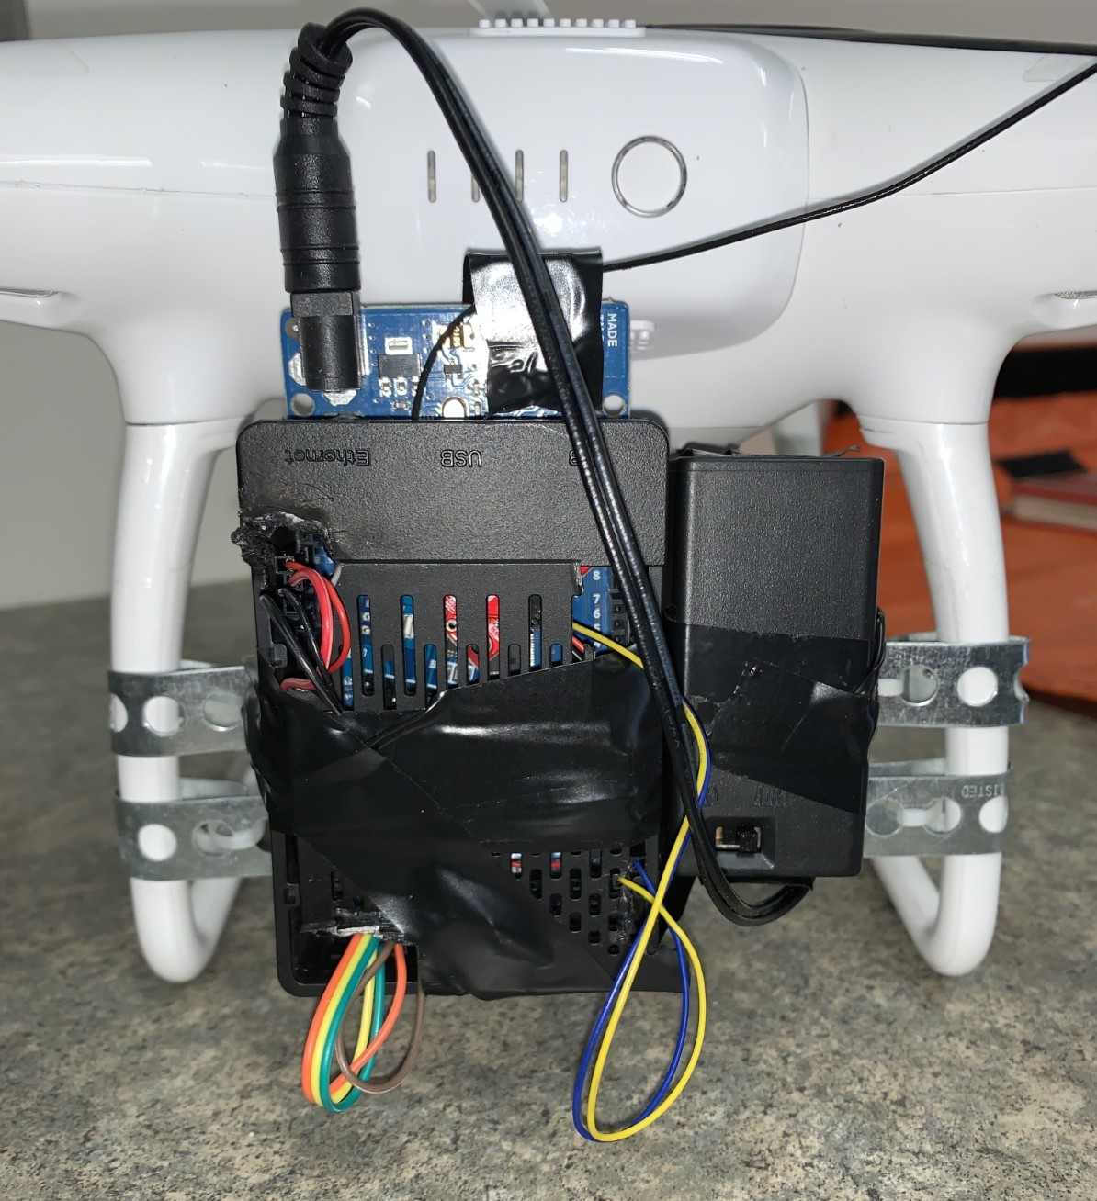
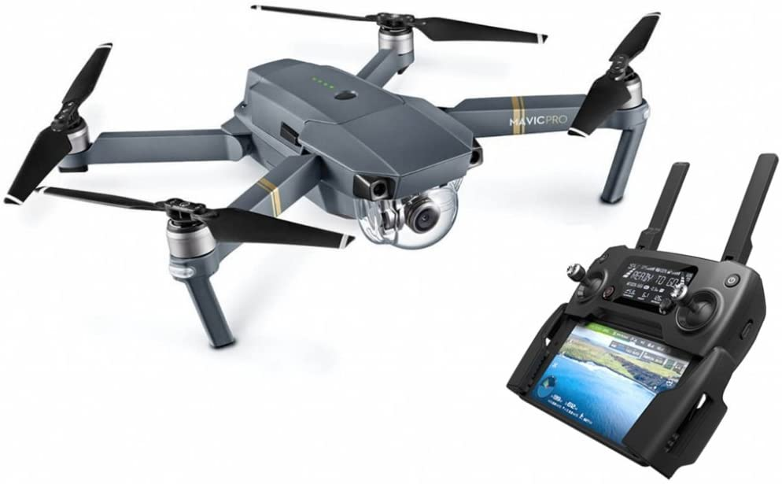
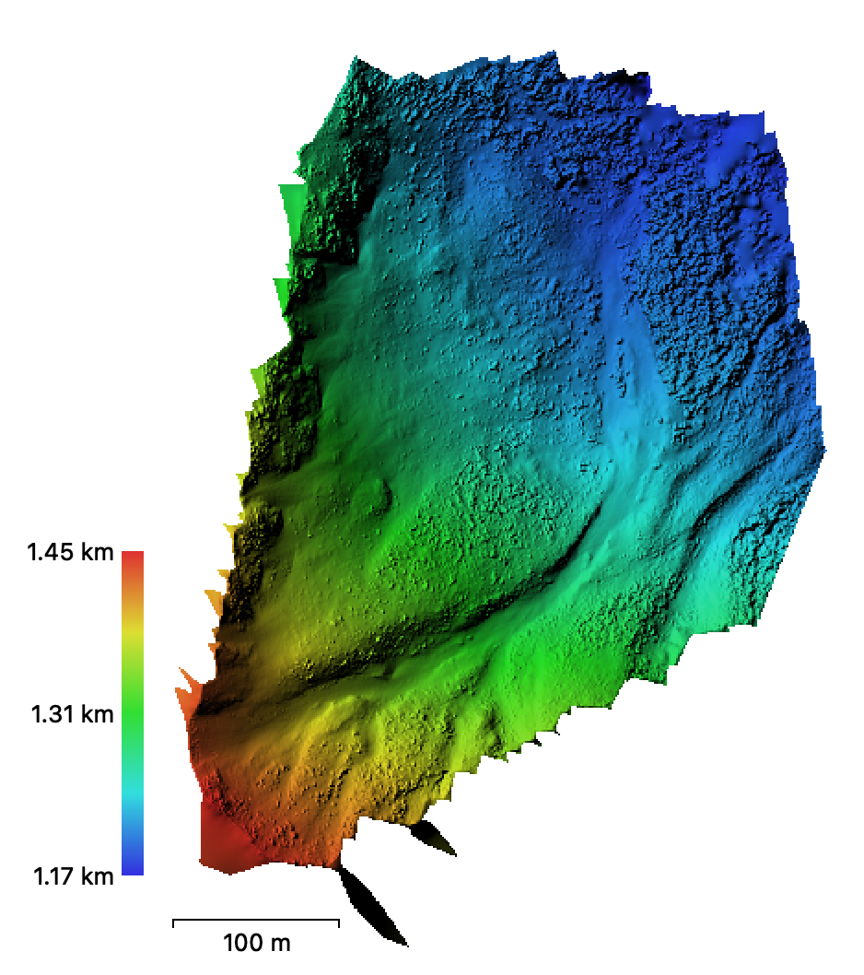
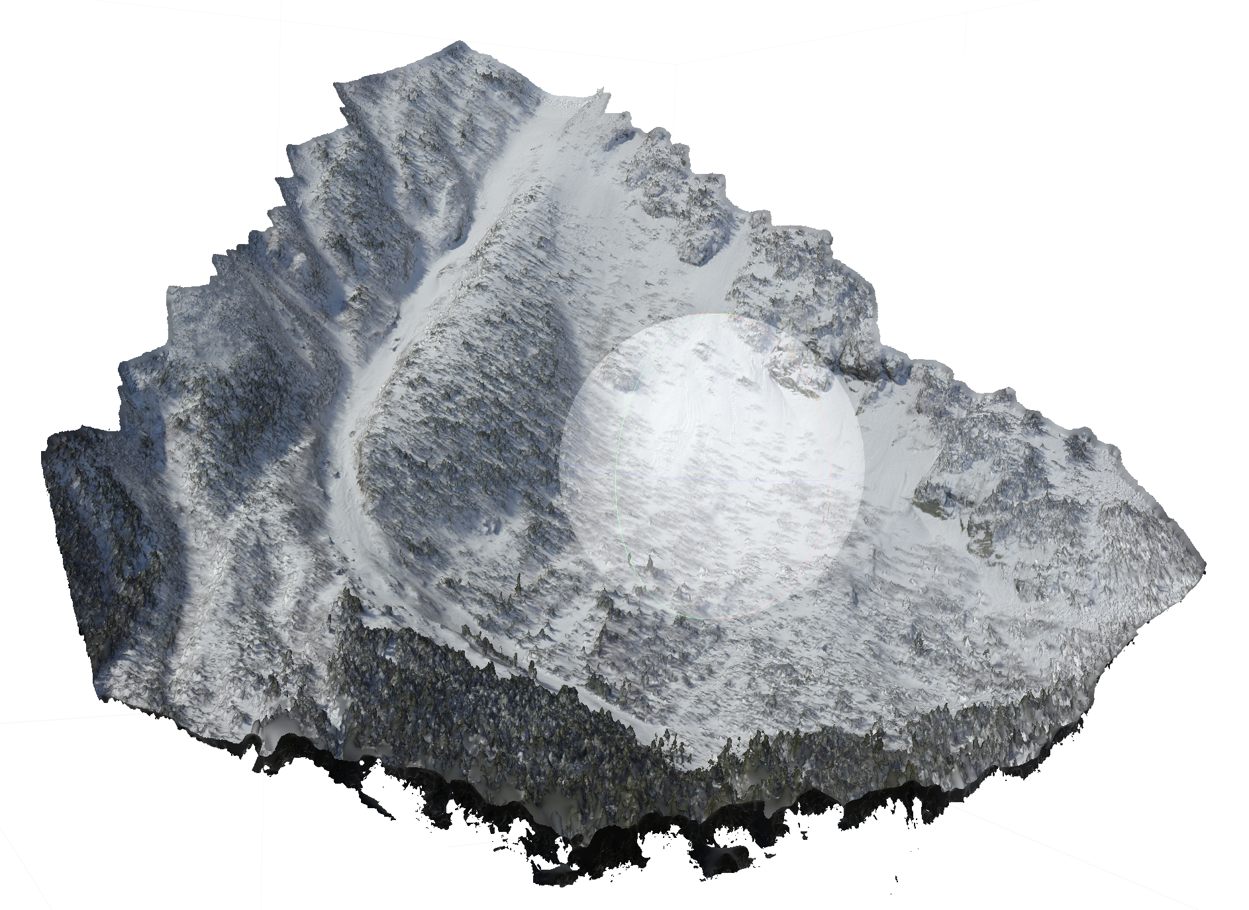
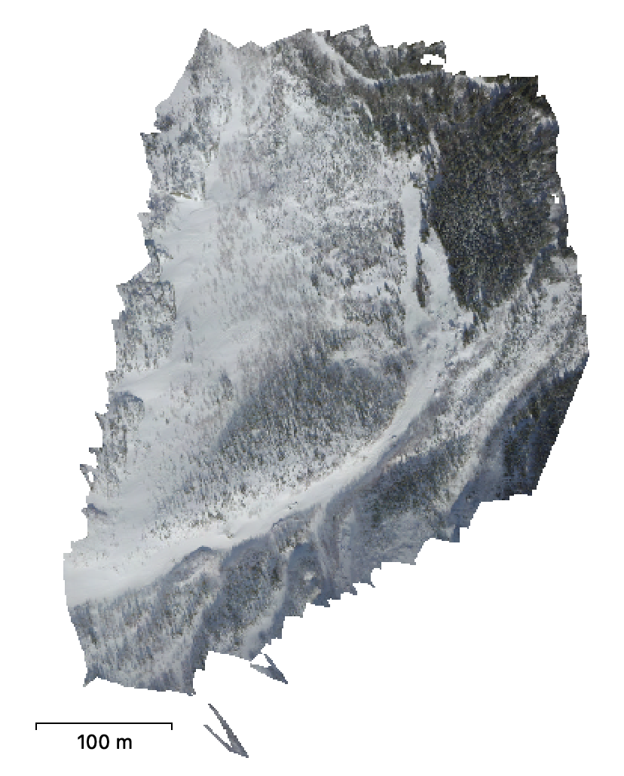
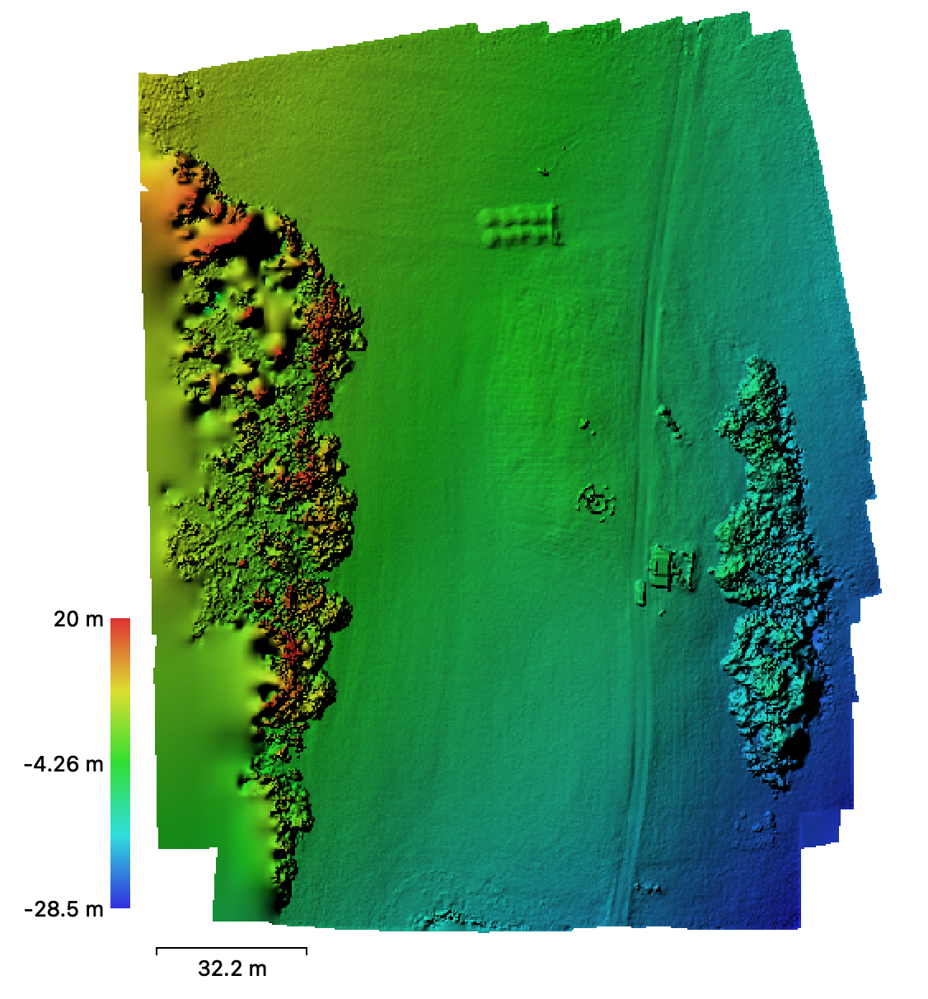
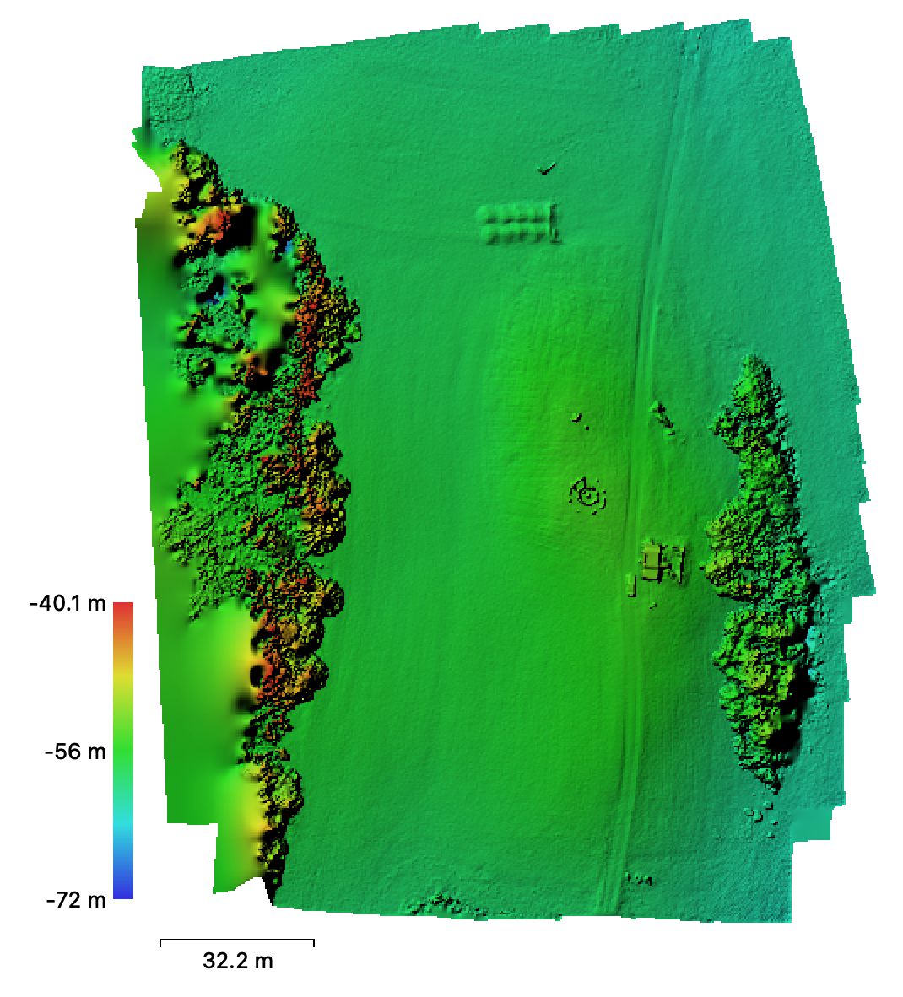
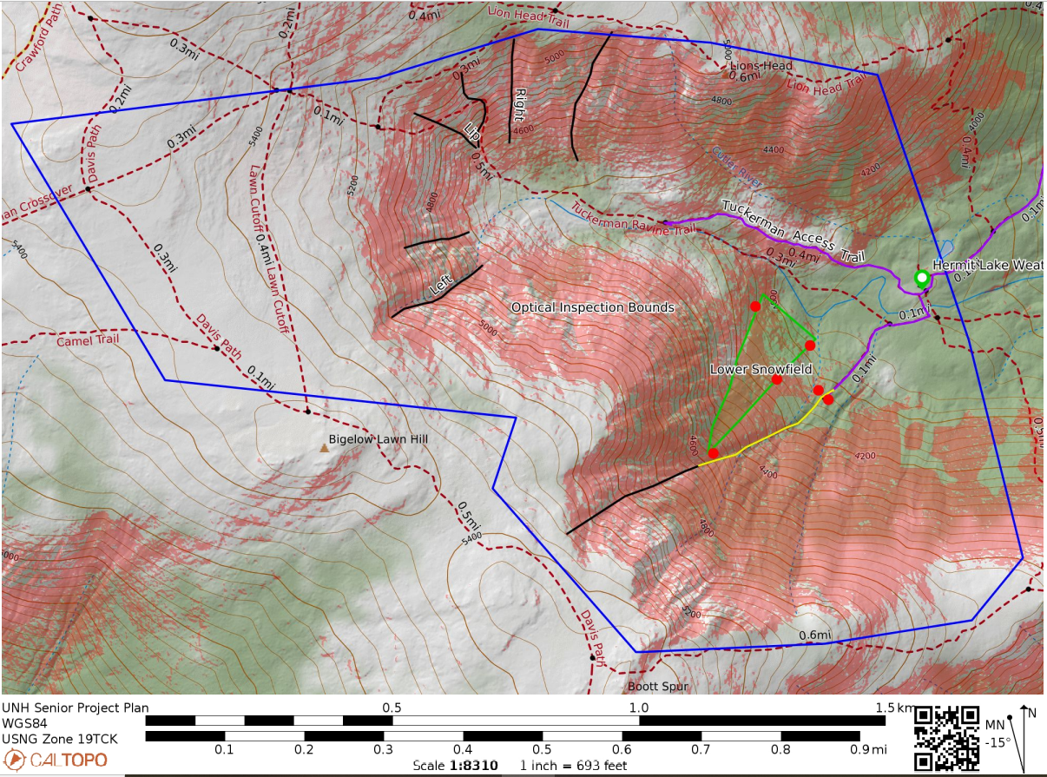
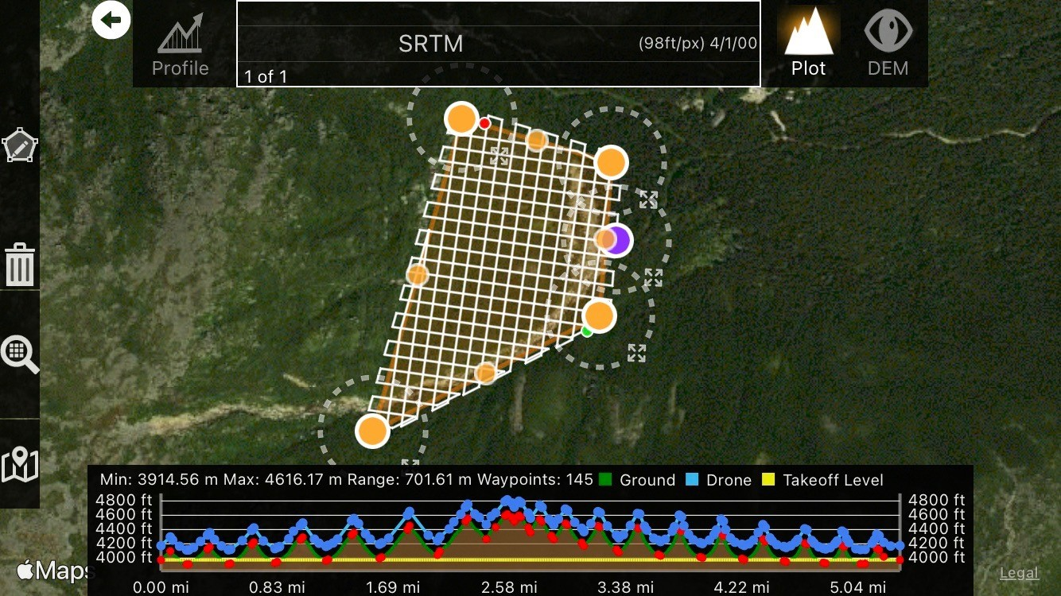
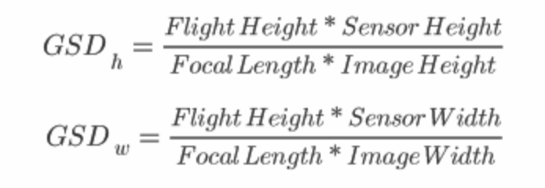
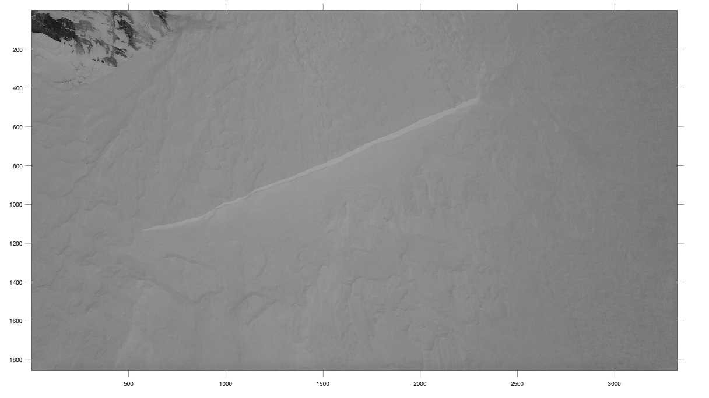
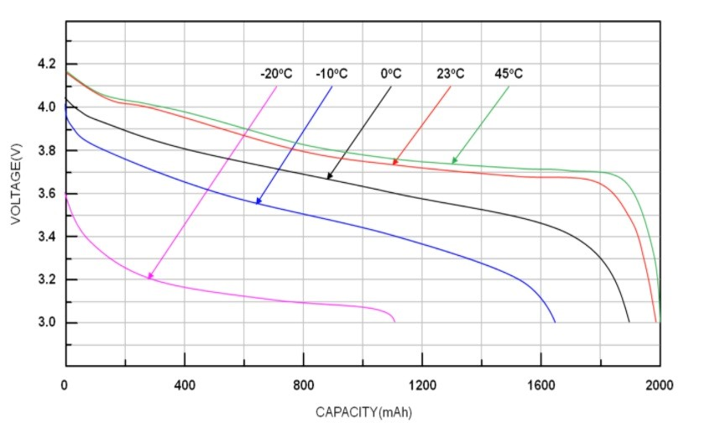
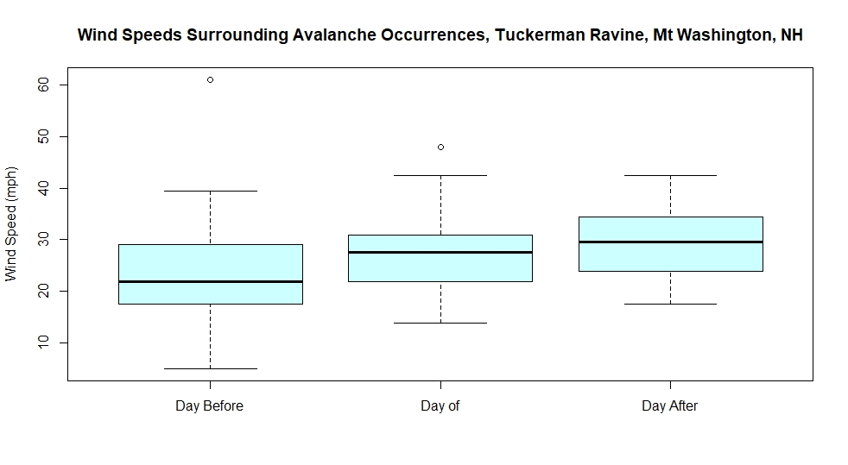
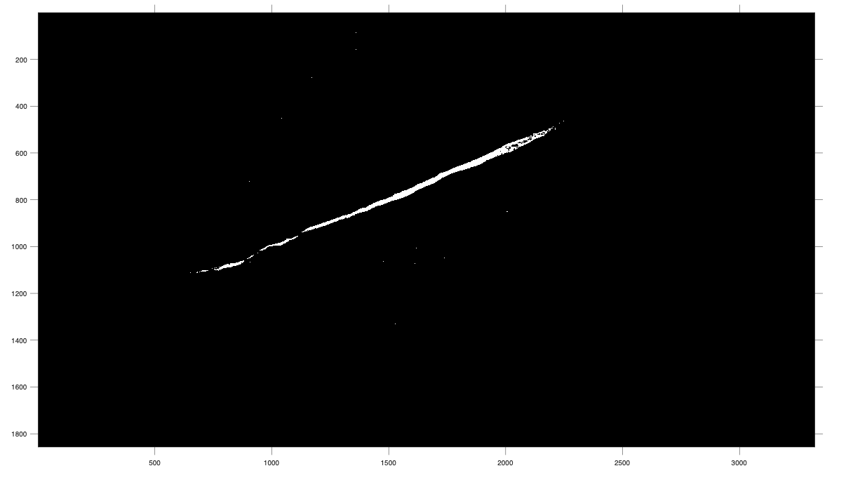
UAVs for Snow Mapping in Tuckerman Ravine
Cameron Wagner, Holly Proulx, Michael Tung, Cameron Ugolini
Abbreviations
UAV – Unmanned aerial vehicle
SfM – Structure from motion
GPS – Global positioning system
DEM – Digital elevation model
Faculty Advisor: Dr. Jennifer Jacobs, Project Sponsor: Frank Carus, MWAC
Department of Civil and Environmental Engineering, University of New Hampshire
Abstract
https://cdn.outdoors.org/wp-content/uploads/2017/06/07144235/Washington-Header-14.jpg
GPS Integration
Avalanche slides are a frequent, natural disaster which vary in size and can be catastrophic in the largest forms. These occurrences are nearly exclusive to snow covered mountain slopes greater than 30 degrees in pitch. To better understand the events and the conditions that lead up to a slide, analysis of known slide events is conducted and weather patterns surrounding the event are sought out. The use of UAVs in remote and dangerous mountain terrain allows for safer, faster, and more accessible snow inspection than in situ observations. Limitations posed on the capabilities of UAVs by mountain terrain and extreme weather conditions are considered and worked around seeking the best results. A UAV can collect photos and videos, which is used with SfM software to generate 3D and DEMs. Geographically accurate models of avalanche terrain will give avalanche forecasters and backcountry travelers more refined information on a potential problem area’s condition.
Instrumentation
Background
Models
DJI Mavic Pro 1
DEM
3-D Model
Orthomosaic
GPS Test Flight DEMs
Study Area
Flight Plan
UAV Flight Limitations
Post-Slide Analysis
Battery Capacity
Wind Speeds
Accomplishments
Flight Permit
Summary
Project Partnership
Based on the flights conducted and data collected for this project, a DJI Mavic Pro 1 UAV can conduct flights of about 12 minutes per each battery on a mild day in areas surrounding Tuckerman Ravine with proper planning and weather forecasting. The UAV likely cannot collect data on days surrounding an avalanche slide event due to increased harsh weather conditions. The GPS unit on board is not sufficient for creating precise 3D snow depth models; an external GPS should be used in the future.

