Slide 1
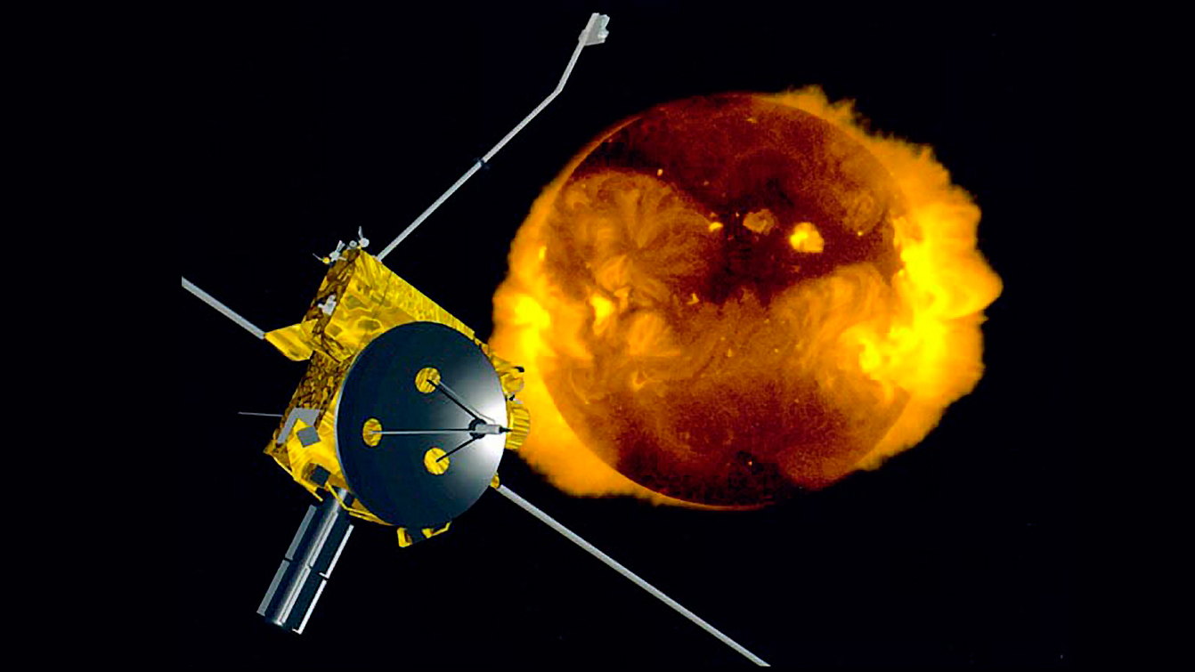
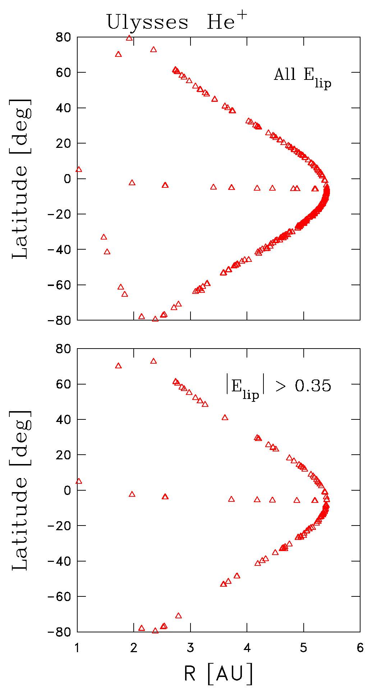
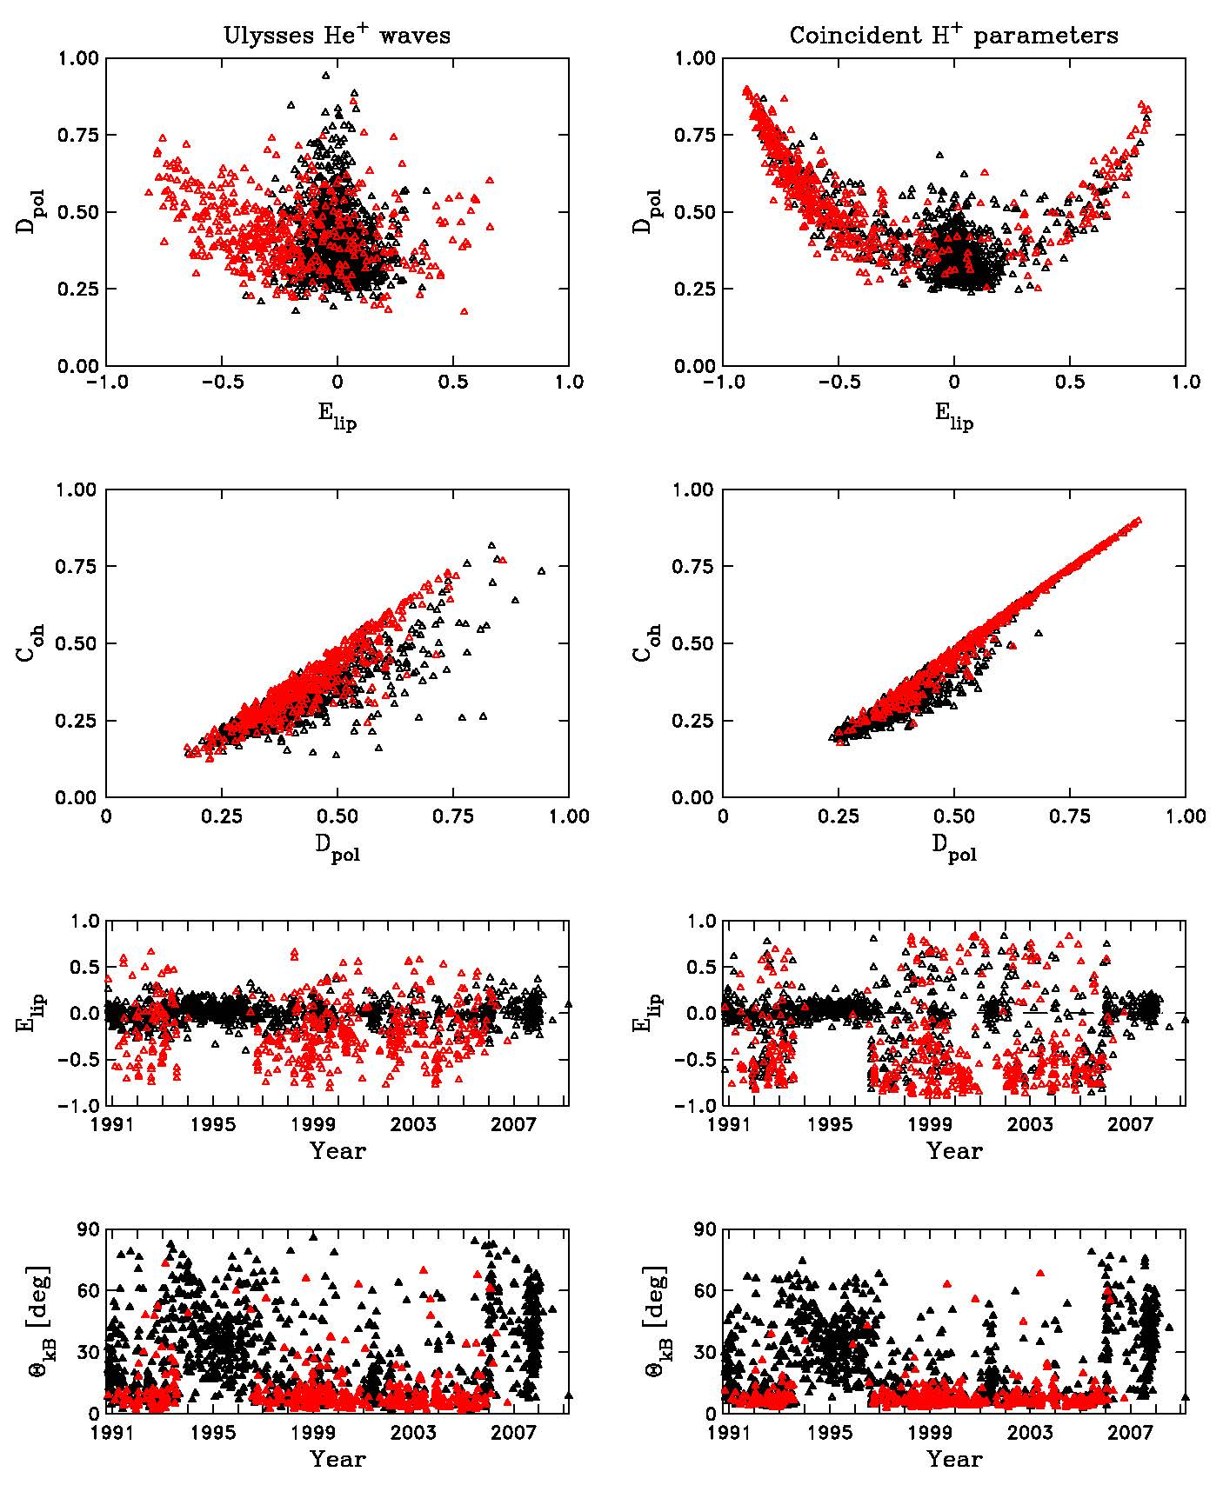
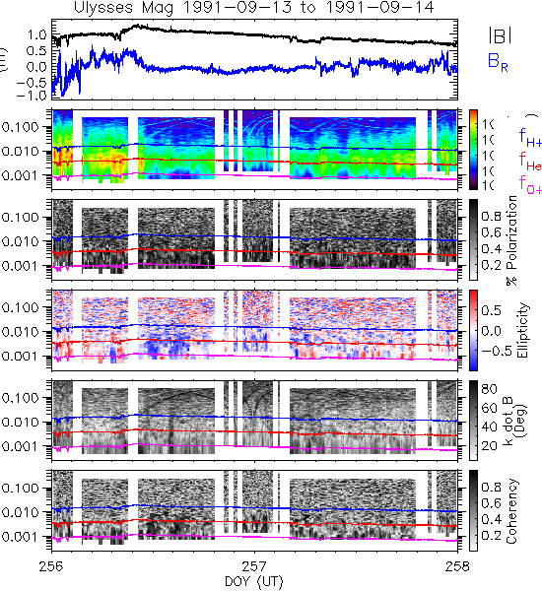
Observations of Low-Frequency Waves Excited by Newborn Interstellar Pickup He+ as Seen by the Ulysses Spacecraft
Anastasia Marchuk, University of New Hampshire
Dr. Charles Smith, University of New Hampshire
Background
Results
Conclusions (cont.)
We report an analysis of low-frequency waves in the Ulysses magnetic field data that arise from newborn interstellar pickup He+. Ulysses observations of waves excited
Most He+ waves are at moderate to low heliolatitudes beyond 3 AU. This may reflect either the nature of the Ulysses orbit or the turbulence conditions. Figure 1 also shows that waves are found at high latitudes inside 3.5 AU, where H= did not excite observable waves. The events in a line where the latitude is about 0° are the result of Ulysses on its
These were not considered wave events in the past, because we were being more conservative, but here we see them in greater detail and seek to address them.
Image 1 – Artist’s rendition of Ulysses spacecraft
by interstellar H+ have already been reported, but in this analysis we identify waves due to the ionization of He atoms. While neutral He can reach inside 1 AU in significant numbers whereas interstellar neutral H cannot, we find that most of the waves due to He+ are seen at moderate to low heliolatitude beyond 3 AU. This may reflect the nature of the orbit where Ulysses spends a greater fraction of its time in this region, or it may reflect the turbulence conditions. Our analysis will address this and related questions.
Figure 1
Figure 2
journey to Jupiter before entering its high latitude orbit by passing over the Jovian poles. The bottom half of this figure shows events with ellipticity greater than +0.35. This reduces the number of wave events to 180 but doesn’t preferentially remove high latitude or more distant observations.
Introduction and Methods
Areas for Further Study
Ulysses was in orbit from Jupiter around the poles of the sun from 1990 to 2009. We used data from the flux magnetometer instrument to look for waves caused by interstellar pickup He+ ions. When interstellar neutrals are ionized, they interact with our sun’s magnetic field, orbiting at the ion cyclotron field. They resonate with magnetic fluctuations on that scale, creating magnetic waves.
Using one second magnetic field observations from the flux gate magnetometer instrument on Ulysses, we created automated daily spectrograms. We then selected candidate intervals for wave events and turbulence – there are about 1479 total intervals, with 452
Textbook examples of helium waves are those with high ellipticity and growth rates greater than the turbulence rate. The nonlinear processes that make up turbulence absorb wave energy and transport it to small scales, so no waves can be observed when the wave growth rate exceeds the turbulence rate. If the growth rate is too low, the interval does not exhibit wave traits at all. The open question is, why do some intervals have high growth rates, but show poor wave signatures? In the future, we plan to study ion distribution functions.
Conclusions
As seen in the top left panel of Figure 2 with the degree of polarization plotted against ellipticity. It shows behavior similar to related plots in Hollick et al. (2018a). A central cluster of control intervals forms a black triangle. The wave events, which are the red symbols, are normally seen as two wings at |Elip| > 0.35. However, here we see what we judge to be examples of wave excitation at He+ frequencies with lower values of ellipticity. These are the events with either significant bias in ellipticity, elevation of degree of polarization, coherency that seems to extend below the proton cyclotron frequency, or ones that are within the range but may not extend down to the helium cyclotron frequency.
showing waves due to He+ and 962 controls showing either turbulence or waves due to H+.
Then, the polarization spectra were examined for selected intervals to determine evidence of wave activity.
Contact Information
Anastasia Marchuk: avm1020@wildcats.unh.edu
Dr. Charles Smith: charles.smith@unh.edu
Acknowledgements
Abbey Watson, Matthew R. Argall, Colin J. Joyce, Philip A. Isenberg, Bernard J. Vasquez, Nathan A. Schwadron, Justyna M. Sokol, Maciej Bzowski, and Marzena A. Kubiak

