Slide 1
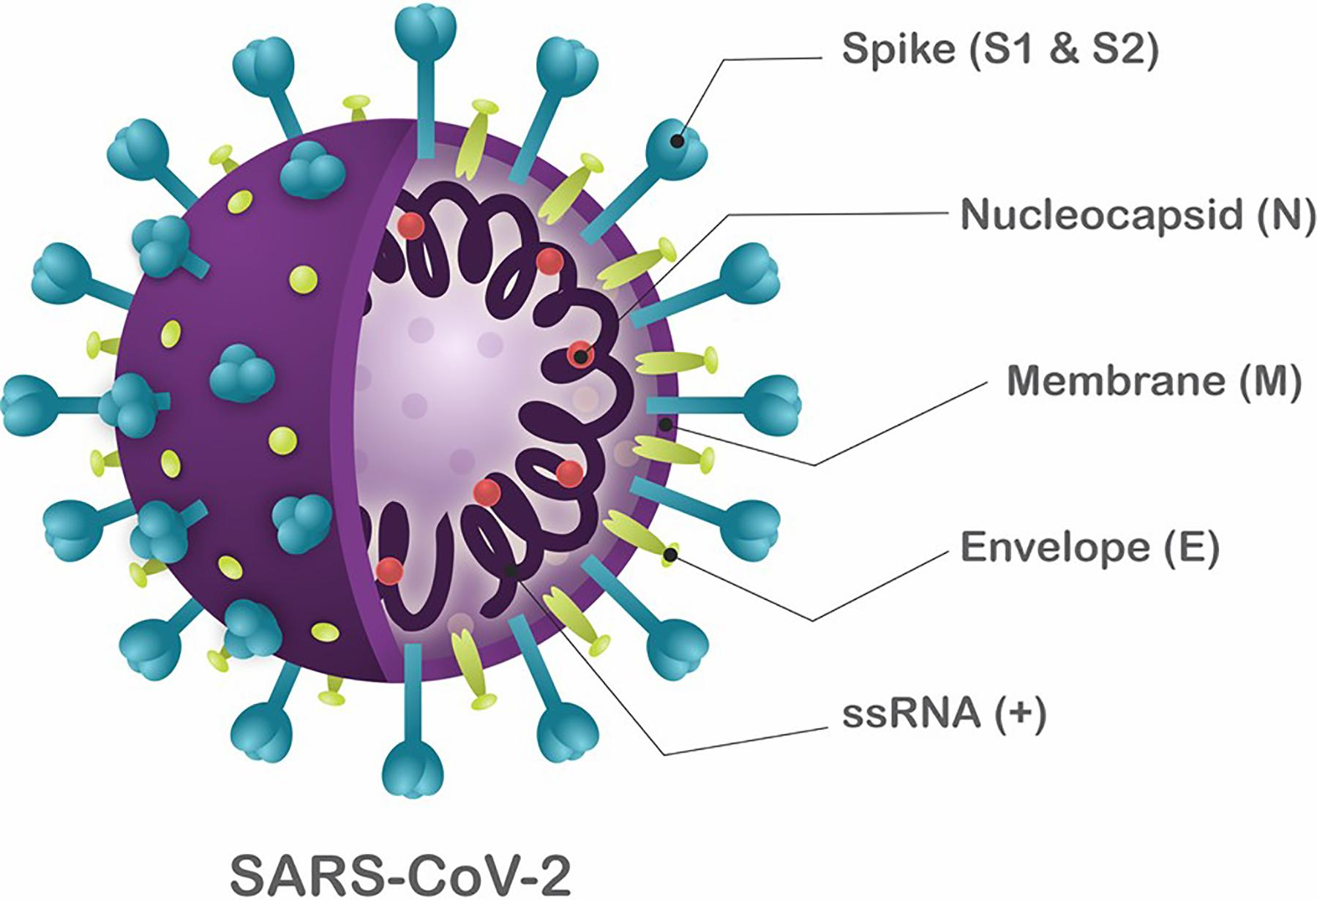
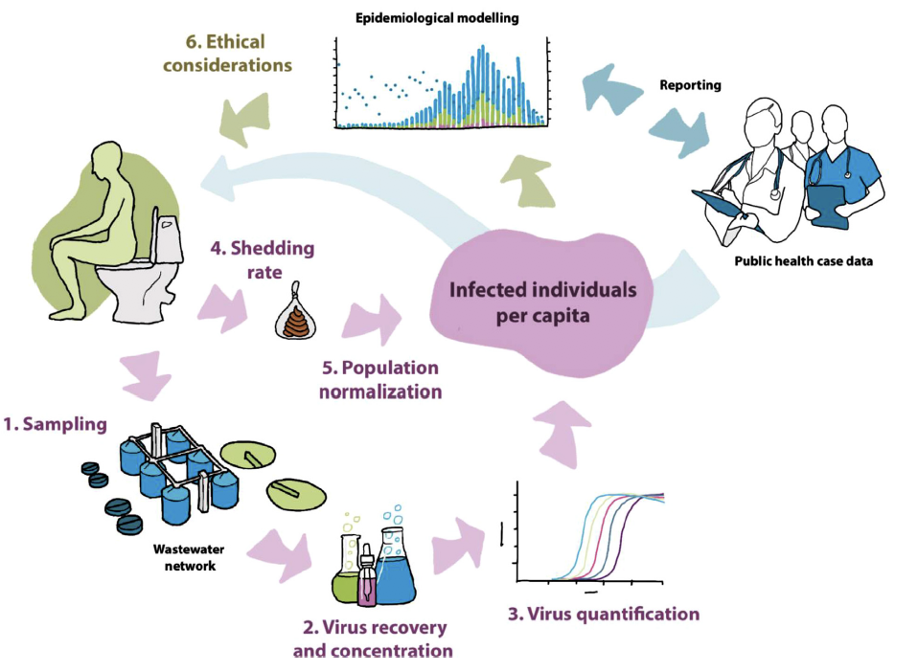
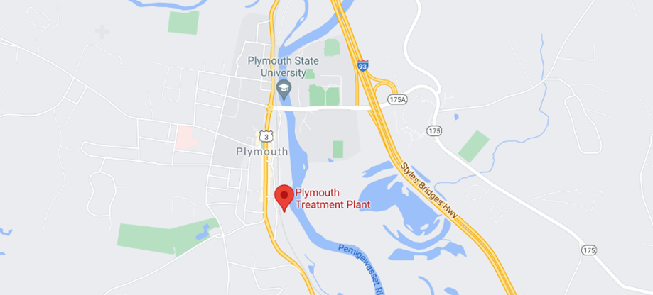
An analysis of SARS-CoV-2 biomarkers at the Durham and Plymouth WWTP’s Ryan Fournier, Faculty Advisor: Dr. Paula Mouser Civil and Environmental Engineering, University of New Hampshire, Durham, NH 03824
1. Introduction
4. Model Construction
Wastewater-based epidemiology (WBE) is a branch of epidemiology that helps to assess community exposure to pollutants and chemicals by sampling the raw sewage at individual sewer sheds or wastewater treatment plants. In the past, wastewater epidemiology has been used to track the use of pharmaceuticals and illicit drug use within communities. The applications of wastewater epidemiology have since expanded to track the incidence of diseases such as diabetes, allergies, and cancer. With such a wide base of applications, yielding practical results for the monitoring of a community’s health, combined with the circumstances of a pandemic, wastewater epidemiology found a new application in the tracing of COVID-19. This study will use wastewater data collected during the fall semester of 2020 by the Mouser Research Group to:
Analyze the effects of dilution on N1 and N2 biomarkers in wastewater.
Understand how N1 and N2 biomarkers correspond to COVID-19 cases
Compare results between Plymouth State University and the University of New Hampshire
Case Equivalence obtained from fitting projected signal to reported signal
Population on-campus at PSU/UNH
Note: When precipitation is equal to zero, e.g., 1.0023-0.1863*0. The dilution due to infiltration equation was set to 1, as opposed to 1.0023. This ensures that on days where no precipitation occurs, the equation has no effect.
Precipitation obtained from NOAA/UNH weather station
Shedding Rate: The shedding rate of the viral biomarkers was assumed to decay by 50% each day until the signal became weak (below 10 copies/100mL). As shown in the screen shot to the right, on 9/2/2020 there are three signals contributing to the overall signal. Two from cases on days prior 8/29/2020 and 8/30/2020), and one case on the day of 9/2/2020. This column was summed to obtain the total signal for this day. This is important because residual signals from cases on days prior (highlighted) can significantly increase the biomarker signal.
E_{D} = E*(D_{w}*P/Q_{w})* (1.0023-0.1863*P_{R})
Wastewater Duty estimated based on dorm flow and dorm occupancy
Total wastewater influent flow measured at the Durham/Plymouth WWTP
Dilution due to infiltration equation obtained from a TSS analysis. The TSS dilution due to precipitation relationship was assumed to affect viral biomarkers similarly.
Temporal Offset: Often times wastewater samples will pick up a signal before there is a positive test. This is because a person may be shedding the virus but have yet to receive positive test result. A temporal offset was used to remedy this is issue and was theorized to be anywhere from 4-10 days, varying with testing and sampling frequency. The models were shifted accordingly to achieve a better fit with the sampled data.
2. N1 and N2 Biomarkers
Nucleocapsid protein (N):
Contains genomic RNA
Defends genome against the environment of the host body.
Responsible for the replication of the SARS-CoV-2 genome.
Good biomarker
E_{D} = Case Equivalence adjusted for Dilution E = Case Equivalence D_{w}= Wastewater Duty P = Population Q_{w} = Wastewater Treatment Plant Flow P_{R}= Precipitation
Highlighted cells indicate the day a case is reported. The days following the report date (where the signal begins) represent the signal decaying.
5. Results
6. Future Recommendations
Statistical Analysis of Model Fit: A method of statistical evaluation is necessary in order to assess the models quantitatively. Not only will this help to more accurately predict case equivalence, but it will also allow for the confirmation of other parts of the model such as shedding rate.
Applying the Model to alternate locations: The model can be modified for different locations as shown in this study. If an area has incidence data available, and a sampling program is in place, parameters can be estimated to fit the sampled data and develop a case equivalence relationship.
Applying the Model to different viruses: If WBE (Wastewater based Epidemiology) is considered for different viruses, the model is adaptable by fitting wastewater sample to proper case equivalence estimates. Fitting the model to different viruses may also require adjusting shedding rate based on the characteristics of the virus.
Taken from Andrade Santos et al., (2020)
7. Acknowledgements
Polo et al, 2020. Water Research. doi: 10.1016/j.watres.2020.116404
Thank you to everyone in the Mouser Lab who helped me out along the way, Dr. Paula Mouser, Emily Wilcox, Aaron Kearnan, Dr. Fabrizio Colosimo, Mina Aghababaei, Nick Querrazzi, and Kellen Sawyer.
Thanks to Meredith Hoyt of the Durham WWTP and to Jason Randall and Jay Harrington of the Plymouth WWTP.
3. Study Area
Site map displaying UNH and the Durham WWTP
5,124 students and faculty on-campus at UNH
Average WWTP inflow of 655,000 gal/day during fall semester
8. References
The sampling coverage for the University of New Hampshire was 41.3% (59 days sampled /143 days total).
Average dilution factor of 5.46 during fall semester
Case equivalence fit of 1700 copies/ 100mL = 1 COVID-19 case
Case equivalence of 311 copies/ 100mL = 1 COVID-19 case after accounting for dilution
The sampling coverage for Plymouth State University was 28.8% (32 days sampled / 111 days total).
Average dilution factor of 5.49 during fall semester.
Case equivalence fit of 1600 copies/ 100mL = 1 COVID-19 case
Case equivalence of 291 copies/ 100mL = 1 COVID-19 case after accounting for dilution
Cevik, Muge, et al. “SARS-CoV-2, SARS-CoV, and MERS-CoV Viral Load Dynamics, Duration of Viral Shedding, and Infectiousness: a Systematic Review and Meta-Analysis.” The Lancet Microbe, Elsievier, Jan. 2021, doi.org/10.1016/S2666-5247(20)30172-5.
“Coronavirus Disease 2019 (COVID-19).” Centers for Disease Control and Prevention, Centers for Disease Control and Prevention, 2020, www.cdc.gov/coronavirus/2019-nCoV/index.html.
Foladori, Paola, et al. “SARS-CoV-2 from Faeces to Wastewater Treatment: What Do We Know? A Review.” Science of The Total Environment, Elsevier, 24 June 2020, https://doi.org/10.1016/j.scitotenv.2020.140444
Kitajima, Masaaki, et al. “SARS-CoV-2 in Wastewater: State of the Knowledge and Research Needs.” Science of The Total Environment, Elsevier, 30 Apr. 2020, www.sciencedirect.com/science/article/pii/S0048969720325936.
Maria Lorenzo, Yolanda Picó, Wastewater-based epidemiology: current status and future prospects, Current Opinion in Environmental Science & Health, Volume 9, 2019, Pages 77-84, ISSN 2468-5844, https://doi.org/10.1016/j.coesh.2019.05.007
S. van Doorn, Amarylle, et al. “Systematic Review with Meta‐Analysis: SARS‐CoV‐2 Stool Testing and the Potential for Faecal‐Oral Transmission.” Aliment Pharmacol Ther., July 2020, onlinelibrary.wiley.com/doi/epdf/10.1111/apt.16036.
Wu, Fuqing, et al. “SARS-CoV-2 in Wastewater Foreshadow Dynamics and Clinical Presentation of New COVID-19 Cases.” MedRxiv, Cold Spring Harbor Laboratory Press, 1 Jan. 2020, www.medrxiv.org/content/10.1101/2020.06.15.20117747v2.
Site map displaying PSU and the Plymouth WWTP
2,440 students and faculty on-campus at PSU
Average WWTP inflow of 313,000 gal/day during fall semester
Site map images taken from Google Maps

