Slide 1
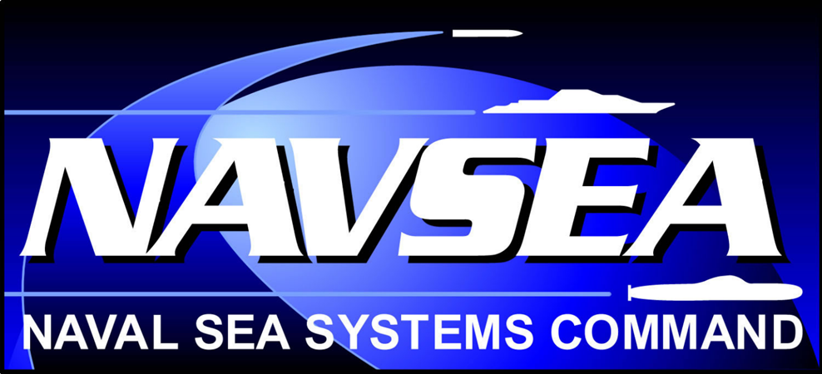
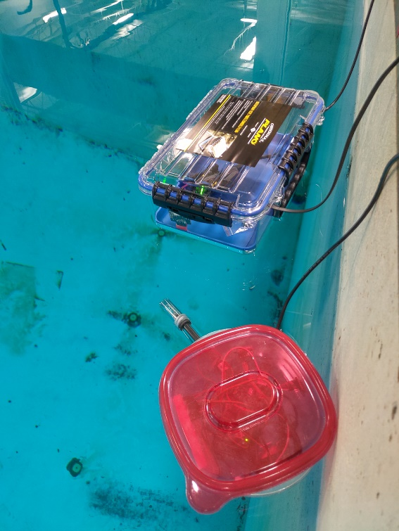
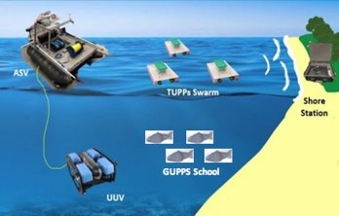
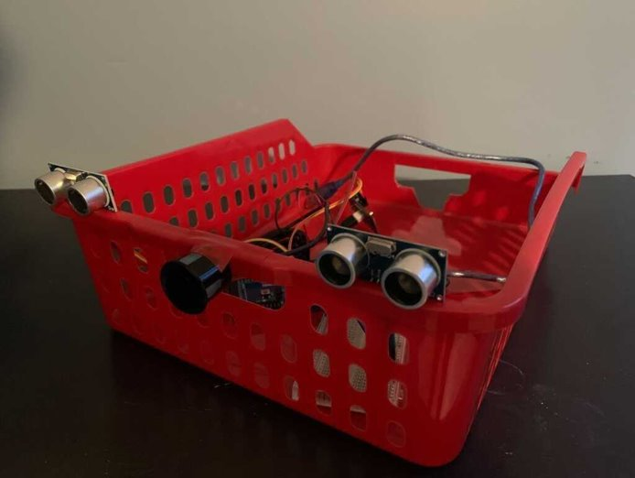
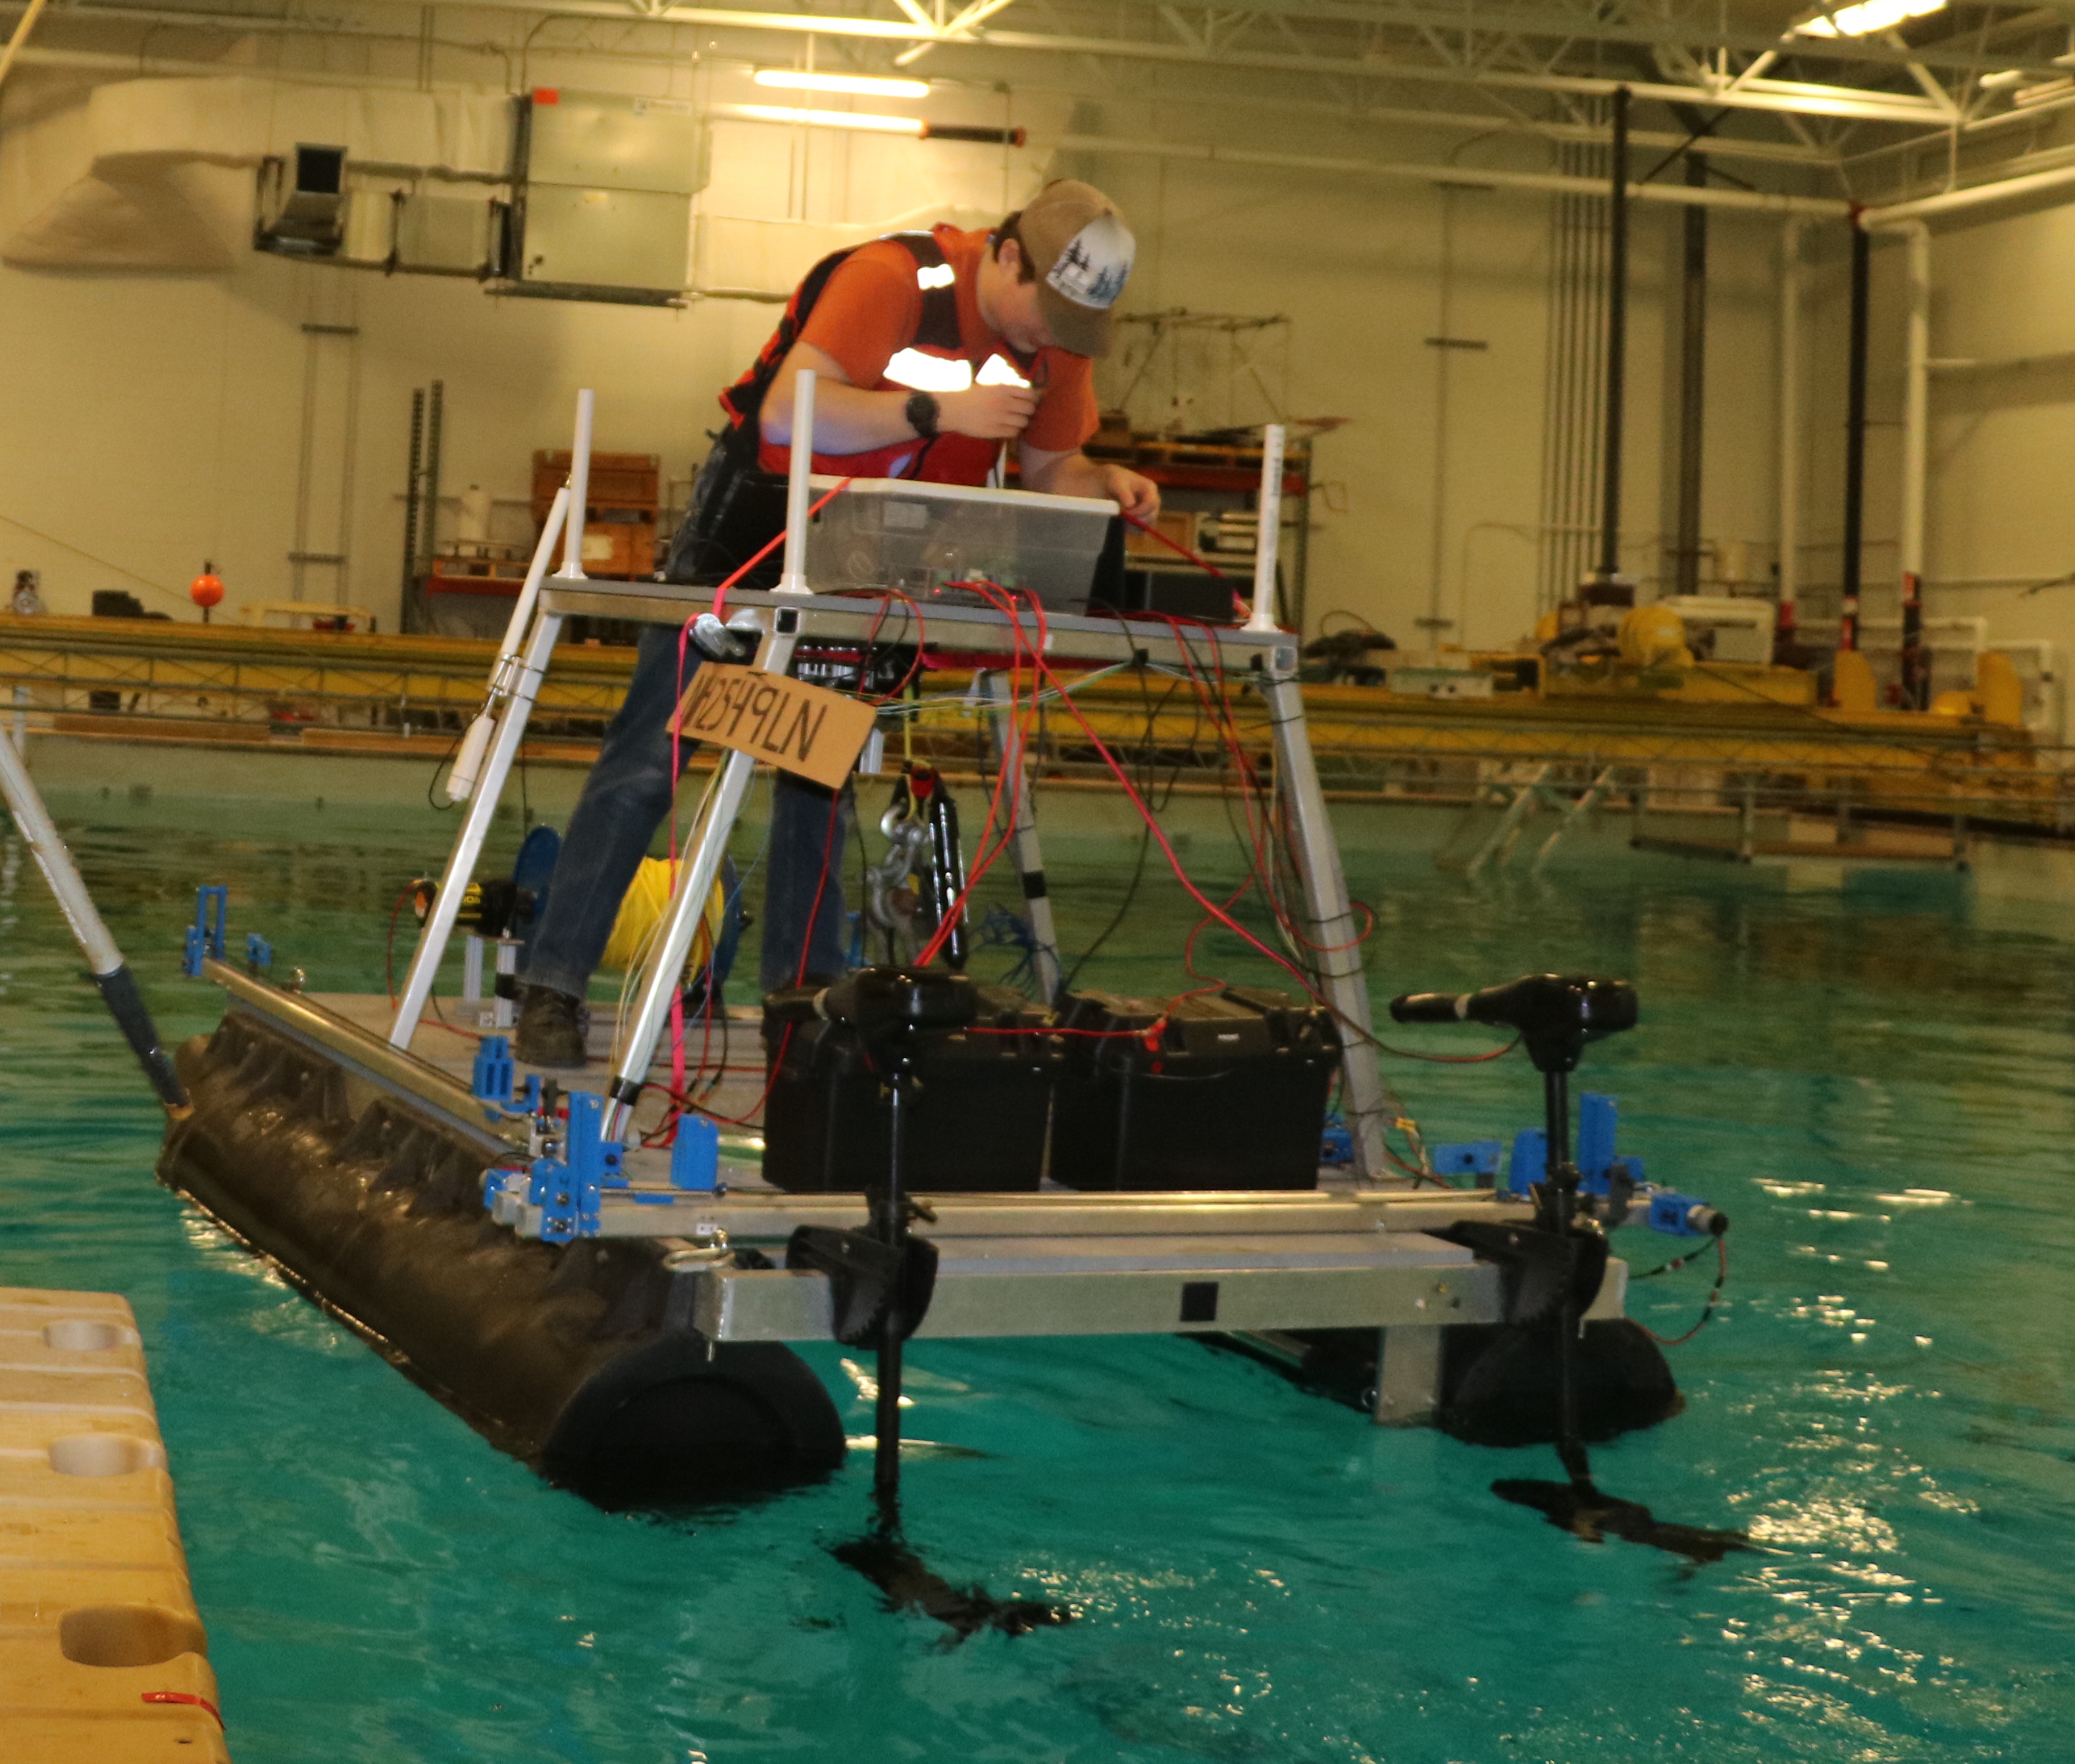
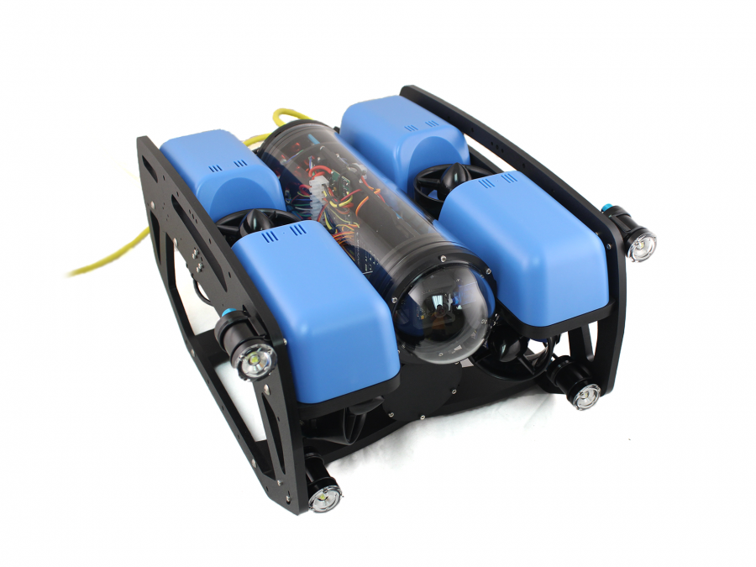
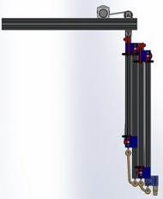
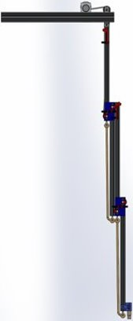
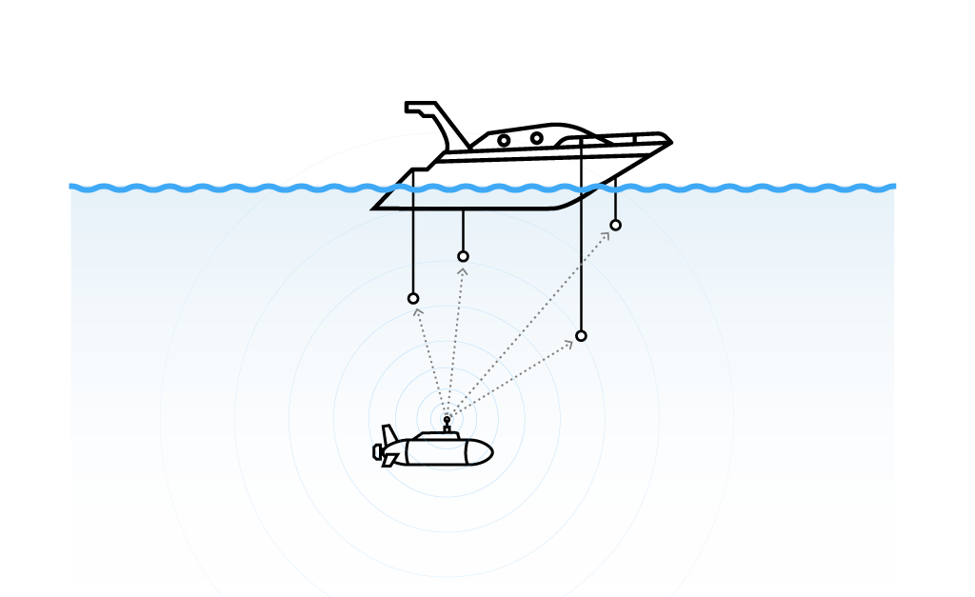
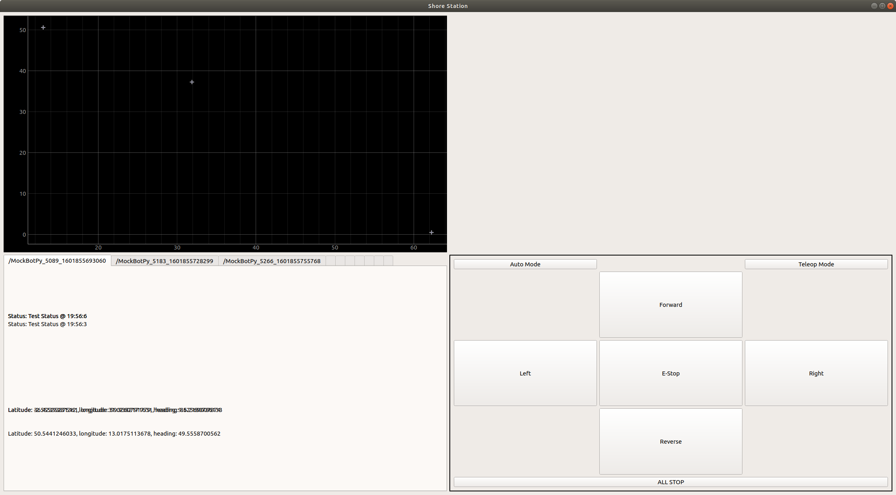
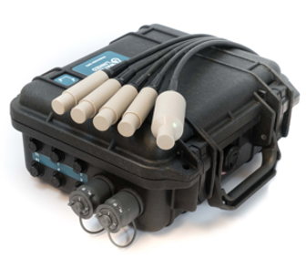
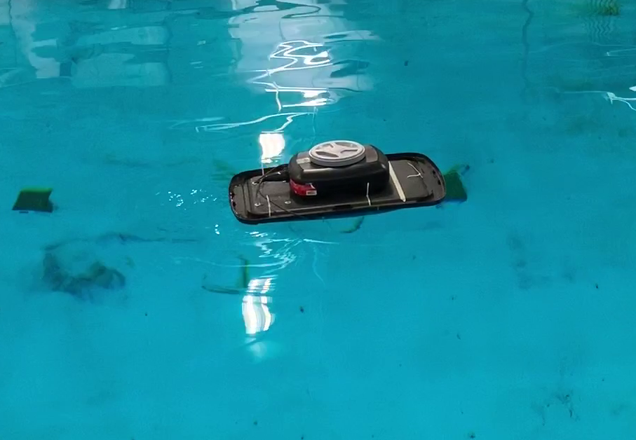
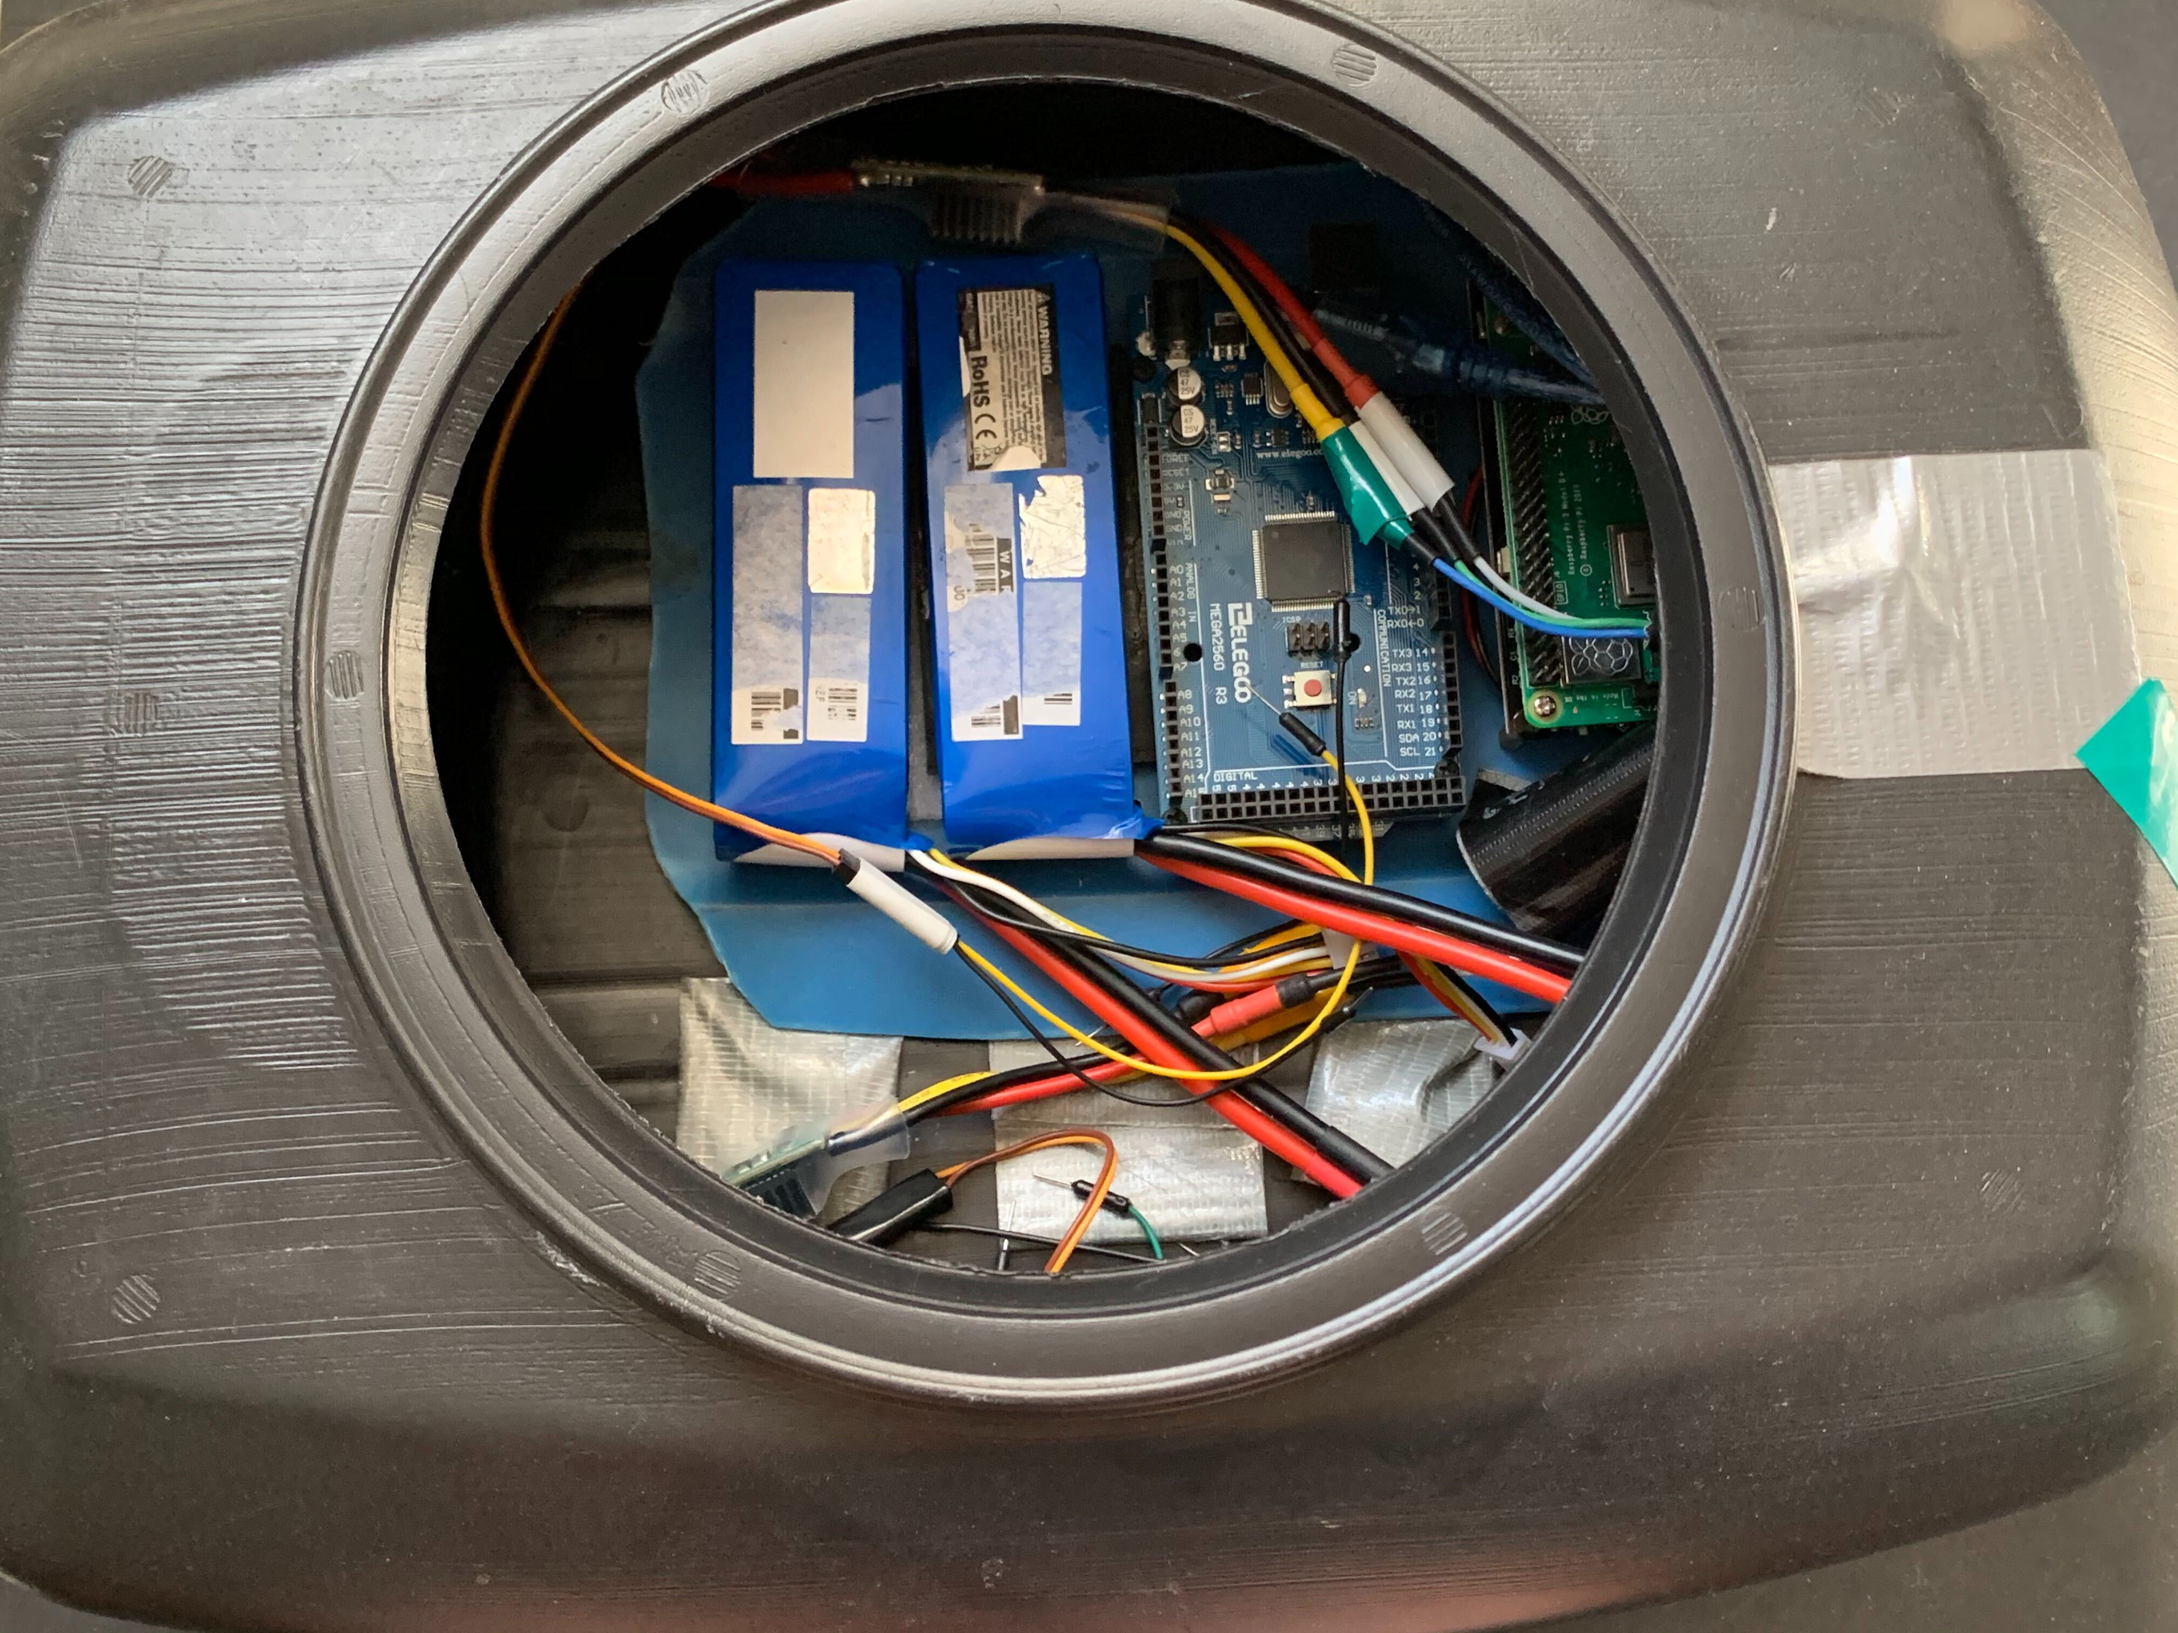
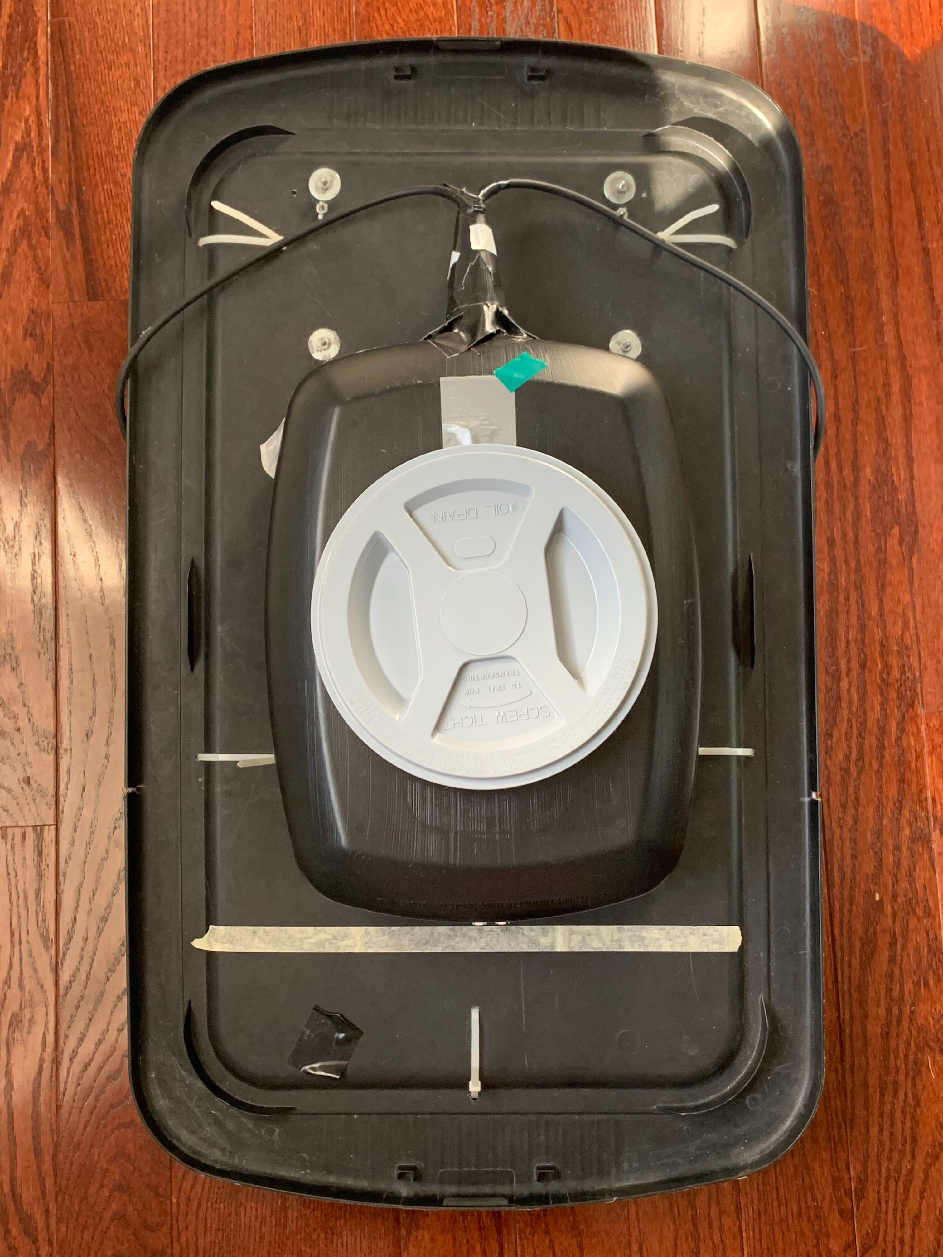
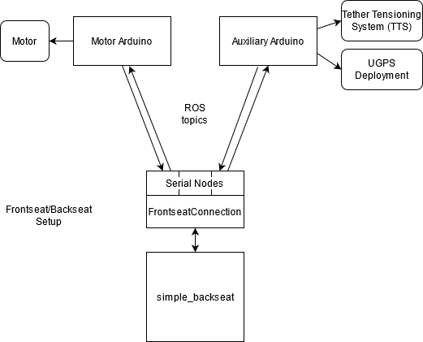
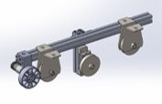
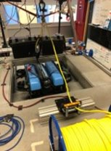
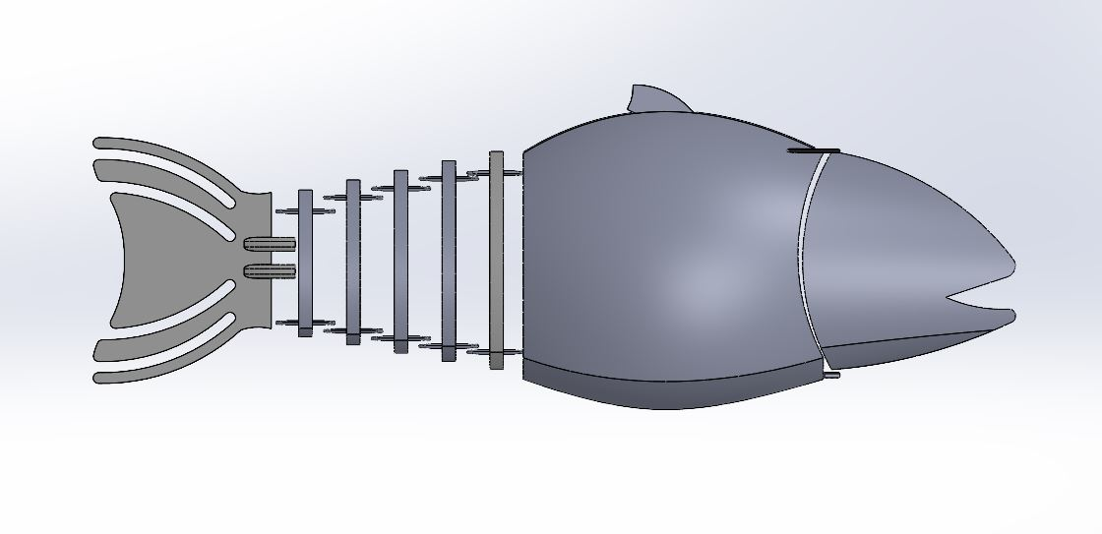
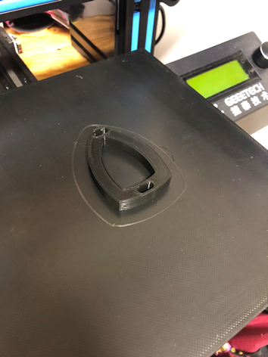
Marine And Naval Technological Advancements for Robotic AutonomY (MANTA RAY)
Team Members: Richard Randall (ME), Jenna Ehnot (OE), Vincent Dejana (ME), Wing Kiu Jiang (ECE), Joseph Eichelser (ECE), James Kahn (CS), Ian Watson (CS), Jakob Velle (CS), Bryan Loh (CS), Benson Cao (CS), Jeffrey Pitts (CS), Jessica Barker (ME), Matthew Radzelovage (ME), Amanda Enderson (ME)
Project Advisors: Dr. May-Win Thein, Dr. Yuri Rzhanov , Dr. Mike Chambers & Dr. Elizabeth Fairchild
Graduate Advisors: Allisa Dalpe, Oguzhan Oruc, Hannah Arnholt & Lee Curtis
Special Thanks to Dr. Martin Renken, Thai Tran, John Ahern, Scott Campbell, Laura Gustafson, Sheri Milllette
Autonomous Surface vehicle (asv)
PROJECT Mission
Sensor Research ECE/CS
Mechanical Design
Built by 2017-2018 ASV Team
Catamaran body: 7’9” length, 5’6” beam
Twin electric trolling motors
"Penthouse" platform to keep electronics far from waterline
Tether winch and trapdoor for UUV tether management and deployment
Capabilities
Tracking system location with GPS and acoustic system (UGPS)
Communication hub for entire system; transmits data and status updates to shore station
UUV deployment and retraction
Autonomous path planning and heading control
Seafloor mapping with acoustic sonar
The purpose of this project is to design and fabricate a network of autonomous vehicles to perform sea floor mapping. The network consists of autonomous surface vehicles (ASVs) and unmanned underwater vehicles (UUVs). The project focuses on the improvement of communication between vehicles, development of autonomous path planning, and mechanical updates to improve system accuracy and precision
Perception and Awareness of GUPPS surroundings
LIDAR: VL53L1X, TF Mini Plus
Ultrasonic: JSN-SR04T, HC-SR04
Sparkfun Temperature and Pressure Sensor
Excel Data Streamer for Sensor Fusion
Underwater “gps” system
Uses a Waterlinked® Underwater USBL© System
4 submersible transducers (on ASV), 1 receiver (on UOV), and an Electronics dry box (on ASV deck)
Updated old linear arm system to cascading arm system
Submerges acoustic transducer further underwater
Faster deployment time
Sturdier, less upkeep
Arms hold and stabilize transducers for precise location monitoring of UUV
Unmanned underwater vehicle (UUV)
Mechanical Design
BlueROV2 from BlueRobotics
Vectored 8-thruster configuration
Open-source software and hardware
Capabilities Design
Optimized for inspection and research-class missions
Live, low-latency 1080p HD video
6 degrees of freedom (DOF) stabilization
Leak detection
Shore to vehicle communications
Shore station equipment stored in a water/dust proof box for safe & efficient transportation
WiFi signal used for telemetry and control
Shore station GUI
ROS communicates across multiple machines to pass data and commands
ASV laptop is vehicle control
Shore station laptop is operator station
Sonar readings and GPS location communicated to shore station
Vehicle system parameters can be monitored (Propulsion, UUV Deployment)
Testing Unmanned performance platform (tupps)
Purpose: A small-scale version of the ASV for indoor testing in a tank.
Cost-effective, modular construction
Arduino, Raspberry Pi, and other open-source components
Inertial Measurement Unit for heading control
PID Control in early stages
Blue Robotics thrusters
Retracted
Deployed
Cascading Arm Solidworks Rendering
Waterlinked® Components
Controls and autonomy
Tether tensioning system
Ghost Unmanned Performance Platform Submersible (GUPPS/RObofish)
Created Front Seat implementation
Implemented ROS connections between Front and Back seat nodes
Frontseat PID heading controls
Reduces overshoot and decreases settling time of direction control
UUV connection to Back seat
PyMavLink in parallel with QGroundControl
Rotary encoder added to allow for deployment/retrieval of tether based on distance, rather than time
Three pully system with motorized rubber wheel that spins at the rate of tether deployment, applies tension to tether and prevents back spooling at the winch
Designed after a Steelhead Trout
Design for the main body of the fish is complete
3D printing the model out of PLA
Printing tail first to work on the movement of the fish
Notes:
To change this poster, replace our sample content with your own. Or, if you'd rather start from a clean slate, use the New Slide button on the Home tab to insert a new page, then enter your text and content in the empty placeholders. If you need more placeholders for titles, subtitles or body text, copy any of the existing placeholders, then drag the new one into place.

