Slide 1
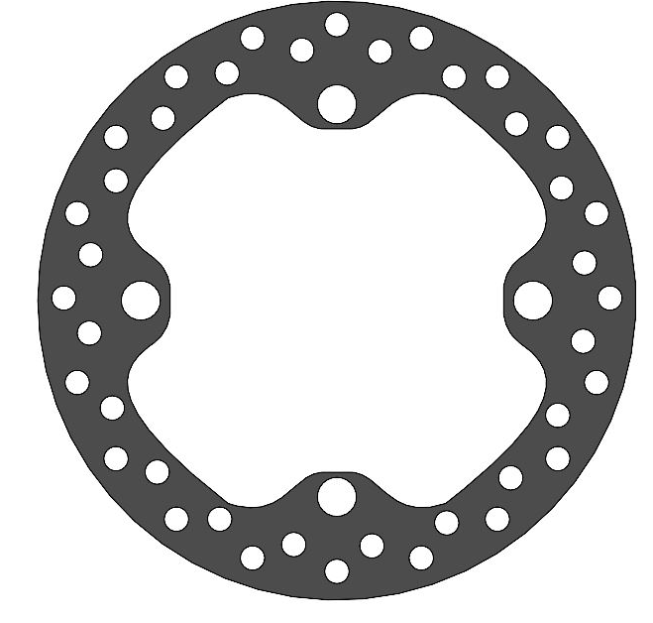
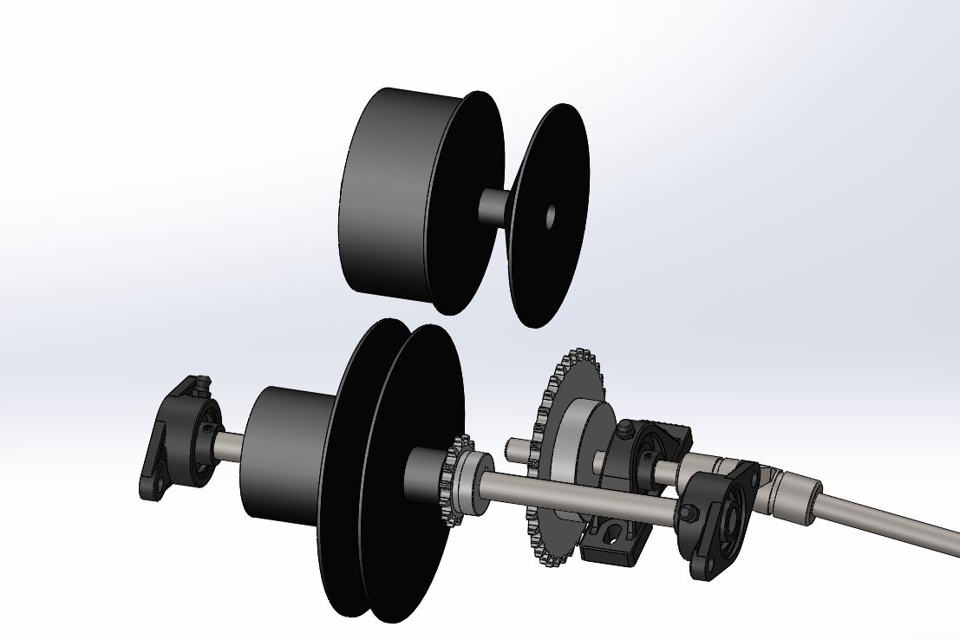
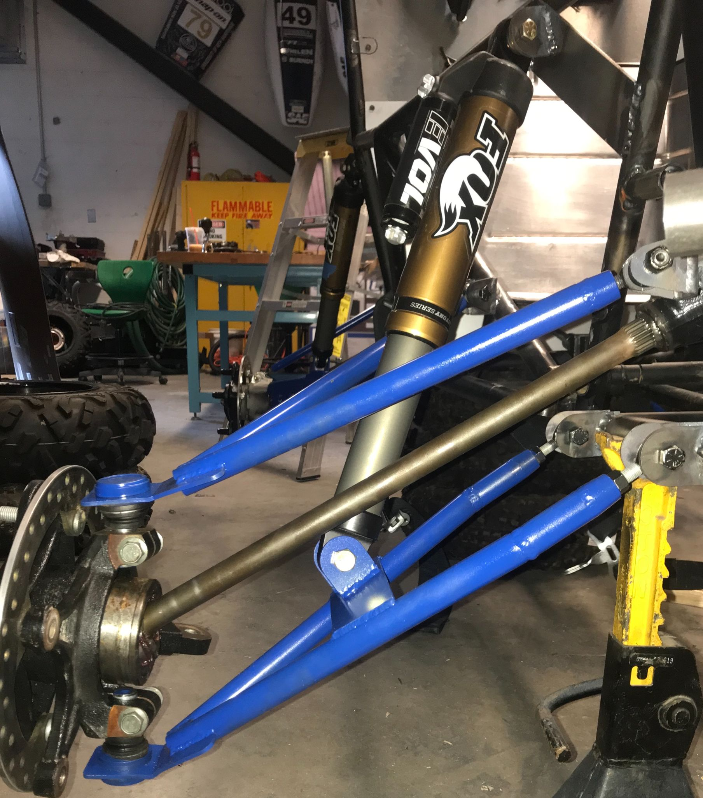
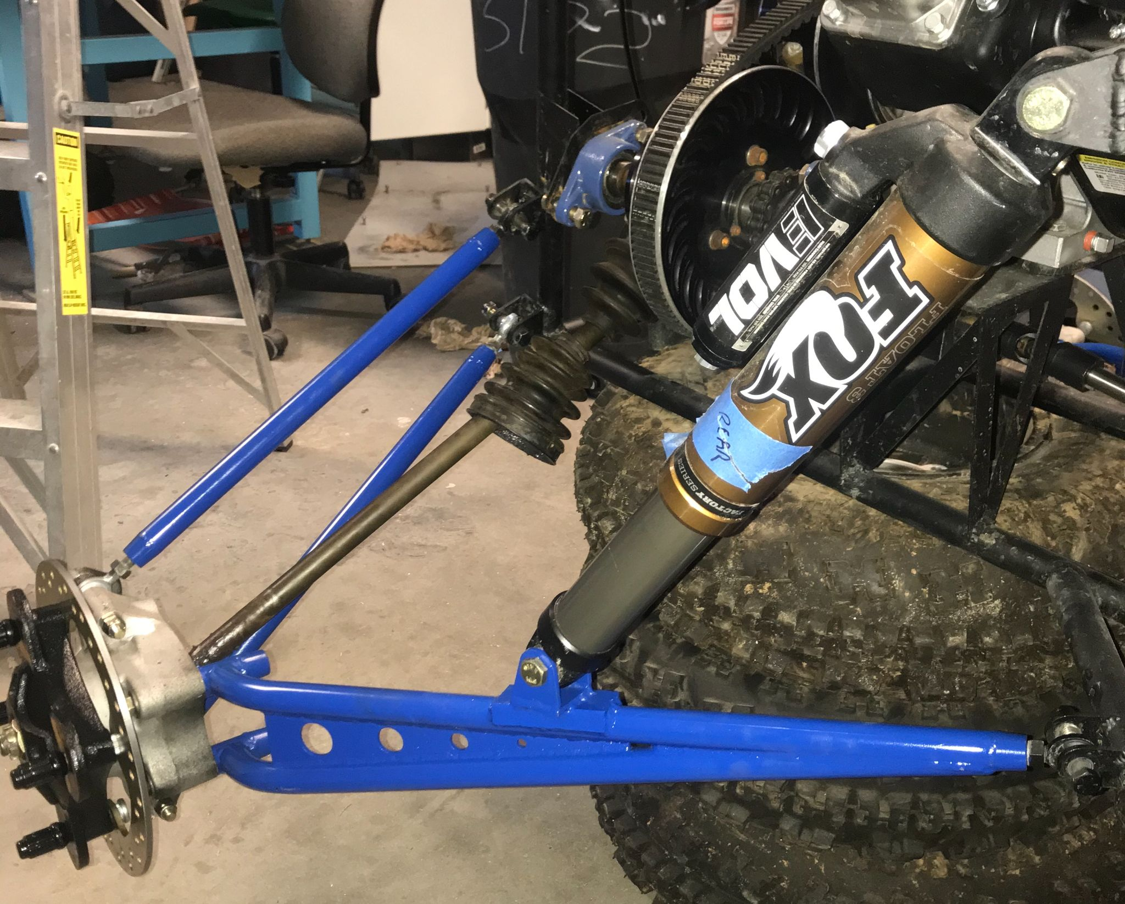
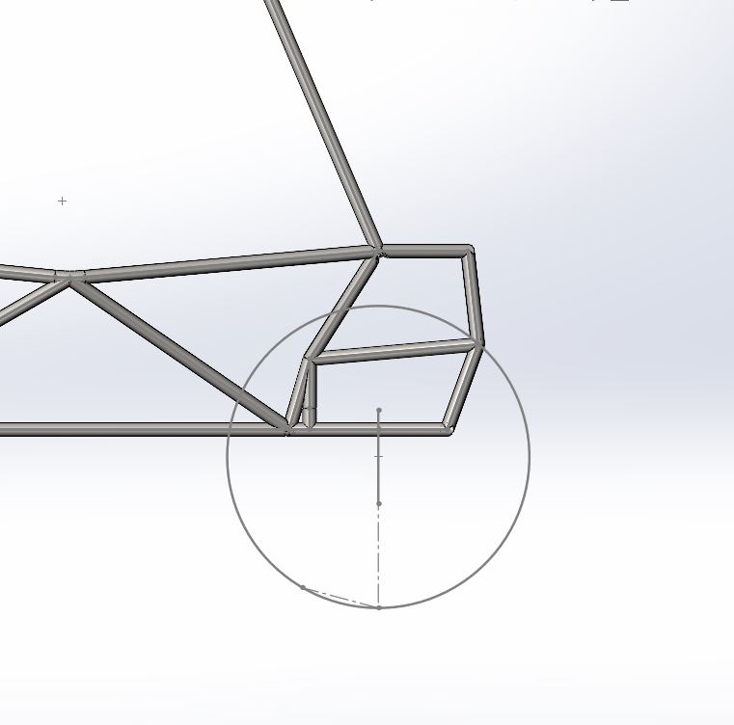
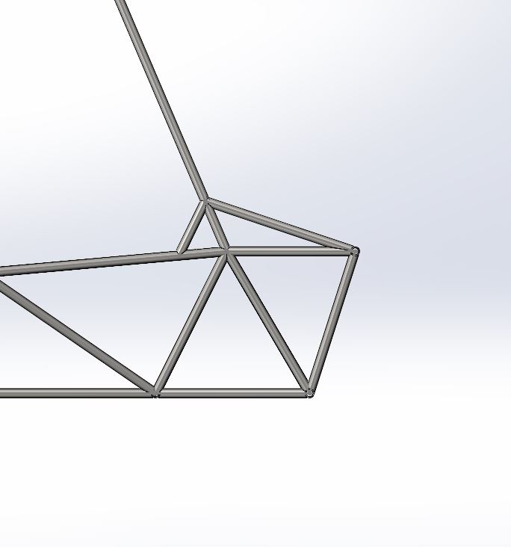
Drivetrain
fl;jf;adladalkadddddddd
2020–2021 UNH Mini Baja Racing
Controls
Objectives: To design and fabricate a safe, reliable, and high performance AWD system per competition rules.
Objectives: To design and fabricate a robust, driver friendly front panel assembly with accessible components and comfortable driving position, along with maximizing the performance of the vehicles steering and braking system.
Engine
Transmission
Andrew Williams, Tom Cote, Matt Dostie, Ryan Suttmeier, Matt Weaver, Derek Ramsey, Divyamsh Nepal
Braking System
Two independent hydraulic braking circuits (Front & Back) operated with one brake pedal
Master Cylinders: Wilwood ¾” in. bore with adjustable bias bar
Four Calipers with custom mounting brackets
Calipers: 1” Dual Piston Polaris Outlaw 525
Briggs and Stratton motor
Specs
305cc, 10 horsepower
Max RPM @ 3600
Carbureted
*cannot be altered in any way*
Gaged GX-9 CVT
Specs
Start drive ratio - 3.1
Final drive ratio - 0.9
Ability to maintain peak torque during shifting process
Steering
Rack and Pinion
Ratio 2:1
(Rotations of the wheel from lock-to-lock)
Ridgid Tie-Rod Linkage
Quick Release Steering Wheel
Momo Racing Steering Wheel
AWD System
Gear Ratios
Components
Front and rear Polaris differentials
Sprocket and chain reduction for further gear reduction
CVT Make | Total Drivetrain Low Gear Ratio | Total Drivetrain High Gear Ratio | Max Torque at Driveshaft (Low Ratio) | Max Torque at Driveshaft (High Ratio)
Caged GX-9 | 7.1:1 | 30.8:1 | 76.6 ft-lb | 332.5 ft-lb
Background and Objectives
Primary Objective: To design and fabricate a prototype single seat, all terrain sporting vehicle to service the recreational market.
Front Panel Assembly
Engine Kill Switch
Master cylinders and Pedal Assembly mounting position
Steering Column Attachment
Thank You to Our Sponsors
Capabilities
Whelen Engineering, Sparton Technology, UNH Parents Association, & Watts Water Technology.
‘On the fly’ all wheel drive activation
Quick chain reduction sprocket swapping
Special thanks is owed to Kelly Danforth, Scott Campbell, and Mike Locke
nnn
Suspension
Frame
Objectives: To design and fabricate front and rear suspension members to optimize performance with a precedence set on turning ability and obstacle handling.
Objectives: To design and fabricate a frame roll cage to house all components of the vehicle while fully protecting the driver and maximizing driver comfortability and ergonomics.
Components
4130 Chromoly Tubing/ Sheet
Fox Float 3 Evol Shocks
Heim Joints
Constant Velocity Axles
Polaris Hub Assembly
Maxxis Big Horn 2.0 Wheels
Vehicle Characteristics/
Performance
Camber Angle of -3 degrees
Roll Center is 11.8 inches from ground
Designed for oversteer
Offset lower shock mount to allow 4WD capability
Design created using LOTUS and SolidWorks
Design Criteria
Frame designed using triangulation geometry to maximize strength
Designed around suspension geometry and mounting points
Multiple crash scenarios tested using solidworks finite element analysis
Front, side, bump and rollover impacts tested
Manufacturing
Used jigs to refabricate front end of car
TAC welded members together before fully welding all members
All welding completed by TIG
Suspension Types
Front Suspension
Short Long Arm (SLA) suspension
Lower A-arm mounted shock
Creates Low Roll center
Customizable Design
Rear Suspension
Three Link trailing arm
Allows for superior cornering due to lowered roll center and lateral force control
Material Selection
Selected 4130 Chromoly as frame material as compared to other low carbon steels due to its higher yield strength
Stronger material allowed for thinner walled material and reduced overall frame weight

